Slide 1
Engine
A tiny engine chains every PEX stage and reports ok when goldens match
learn_pex — 01 pex engine
Notes:
A tiny engine chains every PEX stage and reports ok when goldens match.

Slide 2
The idea
GOLDEN: ok=True
learn_pex — 01 pex engine
Notes:
GOLDEN: ok=True.

Slide 3

Geo
Geo
learn_pex — 01 pex engine
Notes:
Geometry segment_count=4, layer_count=3.

Slide 4

R/C
R/C
learn_pex — 01 pex engine
Notes:
Resistance r_total=3.06; capacitance c_total=1.376.

Slide 5

Reduce
Reduce
learn_pex — 01 pex engine
Notes:
Reduce after_nodes=2; R_eq/C_eq match.

Slide 6

SPEF
SPEF
learn_pex — 01 pex engine
Notes:
SPEF res_count=1, cap_count=1.

Slide 7
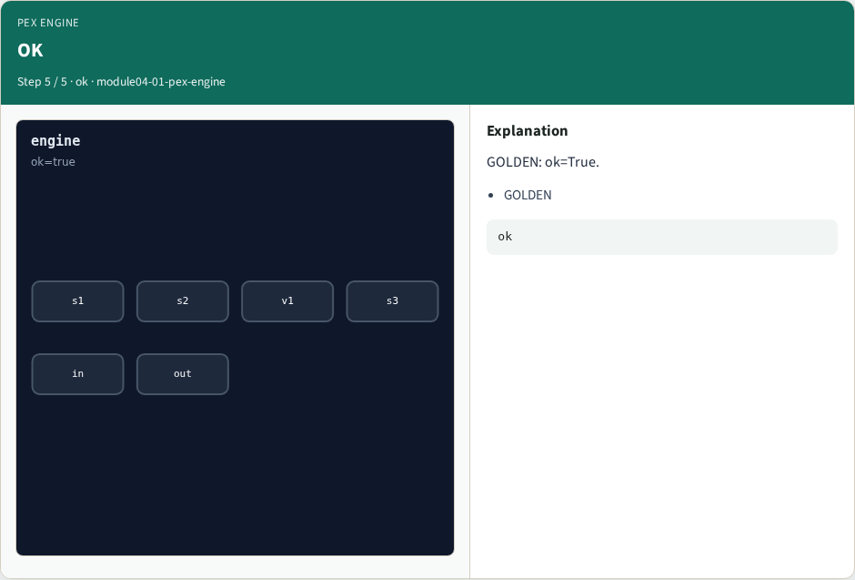
OK
OK
learn_pex — 01 pex engine
Notes:
GOLDEN: ok=True.

Slide 8
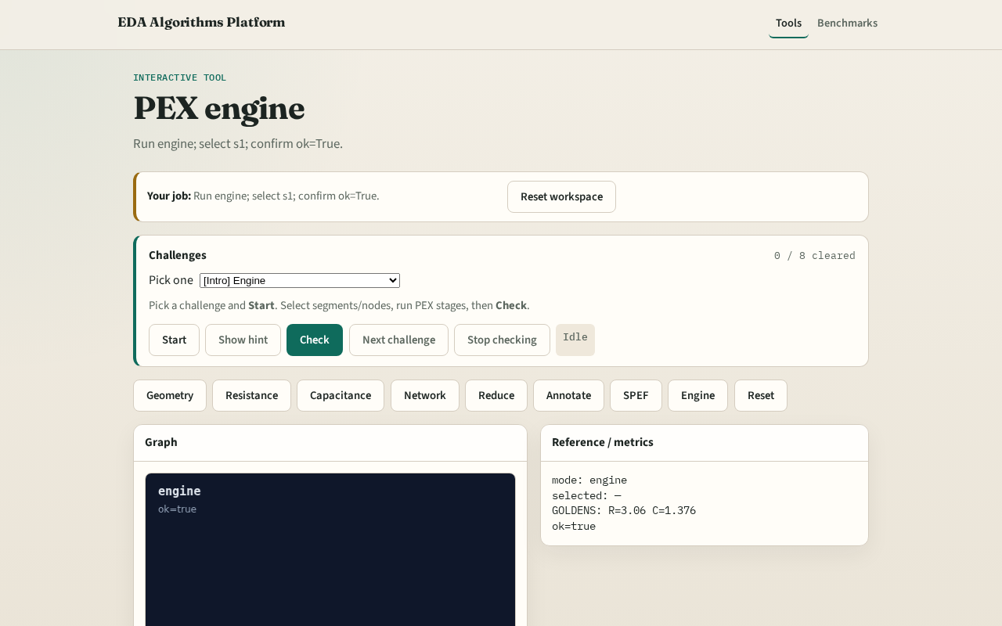
Browser lab track
Browser lab starter
learn_pex — 01 pex engine
Notes:
Open **pex-engine**. Run engine; confirm ok.

Slide 9
Implement track
Call pex_engine(); assert ok is True
learn_pex — 01 pex engine
Notes:
Call pex_engine(); assert ok is True.

Slide 10
Pitfalls
Reporting partial stages
Changing toy without updating goldens
learn_pex — 01 pex engine
Notes:
Reporting partial stages. Changing toy without updating goldens.

Slide 11
Your turn
Next: offline compare, then wrap
learn_pex — 01 pex engine
Notes:
Next: offline compare, then wrap.

