Slide 1
Clock sinks from placement
Every CTS algorithm starts from sinks, cell centers that must receive the clock, and one source
learn_clock_tree — 01 clock sinks
Notes:
Every CTS algorithm starts from sinks—cell centers that must receive the clock—and one source.

Slide 2
The idea
Sink_points reads placement for A through F
Source sits at six comma four
Moving a sink moves its access point for the next tree build
learn_clock_tree — 01 clock sinks
Notes:
sink_points reads placement for A through F. Source sits at six comma four. Moving a sink moves its access point for the next tree build.

Slide 3
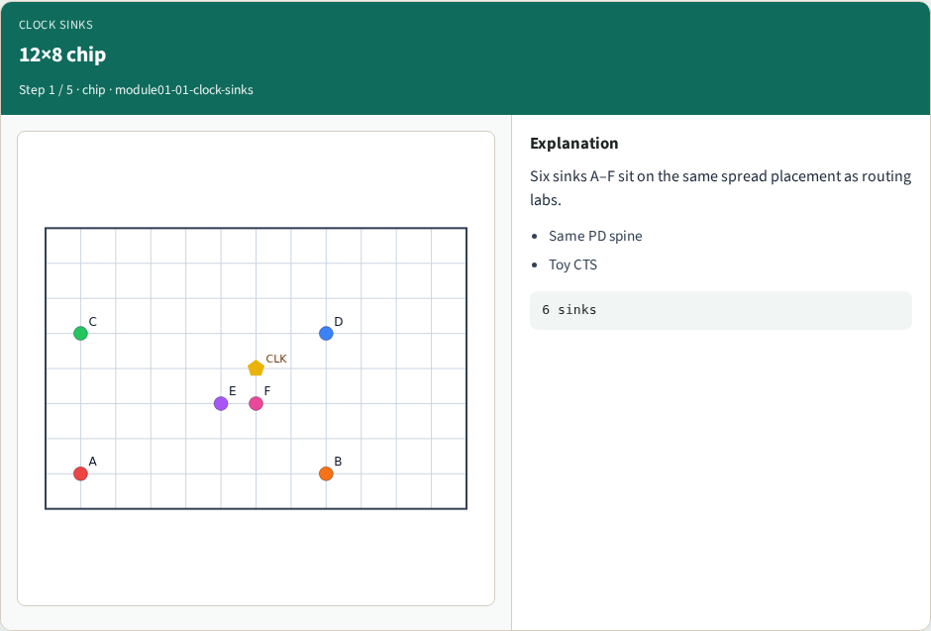
12×8 chip
12×8 chip
learn_clock_tree — 01 clock sinks
Notes:
Six sinks A–F sit on the same spread placement as routing labs.

Slide 4
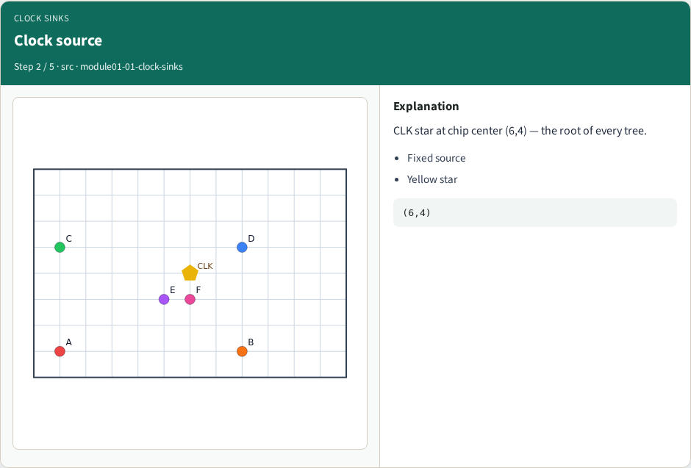
Clock source
Clock source
learn_clock_tree — 01 clock sinks
Notes:
CLK star at chip center (6,4) — the root of every tree.

Slide 5
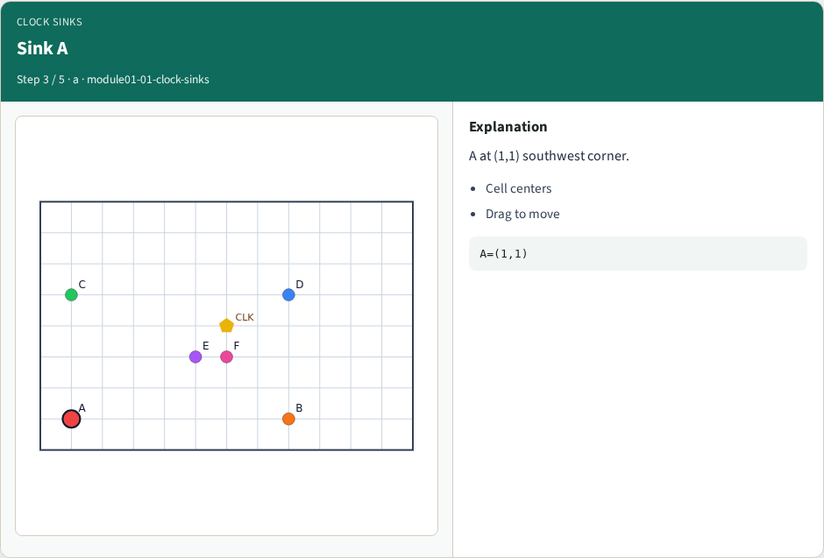
Sink A
Sink A
learn_clock_tree — 01 clock sinks
Notes:
A at (1,1) southwest corner.

Slide 6
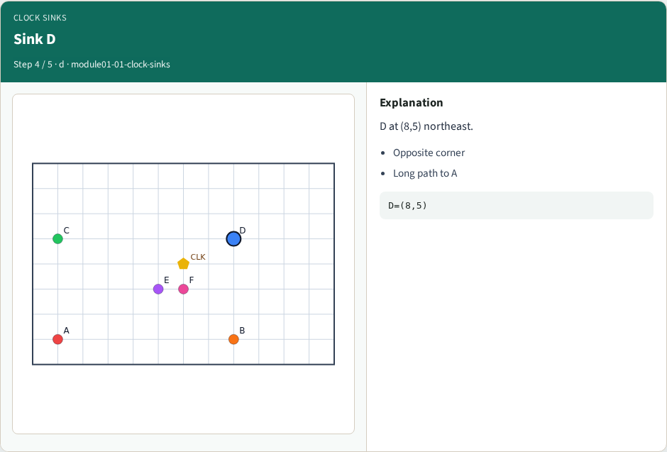
Sink D
Sink D
learn_clock_tree — 01 clock sinks
Notes:
D at (8,5) northeast.

Slide 7
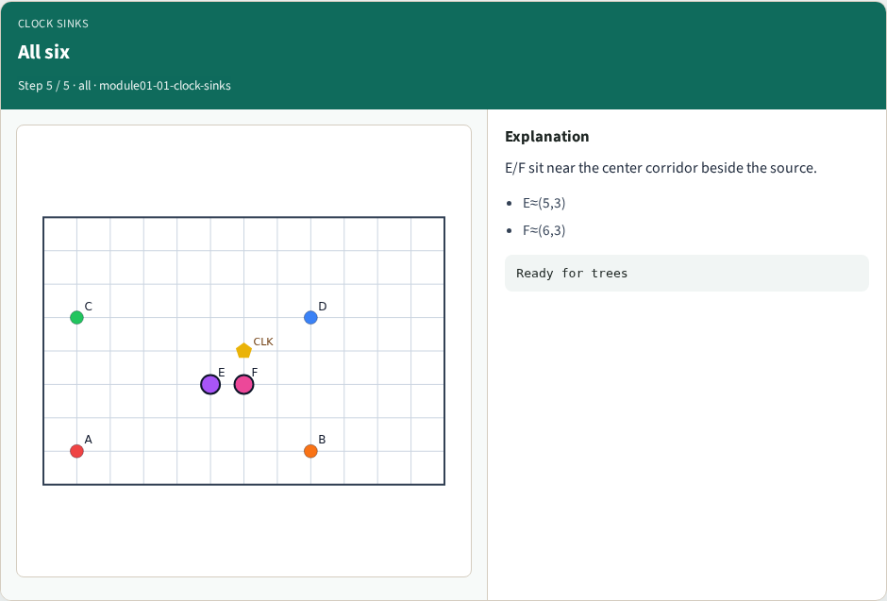
All six
All six
learn_clock_tree — 01 clock sinks
Notes:
E/F sit near the center corridor beside the source.

Slide 8
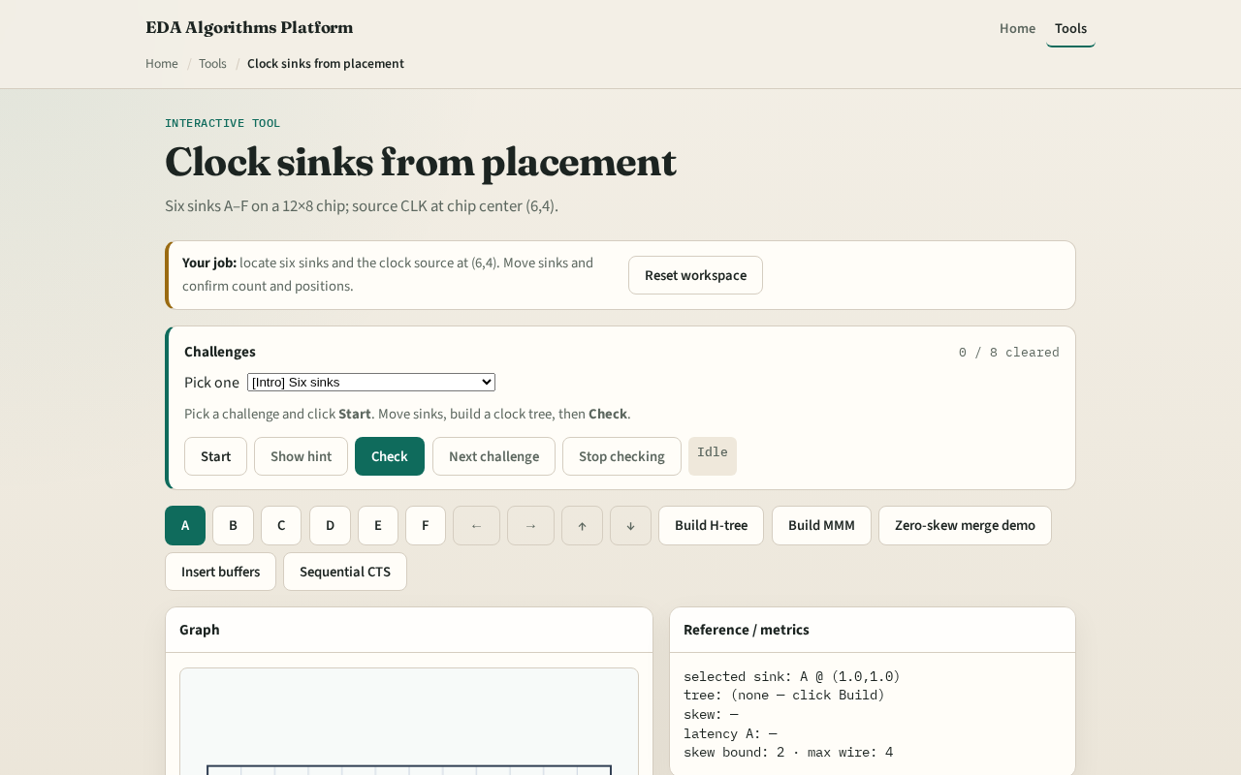
Browser lab track
Browser lab starter
learn_clock_tree — 01 clock sinks
Notes:
Open **clock-sinks**. Confirm six sinks and the yellow CLK star at six comma four. Move B and watch its label follow.

Slide 9
Implement track
Call `sink_points(placement, sinks)` in `common/ctsutil.py`
Print A through F on tiny_cts
Assert source at (6,4)
learn_clock_tree — 01 clock sinks
Notes:
Call `sink_points(placement, sinks)` in `common/ctsutil.py`. Print A through F on tiny_cts. Assert source at (6,4).

Slide 10
Pitfalls
Using GCell indices instead of cell centers
Forgetting the source is fixed
Treating nets as sinks
learn_clock_tree — 01 clock sinks
Notes:
Using GCell indices instead of cell centers. Forgetting the source is fixed. Treating nets as sinks.

Slide 11
Your turn
Next: measure latency and skew on a built tree
learn_clock_tree — 01 clock sinks
Notes:
Next: measure latency and skew on a built tree.

