Slide 1
Latency and skew
Skew is the CTS scoreboard: how different are arrival times at sinks
learn_clock_tree — 03 latency skew
Notes:
Skew is the CTS scoreboard: how different are arrival times at sinks.

Slide 2
The idea
Walk the tree from source to each sink summing Manhattan edge lengths
Skew equals max latency minus min latency
Wire delay per unit is one on the toy
learn_clock_tree — 03 latency skew
Notes:
Walk the tree from source to each sink summing Manhattan edge lengths. Skew equals max latency minus min latency. Wire delay per unit is one on the toy.

Slide 3
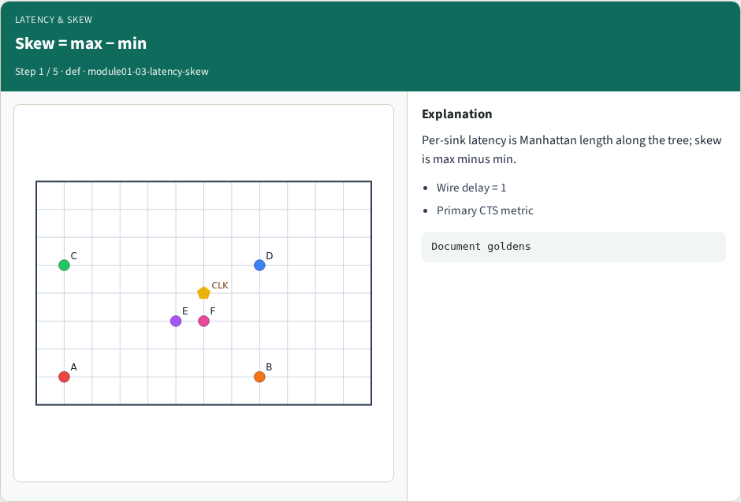
Skew = max − min
Skew = max − min
learn_clock_tree — 03 latency skew
Notes:
Per-sink latency is Manhattan length along the tree; skew is max minus min.

Slide 4
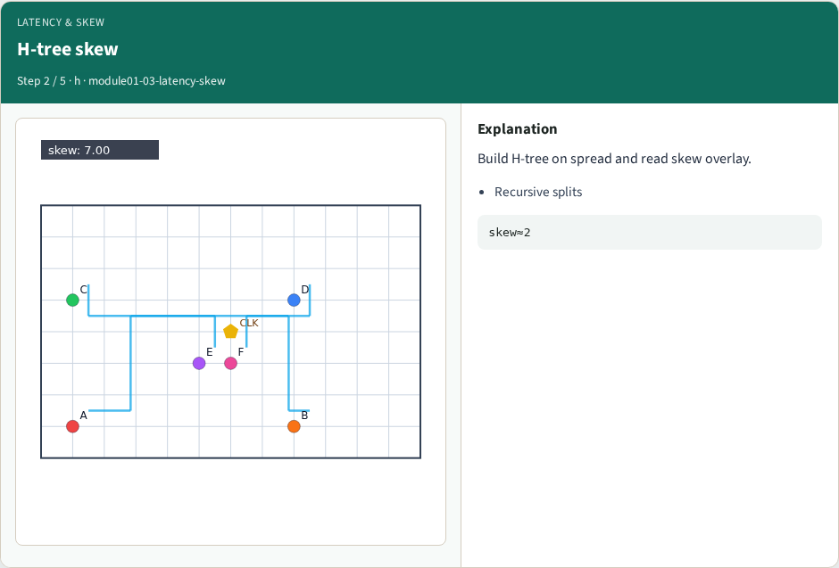
H-tree skew
H-tree skew
learn_clock_tree — 03 latency skew
Notes:
Build H-tree on spread and read skew overlay.

Slide 5
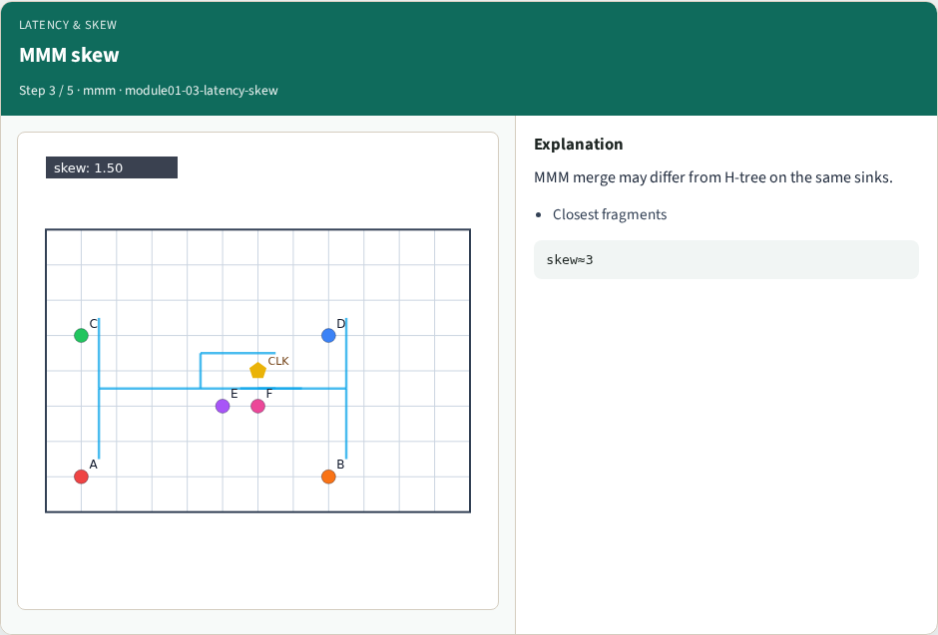
MMM skew
MMM skew
learn_clock_tree — 03 latency skew
Notes:
MMM merge may differ from H-tree on the same sinks.

Slide 6
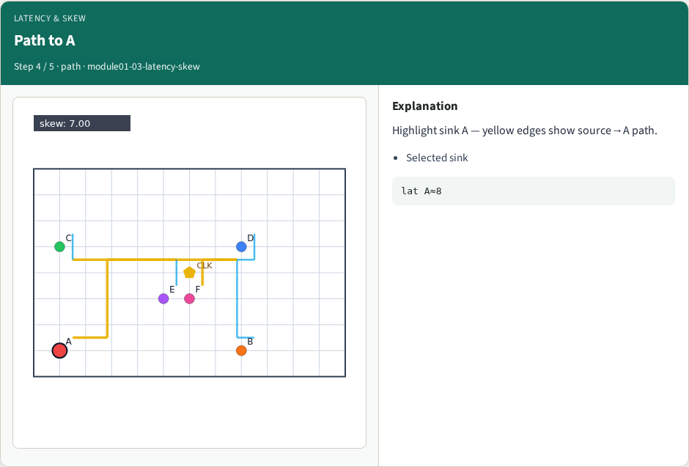
Path to A
Path to A
learn_clock_tree — 03 latency skew
Notes:
Highlight sink A — yellow edges show source→A path.

Slide 7
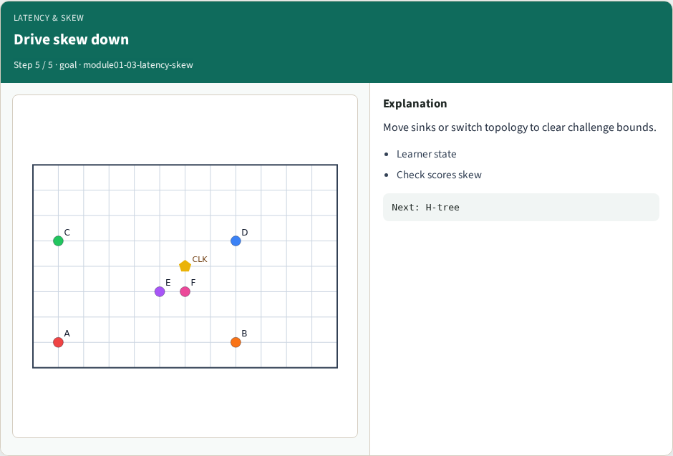
Drive skew down
Drive skew down
learn_clock_tree — 03 latency skew
Notes:
Move sinks or switch topology to clear challenge bounds.

Slide 8
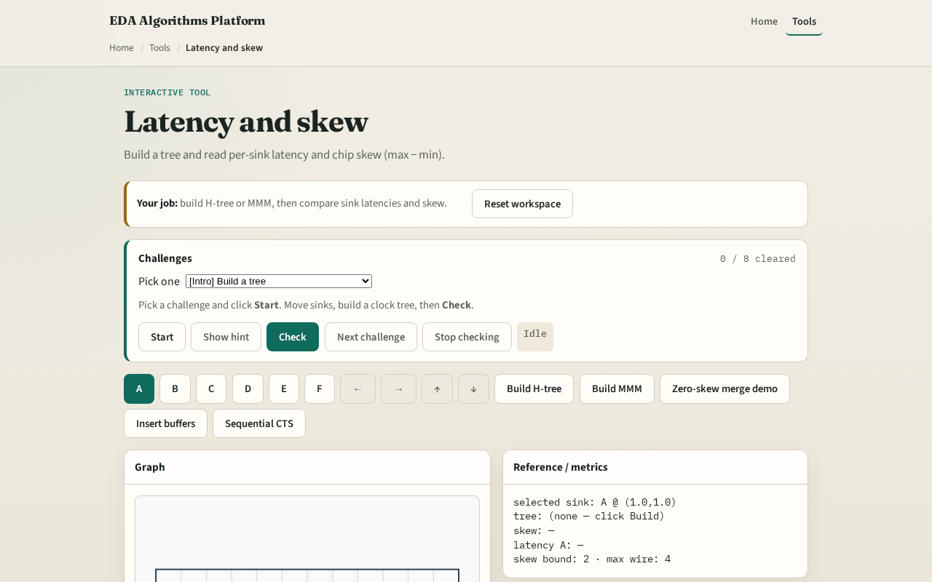
Browser lab track
Browser lab starter
learn_clock_tree — 03 latency skew
Notes:
Open **latency-skew**. Build H-tree, read skew, then Build MMM and compare. Select A to highlight its path.

Slide 9
Implement track
Implement or call `latency(path)` and `skew(latencies)` in `common/solvers.py`
Print skew for MMM on tiny_cts
learn_clock_tree — 03 latency skew
Notes:
Implement or call `latency(path)` and `skew(latencies)` in `common/solvers.py`. Print skew for MMM on tiny_cts.

Slide 10
Pitfalls
Using Euclidean distance
Comparing sinks without a tree
Treating buffer delay as wire length without counting buffers
learn_clock_tree — 03 latency skew
Notes:
Using Euclidean distance. Comparing sinks without a tree. Treating buffer delay as wire length without counting buffers.

Slide 11
Your turn
Next: grow a classic H-tree topology
learn_clock_tree — 03 latency skew
Notes:
Next: grow a classic H-tree topology.

