Slide 1
H-tree topology
H-trees are the classic picture of a balanced clock network on a regular array
learn_clock_tree — 01 h tree
Notes:
H-trees are the classic picture of a balanced clock network on a regular array.

Slide 2
The idea
From the source, alternate horizontal and vertical splits toward sink groups
Each split creates steiner points and L-shaped legs to children
learn_clock_tree — 01 h tree
Notes:
From the source, alternate horizontal and vertical splits toward sink groups. Each split creates steiner points and L-shaped legs to children.

Slide 3
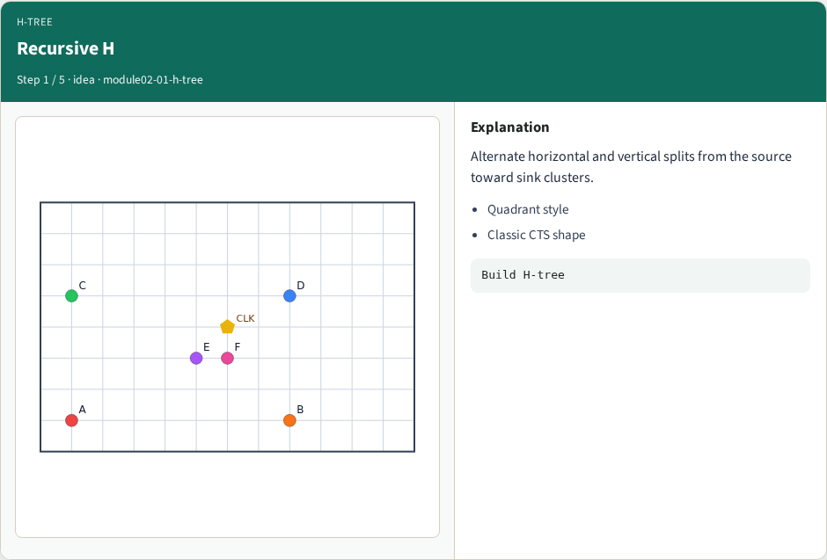
Recursive H
Recursive H
learn_clock_tree — 01 h tree
Notes:
Alternate horizontal and vertical splits from the source toward sink clusters.

Slide 4
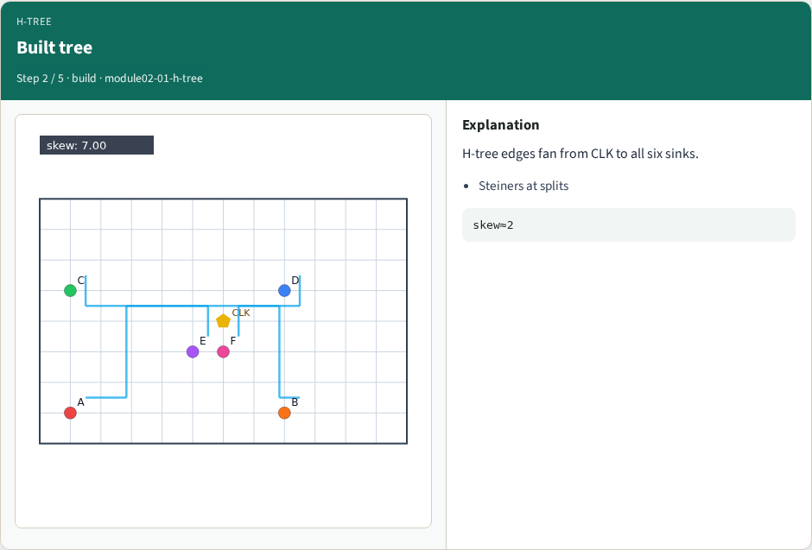
Built tree
Built tree
learn_clock_tree — 01 h tree
Notes:
H-tree edges fan from CLK to all six sinks.

Slide 5
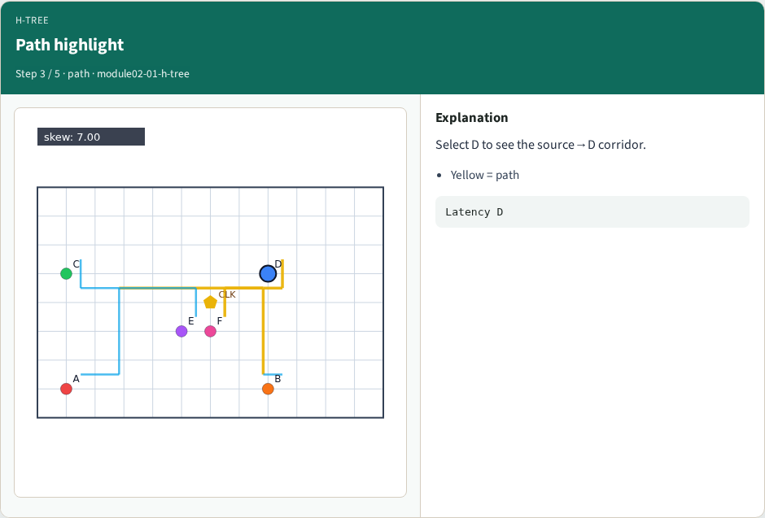
Path highlight
Path highlight
learn_clock_tree — 01 h tree
Notes:
Select D to see the source→D corridor.

Slide 6
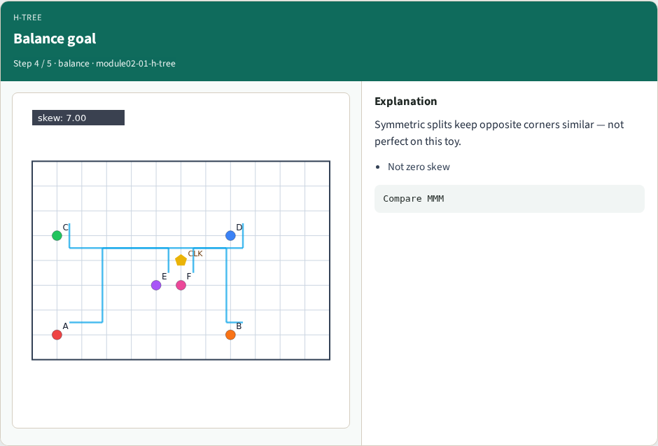
Balance goal
Balance goal
learn_clock_tree — 01 h tree
Notes:
Symmetric splits keep opposite corners similar — not perfect on this toy.

Slide 7
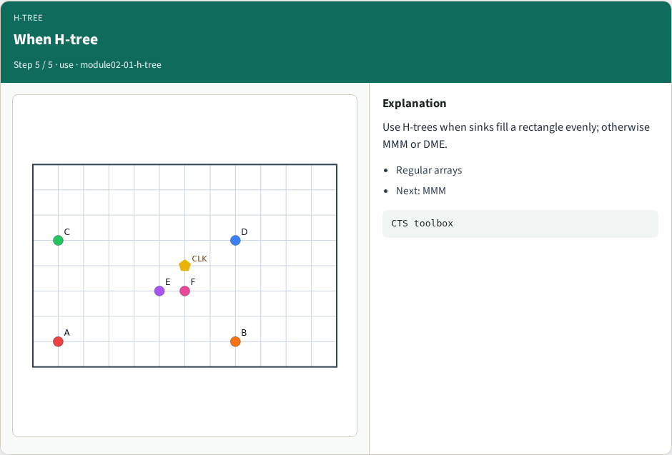
When H-tree
When H-tree
learn_clock_tree — 01 h tree
Notes:
Use H-trees when sinks fill a rectangle evenly; otherwise MMM or DME.

Slide 8
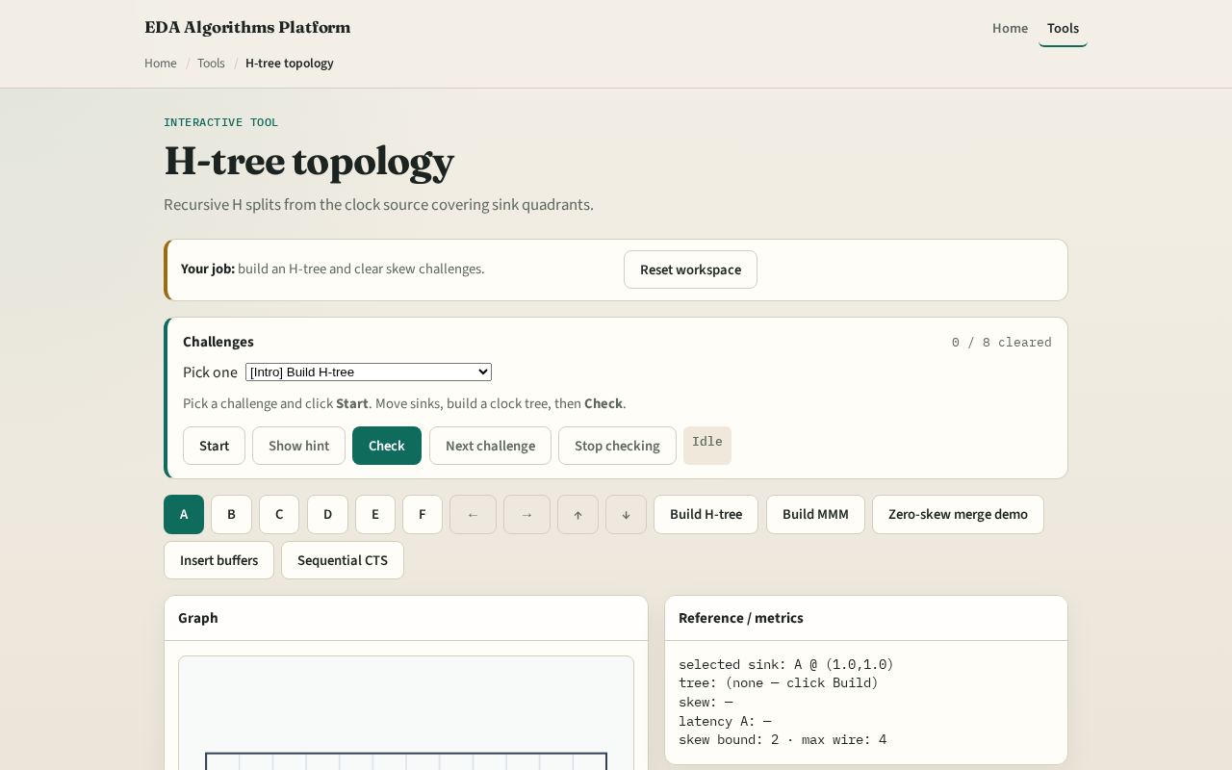
Browser lab track
Browser lab starter
learn_clock_tree — 01 h tree
Notes:
Open **h-tree**. Click Build H-tree. Select D and watch the yellow path. Compare skew to the MMM lab next.

Slide 9
Implement track
Call `h_tree(source, chip)` / browser `hTree(positions)`
Attach sinks and print edge count and skew
learn_clock_tree — 01 h tree
Notes:
Call `h_tree(source, chip)` / browser `hTree(positions)`. Attach sinks and print edge count and skew.

Slide 10
Pitfalls
Stopping after one H without recursion
Connecting sinks with Euclidean edges
Ignoring steiner points when measuring latency
learn_clock_tree — 01 h tree
Notes:
Stopping after one H without recursion. Connecting sinks with Euclidean edges. Ignoring steiner points when measuring latency.

Slide 11
Your turn
Next: Method of Means and Medians for irregular sinks
learn_clock_tree — 01 h tree
Notes:
Next: Method of Means and Medians for irregular sinks.

