Slide 1
Method of Means and Medians
When sinks are irregular, greedy merge adapts better than a pure geometric H
learn_clock_tree — 03 mmm tree
Notes:
When sinks are irregular, greedy merge adapts better than a pure geometric H.

Slide 2
The idea
Treat each sink as a fragment
Repeatedly merge the closest pair of fragment roots at their midpoint
learn_clock_tree — 03 mmm tree
Notes:
Treat each sink as a fragment. Repeatedly merge the closest pair of fragment roots at their midpoint, then trunk the final root to the clock source.

Slide 3
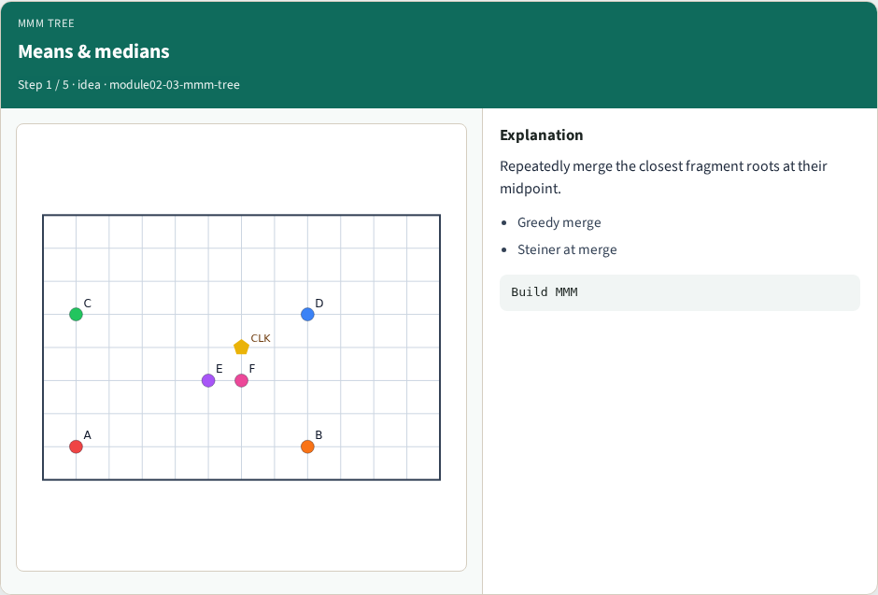
Means & medians
Means & medians
learn_clock_tree — 03 mmm tree
Notes:
Repeatedly merge the closest fragment roots at their midpoint.

Slide 4
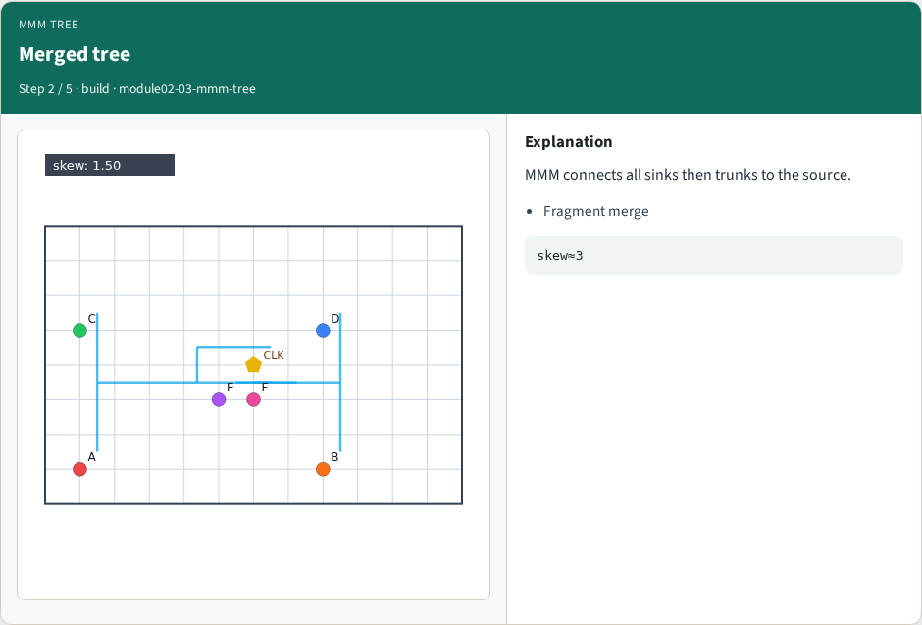
Merged tree
Merged tree
learn_clock_tree — 03 mmm tree
Notes:
MMM connects all sinks then trunks to the source.

Slide 5
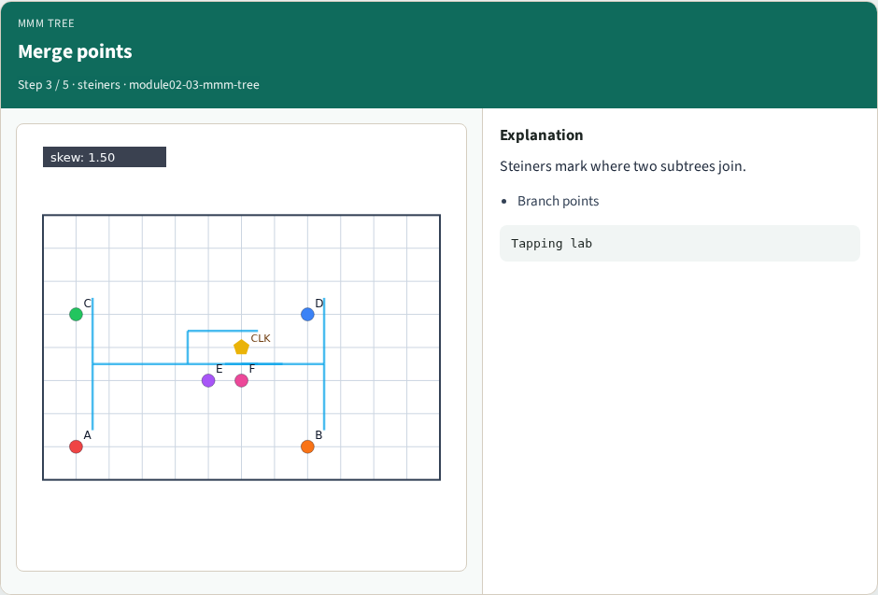
Merge points
Merge points
learn_clock_tree — 03 mmm tree
Notes:
Steiners mark where two subtrees join.

Slide 6
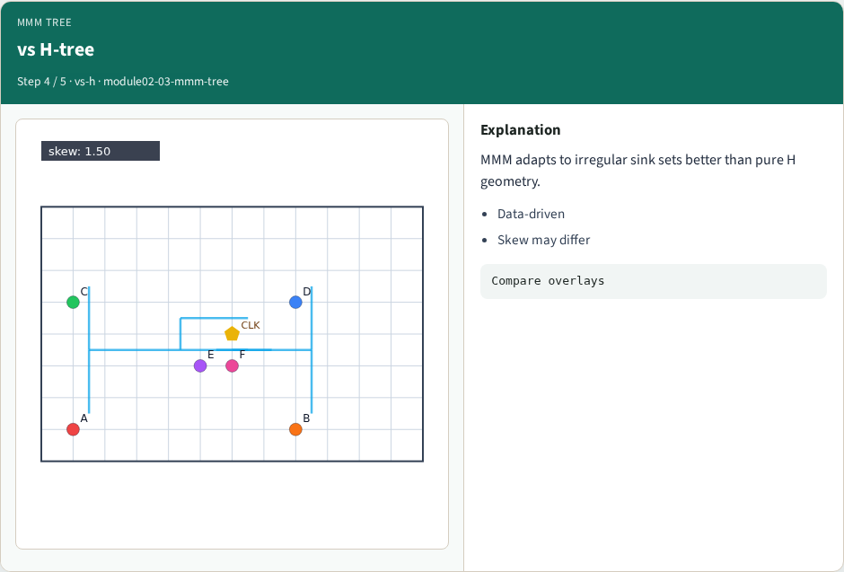
vs H-tree
vs H-tree
learn_clock_tree — 03 mmm tree
Notes:
MMM adapts to irregular sink sets better than pure H geometry.

Slide 7
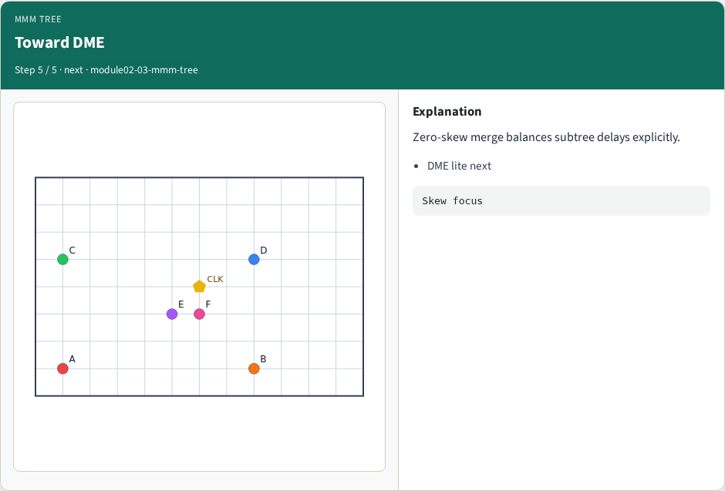
Toward DME
Toward DME
learn_clock_tree — 03 mmm tree
Notes:
Zero-skew merge balances subtree delays explicitly.

Slide 8
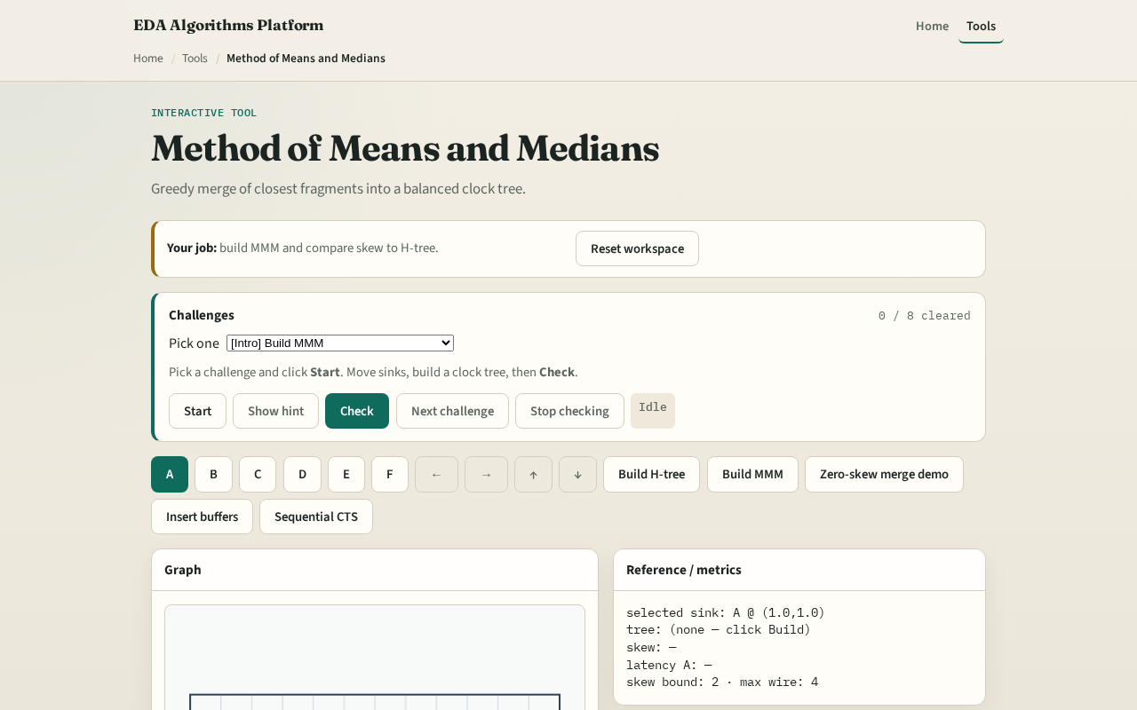
Browser lab track
Browser lab starter
learn_clock_tree — 03 mmm tree
Notes:
Open **mmm-tree**. Build MMM, read skew, then rebuild after moving C. Compare to H-tree skew.

Slide 9
Implement track
Call `mmm_tree(source, sinks)` in solvers
Assert every sink endpoint appears in the edge set
learn_clock_tree — 03 mmm tree
Notes:
Call `mmm_tree(source, sinks)` in solvers. Assert every sink endpoint appears in the edge set.

Slide 10
Pitfalls
Merging by Euclidean when latency is Manhattan
Forgetting to connect the final fragment to the source
Dropping steiner coordinates when buffering
learn_clock_tree — 03 mmm tree
Notes:
Merging by Euclidean when latency is Manhattan. Forgetting to connect the final fragment to the source. Dropping steiner coordinates when buffering.

Slide 11
Your turn
Next: zero-skew merge (DME lite)
learn_clock_tree — 03 mmm tree
Notes:
Next: zero-skew merge (DME lite).

