Slide 1
Zero-skew merge
Deferred-merge embedding equalizes delay so opposite arms arrive together
learn_clock_tree — 05 zero skew merge
Notes:
Deferred-merge embedding equalizes delay so opposite arms arrive together.

Slide 2
The idea
Partition sinks left and right of the source
Choose a meeting steiner so left radius plus wire matches right radius plus wire
That is the zero-skew intuition
learn_clock_tree — 05 zero skew merge
Notes:
Partition sinks left and right of the source. Choose a meeting steiner so left radius plus wire matches right radius plus wire. That is the zero-skew intuition.

Slide 3
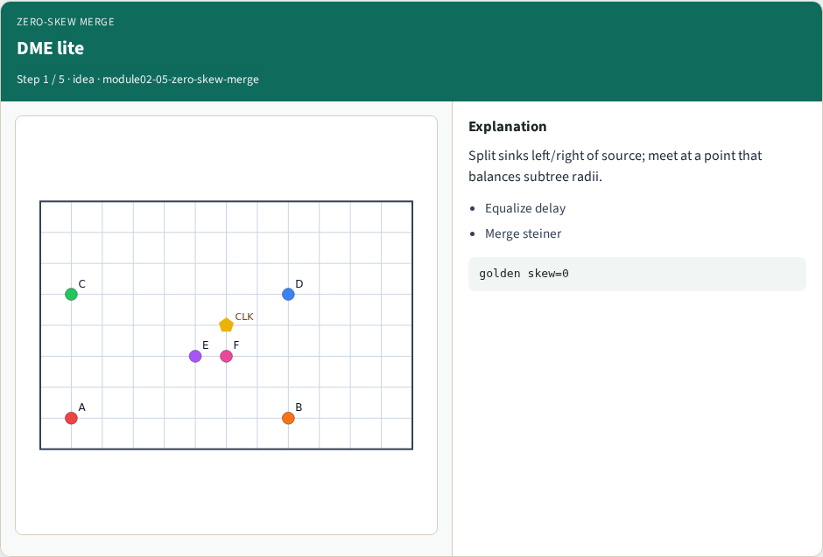
DME lite
DME lite
learn_clock_tree — 05 zero skew merge
Notes:
Split sinks left/right of source; meet at a point that balances subtree radii.

Slide 4
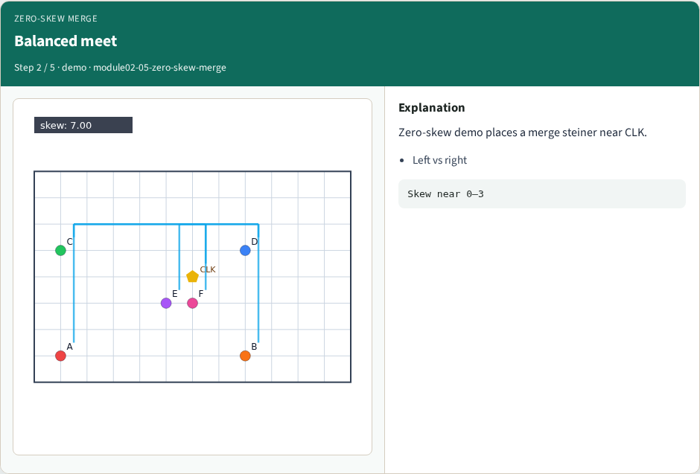
Balanced meet
Balanced meet
learn_clock_tree — 05 zero skew merge
Notes:
Zero-skew demo places a merge steiner near CLK.

Slide 5
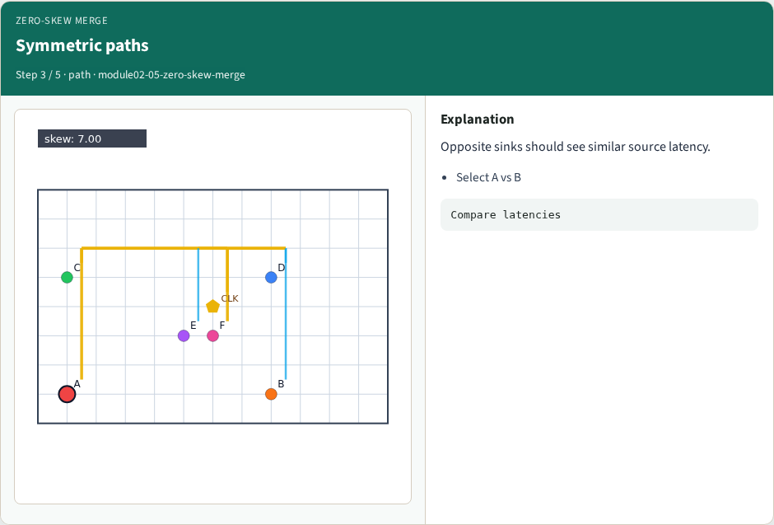
Symmetric paths
Symmetric paths
learn_clock_tree — 05 zero skew merge
Notes:
Opposite sinks should see similar source latency.

Slide 6
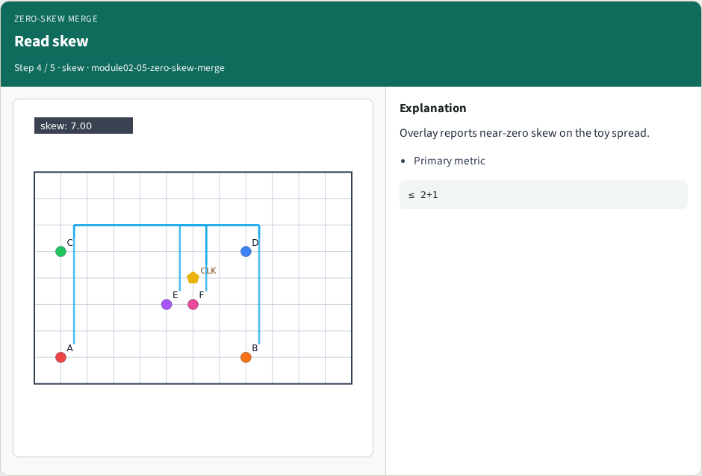
Read skew
Read skew
learn_clock_tree — 05 zero skew merge
Notes:
Overlay reports near-zero skew on the toy spread.

Slide 7
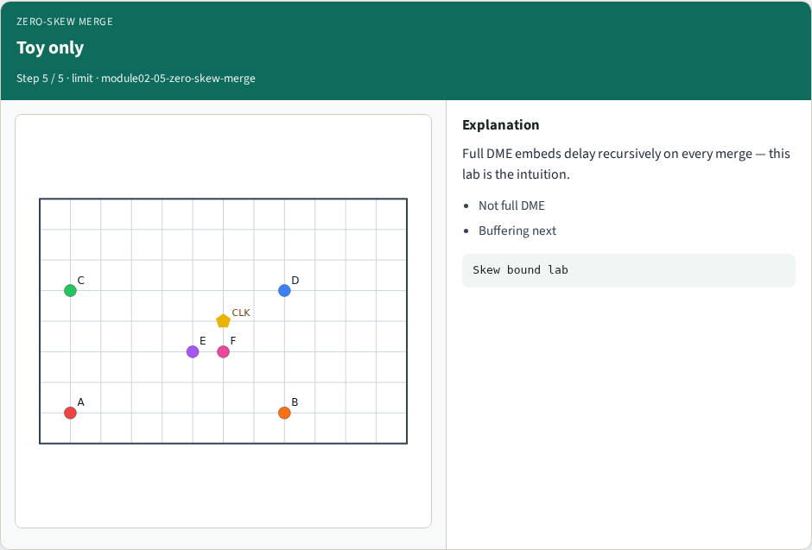
Toy only
Toy only
learn_clock_tree — 05 zero skew merge
Notes:
Full DME embeds delay recursively on every merge — this lab is the intuition.

Slide 8
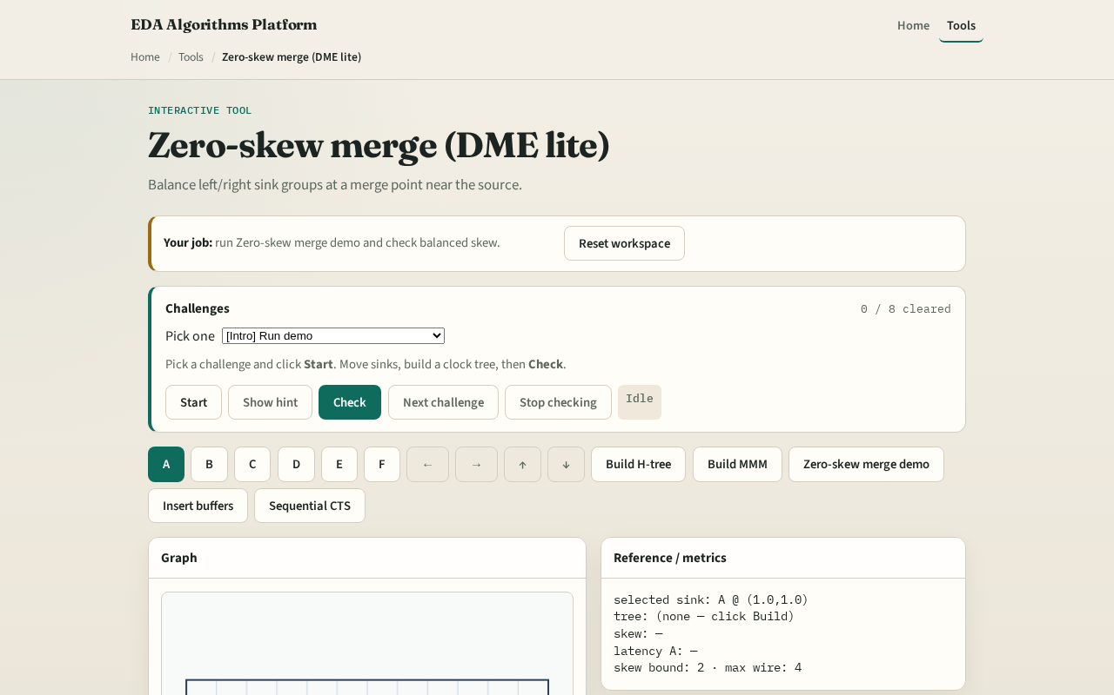
Browser lab track
Browser lab starter
learn_clock_tree — 05 zero skew merge
Notes:
Open **zero-skew-merge**. Run Zero-skew merge demo. Confirm skew near zero to three. Select A and B and compare latencies.

Slide 9
Implement track
Call `zero_skew_merge(a,b,da,db)` for a 1D pair; run the browser demo for the full chip
Assert |la−lb| ≈ 0 for equal da,db
learn_clock_tree — 05 zero skew merge
Notes:
Call `zero_skew_merge(a,b,da,db)` for a 1D pair; run the browser demo for the full chip. Assert |la−lb| ≈ 0 for equal da,db.

Slide 10
Pitfalls
Balancing Euclidean radii
Ignoring existing subtree delay da/db
Expecting full industrial DME from this toy
learn_clock_tree — 05 zero skew merge
Notes:
Balancing Euclidean radii. Ignoring existing subtree delay da/db. Expecting full industrial DME from this toy.

Slide 11
Your turn
Next: tapping points where the tree forks
learn_clock_tree — 05 zero skew merge
Notes:
Next: tapping points where the tree forks.

