Slide 1
Tapping / branch points
Buffers and clock gates often sit where the tree forks
learn_clock_tree — 07 tapping points
Notes:
Buffers and clock gates often sit where the tree forks.

Slide 2
The idea
Collect steiner and edge endpoints
Keep points with degree at least three, those are tapping points
learn_clock_tree — 07 tapping points
Notes:
Collect steiner and edge endpoints. Keep points with degree at least three—those are tapping points.

Slide 3
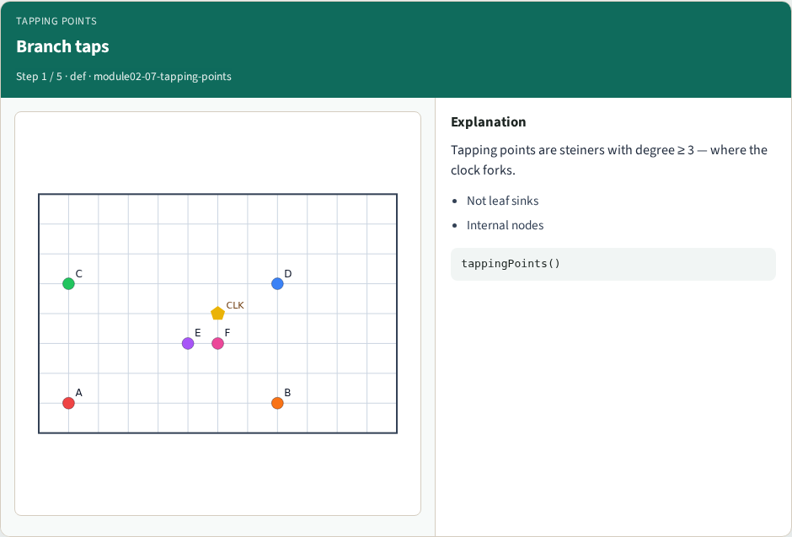
Branch taps
Branch taps
learn_clock_tree — 07 tapping points
Notes:
Tapping points are steiners with degree ≥ 3 — where the clock forks.

Slide 4
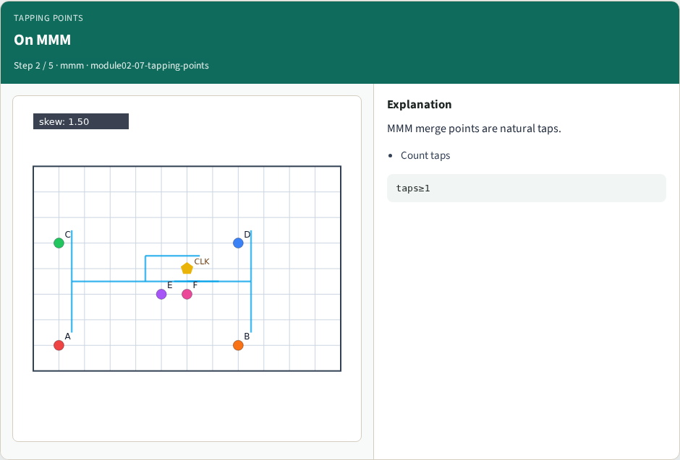
On MMM
On MMM
learn_clock_tree — 07 tapping points
Notes:
MMM merge points are natural taps.

Slide 5
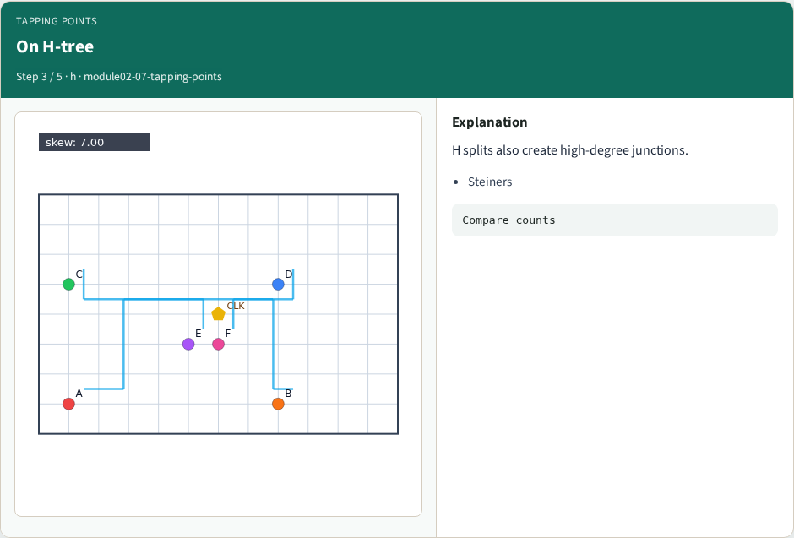
On H-tree
On H-tree
learn_clock_tree — 07 tapping points
Notes:
H splits also create high-degree junctions.

Slide 6
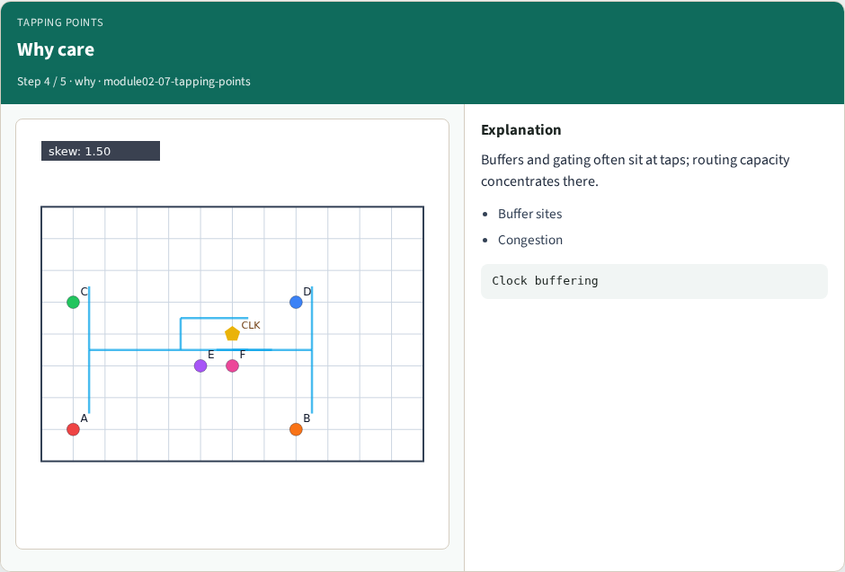
Why care
Why care
learn_clock_tree — 07 tapping points
Notes:
Buffers and gating often sit at taps; routing capacity concentrates there.

Slide 7
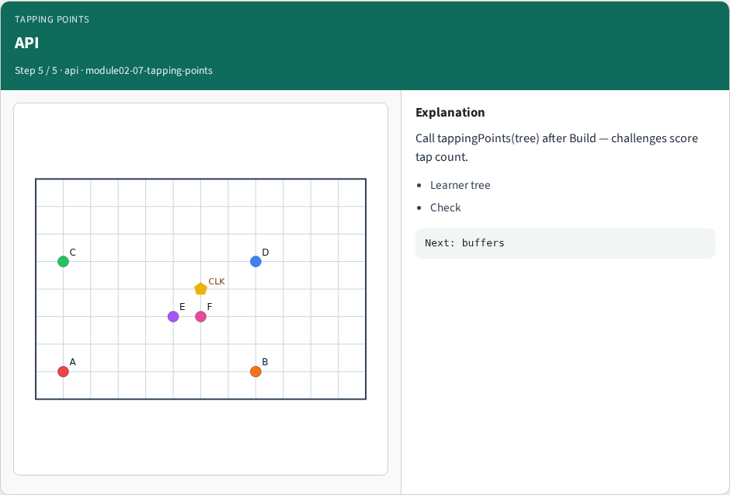
API
API
learn_clock_tree — 07 tapping points
Notes:
Call tappingPoints(tree) after Build — challenges score tap count.

Slide 8
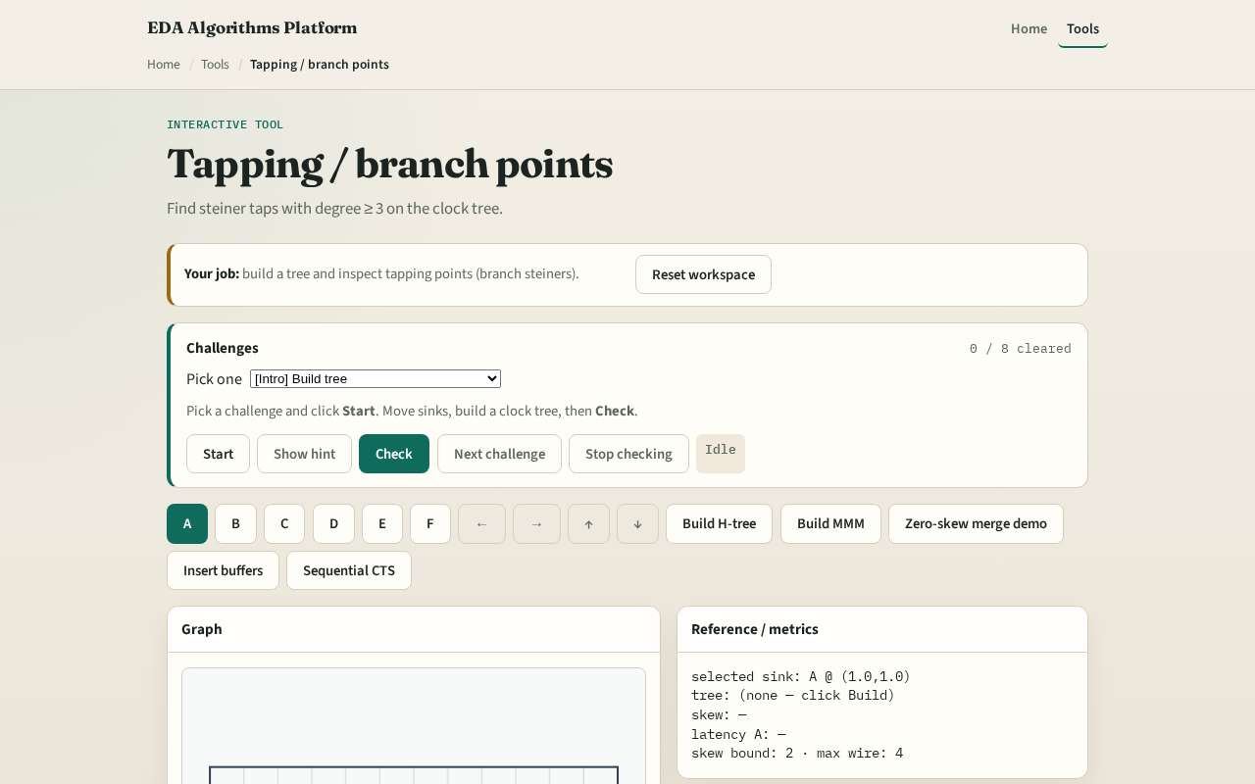
Browser lab track
Browser lab starter
learn_clock_tree — 07 tapping points
Notes:
Open **tapping-points**. Build MMM and confirm taps ≥ 1. Rebuild H-tree and compare tap count.

Slide 9
Implement track
Call `tapping_points(tree)` after `mmm_tree`
Assert length ≥ 1 on tiny_cts
learn_clock_tree — 07 tapping points
Notes:
Call `tapping_points(tree)` after `mmm_tree`. Assert length ≥ 1 on tiny_cts.

Slide 10
Pitfalls
Counting leaf sinks as taps
Using degree on undirected edges inconsistently
Dropping steiners before the degree pass
learn_clock_tree — 07 tapping points
Notes:
Counting leaf sinks as taps. Using degree on undirected edges inconsistently. Dropping steiners before the degree pass.

Slide 11
Your turn
Next: insert buffers on long wires
learn_clock_tree — 07 tapping points
Notes:
Next: insert buffers on long wires.

