Slide 1
Clock buffering on wires
Long wires lose slew; CTS inserts buffers along the tree
learn_clock_tree — 01 clock buffering
Notes:
Long wires lose slew; CTS inserts buffers along the tree.

Slide 2
The idea
If an edge longer than maxWireLen
Buffered latency adds bufferDelay per buffer on the path
learn_clock_tree — 01 clock buffering
Notes:
If an edge longer than maxWireLen, split it into equal pieces and place a buffer at each joint. Buffered latency adds bufferDelay per buffer on the path.

Slide 3
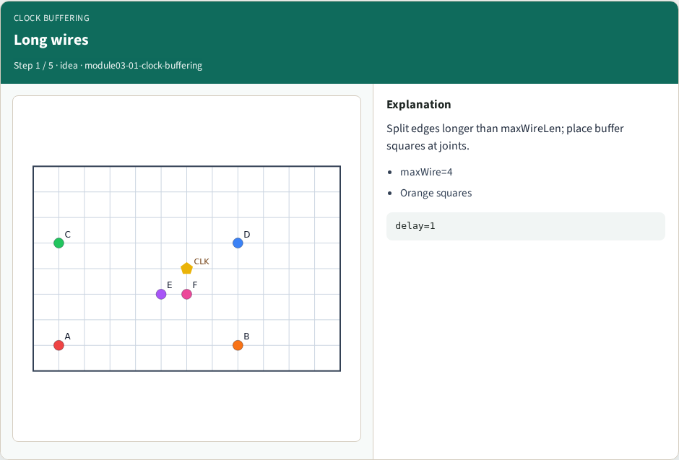
Long wires
Long wires
learn_clock_tree — 01 clock buffering
Notes:
Split edges longer than maxWireLen; place buffer squares at joints.

Slide 4
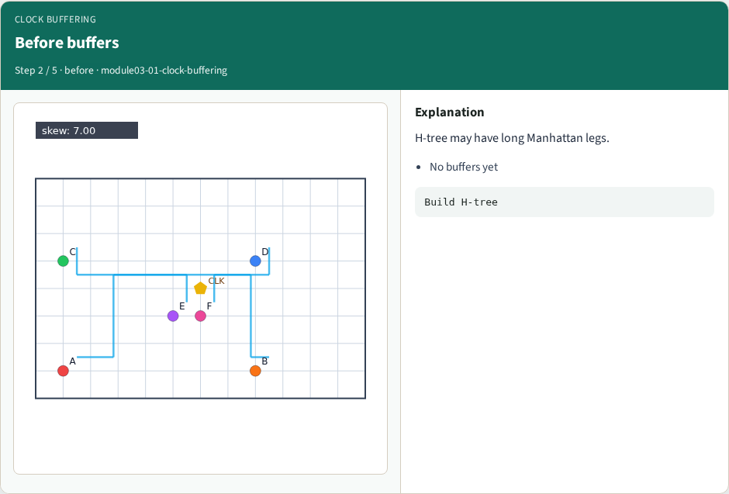
Before buffers
Before buffers
learn_clock_tree — 01 clock buffering
Notes:
H-tree may have long Manhattan legs.

Slide 5
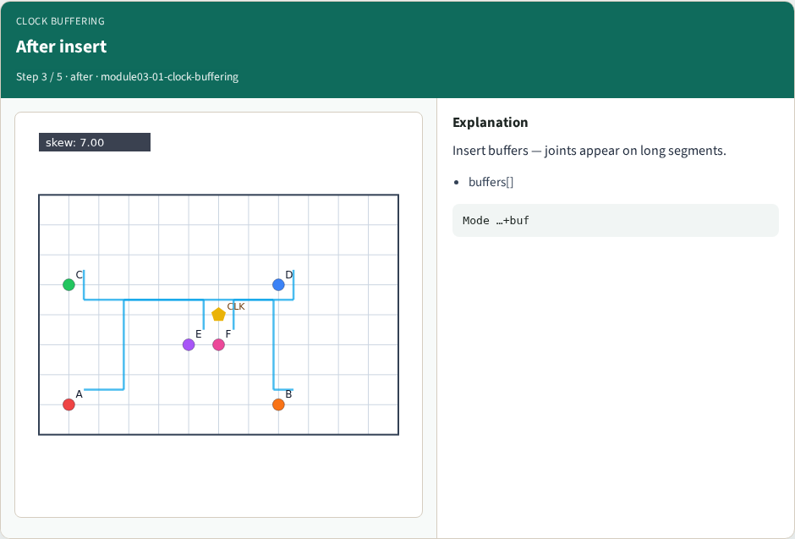
After insert
After insert
learn_clock_tree — 01 clock buffering
Notes:
Insert buffers — joints appear on long segments.

Slide 6
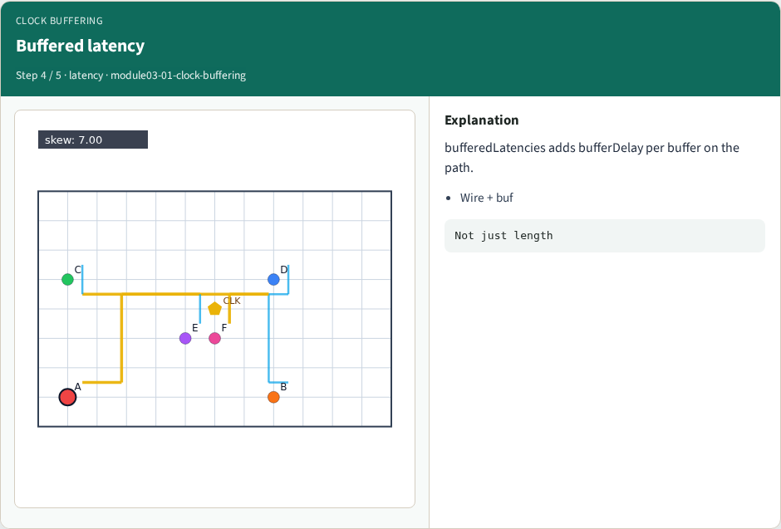
Buffered latency
Buffered latency
learn_clock_tree — 01 clock buffering
Notes:
bufferedLatencies adds bufferDelay per buffer on the path.

Slide 7
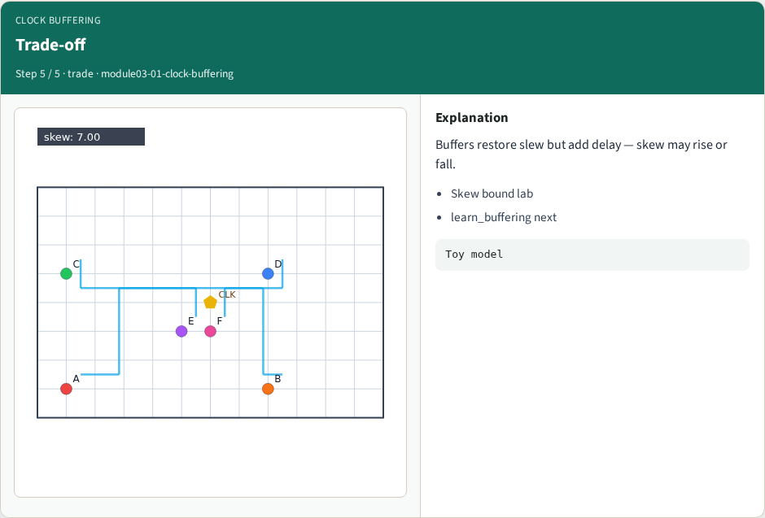
Trade-off
Trade-off
learn_clock_tree — 01 clock buffering
Notes:
Buffers restore slew but add delay — skew may rise or fall.

Slide 8
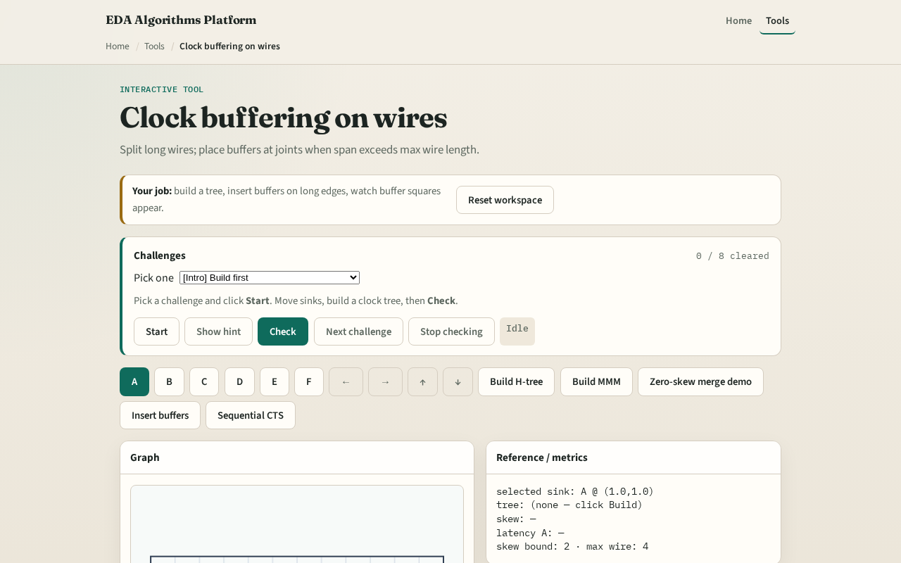
Browser lab track
Browser lab starter
learn_clock_tree — 01 clock buffering
Notes:
Open **clock-buffering**. Build H-tree, click Insert buffers, count orange squares. Read buffered latencies for A.

Slide 9
Implement track
Call `insert_buffers(edge, max_span, buffer_delay)`
Assert max segment length ≤ max_span
learn_clock_tree — 01 clock buffering
Notes:
Call `insert_buffers(edge, max_span, buffer_delay)`. Assert max segment length ≤ max_span.

Slide 10
Pitfalls
Buffering without splitting edges
Counting buffer delay twice
Using max span zero
learn_clock_tree — 01 clock buffering
Notes:
Buffering without splitting edges. Counting buffer delay twice. Using max span zero.

Slide 11
Your turn
Next: meet a skew bound with buffers and topology choice
learn_clock_tree — 01 clock buffering
Notes:
Next: meet a skew bound with buffers and topology choice.

