Slide 1
Skew bound with buffers
Signoff asks: is skew under budget?
learn_clock_tree — 03 skew bound
Notes:
Signoff asks: is skew under budget? This lab makes that a Check button.

Slide 2
The idea
Skew_bound_ok is true when skew ≤ bound
Zero-skew merge often meets bound two on the toy
learn_clock_tree — 03 skew bound
Notes:
skew_bound_ok is true when skew ≤ bound. Zero-skew merge often meets bound two on the toy; H-tree may need moves or a different mode.

Slide 3
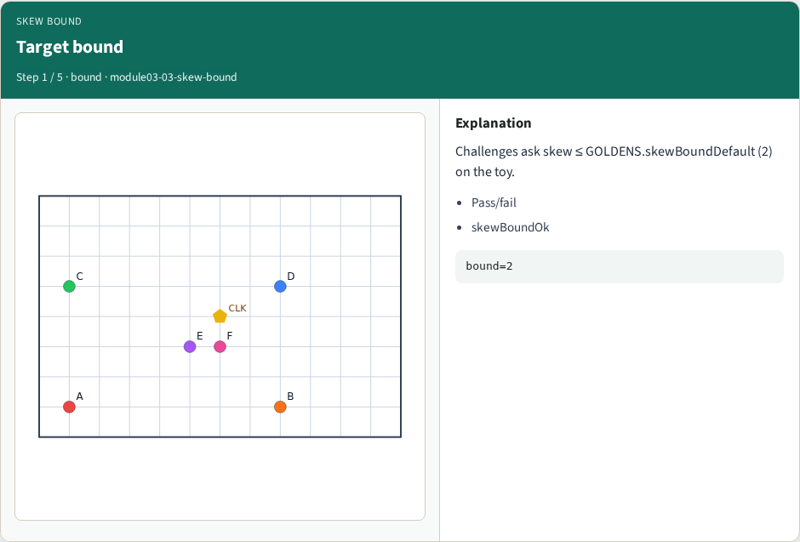
Target bound
Target bound
learn_clock_tree — 03 skew bound
Notes:
Challenges ask skew ≤ GOLDENS.skewBoundDefault (2) on the toy.

Slide 4
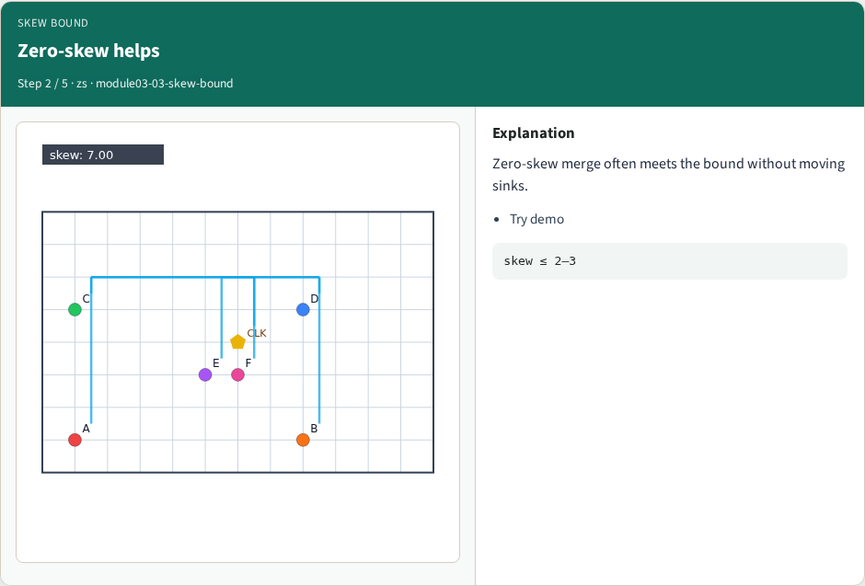
Zero-skew helps
Zero-skew helps
learn_clock_tree — 03 skew bound
Notes:
Zero-skew merge often meets the bound without moving sinks.

Slide 5
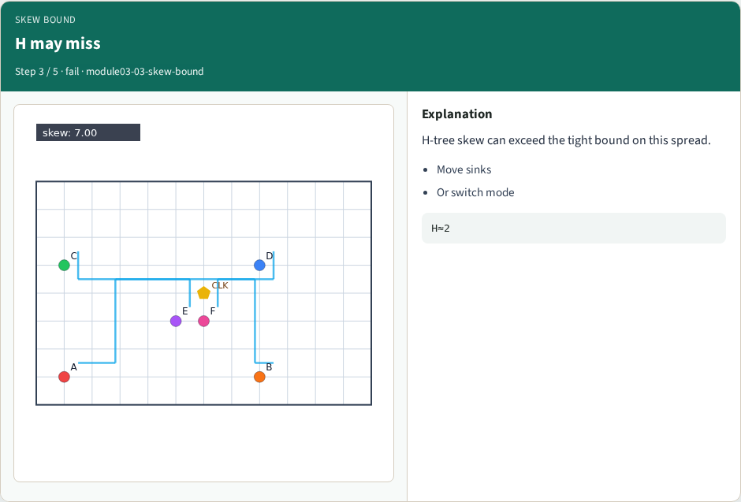
H may miss
H may miss
learn_clock_tree — 03 skew bound
Notes:
H-tree skew can exceed the tight bound on this spread.

Slide 6
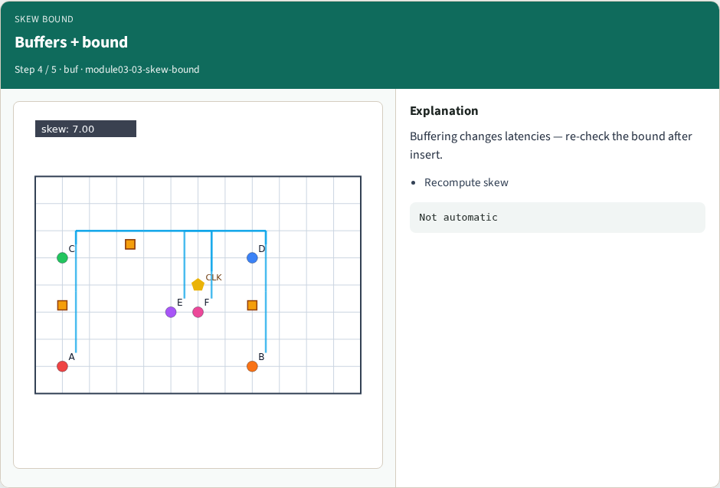
Buffers + bound
Buffers + bound
learn_clock_tree — 03 skew bound
Notes:
Buffering changes latencies — re-check the bound after insert.

Slide 7
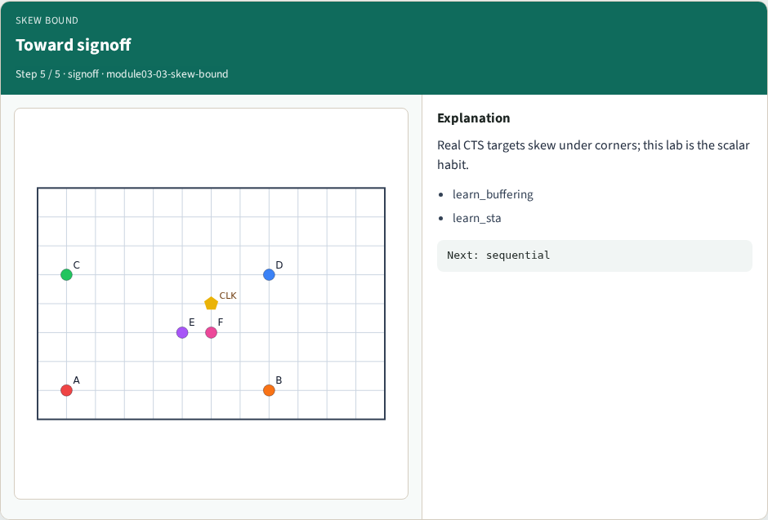
Toward signoff
Toward signoff
learn_clock_tree — 03 skew bound
Notes:
Real CTS targets skew under corners; this lab is the scalar habit.

Slide 8
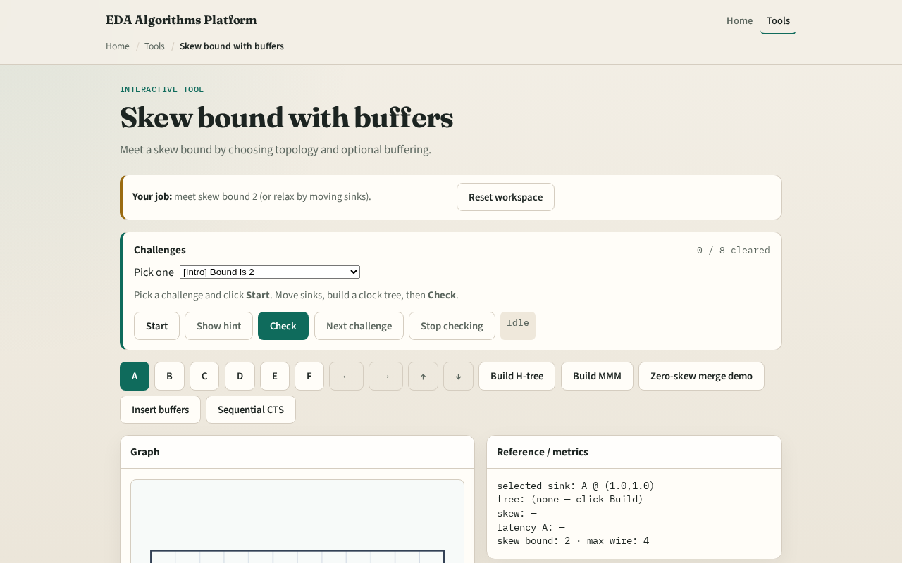
Browser lab track
Browser lab starter
learn_clock_tree — 03 skew bound
Notes:
Open **skew-bound**. Run Zero-skew merge demo and Check. Try H-tree and see if you need to move sinks to meet bound two.

Slide 9
Implement track
Call `skew_bound_ok(latencies, bound)`
Document GOLDENS.skewBoundDefault = 2
learn_clock_tree — 03 skew bound
Notes:
Call `skew_bound_ok(latencies, bound)`. Document GOLDENS.skewBoundDefault = 2.

Slide 10
Pitfalls
Hard-coding pass without measuring
Forgetting to rebuild after moving sinks
Mixing buffered and unbuffered latencies
learn_clock_tree — 03 skew bound
Notes:
Hard-coding pass without measuring. Forgetting to rebuild after moving sinks. Mixing buffered and unbuffered latencies.

Slide 11
Your turn
Next: sequential CTS connecting sinks in order
learn_clock_tree — 03 skew bound
Notes:
Next: sequential CTS connecting sinks in order.

