Slide 1
Sequential CTS pass
Some flows grow the clock net in sink order, order changes skew
learn_clock_tree — 01 sequential cts
Notes:
Some flows grow the clock net in sink order—order changes skew.

Slide 2
The idea
Start from the source
For each sink in order A…F, attach an L-route to the nearest existing tree node
Optional buffering splits long legs afterward
learn_clock_tree — 01 sequential cts
Notes:
Start from the source. For each sink in order A…F, attach an L-route to the nearest existing tree node. Optional buffering splits long legs afterward.

Slide 3
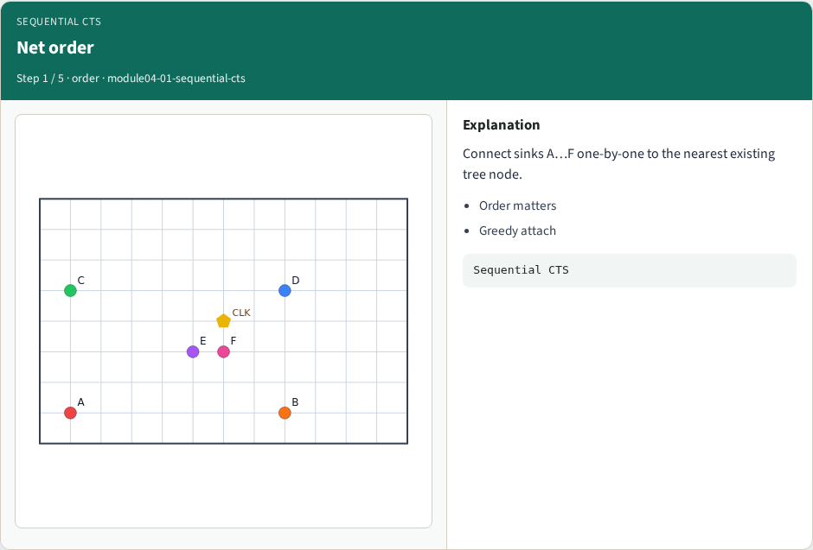
Net order
Net order
learn_clock_tree — 01 sequential cts
Notes:
Connect sinks A…F one-by-one to the nearest existing tree node.

Slide 4
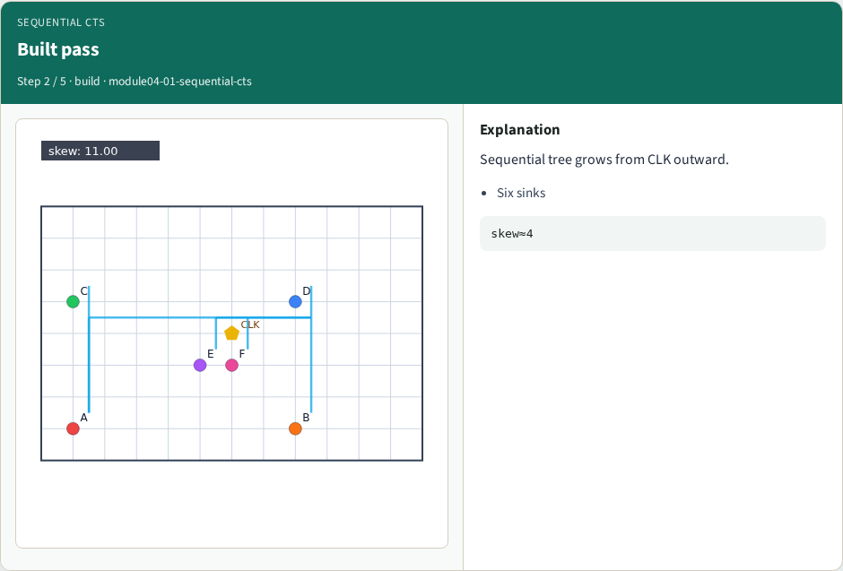
Built pass
Built pass
learn_clock_tree — 01 sequential cts
Notes:
Sequential tree grows from CLK outward.

Slide 5
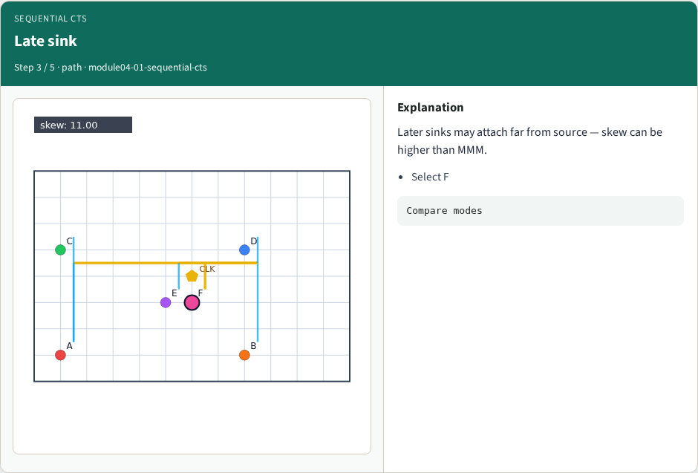
Late sink
Late sink
learn_clock_tree — 01 sequential cts
Notes:
Later sinks may attach far from source — skew can be higher than MMM.

Slide 6
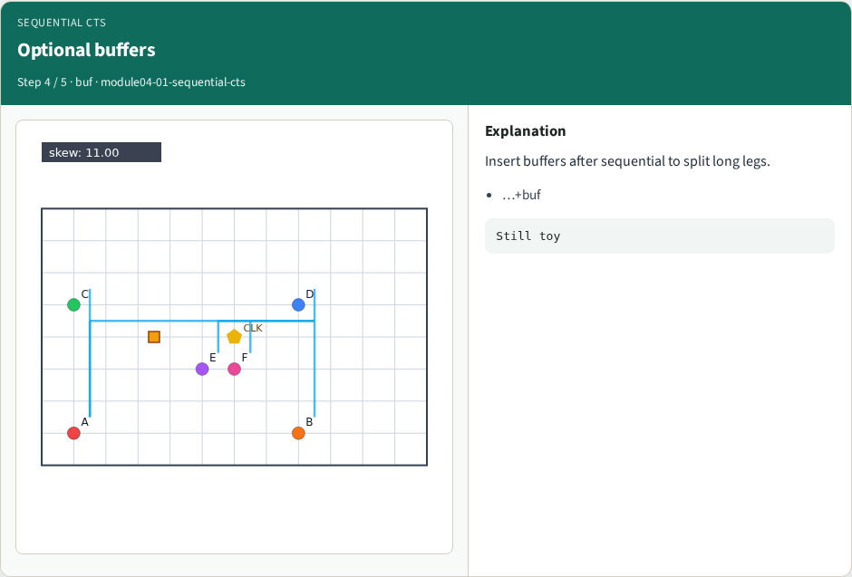
Optional buffers
Optional buffers
learn_clock_tree — 01 sequential cts
Notes:
Insert buffers after sequential to split long legs.

Slide 7
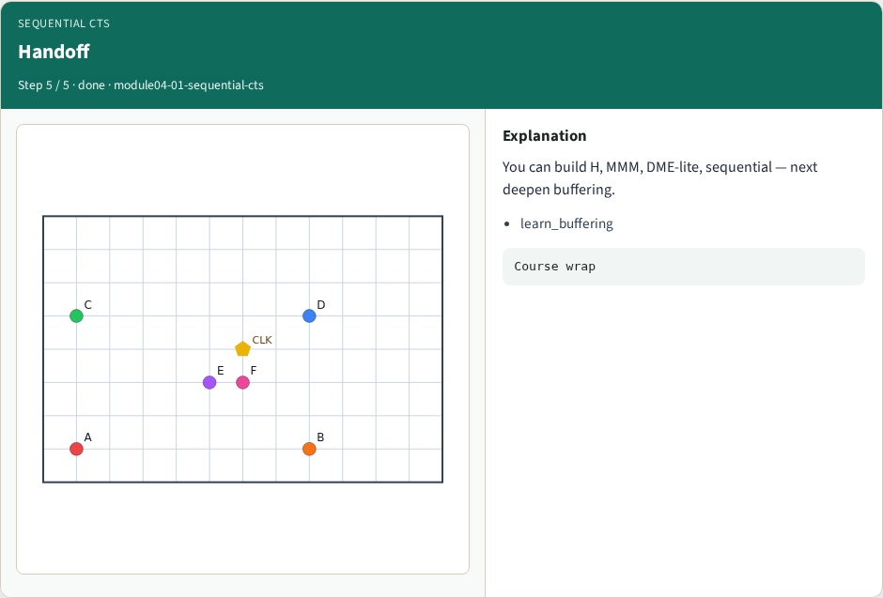
Handoff
Handoff
learn_clock_tree — 01 sequential cts
Notes:
You can build H, MMM, DME-lite, sequential — next deepen buffering.

Slide 8
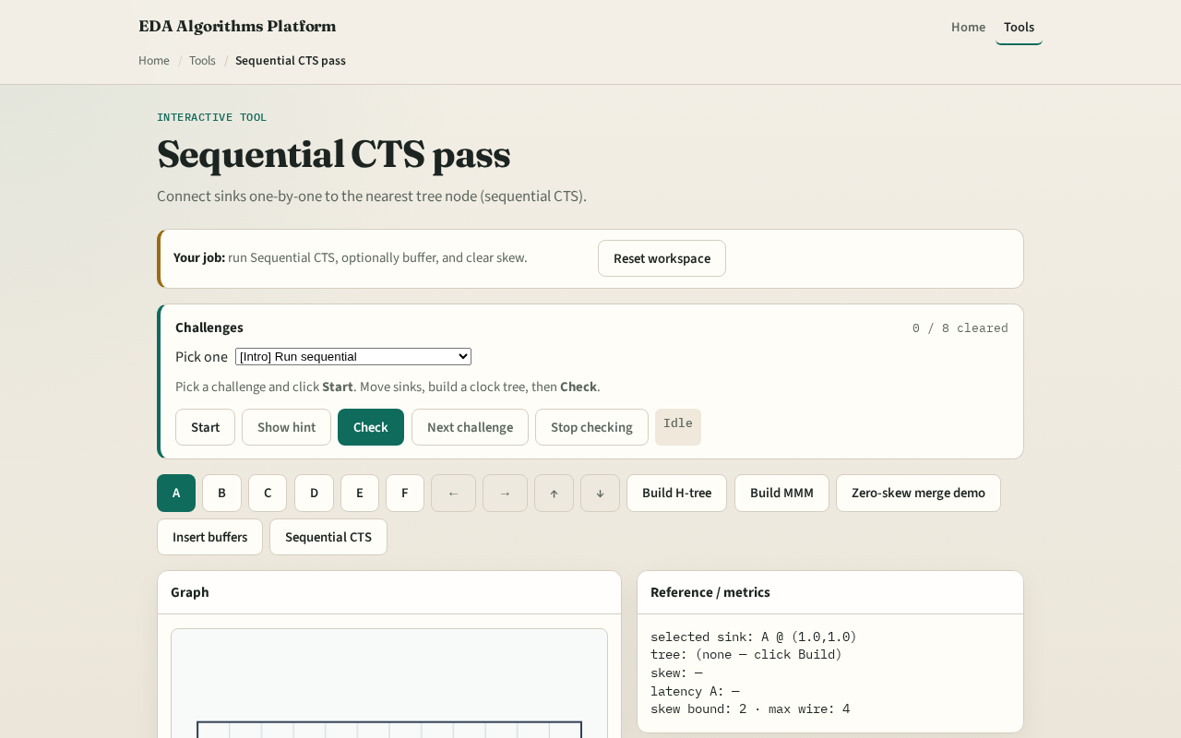
Browser lab track
Browser lab starter
learn_clock_tree — 01 sequential cts
Notes:
Open **sequential-cts**. Run Sequential CTS, read skew, optionally Insert buffers. Compare to MMM on the same placement.

Slide 9
Implement track
Call `sequential_cts(data
Print skew
learn_clock_tree — 01 sequential cts
Notes:
Call `sequential_cts(data, mode='mmm')` for a full pass, or use the browser sequential builder. Print skew.

Slide 10
Pitfalls
Assuming order does not matter
Attaching to sinks only, not steiners
Skipping the source as the first node
learn_clock_tree — 01 sequential cts
Notes:
Assuming order does not matter. Attaching to sinks only, not steiners. Skipping the source as the first node.

Slide 11
Your turn
Next: offline benchmark compare, then wrap
learn_clock_tree — 01 sequential cts
Notes:
Next: offline benchmark compare, then wrap.

