Slide 1
Why Timing
Map netlist cells to the OpenSTA timing graph
learn_opensta — 01 timing graph map
Notes:
Map netlist cells to the OpenSTA timing graph.

Slide 2
The idea
GOLDEN: 3 cells u1/u2/u3; graph nodes = cells + pins
learn_opensta — 01 timing graph map
Notes:
GOLDEN: 3 cells u1/u2/u3; graph nodes = cells + pins.

Slide 3
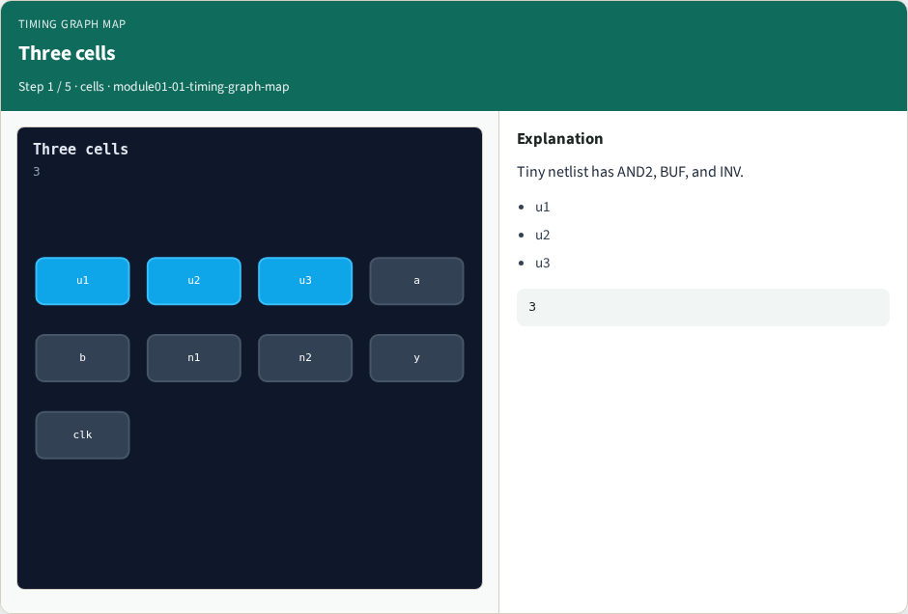
Three cells
Three cells
learn_opensta — 01 timing graph map
Notes:
Tiny netlist has AND2, BUF, and INV.

Slide 4
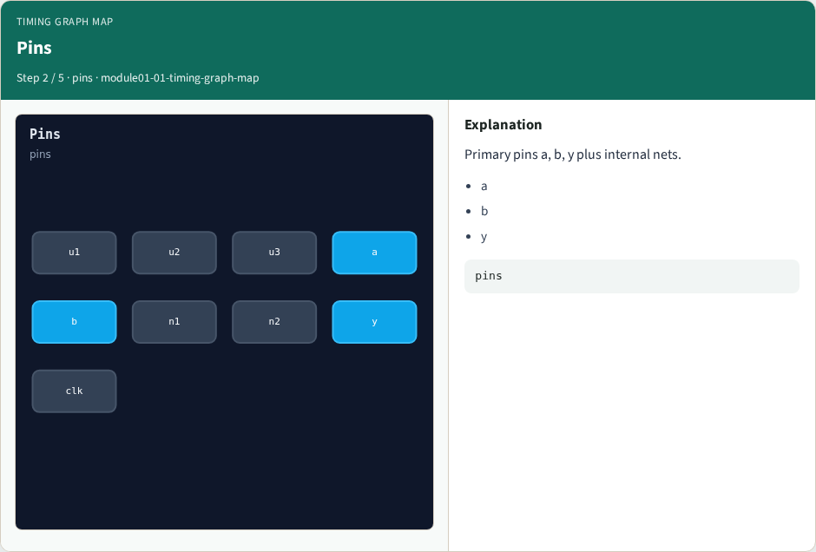
Pins
Pins
learn_opensta — 01 timing graph map
Notes:
Primary pins a, b, y plus internal nets.

Slide 5
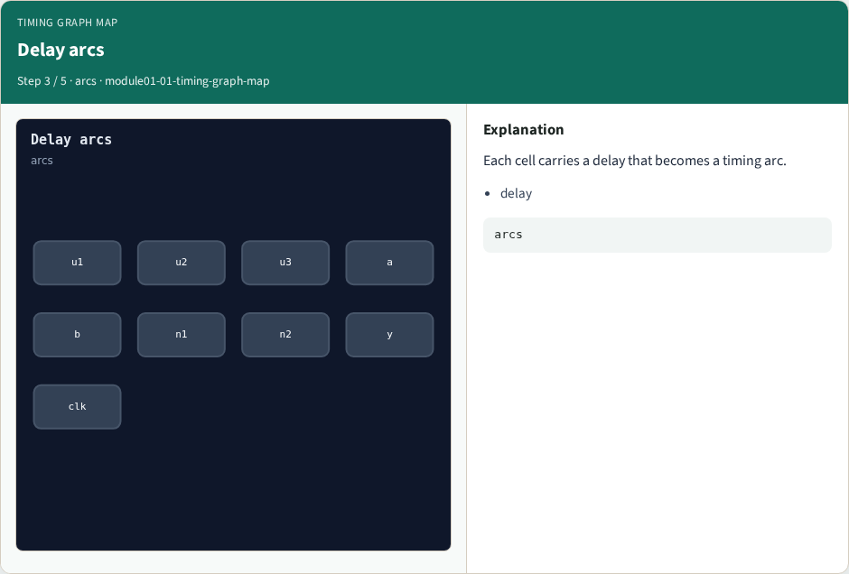
Delay arcs
Delay arcs
learn_opensta — 01 timing graph map
Notes:
Each cell carries a delay that becomes a timing arc.

Slide 6
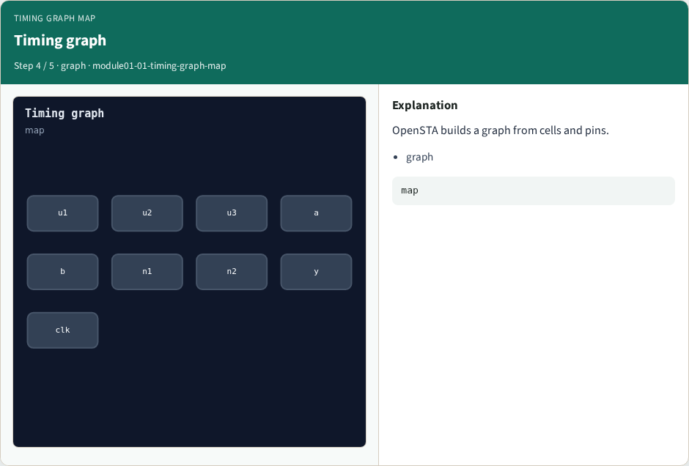
Timing graph
Timing graph
learn_opensta — 01 timing graph map
Notes:
OpenSTA builds a graph from cells and pins.

Slide 7
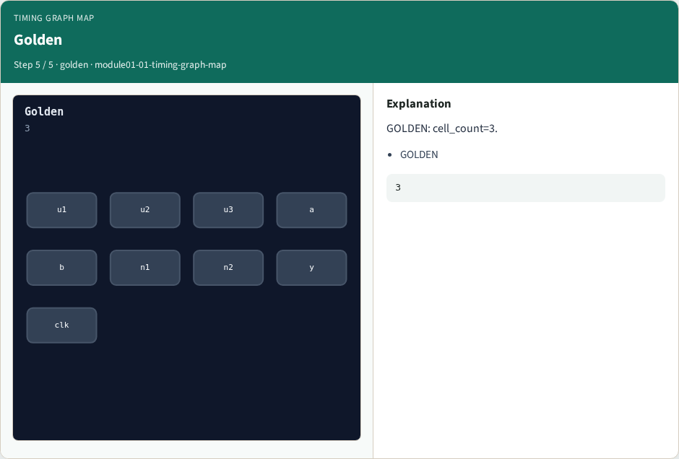
Golden
Golden
learn_opensta — 01 timing graph map
Notes:
GOLDEN: cell_count=3.

Slide 8
Browser lab track
Open timing-graph-map
Run the stage buttons and Check the goldens
learn_opensta — 01 timing graph map
Notes:
Open **timing-graph-map**. Run the stage buttons and Check the goldens.

Slide 9
Implement track
From common/, run solvers.py and confirm OPENSTA_MAP_OK
learn_opensta — 01 timing graph map
Notes:
From common/, run solvers.py and confirm OPENSTA_MAP_OK.

Slide 10
Pitfalls
Mixing algorithm STA from learn_sta with OpenSTA command names
Forgetting the clock period when reading slack
learn_opensta — 01 timing graph map
Notes:
Mixing algorithm STA from learn_sta with OpenSTA command names. Forgetting the clock period when reading slack.

Slide 11
Try these
From the common folder, run the OpenSTA map self-test
learn_opensta — 01 timing graph map
Notes:
From the common folder, run the OpenSTA map self-test.

Slide 12
Try these — try these
cd courses/learn_opensta/common
python3 solvers.py
learn_opensta — 01 timing graph map

Slide 13
Pseudocode
Here is the check in plain steps
learn_opensta — 01 timing graph map
Notes:
Here is the check in plain steps.

Slide 14
Pseudocode — try these
3 cells u1/u2/u3; graph nodes = cells + pins.
ok if goldens match
learn_opensta — 01 timing graph map

Slide 15
Next
Complete the quiz for this part
Continue the OpenSTA Part A map, then the real CLI track
learn_opensta — 01 timing graph map
Notes:
Continue the OpenSTA Part A map, then the real CLI track.

