Slide 1
Why SDC
Declare create_clock period and name on clk
learn_opensta — 03 sdc clocks
Notes:
Declare create_clock period and name on clk.

Slide 2
The idea
GOLDEN: create_clock -period 10 → clk period=10
learn_opensta — 03 sdc clocks
Notes:
GOLDEN: create_clock -period 10 → clk period=10.

Slide 3
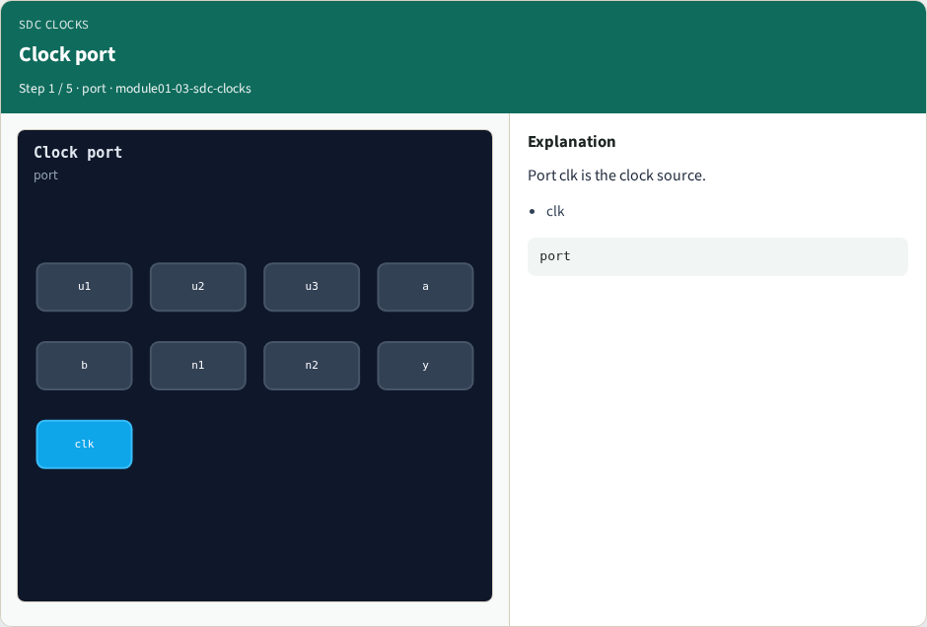
Clock port
Clock port
learn_opensta — 03 sdc clocks
Notes:
Port clk is the clock source.

Slide 4
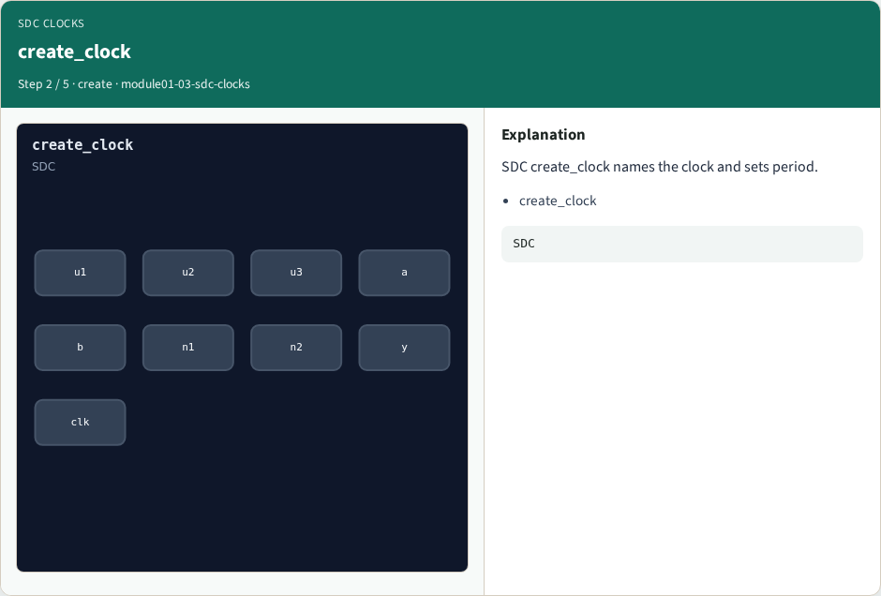
create_clock
create_clock
learn_opensta — 03 sdc clocks
Notes:
SDC create_clock names the clock and sets period.

Slide 5

Period 10
Period 10
learn_opensta — 03 sdc clocks
Notes:
Period is 10 time units on this tiny design.

Slide 6
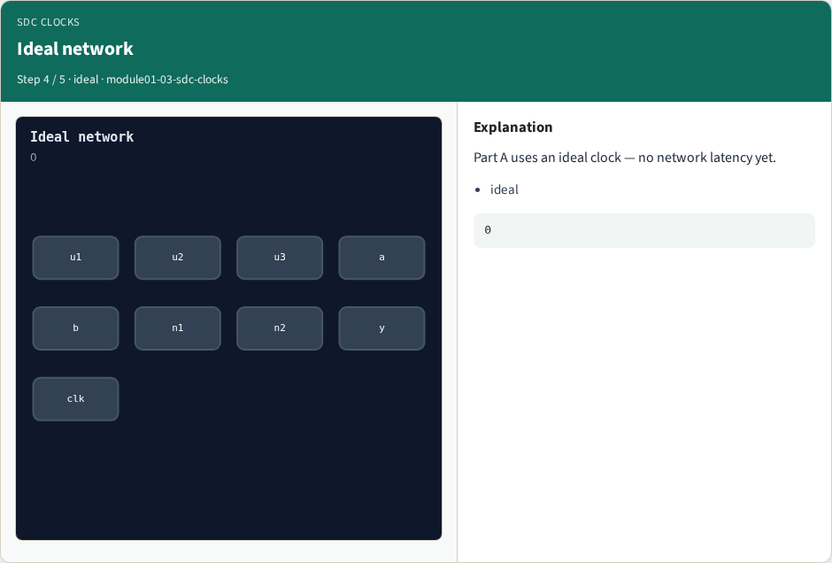
Ideal network
Ideal network
learn_opensta — 03 sdc clocks
Notes:
Part A uses an ideal clock — no network latency yet.

Slide 7
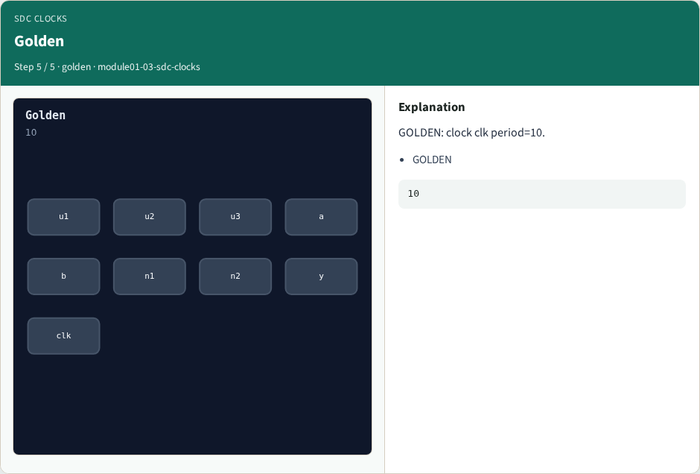
Golden
Golden
learn_opensta — 03 sdc clocks
Notes:
GOLDEN: clock clk period=10.

Slide 8
Browser lab track
Open sdc-clocks
Run the stage buttons and Check the goldens
learn_opensta — 03 sdc clocks
Notes:
Open **sdc-clocks**. Run the stage buttons and Check the goldens.

Slide 9
Implement track
From common/, run solvers.py and confirm OPENSTA_MAP_OK
learn_opensta — 03 sdc clocks
Notes:
From common/, run solvers.py and confirm OPENSTA_MAP_OK.

Slide 10
Pitfalls
Mixing algorithm STA from learn_sta with OpenSTA command names
Forgetting the clock period when reading slack
learn_opensta — 03 sdc clocks
Notes:
Mixing algorithm STA from learn_sta with OpenSTA command names. Forgetting the clock period when reading slack.

Slide 11
Try these
From the common folder, run the OpenSTA map self-test
learn_opensta — 03 sdc clocks
Notes:
From the common folder, run the OpenSTA map self-test.

Slide 12
Try these — try these
cd courses/learn_opensta/common
python3 solvers.py
learn_opensta — 03 sdc clocks

Slide 13
Pseudocode
Here is the check in plain steps
learn_opensta — 03 sdc clocks
Notes:
Here is the check in plain steps.

Slide 14
Pseudocode — try these
create_clock -period 10 → clk period=10.
ok if goldens match
learn_opensta — 03 sdc clocks

Slide 15
Next
Complete the quiz for this part
Continue the OpenSTA Part A map, then the real CLI track
learn_opensta — 03 sdc clocks
Notes:
Continue the OpenSTA Part A map, then the real CLI track.

