Slide 1
Why Arrival
Propagate arrivals and set required at the endpoint
learn_opensta — 01 arrival required
Notes:
Propagate arrivals and set required at the endpoint.

Slide 2
The idea
GOLDEN: A(y)=2.0; R(y)=10.0
learn_opensta — 01 arrival required
Notes:
GOLDEN: A(y)=2.0; R(y)=10.0.

Slide 3
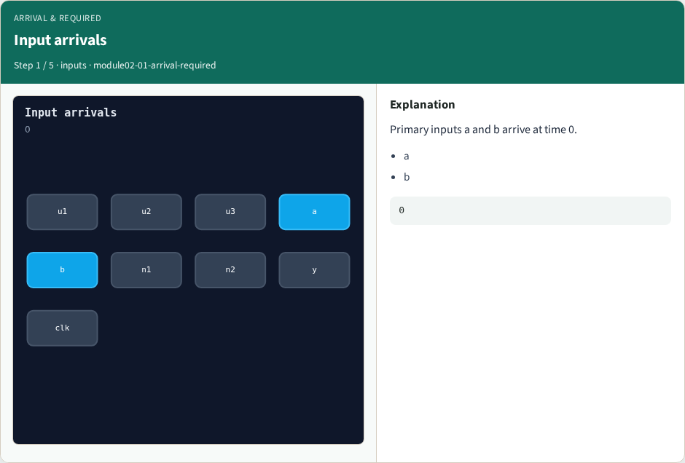
Input arrivals
Input arrivals
learn_opensta — 01 arrival required
Notes:
Primary inputs a and b arrive at time 0.

Slide 4
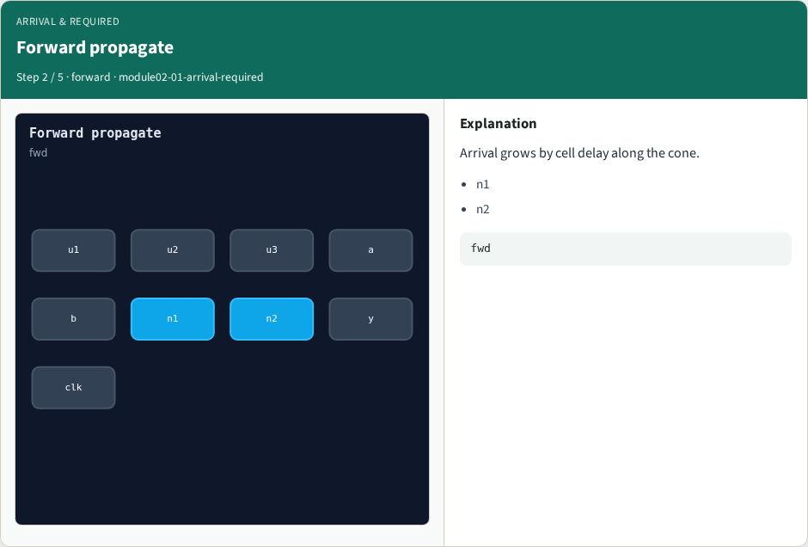
Forward propagate
Forward propagate
learn_opensta — 01 arrival required
Notes:
Arrival grows by cell delay along the cone.

Slide 5
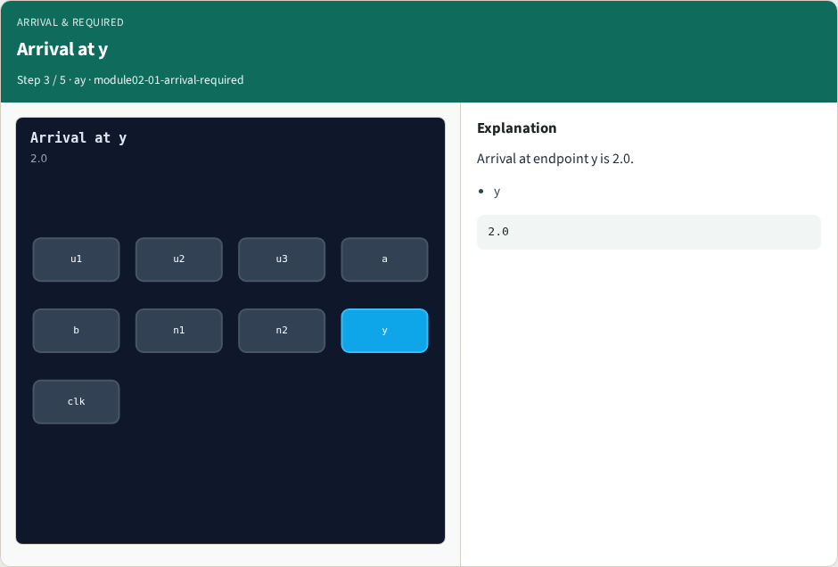
Arrival at y
Arrival at y
learn_opensta — 01 arrival required
Notes:
Arrival at endpoint y is 2.0.

Slide 6
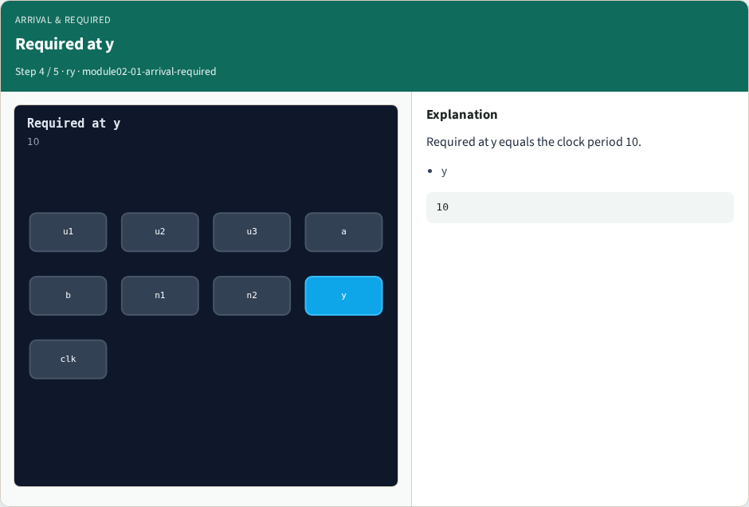
Required at y
Required at y
learn_opensta — 01 arrival required
Notes:
Required at y equals the clock period 10.

Slide 7
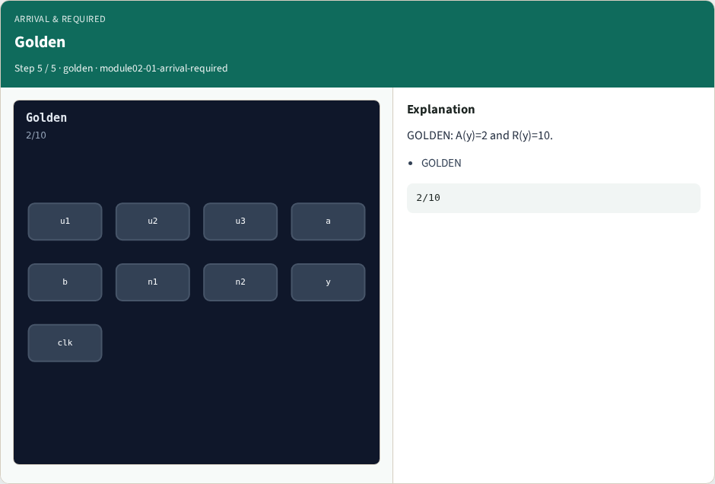
Golden
Golden
learn_opensta — 01 arrival required
Notes:
GOLDEN: A(y)=2 and R(y)=10.

Slide 8
Browser lab track
Open arrival-required
Run the stage buttons and Check the goldens
learn_opensta — 01 arrival required
Notes:
Open **arrival-required**. Run the stage buttons and Check the goldens.

Slide 9
Implement track
From common/, run solvers.py and confirm OPENSTA_MAP_OK
learn_opensta — 01 arrival required
Notes:
From common/, run solvers.py and confirm OPENSTA_MAP_OK.

Slide 10
Pitfalls
Mixing algorithm STA from learn_sta with OpenSTA command names
Forgetting the clock period when reading slack
learn_opensta — 01 arrival required
Notes:
Mixing algorithm STA from learn_sta with OpenSTA command names. Forgetting the clock period when reading slack.

Slide 11
Try these
From the common folder, run the OpenSTA map self-test
learn_opensta — 01 arrival required
Notes:
From the common folder, run the OpenSTA map self-test.

Slide 12
Try these — try these
cd courses/learn_opensta/common
python3 solvers.py
learn_opensta — 01 arrival required

Slide 13
Pseudocode
Here is the check in plain steps
learn_opensta — 01 arrival required
Notes:
Here is the check in plain steps.

Slide 14
Pseudocode — try these
A(y)=2.0; R(y)=10.0.
ok if goldens match
learn_opensta — 01 arrival required

Slide 15
Next
Complete the quiz for this part
Continue the OpenSTA Part A map, then the real CLI track
learn_opensta — 01 arrival required
Notes:
Continue the OpenSTA Part A map, then the real CLI track.

