Slide 1
Why Slack
Compute slack = required − arrival on the critical path
learn_opensta — 03 slack critical
Notes:
Compute slack = required − arrival on the critical path.

Slide 2
The idea
GOLDEN: slack = 10 − 2 = 8
learn_opensta — 03 slack critical
Notes:
GOLDEN: slack = 10 − 2 = 8.

Slide 3
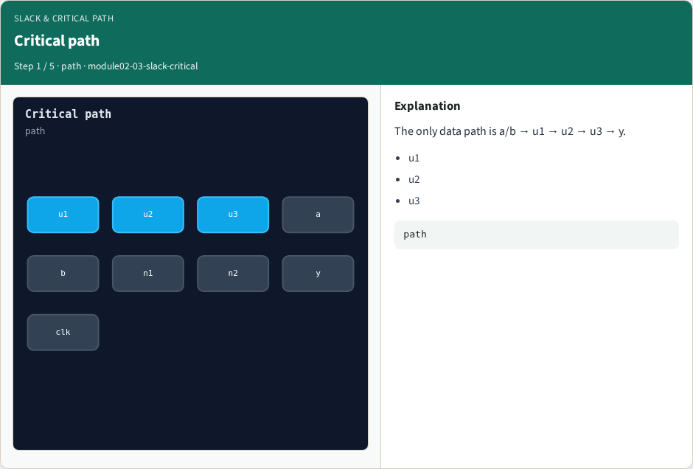
Critical path
Critical path
learn_opensta — 03 slack critical
Notes:
The only data path is a/b → u1 → u2 → u3 → y.

Slide 4
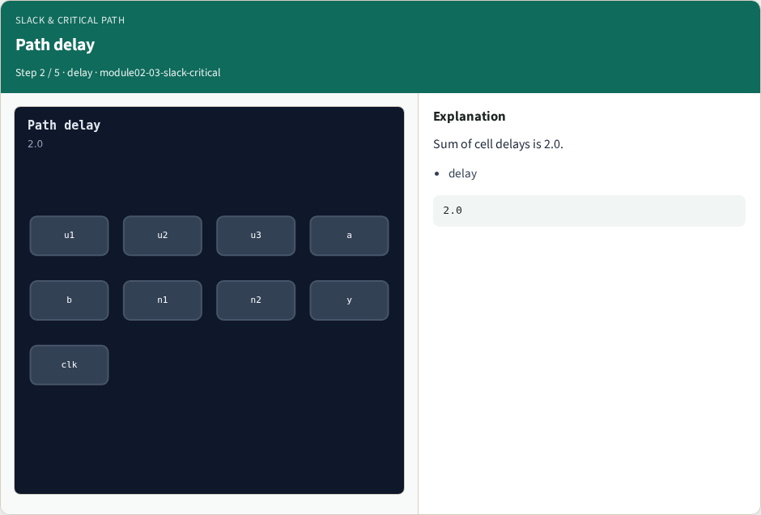
Path delay
Path delay
learn_opensta — 03 slack critical
Notes:
Sum of cell delays is 2.0.

Slide 5
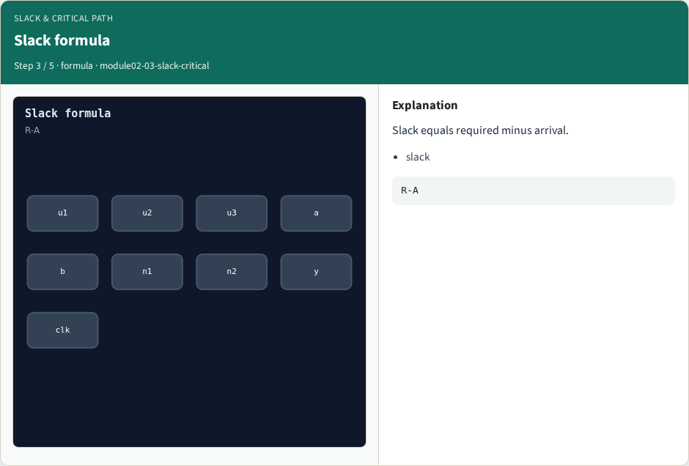
Slack formula
Slack formula
learn_opensta — 03 slack critical
Notes:
Slack equals required minus arrival.

Slide 6
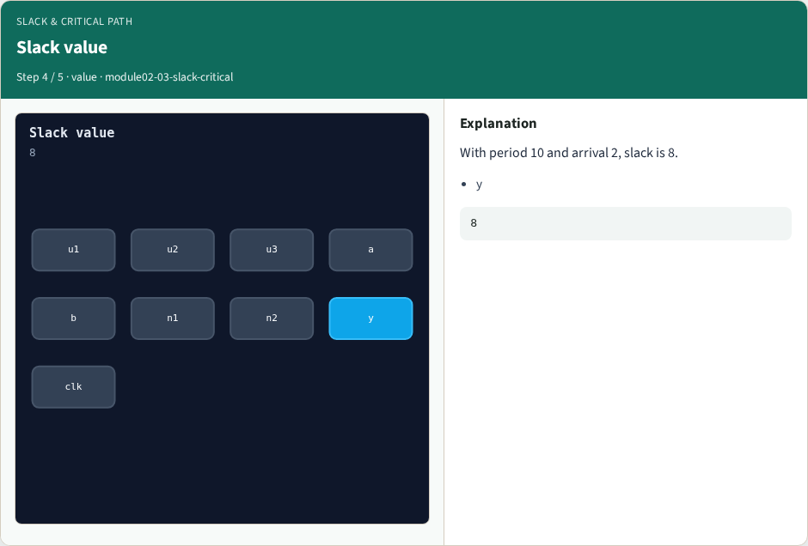
Slack value
Slack value
learn_opensta — 03 slack critical
Notes:
With period 10 and arrival 2, slack is 8.

Slide 7
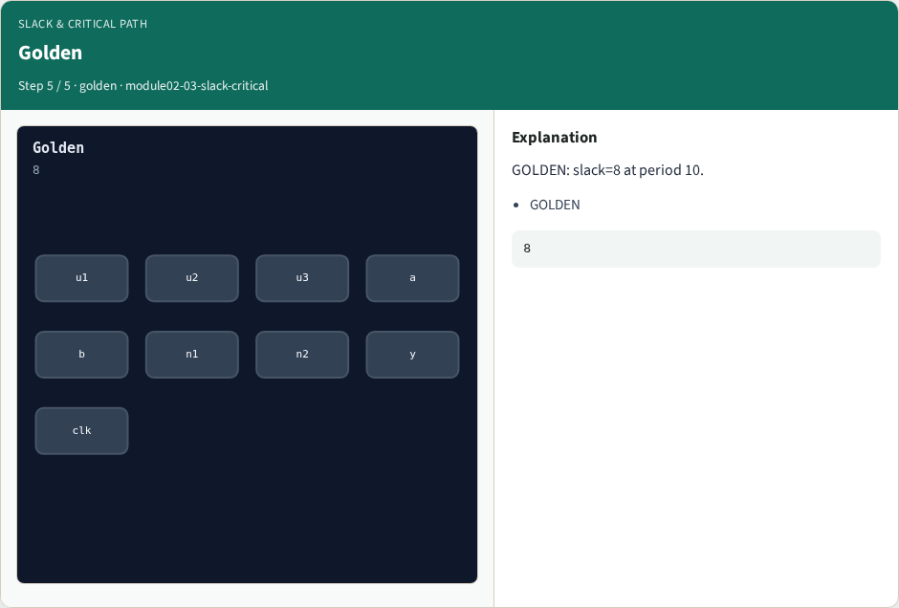
Golden
Golden
learn_opensta — 03 slack critical
Notes:
GOLDEN: slack=8 at period 10.

Slide 8
Browser lab track
Open slack-critical
Run the stage buttons and Check the goldens
learn_opensta — 03 slack critical
Notes:
Open **slack-critical**. Run the stage buttons and Check the goldens.

Slide 9
Implement track
From common/, run solvers.py and confirm OPENSTA_MAP_OK
learn_opensta — 03 slack critical
Notes:
From common/, run solvers.py and confirm OPENSTA_MAP_OK.

Slide 10
Pitfalls
Mixing algorithm STA from learn_sta with OpenSTA command names
Forgetting the clock period when reading slack
learn_opensta — 03 slack critical
Notes:
Mixing algorithm STA from learn_sta with OpenSTA command names. Forgetting the clock period when reading slack.

Slide 11
Try these
From the common folder, run the OpenSTA map self-test
learn_opensta — 03 slack critical
Notes:
From the common folder, run the OpenSTA map self-test.

Slide 12
Try these — try these
cd courses/learn_opensta/common
python3 solvers.py
learn_opensta — 03 slack critical

Slide 13
Pseudocode
Here is the check in plain steps
learn_opensta — 03 slack critical
Notes:
Here is the check in plain steps.

Slide 14
Pseudocode — try these
slack = 10 − 2 = 8.
ok if goldens match
learn_opensta — 03 slack critical

Slide 15
Next
Complete the quiz for this part
Continue the OpenSTA Part A map, then the real CLI track
learn_opensta — 03 slack critical
Notes:
Continue the OpenSTA Part A map, then the real CLI track.

