Slide 1
Why report_checks
Read a report_checks-shaped endpoint summary
learn_opensta — 01 report checks
Notes:
Read a report_checks-shaped endpoint summary.

Slide 2
The idea
GOLDEN: endpoint y; path delay 2; slack 8
learn_opensta — 01 report checks
Notes:
GOLDEN: endpoint y; path delay 2; slack 8.

Slide 3
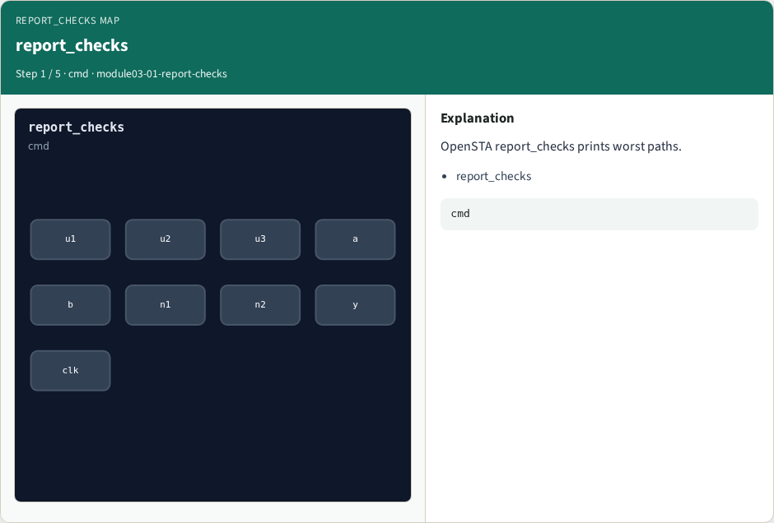
report_checks
report_checks
learn_opensta — 01 report checks
Notes:
OpenSTA report_checks prints worst paths.

Slide 4
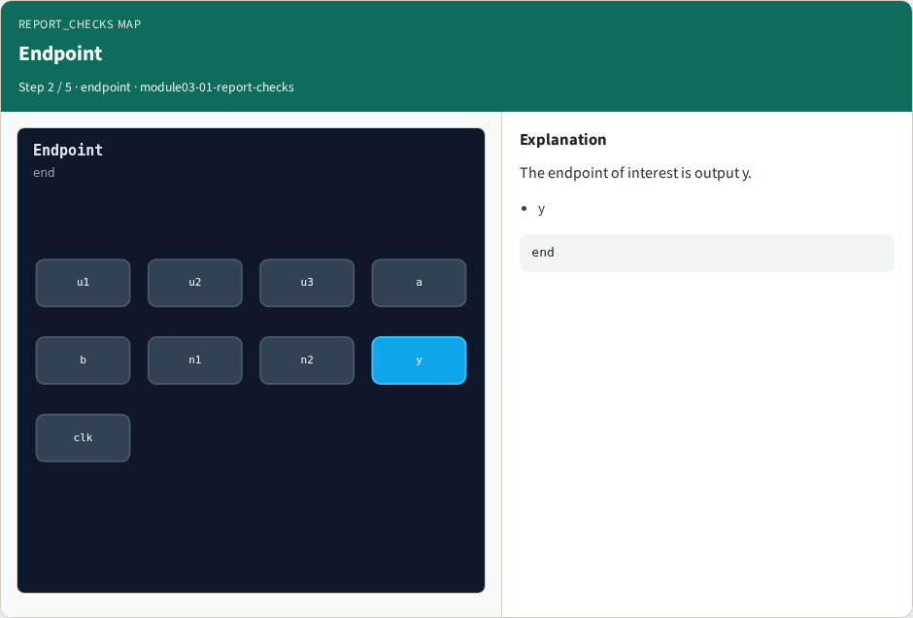
Endpoint
Endpoint
learn_opensta — 01 report checks
Notes:
The endpoint of interest is output y.

Slide 5
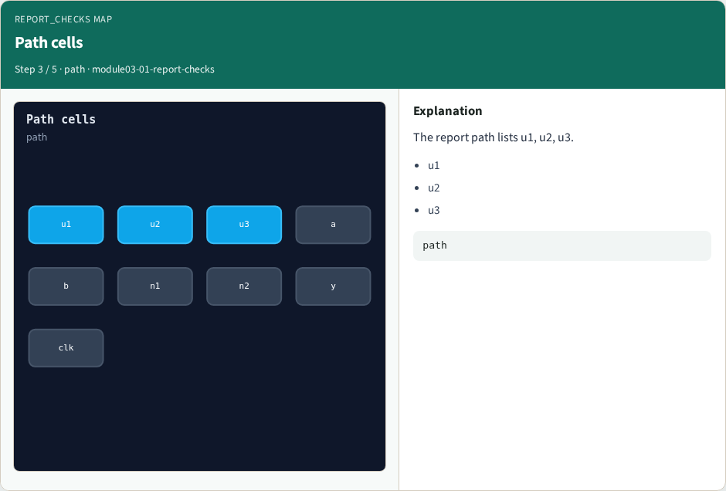
Path cells
Path cells
learn_opensta — 01 report checks
Notes:
The report path lists u1, u2, u3.

Slide 6

Reported slack
Reported slack
learn_opensta — 01 report checks
Notes:
The reported slack matches 8.

Slide 7
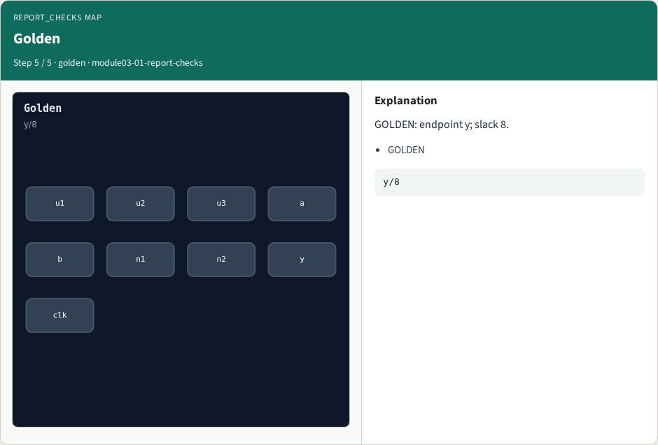
Golden
Golden
learn_opensta — 01 report checks
Notes:
GOLDEN: endpoint y; slack 8.

Slide 8
Browser lab track
Open report-checks
Run the stage buttons and Check the goldens
learn_opensta — 01 report checks
Notes:
Open **report-checks**. Run the stage buttons and Check the goldens.

Slide 9
Implement track
From common/, run solvers.py and confirm OPENSTA_MAP_OK
learn_opensta — 01 report checks
Notes:
From common/, run solvers.py and confirm OPENSTA_MAP_OK.

Slide 10
Pitfalls
Mixing algorithm STA from learn_sta with OpenSTA command names
Forgetting the clock period when reading slack
learn_opensta — 01 report checks
Notes:
Mixing algorithm STA from learn_sta with OpenSTA command names. Forgetting the clock period when reading slack.

Slide 11
Try these
From the common folder, run the OpenSTA map self-test
learn_opensta — 01 report checks
Notes:
From the common folder, run the OpenSTA map self-test.

Slide 12
Try these — try these
cd courses/learn_opensta/common
python3 solvers.py
learn_opensta — 01 report checks

Slide 13
Pseudocode
Here is the check in plain steps
learn_opensta — 01 report checks
Notes:
Here is the check in plain steps.

Slide 14
Pseudocode — try these
endpoint y; path delay 2; slack 8.
ok if goldens match
learn_opensta — 01 report checks

Slide 15
Next
Complete the quiz for this part
Continue the OpenSTA Part A map, then the real CLI track
learn_opensta — 01 report checks
Notes:
Continue the OpenSTA Part A map, then the real CLI track.

