Slide 1
Why OpenSTA
Run the full Part A engine; ok when every golden matches
learn_opensta — 03 opensta engine
Notes:
Run the full Part A engine; ok when every golden matches.

Slide 2
The idea
GOLDEN: opensta_engine ok=True
learn_opensta — 03 opensta engine
Notes:
GOLDEN: opensta_engine ok=True.

Slide 3
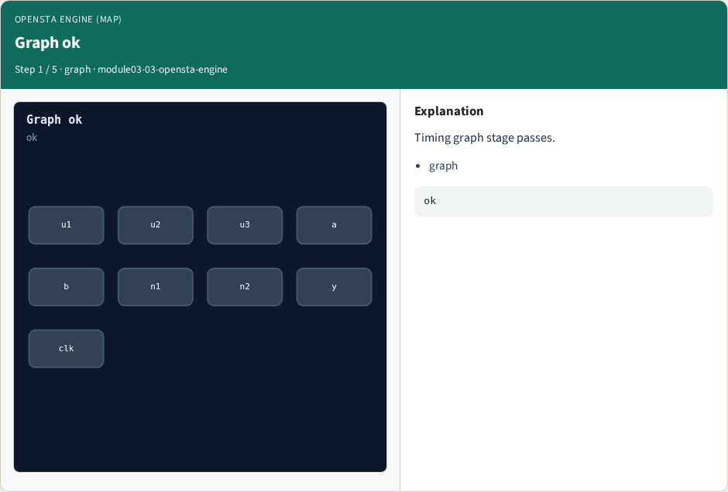
Graph ok
Graph ok
learn_opensta — 03 opensta engine
Notes:
Timing graph stage passes.

Slide 4
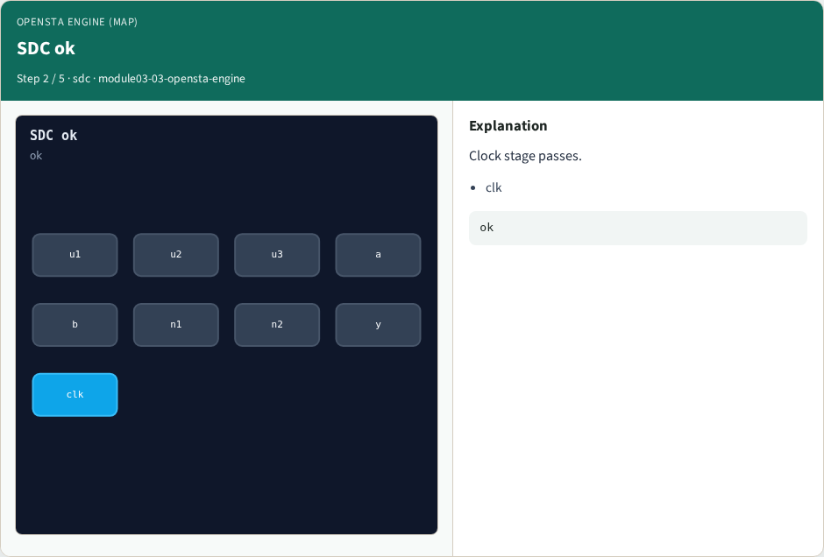
SDC ok
SDC ok
learn_opensta — 03 opensta engine
Notes:
Clock stage passes.

Slide 5
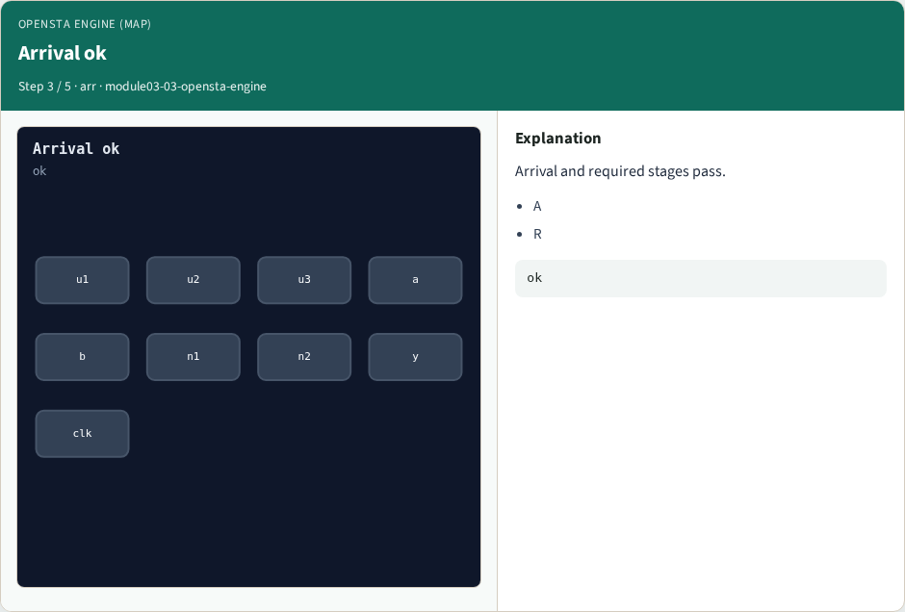
Arrival ok
Arrival ok
learn_opensta — 03 opensta engine
Notes:
Arrival and required stages pass.

Slide 6
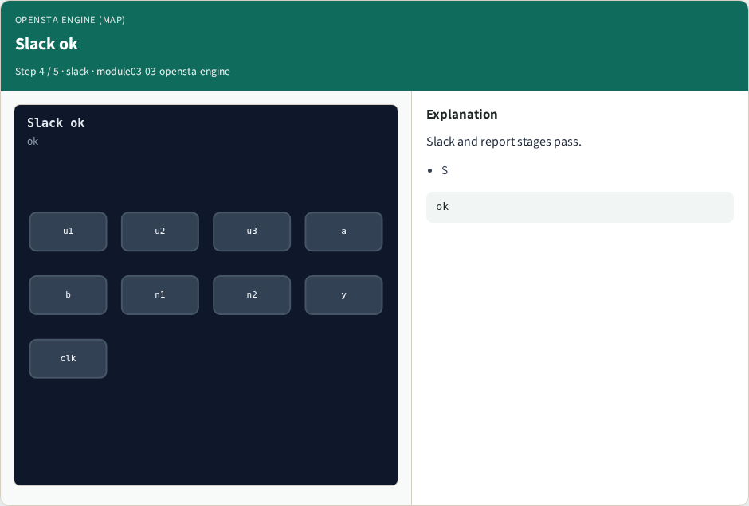
Slack ok
Slack ok
learn_opensta — 03 opensta engine
Notes:
Slack and report stages pass.

Slide 7

Engine golden
Engine golden
learn_opensta — 03 opensta engine
Notes:
GOLDEN: opensta_engine ok=True.

Slide 8
Browser lab track
Open opensta-engine
Run the stage buttons and Check the goldens
learn_opensta — 03 opensta engine
Notes:
Open **opensta-engine**. Run the stage buttons and Check the goldens.

Slide 9
Implement track
From common/, run solvers.py and confirm OPENSTA_MAP_OK
learn_opensta — 03 opensta engine
Notes:
From common/, run solvers.py and confirm OPENSTA_MAP_OK.

Slide 10
Pitfalls
Mixing algorithm STA from learn_sta with OpenSTA command names
Forgetting the clock period when reading slack
learn_opensta — 03 opensta engine
Notes:
Mixing algorithm STA from learn_sta with OpenSTA command names. Forgetting the clock period when reading slack.

Slide 11
Try these
From the common folder, run the OpenSTA map self-test
learn_opensta — 03 opensta engine
Notes:
From the common folder, run the OpenSTA map self-test.

Slide 12
Try these — try these
cd courses/learn_opensta/common
python3 solvers.py
learn_opensta — 03 opensta engine

Slide 13
Pseudocode
Here is the check in plain steps
learn_opensta — 03 opensta engine
Notes:
Here is the check in plain steps.

Slide 14
Pseudocode — try these
opensta_engine ok=True.
ok if goldens match
learn_opensta — 03 opensta engine

Slide 15
Next
Complete the quiz for this part
Continue the OpenSTA Part A map, then the real CLI track
learn_opensta — 03 opensta engine
Notes:
Continue the OpenSTA Part A map, then the real CLI track.

