Slide 1
Why real OpenSTA
Invoke sta -exit script.tcl; recipe starts read_liberty→read_verilog→link_design
learn_opensta — 01 opensta cli
Notes:
Invoke sta -exit script.tcl; recipe starts read_liberty→read_verilog→link_design.

Slide 2
The idea
GOLDEN: First three cmds: read_liberty, read_verilog, link_design
learn_opensta — 01 opensta cli
Notes:
GOLDEN: First three cmds: read_liberty, read_verilog, link_design.

Slide 3
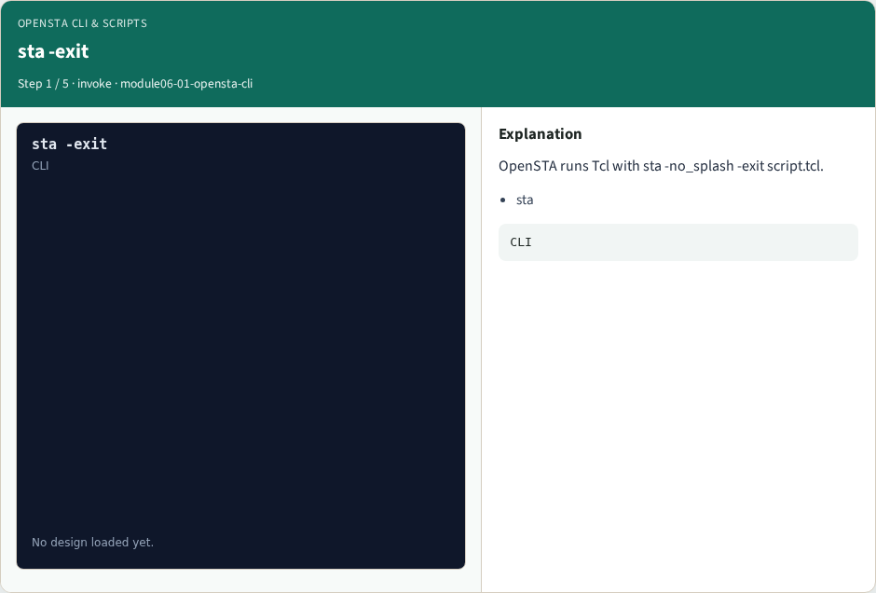
sta -exit
sta -exit
learn_opensta — 01 opensta cli
Notes:
OpenSTA runs Tcl with sta -no_splash -exit script.tcl.

Slide 4
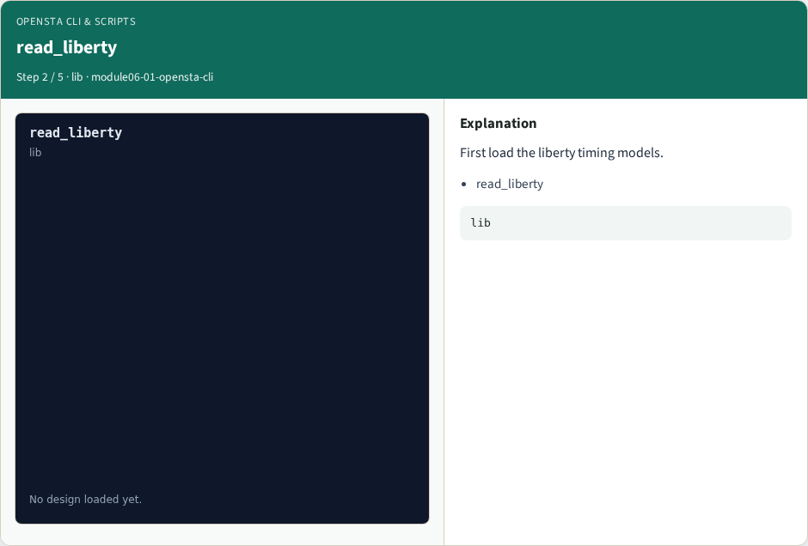
read_liberty
read_liberty
learn_opensta — 01 opensta cli
Notes:
First load the liberty timing models.

Slide 5

read_verilog
read_verilog
learn_opensta — 01 opensta cli
Notes:
Then read the gate-level netlist.

Slide 6

link_design
link_design
learn_opensta — 01 opensta cli
Notes:
link_design binds cell instances to liberty.

Slide 7

Golden
Golden
learn_opensta — 01 opensta cli
Notes:
GOLDEN: recipe prefix liberty→verilog→link.

Slide 8
Browser lab track
Open opensta-cli
Build the Tcl recipe or open evidence stages, then Check
learn_opensta — 01 opensta cli
Notes:
Open **opensta-cli**. Build the Tcl recipe or open evidence stages, then Check.

Slide 9
Implement track
From common/, run real_solvers.py and confirm REAL_OPENSTA_OK
learn_opensta — 01 opensta cli
Notes:
From common/, run real_solvers.py and confirm REAL_OPENSTA_OK.

Slide 10
Pitfalls
Editing goldens by hand without re-running sta
Confusing Part A map JSON with real liberty delays
learn_opensta — 01 opensta cli
Notes:
Editing goldens by hand without re-running sta. Confusing Part A map JSON with real liberty delays.

Slide 11
Try these
From the common folder, run the real OpenSTA self-test
learn_opensta — 01 opensta cli
Notes:
From the common folder, run the real OpenSTA self-test.

Slide 12
Try these — try these
cd courses/learn_opensta/common
python3 real_solvers.py
learn_opensta — 01 opensta cli

Slide 13
Pseudocode
Here is the check in plain steps
learn_opensta — 01 opensta cli
Notes:
Here is the check in plain steps.

Slide 14
Pseudocode — try these
First three cmds: read_liberty, read_verilog, link_design.
ok if goldens match
learn_opensta — 01 opensta cli

Slide 15
Next
Complete the quiz for this part
Continue the Part B evidence track, then wrap , algorithms and internals come later
learn_opensta — 01 opensta cli
Notes:
Continue the Part B evidence track, then wrap — algorithms and internals come later.

