Slide 1
Why real OpenSTA
Link tiny_combo and see instances u1/u2/u3
learn_opensta — 01 real read netlist
Notes:
Link tiny_combo and see instances u1/u2/u3.

Slide 2
The idea
GOLDEN: top=tiny_combo; cells u1,u2,u3
learn_opensta — 01 real read netlist
Notes:
GOLDEN: top=tiny_combo; cells u1,u2,u3.

Slide 3

Top design
Top design
learn_opensta — 01 real read netlist
Notes:
link_design tiny_combo sets the top.

Slide 4
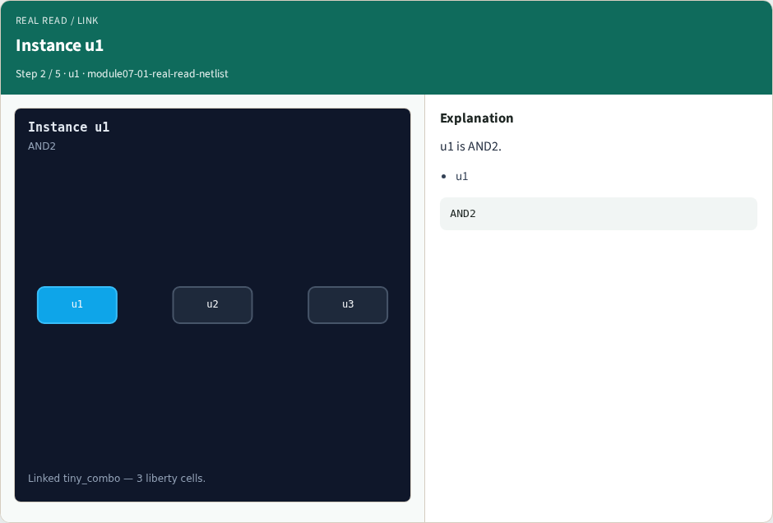
Instance u1
Instance u1
learn_opensta — 01 real read netlist
Notes:
u1 is AND2.

Slide 5
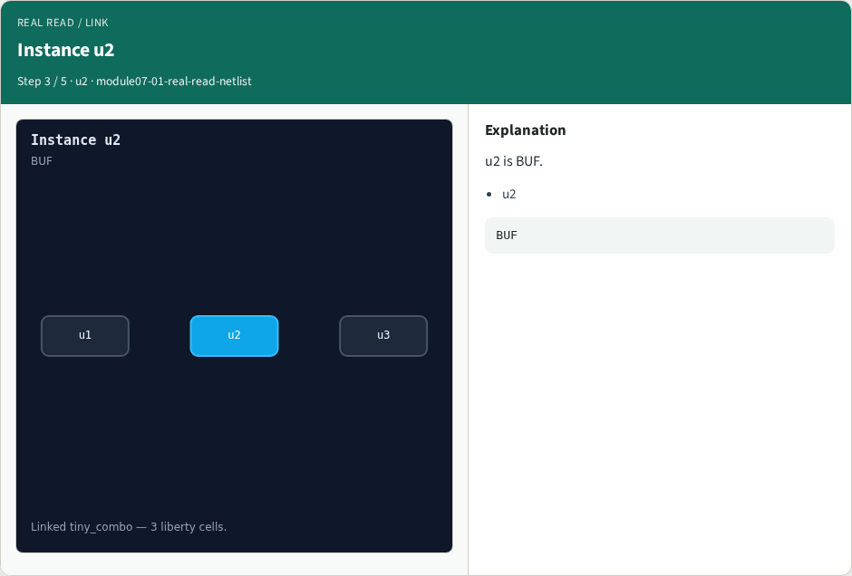
Instance u2
Instance u2
learn_opensta — 01 real read netlist
Notes:
u2 is BUF.

Slide 6
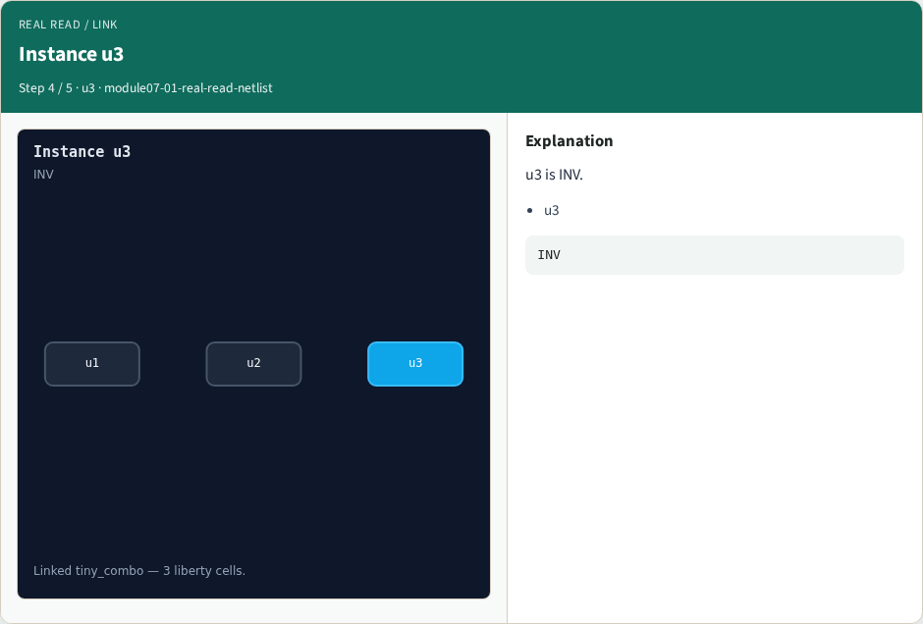
Instance u3
Instance u3
learn_opensta — 01 real read netlist
Notes:
u3 is INV.

Slide 7

Golden
Golden
learn_opensta — 01 real read netlist
Notes:
GOLDEN: cell_count=3 after link.

Slide 8
Browser lab track
Open real-read-netlist
Build the Tcl recipe or open evidence stages, then Check
learn_opensta — 01 real read netlist
Notes:
Open **real-read-netlist**. Build the Tcl recipe or open evidence stages, then Check.

Slide 9
Implement track
From common/, run real_solvers.py and confirm REAL_OPENSTA_OK
learn_opensta — 01 real read netlist
Notes:
From common/, run real_solvers.py and confirm REAL_OPENSTA_OK.

Slide 10
Pitfalls
Editing goldens by hand without re-running sta
Confusing Part A map JSON with real liberty delays
learn_opensta — 01 real read netlist
Notes:
Editing goldens by hand without re-running sta. Confusing Part A map JSON with real liberty delays.

Slide 11
Try these
From the common folder, run the real OpenSTA self-test
learn_opensta — 01 real read netlist
Notes:
From the common folder, run the real OpenSTA self-test.

Slide 12
Try these — try these
cd courses/learn_opensta/common
python3 real_solvers.py
learn_opensta — 01 real read netlist

Slide 13
Pseudocode
Here is the check in plain steps
learn_opensta — 01 real read netlist
Notes:
Here is the check in plain steps.

Slide 14
Pseudocode — try these
top=tiny_combo; cells u1,u2,u3.
ok if goldens match
learn_opensta — 01 real read netlist

Slide 15
Next
Complete the quiz for this part
Continue the Part B evidence track, then wrap , algorithms and internals come later
learn_opensta — 01 real read netlist
Notes:
Continue the Part B evidence track, then wrap — algorithms and internals come later.

