Slide 1
Why real OpenSTA
Apply create_clock period 10 and I/O delays
learn_opensta — 03 real sdc
Notes:
Apply create_clock period 10 and I/O delays.

Slide 2
The idea
GOLDEN: clock clk period=10
learn_opensta — 03 real sdc
Notes:
GOLDEN: clock clk period=10.

Slide 3
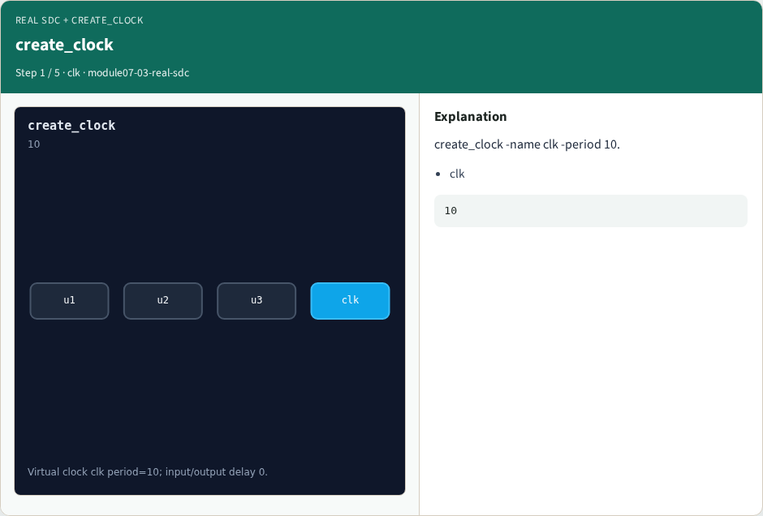
create_clock
create_clock
learn_opensta — 03 real sdc
Notes:
create_clock -name clk -period 10.

Slide 4

Input delay
Input delay
learn_opensta — 03 real sdc
Notes:
set_input_delay 0 on all inputs.

Slide 5

Output delay
Output delay
learn_opensta — 03 real sdc
Notes:
set_output_delay 0 on all outputs.

Slide 6

Ideal network
Ideal network
learn_opensta — 03 real sdc
Notes:
Clock network delay is ideal in this lab.

Slide 7

Golden
Golden
learn_opensta — 03 real sdc
Notes:
GOLDEN: clock clk period=10.

Slide 8
Browser lab track
Open real-sdc
Build the Tcl recipe or open evidence stages, then Check
learn_opensta — 03 real sdc
Notes:
Open **real-sdc**. Build the Tcl recipe or open evidence stages, then Check.

Slide 9
Implement track
From common/, run real_solvers.py and confirm REAL_OPENSTA_OK
learn_opensta — 03 real sdc
Notes:
From common/, run real_solvers.py and confirm REAL_OPENSTA_OK.

Slide 10
Pitfalls
Editing goldens by hand without re-running sta
Confusing Part A map JSON with real liberty delays
learn_opensta — 03 real sdc
Notes:
Editing goldens by hand without re-running sta. Confusing Part A map JSON with real liberty delays.

Slide 11
Try these
From the common folder, run the real OpenSTA self-test
learn_opensta — 03 real sdc
Notes:
From the common folder, run the real OpenSTA self-test.

Slide 12
Try these — try these
cd courses/learn_opensta/common
python3 real_solvers.py
learn_opensta — 03 real sdc

Slide 13
Pseudocode
Here is the check in plain steps
learn_opensta — 03 real sdc
Notes:
Here is the check in plain steps.

Slide 14
Pseudocode — try these
clock clk period=10.
ok if goldens match
learn_opensta — 03 real sdc

Slide 15
Next
Complete the quiz for this part
Continue the Part B evidence track, then wrap , algorithms and internals come later
learn_opensta — 03 real sdc
Notes:
Continue the Part B evidence track, then wrap — algorithms and internals come later.

