Slide 1
Why real OpenSTA
Read real report_checks path delay and slack
learn_opensta — 01 real report checks
Notes:
Read real report_checks path delay and slack.

Slide 2
The idea
GOLDEN: endpoint y; delay 2.0; slack 8.0 MET
learn_opensta — 01 real report checks
Notes:
GOLDEN: endpoint y; delay 2.0; slack 8.0 MET.

Slide 3

report_checks
report_checks
learn_opensta — 01 real report checks
Notes:
report_checks -path_delay max prints the worst path.

Slide 4

Startpoint
Startpoint
learn_opensta — 01 real report checks
Notes:
Startpoint is input b.

Slide 5
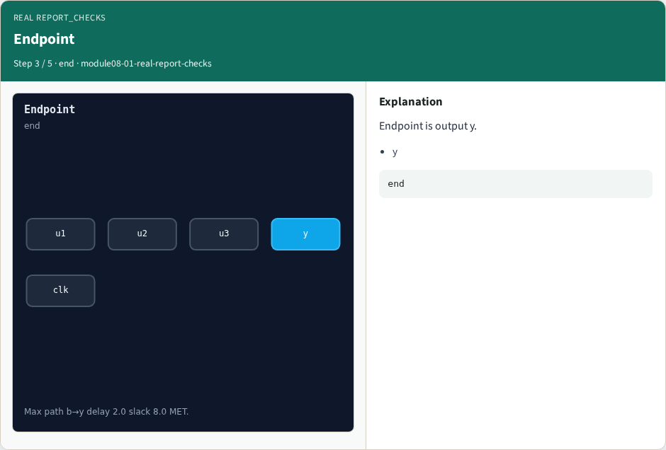
Endpoint
Endpoint
learn_opensta — 01 real report checks
Notes:
Endpoint is output y.

Slide 6

Slack MET
Slack MET
learn_opensta — 01 real report checks
Notes:
Arrival 2.0 required 10.0 → slack 8.0 MET.

Slide 7

Golden
Golden
learn_opensta — 01 real report checks
Notes:
GOLDEN: path_delay=2 slack=8.

Slide 8
Browser lab track
Open real-report-checks
Build the Tcl recipe or open evidence stages, then Check
learn_opensta — 01 real report checks
Notes:
Open **real-report-checks**. Build the Tcl recipe or open evidence stages, then Check.

Slide 9
Implement track
From common/, run real_solvers.py and confirm REAL_OPENSTA_OK
learn_opensta — 01 real report checks
Notes:
From common/, run real_solvers.py and confirm REAL_OPENSTA_OK.

Slide 10
Pitfalls
Editing goldens by hand without re-running sta
Confusing Part A map JSON with real liberty delays
learn_opensta — 01 real report checks
Notes:
Editing goldens by hand without re-running sta. Confusing Part A map JSON with real liberty delays.

Slide 11
Try these
From the common folder, run the real OpenSTA self-test
learn_opensta — 01 real report checks
Notes:
From the common folder, run the real OpenSTA self-test.

Slide 12
Try these — try these
cd courses/learn_opensta/common
python3 real_solvers.py
learn_opensta — 01 real report checks

Slide 13
Pseudocode
Here is the check in plain steps
learn_opensta — 01 real report checks
Notes:
Here is the check in plain steps.

Slide 14
Pseudocode — try these
endpoint y; delay 2.0; slack 8.0 MET.
ok if goldens match
learn_opensta — 01 real report checks

Slide 15
Next
Complete the quiz for this part
Continue the Part B evidence track, then wrap , algorithms and internals come later
learn_opensta — 01 real report checks
Notes:
Continue the Part B evidence track, then wrap — algorithms and internals come later.

