Slide 1
Why RTLIL C++
Browser IR and JSON are maps
learn_yosys — 01 rtlil cpp model
Notes:
Browser IR and JSON are maps. Real Yosys stores the same ideas as C++ objects in RTLIL.

Slide 2
The idea
GOLDEN: Design owns Modules; Module owns Wires, Cells, Processes; ports use SigSpec
learn_yosys — 01 rtlil cpp model
Notes:
GOLDEN: Design owns Modules; Module owns Wires, Cells, Processes; ports use SigSpec.

Slide 3

Design
Design
learn_yosys — 01 rtlil cpp model
Notes:
Design is the root container for modules.

Slide 4

Module
Module
learn_yosys — 01 rtlil cpp model
Notes:
Module holds wires, cells, and processes.

Slide 5
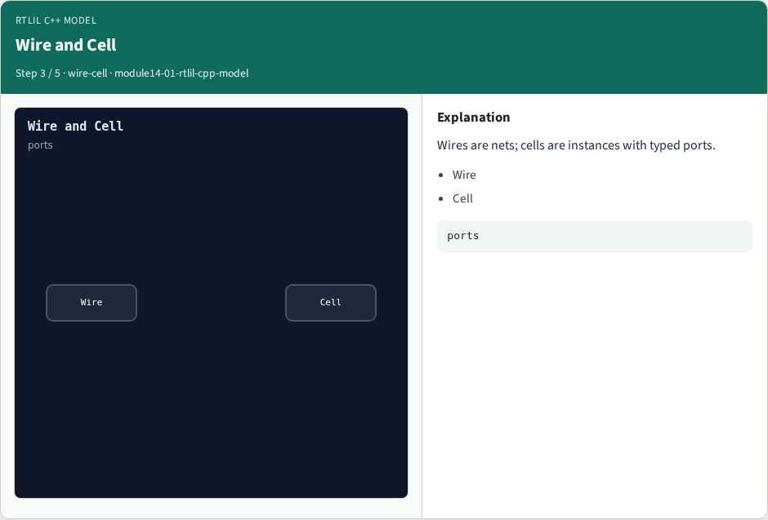
Wire and Cell
Wire and Cell
learn_yosys — 01 rtlil cpp model
Notes:
Wires are nets; cells are instances with typed ports.

Slide 6

SigSpec
SigSpec
learn_yosys — 01 rtlil cpp model
Notes:
SigSpec is the bit-accurate connection fabric.

Slide 7

Golden
Golden
learn_yosys — 01 rtlil cpp model
Notes:
GOLDEN: five pillars — Design, Module, Wire, Cell, SigSpec.

Slide 8
Browser lab track
Open rtlil-cpp-model
Click through the object graph and check the goldens
learn_yosys — 01 rtlil cpp model
Notes:
Open **rtlil-cpp-model**. Click through the object graph and check the goldens.

Slide 9
Implement track
Call rtlil_cpp_model() in internals_solvers; assert pillar count and nesting
learn_yosys — 01 rtlil cpp model
Notes:
Call rtlil_cpp_model() in internals_solvers; assert pillar count and nesting.

Slide 10
Pitfalls
Treating JSON keys as the C++ API
Forgetting SigSpec between cells and wires
learn_yosys — 01 rtlil cpp model
Notes:
Treating JSON keys as the C++ API. Forgetting SigSpec between cells and wires.

Slide 11
Try these
From the common folder, run the internals solvers self-test
learn_yosys — 01 rtlil cpp model
Notes:
From the common folder, run the internals solvers self-test.

Slide 12
Try these — try these
cd courses/learn_yosys/common
python3 internals_solvers.py
learn_yosys — 01 rtlil cpp model

Slide 13
Pseudocode
Here is the RTLIL nesting in plain steps
learn_yosys — 01 rtlil cpp model
Notes:
Here is the RTLIL nesting in plain steps.

Slide 14
Pseudocode — try these
design.modules[name] → module
module.wires / module.cells / module.processes
cell.connections[port] → SigSpec
learn_yosys — 01 rtlil cpp model

Slide 15
Next
Complete the quiz for this part
Next: how passes register and run on a Design
learn_yosys — 01 rtlil cpp model
Notes:
Next: how passes register and run on a Design.

