Slide 1
Why registration
Yosys is a pass engine
learn_yosys — 03 pass registration
Notes:
Yosys is a pass engine. Your code becomes a command when it registers a Pass.

Slide 2
The idea
GOLDEN: subclass Pass, REGISTER_PASS, implement execute(args, design)
learn_yosys — 03 pass registration
Notes:
GOLDEN: subclass Pass, REGISTER_PASS, implement execute(args, design).

Slide 3

Pass class
Pass class
learn_yosys — 03 pass registration
Notes:
Pass stores the command name and short help.

Slide 4
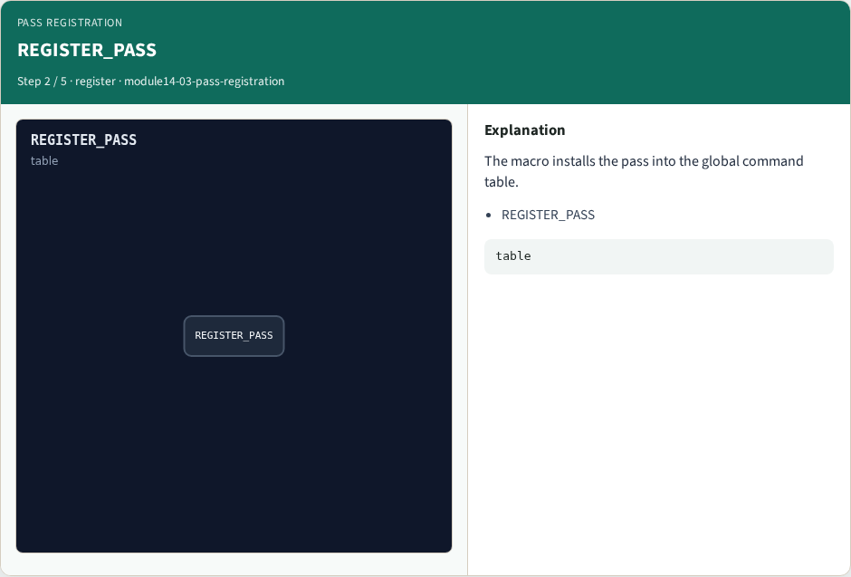
REGISTER_PASS
REGISTER_PASS
learn_yosys — 03 pass registration
Notes:
The macro installs the pass into the global command table.

Slide 5

execute
execute
learn_yosys — 03 pass registration
Notes:
execute receives args and the live Design pointer.

Slide 6

Selection
Selection
learn_yosys — 03 pass registration
Notes:
extra_args applies the selection stack.

Slide 7
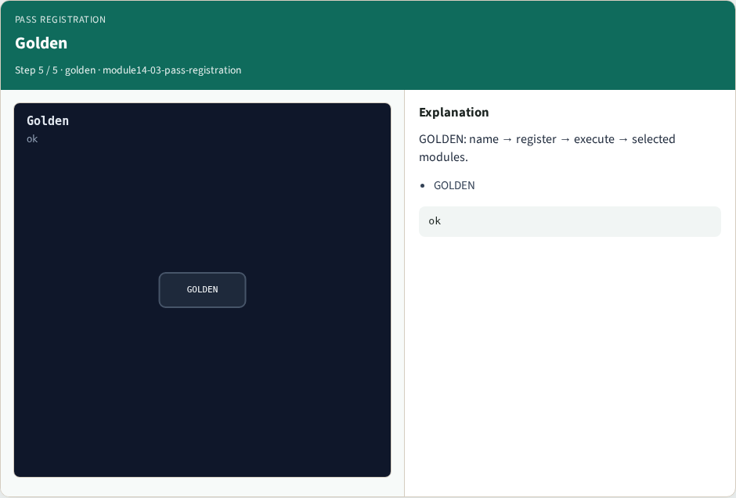
Golden
Golden
learn_yosys — 03 pass registration
Notes:
GOLDEN: name → register → execute → selected modules.

Slide 8
Browser lab track
Open pass-registration
Order the registration steps and check
learn_yosys — 03 pass registration
Notes:
Open **pass-registration**. Order the registration steps and check.

Slide 9
Implement track
Call pass_registration(); assert recipe ids match the golden sequence
learn_yosys — 03 pass registration
Notes:
Call pass_registration(); assert recipe ids match the golden sequence.

Slide 10
Pitfalls
Forgetting REGISTER_PASS
Mutating modules that are not selected
learn_yosys — 03 pass registration
Notes:
Forgetting REGISTER_PASS. Mutating modules that are not selected.

Slide 11
Try these
From the common folder, call pass_registration and print the recipe
learn_yosys — 03 pass registration
Notes:
From the common folder, call pass_registration and print the recipe.

Slide 12
Try these — try these
cd courses/learn_yosys/common
python3 -c "from internals_solvers import pass_registration;
print(pass_registration())"
learn_yosys — 03 pass registration

Slide 13
Pseudocode
Here is the Pass registration shape in plain steps
learn_yosys — 03 pass registration
Notes:
Here is the Pass registration shape in plain steps.

Slide 14
Pseudocode — try these
struct MyPass : Pass { MyPass(): Pass("my_pass", "help") {}
void execute(args, design) override { ... } };
REGISTER_PASS(MyPass)
learn_yosys — 03 pass registration

Slide 15
Next
Complete the quiz for this part
Next: read the real opt_clean shape in the Yosys tree
learn_yosys — 03 pass registration
Notes:
Next: read the real opt_clean shape in the Yosys tree.

