Slide 1
Why read a real pass
Algorithms in Part C match moves
learn_yosys — 01 read opt clean
Notes:
Algorithms in Part C match moves. Now map those moves onto the real C++ file shape.

Slide 2
The idea
GOLDEN: mark used from outputs; delete unused cells; then unused wires
Prefer proc before opt_clean
learn_yosys — 01 read opt clean
Notes:
GOLDEN: mark used from outputs; delete unused cells; then unused wires. Prefer proc before opt_clean.

Slide 3

File home
File home
learn_yosys — 01 read opt clean
Notes:
Real file: passes/opt/opt_clean.cc — OptCleanPass.

Slide 4

Mark used
Mark used
learn_yosys — 01 read opt clean
Notes:
Walk drivers and keep signals that fan out.

Slide 5

Remove cells
Remove cells
learn_yosys — 01 read opt clean
Notes:
rmunused_module_cells drops unused cells.

Slide 6

Remove wires
Remove wires
learn_yosys — 01 read opt clean
Notes:
rmunused_module_signals cleans leftover nets.

Slide 7
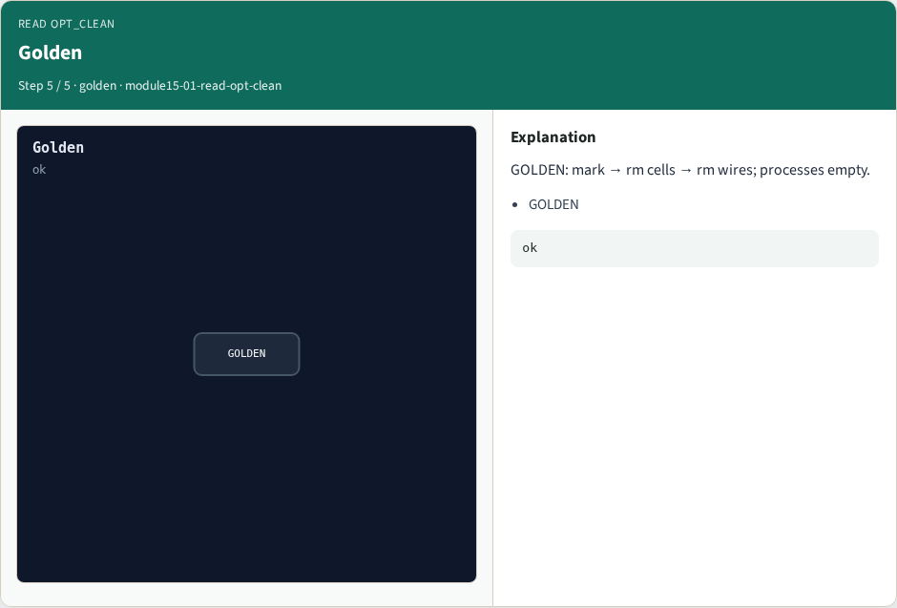
Golden
Golden
learn_yosys — 01 read opt clean
Notes:
GOLDEN: mark → rm cells → rm wires; processes empty.

Slide 8
Browser lab track
Open read-opt-clean
Step the mark/delete pipeline and check
learn_yosys — 01 read opt clean
Notes:
Open **read-opt-clean**. Step the mark/delete pipeline and check.

Slide 9
Implement track
Call read_opt_clean(); assert stage order and process guard
learn_yosys — 01 read opt clean
Notes:
Call read_opt_clean(); assert stage order and process guard.

Slide 10
Pitfalls
Expecting opt_clean to lower processes
Deleting wires before cells blindly
learn_yosys — 01 read opt clean
Notes:
Expecting opt_clean to lower processes. Deleting wires before cells blindly.

Slide 11
Try these
From the common folder, call read_opt_clean and print the stages
learn_yosys — 01 read opt clean
Notes:
From the common folder, call read_opt_clean and print the stages.

Slide 12
Try these — try these
cd courses/learn_yosys/common
python3 -c "from internals_solvers import read_opt_clean;
print(read_opt_clean())"
learn_yosys — 01 read opt clean

Slide 13
Pseudocode
Here is the opt_clean flow in plain steps
learn_yosys — 01 read opt clean
Notes:
Here is the opt_clean flow in plain steps.

Slide 14
Pseudocode — try these
for module in selected:
if processes: warn/skip
mark_used(outputs)
rmunused_module_cells
rmunused_module_signals
learn_yosys — 01 read opt clean

Slide 15
Next
Complete the quiz for this part
Next: contribute a minimal pass of your own
learn_yosys — 01 read opt clean
Notes:
Next: contribute a minimal pass of your own.

