Slide 1
Why contribute
Reading is not enough
learn_yosys — 03 contribute pass
Notes:
Reading is not enough. A contributor knows where a pass lives and how it enters the build.

Slide 2
The idea
GOLDEN: add passes/area/name.cc
learn_yosys — 03 contribute pass
Notes:
GOLDEN: add passes/area/name.cc, register the pass, list it in the Makefile, rebuild, yosys -h name.

Slide 3
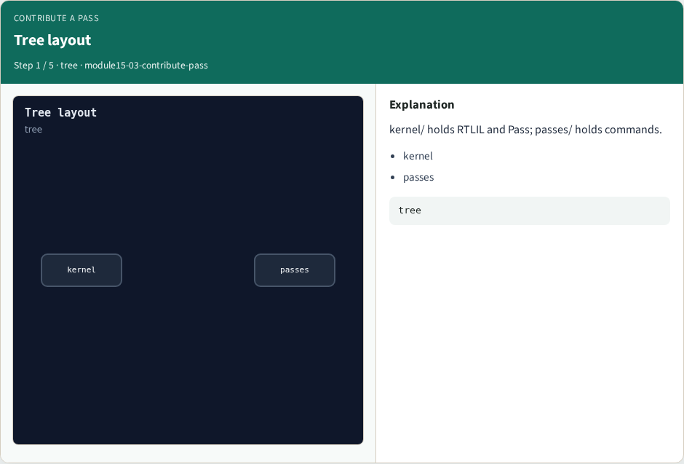
Tree layout
Tree layout
learn_yosys — 03 contribute pass
Notes:
kernel/ holds RTLIL and Pass; passes/ holds commands.

Slide 4
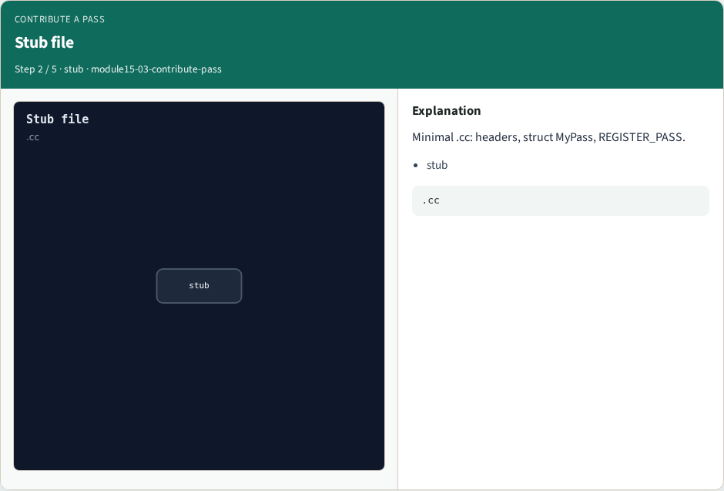
Stub file
Stub file
learn_yosys — 03 contribute pass
Notes:
Minimal .cc: headers, struct MyPass, REGISTER_PASS.

Slide 5

Build hook
Build hook
learn_yosys — 03 contribute pass
Notes:
Add the object to the Makefile and rebuild.

Slide 6

Smoke
Smoke
learn_yosys — 03 contribute pass
Notes:
yosys -h my_pass proves the command exists.

Slide 7

Golden
Golden
learn_yosys — 03 contribute pass
Notes:
GOLDEN: path + REGISTER_PASS + build + help smoke.

Slide 8
Browser lab track
Open contribute-pass
Assemble the contribute checklist and check
learn_yosys — 03 contribute pass
Notes:
Open **contribute-pass**. Assemble the contribute checklist and check.

Slide 9
Implement track
Call contribute_pass(); assert checklist length and smoke cmd
learn_yosys — 03 contribute pass
Notes:
Call contribute_pass(); assert checklist length and smoke cmd.

Slide 10
Pitfalls
Editing only docs
Forgetting the build system entry
Skipping help smoke
learn_yosys — 03 contribute pass
Notes:
Editing only docs. Forgetting the build system entry. Skipping help smoke.

Slide 11
Try these
From the common folder, call contribute_pass and print the checklist
learn_yosys — 03 contribute pass
Notes:
From the common folder, call contribute_pass and print the checklist.

Slide 12
Try these — try these
cd courses/learn_yosys/common
python3 -c "from internals_solvers import contribute_pass;
print(contribute_pass())"
learn_yosys — 03 contribute pass

Slide 13
Pseudocode
Here is the contribute checklist in plain steps
learn_yosys — 03 contribute pass
Notes:
Here is the contribute checklist in plain steps.

Slide 14
Pseudocode — try these
path ← passes/demo/hello_pass.cc
REGISTER_PASS(HelloPass)
add to Makefile; rebuild
smoke ← yosys -h hello_pass
learn_yosys — 03 contribute pass

Slide 15
Next
Complete the quiz for this part
Wrap the Yosys path , you can use Yosys and open the C++ tree with intent
learn_yosys — 03 contribute pass
Notes:
Wrap the Yosys path — you can use Yosys and open the C++ tree with intent.

