Slide 1
Leaf cells
Compaction starts from leaf geometries , cells and wires with axis-aligned boxes
learn_compaction — 01 leaf cells
Notes:
Compaction starts from leaf geometries — cells and wires with axis-aligned boxes.

Slide 2
The idea
A,B,C are cells; W is a horizontal wire
GOLDEN: 4 objects, bbox width 20, height 6
learn_compaction — 01 leaf cells
Notes:
A,B,C are cells; W is a horizontal wire. GOLDEN: 4 objects, bbox width 20, height 6.

Slide 3
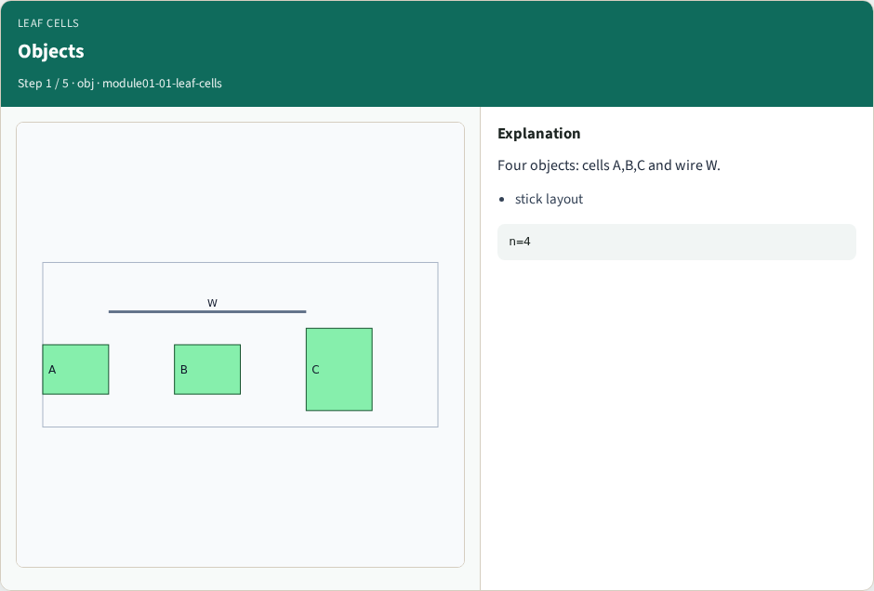
Objects
Objects
learn_compaction — 01 leaf cells
Notes:
Four objects: cells A,B,C and wire W.

Slide 4
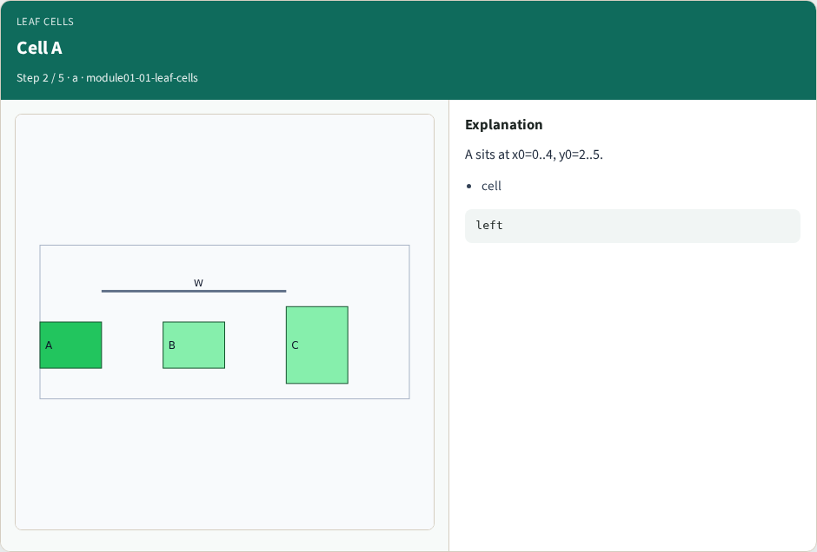
Cell A
Cell A
learn_compaction — 01 leaf cells
Notes:
A sits at x0=0..4, y0=2..5.

Slide 5
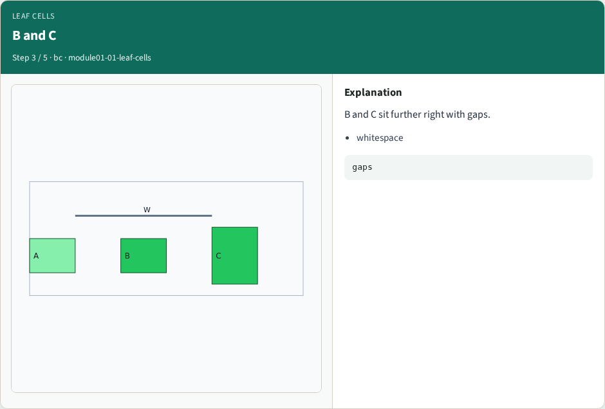
B and C
B and C
learn_compaction — 01 leaf cells
Notes:
B and C sit further right with gaps.

Slide 6
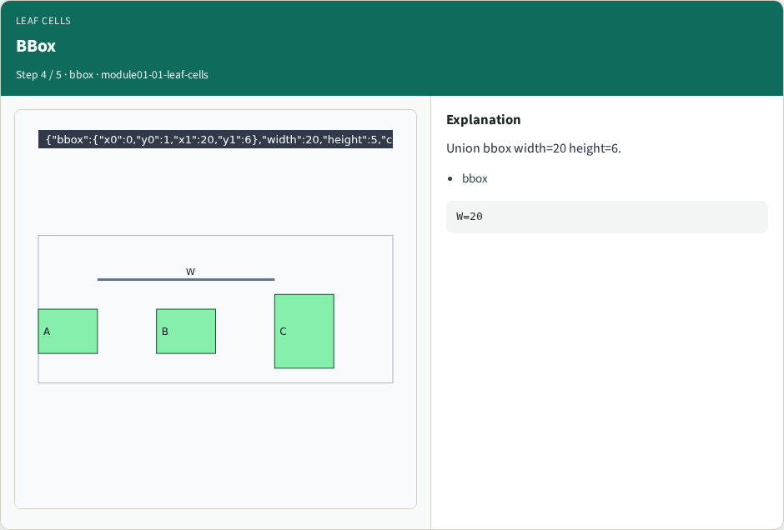
BBox
BBox
learn_compaction — 01 leaf cells
Notes:
Union bbox width=20 height=6.

Slide 7
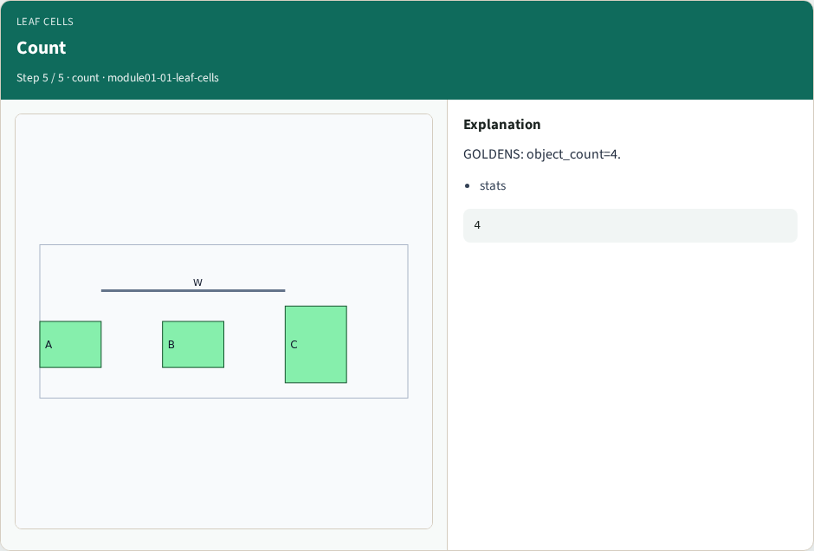
Count
Count
learn_compaction — 01 leaf cells
Notes:
GOLDENS: object_count=4.

Slide 8
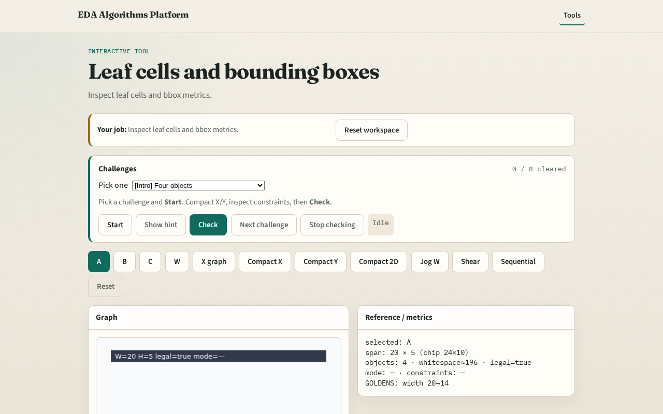
Browser lab track
Browser lab starter
learn_compaction — 01 leaf cells
Notes:
Open **leaf-cells**. Click cells; read bbox metrics.

Slide 9
Implement track
Call layout_stats; assert object_count==4 and width==20
learn_compaction — 01 leaf cells
Notes:
Call layout_stats; assert object_count==4 and width==20.

Slide 10
Pitfalls
Treating wire as a cell
Confusing chip size with bbox
learn_compaction — 01 leaf cells
Notes:
Treating wire as a cell. Confusing chip size with bbox.

Slide 11
Your turn
Next: spacing / gap rules
learn_compaction — 01 leaf cells
Notes:
Next: spacing / gap rules.

