Slide 1
Spacing
Design rules demand a minimum gap between adjacent shapes that project on an axis
learn_compaction — 03 spacing rules
Notes:
Design rules demand a minimum gap between adjacent shapes that project on an axis.

Slide 2
The idea
Min_gap=1 on the toy
Initial layout is legal; illegal if two cells overlap or gap < 1
learn_compaction — 03 spacing rules
Notes:
min_gap=1 on the toy. Initial layout is legal; illegal if two cells overlap or gap < 1.

Slide 3
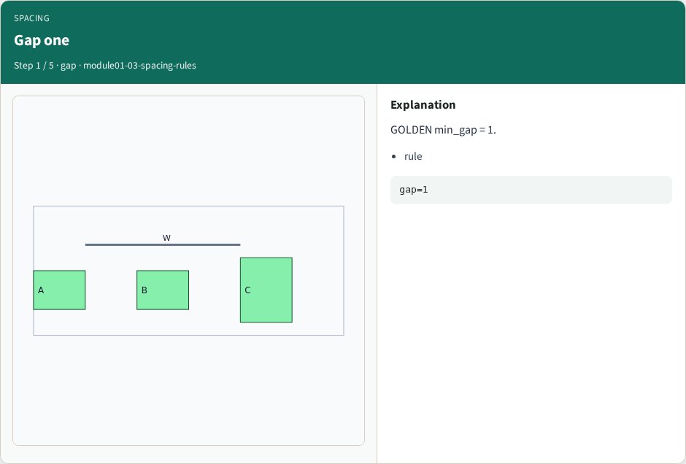
Gap one
Gap one
learn_compaction — 03 spacing rules
Notes:
GOLDEN min_gap = 1.

Slide 4
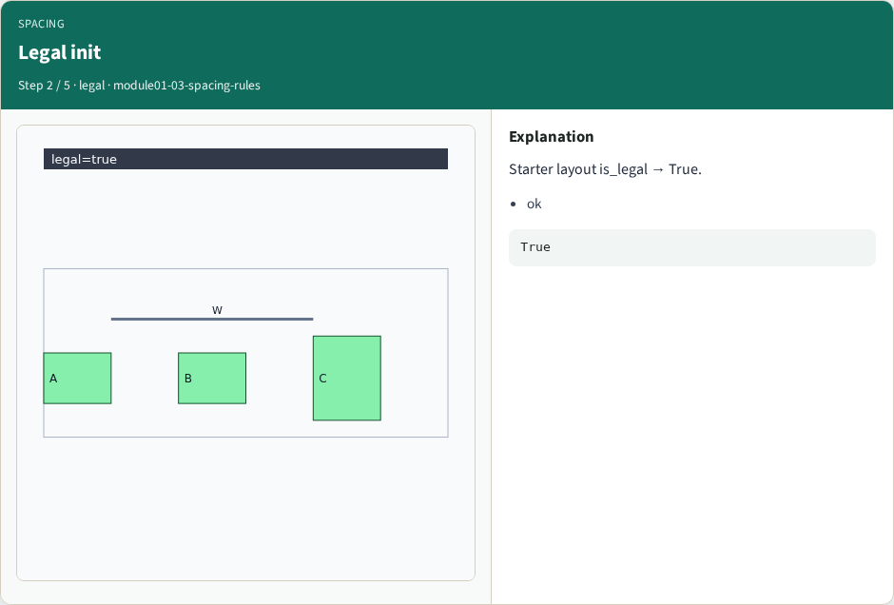
Legal init
Legal init
learn_compaction — 03 spacing rules
Notes:
Starter layout is_legal → True.

Slide 5
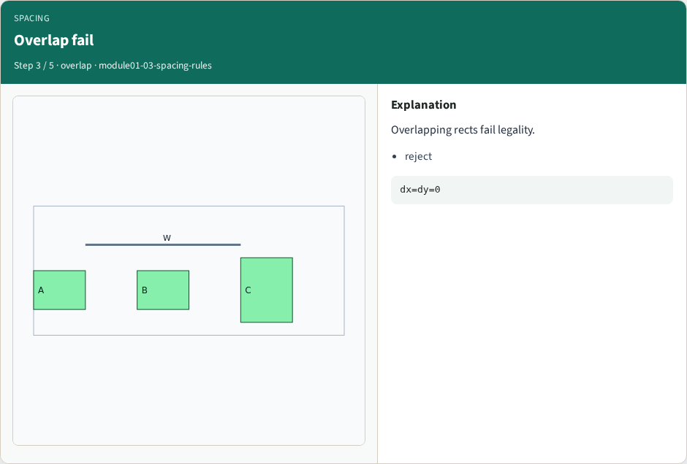
Overlap fail
Overlap fail
learn_compaction — 03 spacing rules
Notes:
Overlapping rects fail legality.

Slide 6
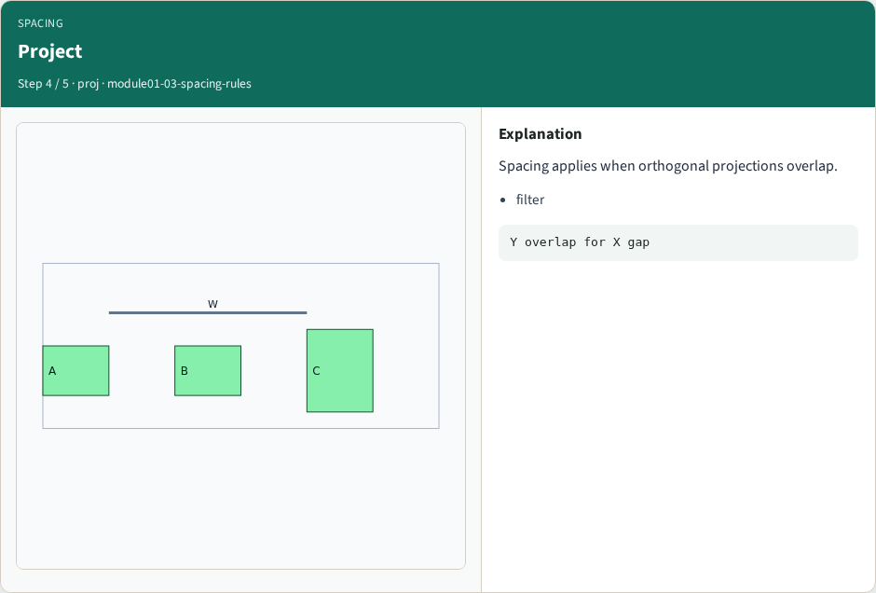
Project
Project
learn_compaction — 03 spacing rules
Notes:
Spacing applies when orthogonal projections overlap.

Slide 7
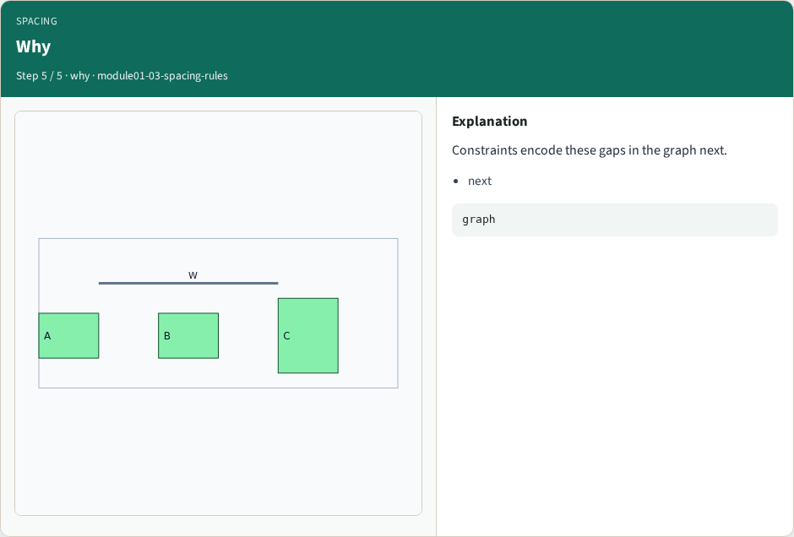
Why
Why
learn_compaction — 03 spacing rules
Notes:
Constraints encode these gaps in the graph next.

Slide 8
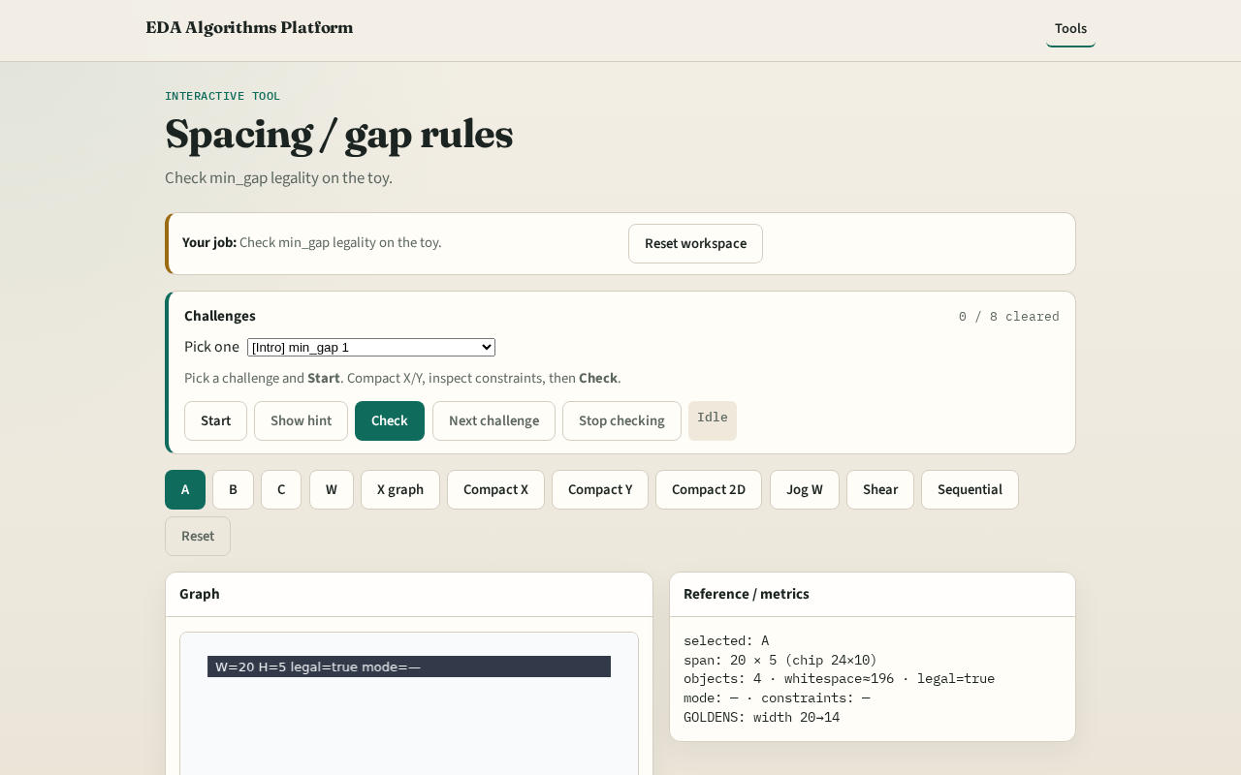
Browser lab track
Browser lab starter
learn_compaction — 03 spacing rules
Notes:
Open **spacing-rules**. Confirm min_gap=1 and legal starter.

Slide 9
Implement track
Call is_legal(DATA); assert True
Print min_gap
learn_compaction — 03 spacing rules
Notes:
Call is_legal(DATA); assert True. Print min_gap.

Slide 10
Pitfalls
Applying gap without projection overlap
Ignoring wires wrongly as cells
learn_compaction — 03 spacing rules
Notes:
Applying gap without projection overlap. Ignoring wires wrongly as cells.

Slide 11
Your turn
Next: the constraint graph
learn_compaction — 03 spacing rules
Notes:
Next: the constraint graph.

