Slide 1
Constraints
Compaction models geometry as a directed constraint graph
learn_compaction — 01 constraint graph
Notes:
Compaction models geometry as a directed constraint graph.

Slide 2
The idea
Nodes L_A,R_A,…; size edges R≥L+width; spacing edges L_right ≥ R_left + gap
GOLDEN ~10 X edges
learn_compaction — 01 constraint graph
Notes:
Nodes L_A,R_A,…; size edges R≥L+width; spacing edges L_right ≥ R_left + gap. GOLDEN ~10 X edges.

Slide 3
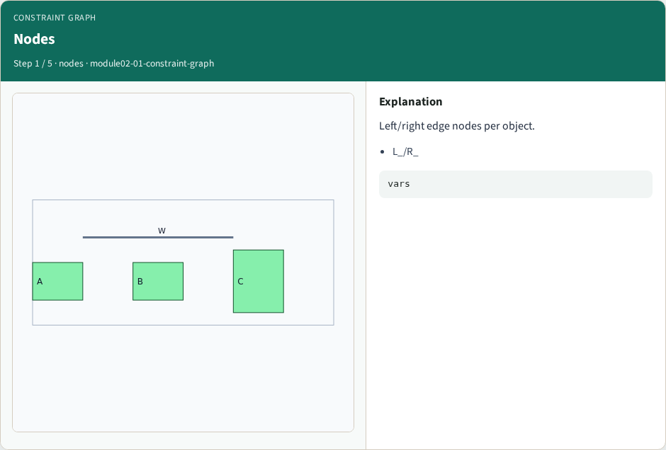
Nodes
Nodes
learn_compaction — 01 constraint graph
Notes:
Left/right edge nodes per object.

Slide 4
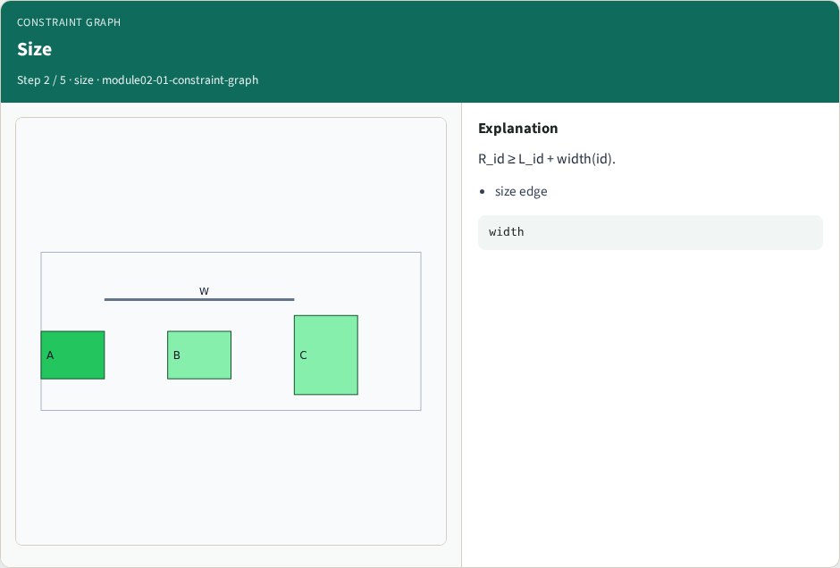
Size
Size
learn_compaction — 01 constraint graph
Notes:
R_id ≥ L_id + width(id).

Slide 5
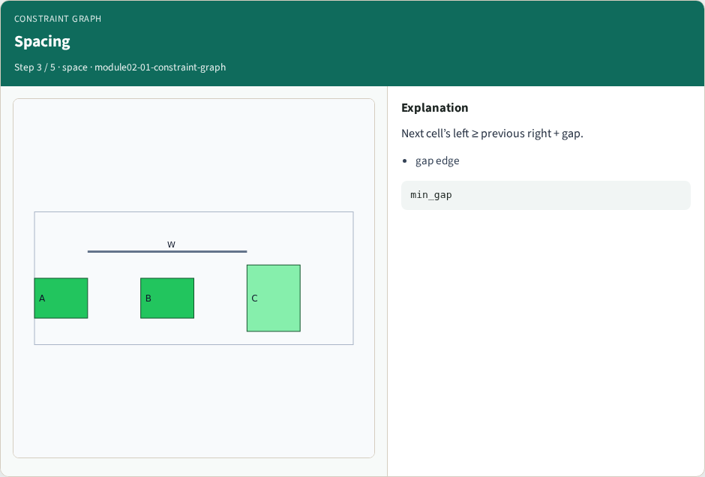
Spacing
Spacing
learn_compaction — 01 constraint graph
Notes:
Next cell’s left ≥ previous right + gap.

Slide 6

Source
Source
learn_compaction — 01 constraint graph
Notes:
SRC_X anchors the left of the chip.

Slide 7
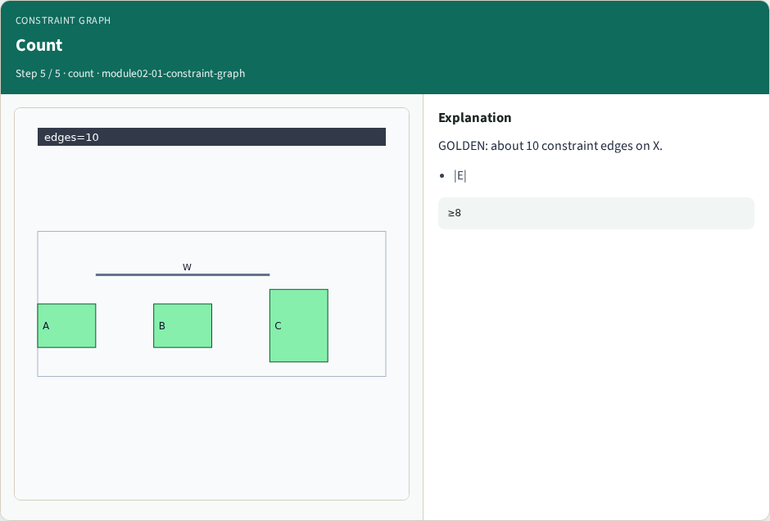
Count
Count
learn_compaction — 01 constraint graph
Notes:
GOLDEN: about 10 constraint edges on X.

Slide 8
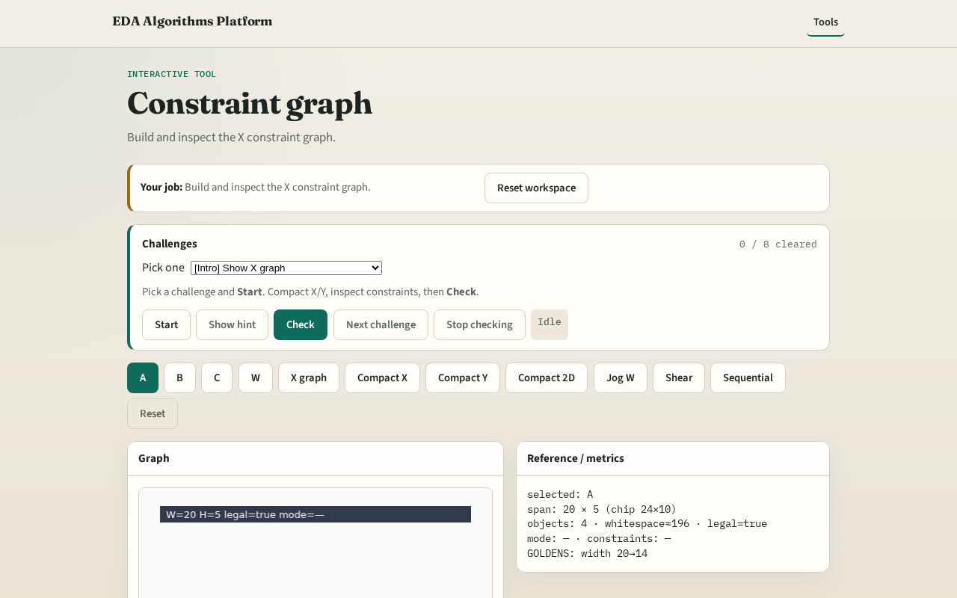
Browser lab track
Browser lab starter
learn_compaction — 01 constraint graph
Notes:
Open **constraint-graph**. Inspect X graph node/edge counts.

Slide 9
Implement track
Call build_constraint_graph(DATA,'x'); print len(edges)
learn_compaction — 01 constraint graph
Notes:
Call build_constraint_graph(DATA,'x'); print len(edges).

Slide 10
Pitfalls
Forgetting size edges
Mixing X and Y nodes
learn_compaction — 01 constraint graph
Notes:
Forgetting size edges. Mixing X and Y nodes.

Slide 11
Your turn
Next: longest-path placement
learn_compaction — 01 constraint graph
Notes:
Next: longest-path placement.

