Slide 1
Longest path
Classic 1-D compaction sets each variable to the longest path from the source
learn_compaction — 03 longest path
Notes:
Classic 1-D compaction sets each variable to the longest path from the source.

Slide 2
The idea
Relax edges until positions stabilize; left edges pull rightward to minimum legal places
learn_compaction — 03 longest path
Notes:
Relax edges until positions stabilize; left edges pull rightward to minimum legal places.

Slide 3
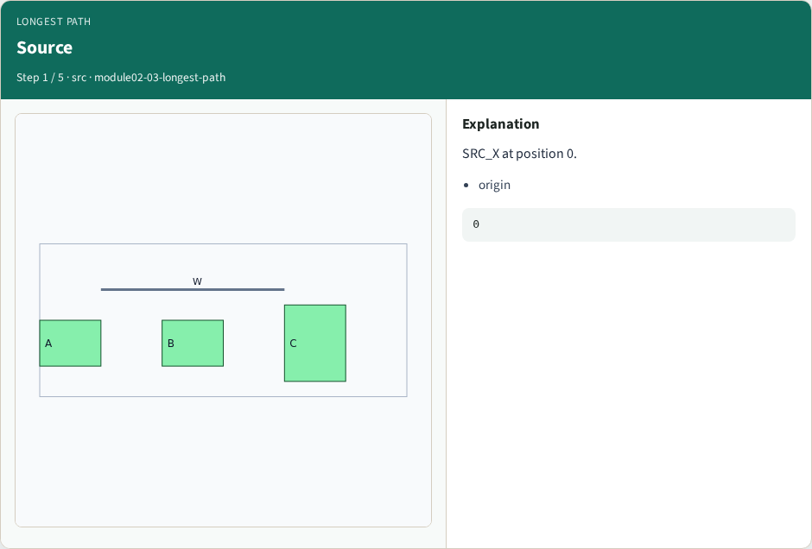
Source
Source
learn_compaction — 03 longest path
Notes:
SRC_X at position 0.

Slide 4
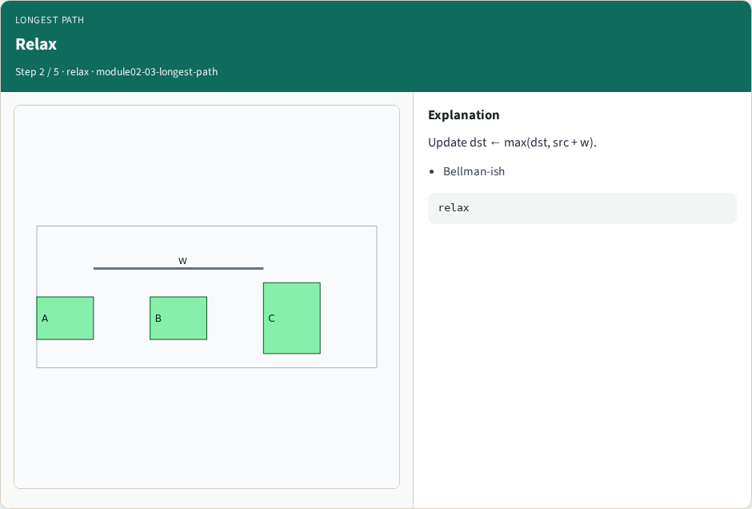
Relax
Relax
learn_compaction — 03 longest path
Notes:
Update dst ← max(dst, src + w).

Slide 5
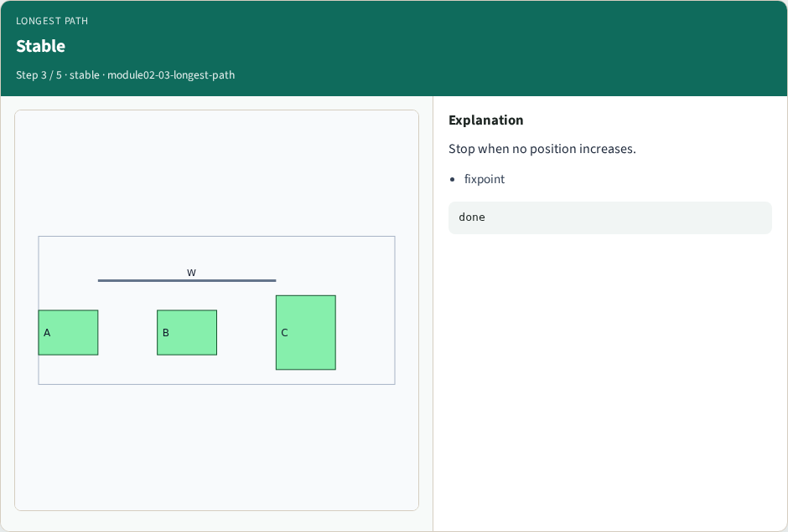
Stable
Stable
learn_compaction — 03 longest path
Notes:
Stop when no position increases.

Slide 6
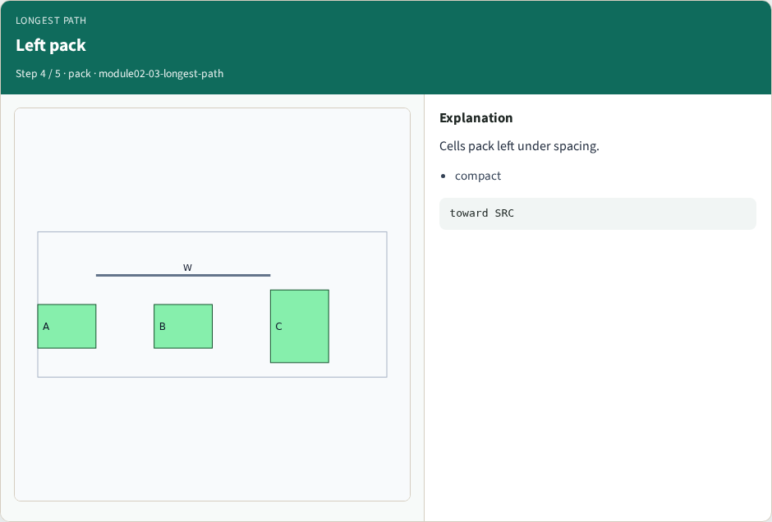
Left pack
Left pack
learn_compaction — 03 longest path
Notes:
Cells pack left under spacing.

Slide 7

Ready
Ready
learn_compaction — 03 longest path
Notes:
Positions feed compact_1d next.

Slide 8
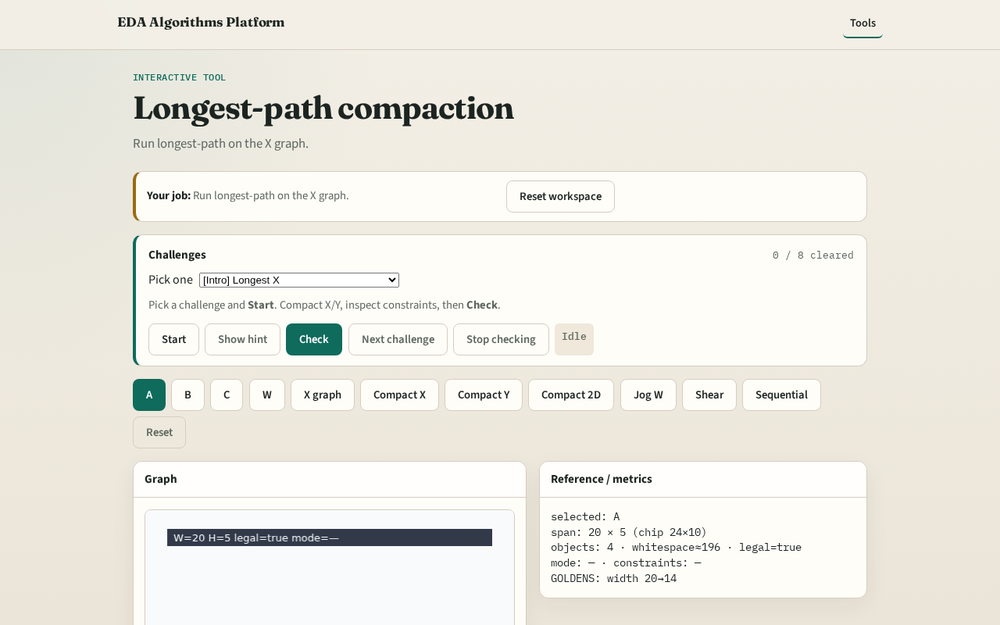
Browser lab track
Browser lab starter
learn_compaction — 03 longest path
Notes:
Open **longest-path**. Run longest-path on the X graph.

Slide 9
Implement track
Call longest_path_compact(build_constraint_graph(...))
learn_compaction — 03 longest path
Notes:
Call longest_path_compact(build_constraint_graph(...)).

Slide 10
Pitfalls
Using shortest-path instead
Not iterating to fixpoint
learn_compaction — 03 longest path
Notes:
Using shortest-path instead. Not iterating to fixpoint.

Slide 11
Your turn
Next: apply 1-D compaction
learn_compaction — 03 longest path
Notes:
Next: apply 1-D compaction.

