Slide 1
1-D compact
One axis at a time: build graph, longest-path, rewrite coordinates
learn_compaction — 05 compact 1d
Notes:
One axis at a time: build graph, longest-path, rewrite coordinates.

Slide 2
The idea
GOLDEN: X compaction before_span=20, after_span=14, improved=True
learn_compaction — 05 compact 1d
Notes:
GOLDEN: X compaction before_span=20, after_span=14, improved=True.

Slide 3
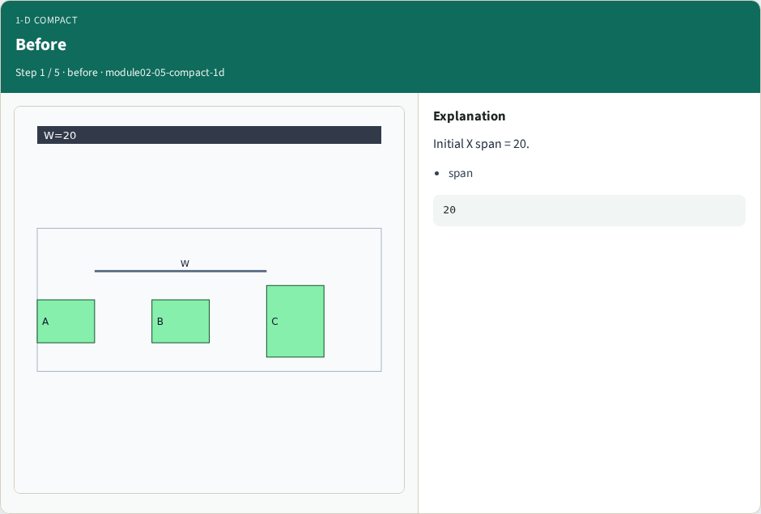
Before
Before
learn_compaction — 05 compact 1d
Notes:
Initial X span = 20.

Slide 4
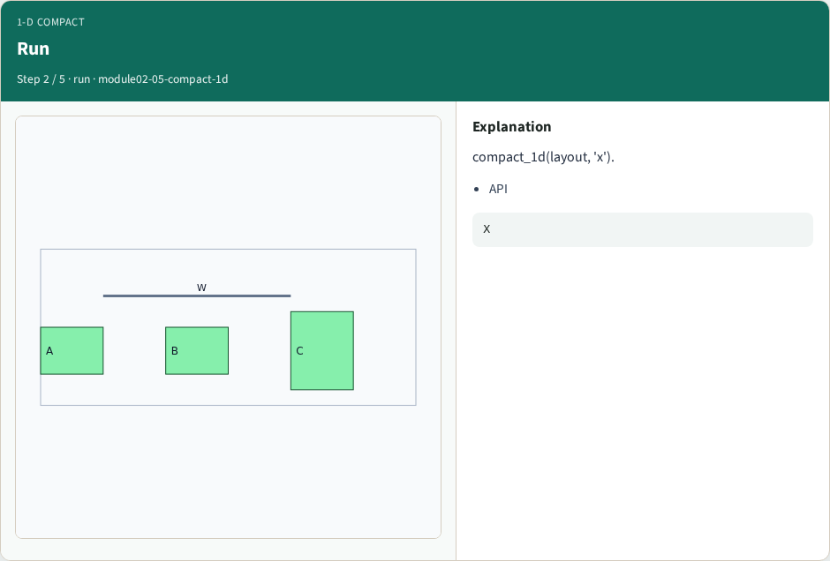
Run
Run
learn_compaction — 05 compact 1d
Notes:
compact_1d(layout, 'x').

Slide 5
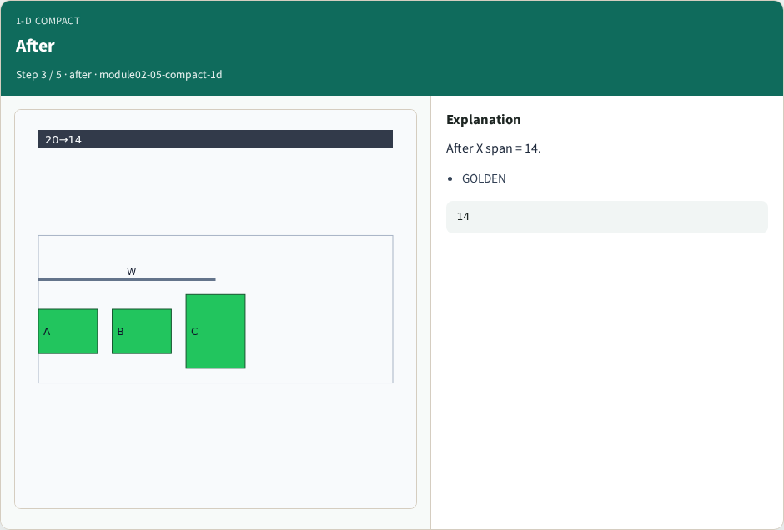
After
After
learn_compaction — 05 compact 1d
Notes:
After X span = 14.

Slide 6
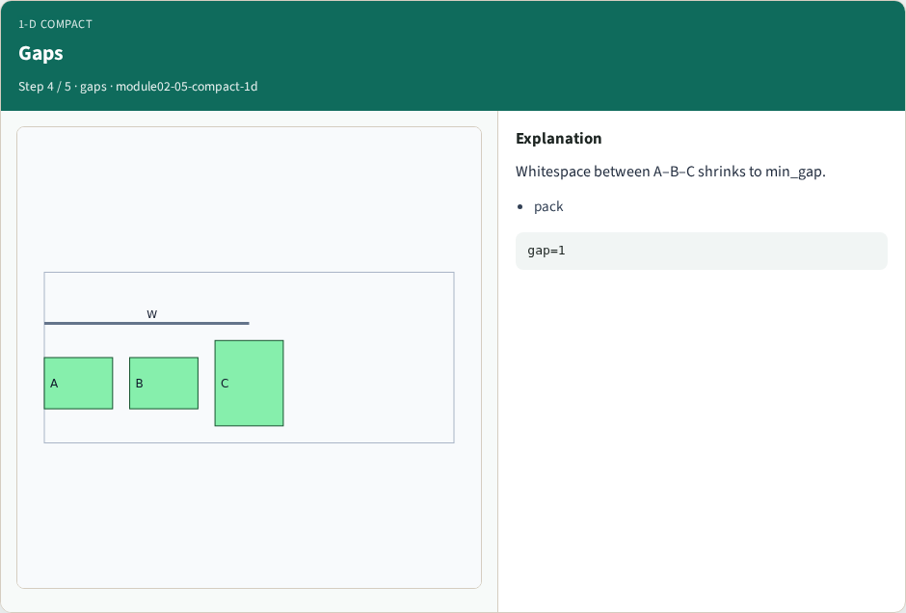
Gaps
Gaps
learn_compaction — 05 compact 1d
Notes:
Whitespace between A–B–C shrinks to min_gap.

Slide 7
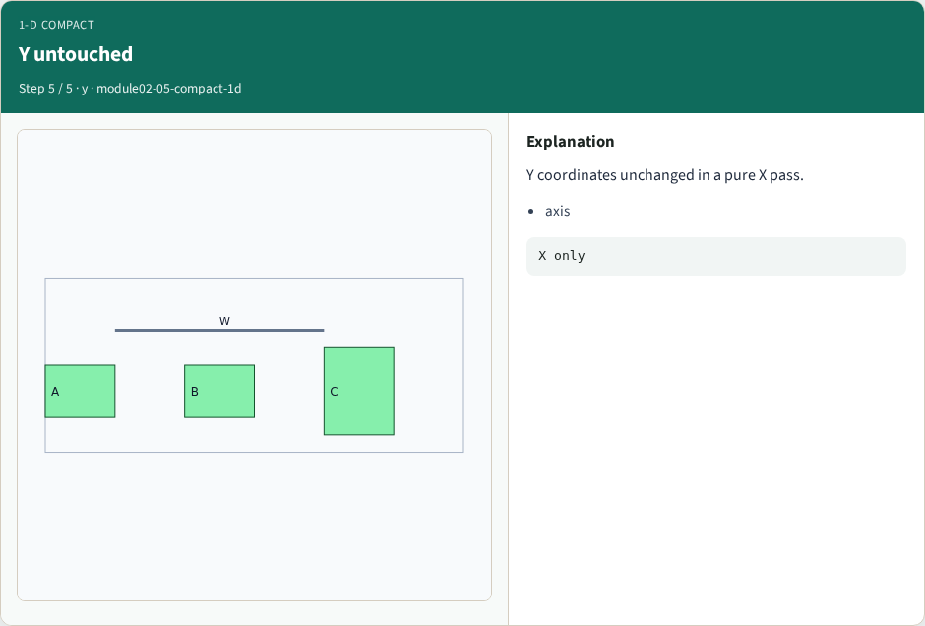
Y untouched
Y untouched
learn_compaction — 05 compact 1d
Notes:
Y coordinates unchanged in a pure X pass.

Slide 8
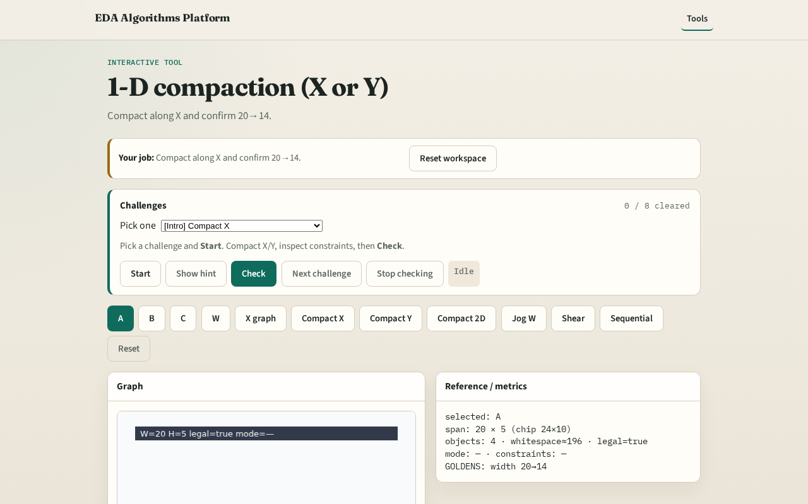
Browser lab track
Browser lab starter
learn_compaction — 05 compact 1d
Notes:
Open **compact-1d**. Click Compact X; confirm 20→14.

Slide 9
Implement track
Call compact_1d(DATA,'x'); assert after_span==14
learn_compaction — 05 compact 1d
Notes:
Call compact_1d(DATA,'x'); assert after_span==14.

Slide 10
Pitfalls
Expecting Y to change
Ignoring improved flag
learn_compaction — 05 compact 1d
Notes:
Expecting Y to change. Ignoring improved flag.

Slide 11
Your turn
Next: 2-D compaction
learn_compaction — 05 compact 1d
Notes:
Next: 2-D compaction.

