Slide 1
2-D compact
2-D compaction usually alternates axes (X then Y on the toy)
learn_compaction — 07 compact 2d
Notes:
2-D compaction usually alternates axes (X then Y on the toy).

Slide 2
The idea
GOLDEN: initial 20×6 → final width 14 (height may shift slightly with projections)
learn_compaction — 07 compact 2d
Notes:
GOLDEN: initial 20×6 → final width 14 (height may shift slightly with projections).

Slide 3
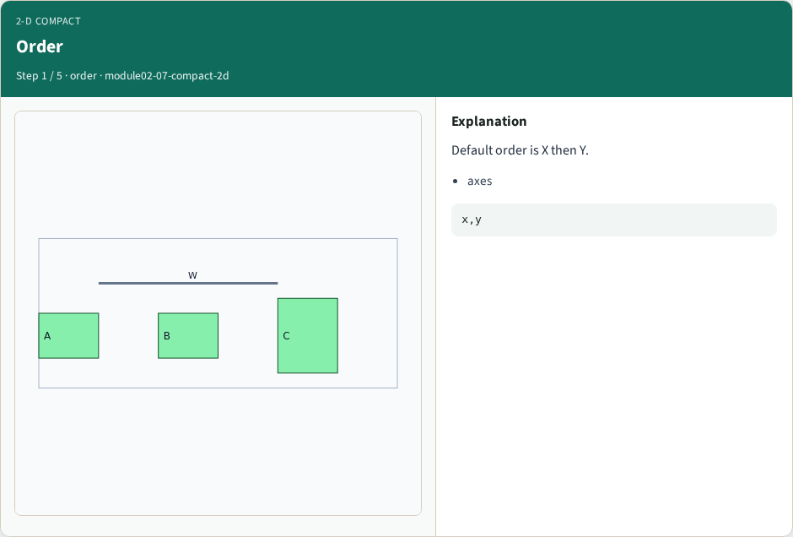
Order
Order
learn_compaction — 07 compact 2d
Notes:
Default order is X then Y.

Slide 4

X step
X step
learn_compaction — 07 compact 2d
Notes:
First step shrinks width.

Slide 5
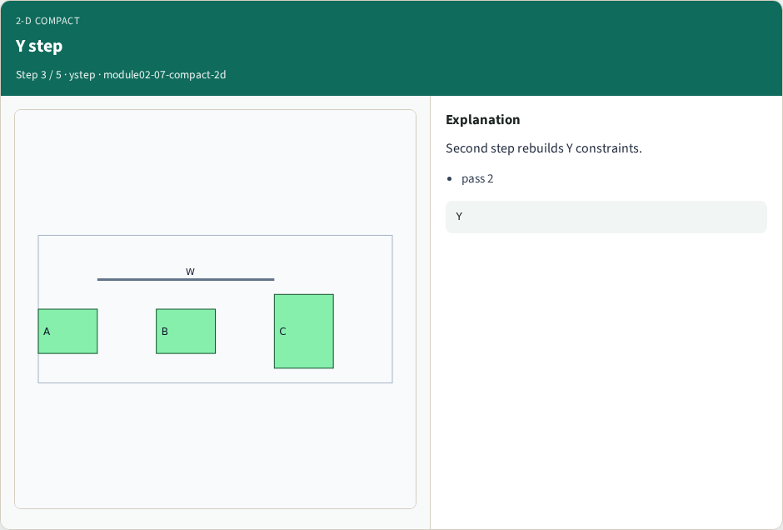
Y step
Y step
learn_compaction — 07 compact 2d
Notes:
Second step rebuilds Y constraints.

Slide 6
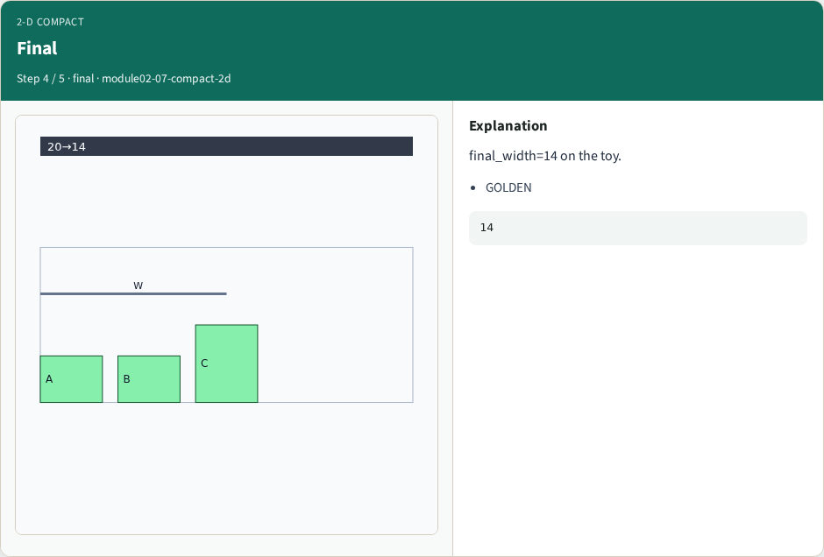
Final
Final
learn_compaction — 07 compact 2d
Notes:
final_width=14 on the toy.

Slide 7
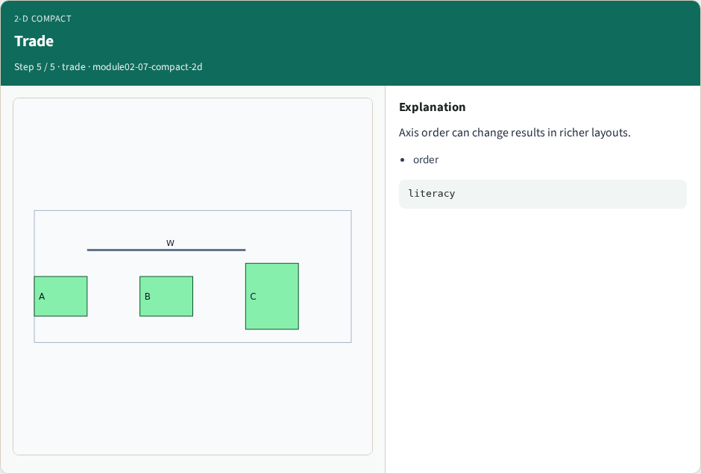
Trade
Trade
learn_compaction — 07 compact 2d
Notes:
Axis order can change results in richer layouts.

Slide 8
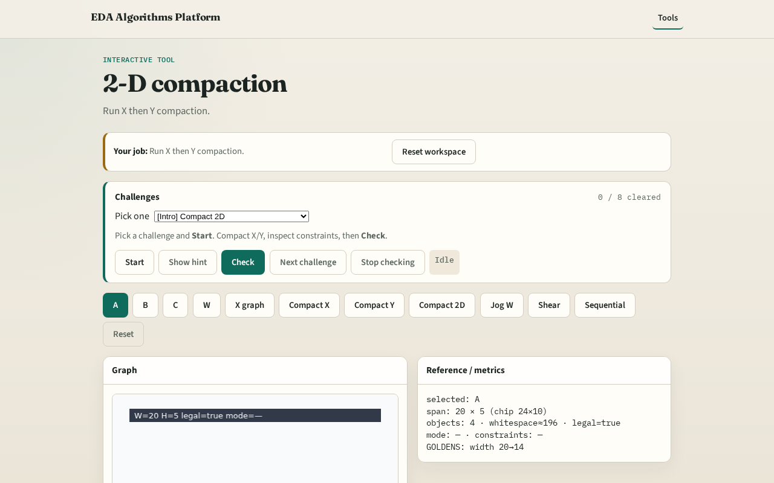
Browser lab track
Browser lab starter
learn_compaction — 07 compact 2d
Notes:
Open **compact-2d**. Run 2-D; read final width 14.

Slide 9
Implement track
Call compact_2d(DATA); assert final_width==14
learn_compaction — 07 compact 2d
Notes:
Call compact_2d(DATA); assert final_width==14.

Slide 10
Pitfalls
Assuming one axis is enough
Ignoring order sensitivity
learn_compaction — 07 compact 2d
Notes:
Assuming one axis is enough. Ignoring order sensitivity.

Slide 11
Your turn
Next: wire jogs
learn_compaction — 07 compact 2d
Notes:
Next: wire jogs.

