Slide 1
Wire jogs
Wires must bend or stretch when cells move during compaction
learn_compaction — 01 wire jogs
Notes:
Wires must bend or stretch when cells move during compaction.

Slide 2
The idea
Add_jog inserts a bend; stretch_wire_to_bbox retargets a horizontal wire to the cell union
learn_compaction — 01 wire jogs
Notes:
add_jog inserts a bend; stretch_wire_to_bbox retargets a horizontal wire to the cell union.

Slide 3
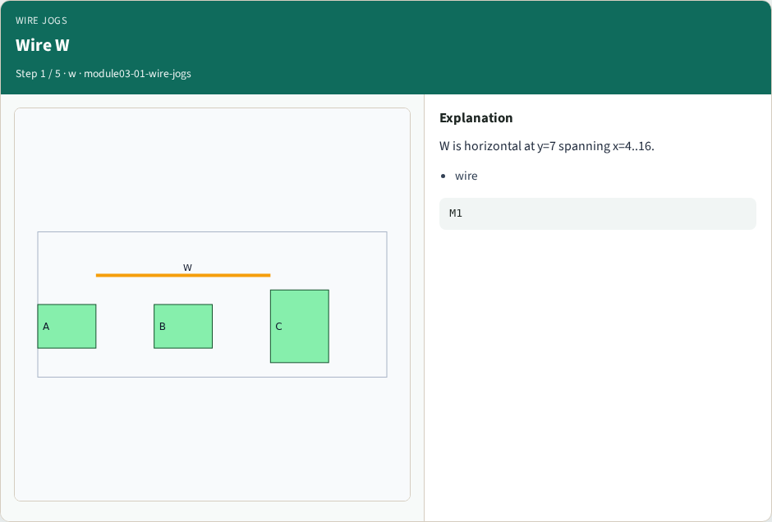
Wire W
Wire W
learn_compaction — 01 wire jogs
Notes:
W is horizontal at y=7 spanning x=4..16.

Slide 4
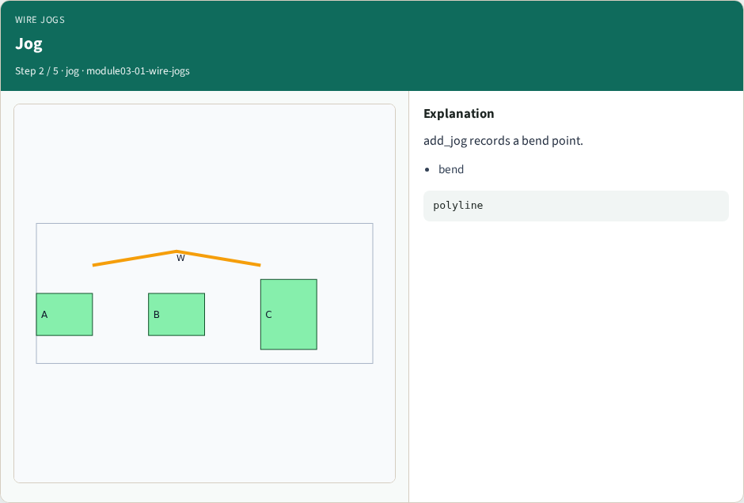
Jog
Jog
learn_compaction — 01 wire jogs
Notes:
add_jog records a bend point.

Slide 5

Stretch
Stretch
learn_compaction — 01 wire jogs
Notes:
After compact, stretch W to cell bbox.

Slide 6
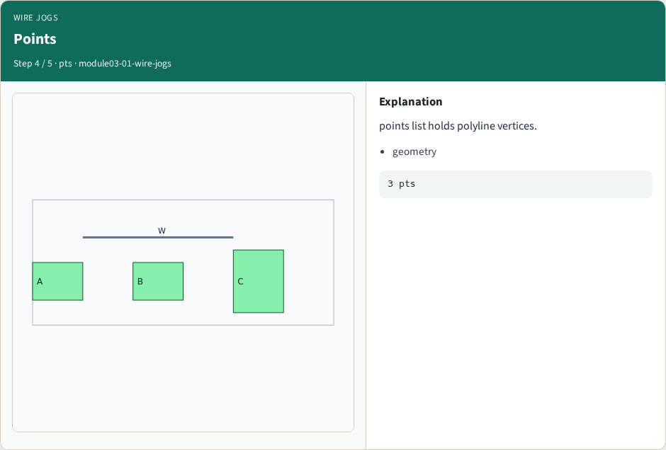
Points
Points
learn_compaction — 01 wire jogs
Notes:
points list holds polyline vertices.

Slide 7
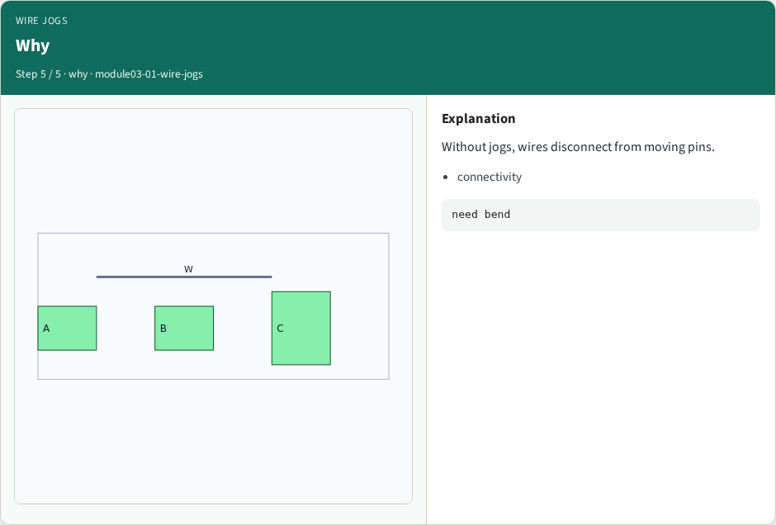
Why
Why
learn_compaction — 01 wire jogs
Notes:
Without jogs, wires disconnect from moving pins.

Slide 8
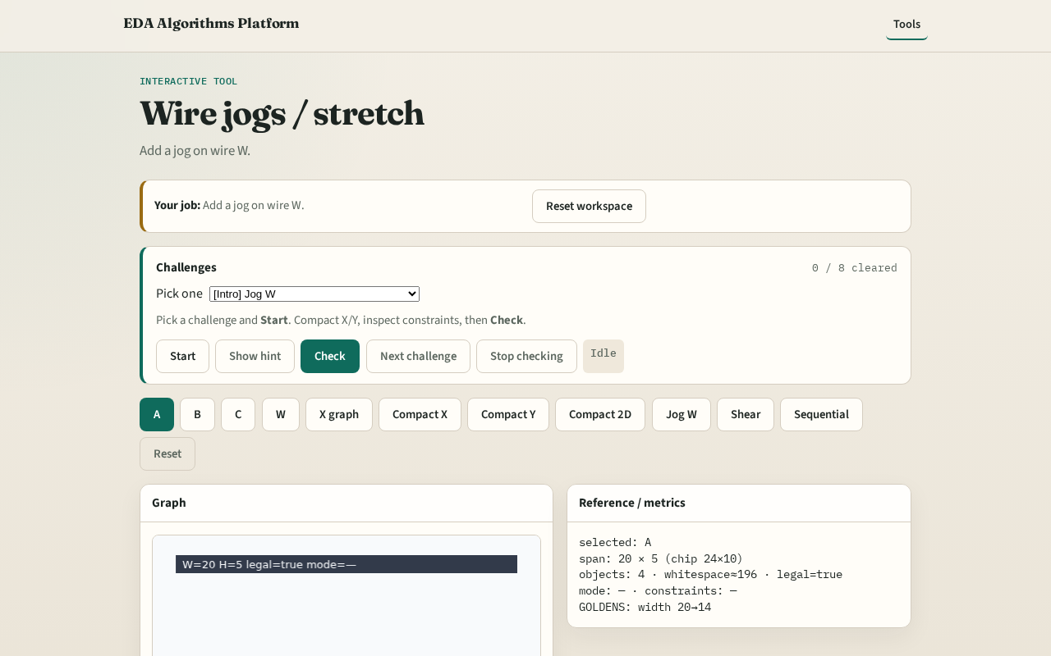
Browser lab track
Browser lab starter
learn_compaction — 01 wire jogs
Notes:
Open **wire-jogs**. Add a jog; stretch W after compact.

Slide 9
Implement track
Call add_jog on W; stretch_wire_to_bbox after compact_1d
learn_compaction — 01 wire jogs
Notes:
Call add_jog on W; stretch_wire_to_bbox after compact_1d.

Slide 10
Pitfalls
Deleting the wire
Stretching without updating y
learn_compaction — 01 wire jogs
Notes:
Deleting the wire. Stretching without updating y.

Slide 11
Your turn
Next: shear lite
learn_compaction — 01 wire jogs
Notes:
Next: shear lite.

