Slide 1
Shear
Shear slides a channel to open or close space without full recompaction
learn_compaction — 03 shear lite
Notes:
Shear slides a channel to open or close space without full recompaction.

Slide 2
The idea
Shear_channel_lite(x_lo,x_hi,delta_y) moves objects intersecting the band
learn_compaction — 03 shear lite
Notes:
shear_channel_lite(x_lo,x_hi,delta_y) moves objects intersecting the band.

Slide 3
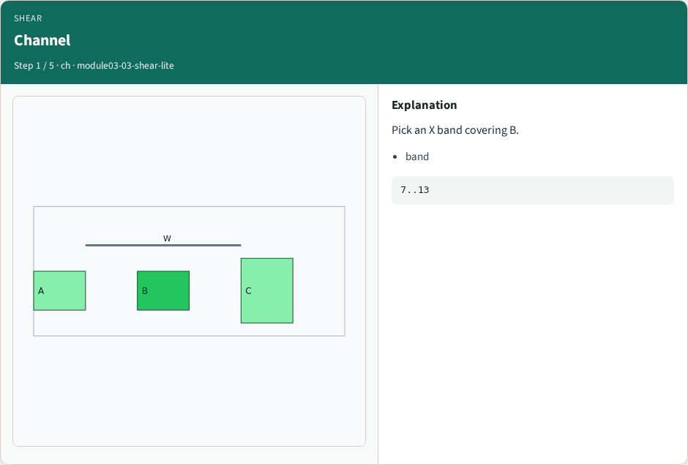
Channel
Channel
learn_compaction — 03 shear lite
Notes:
Pick an X band covering B.

Slide 4
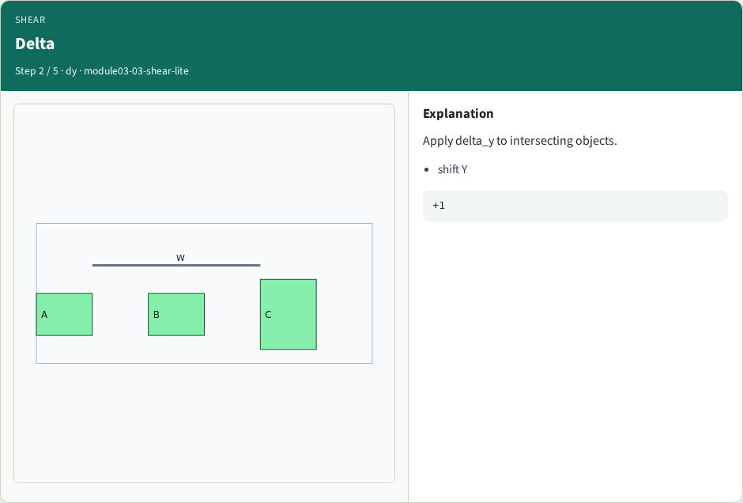
Delta
Delta
learn_compaction — 03 shear lite
Notes:
Apply delta_y to intersecting objects.

Slide 5
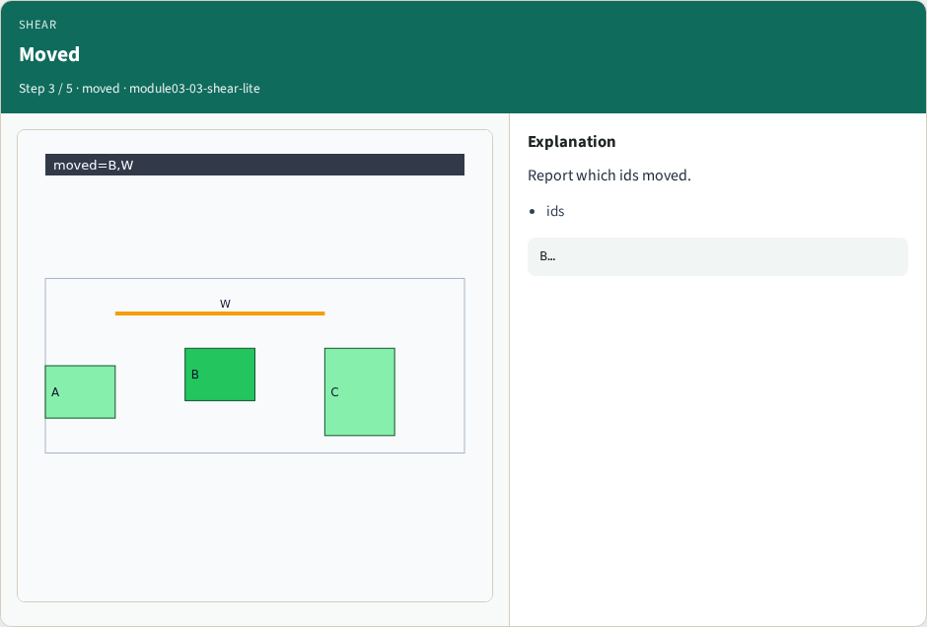
Moved
Moved
learn_compaction — 03 shear lite
Notes:
Report which ids moved.

Slide 6
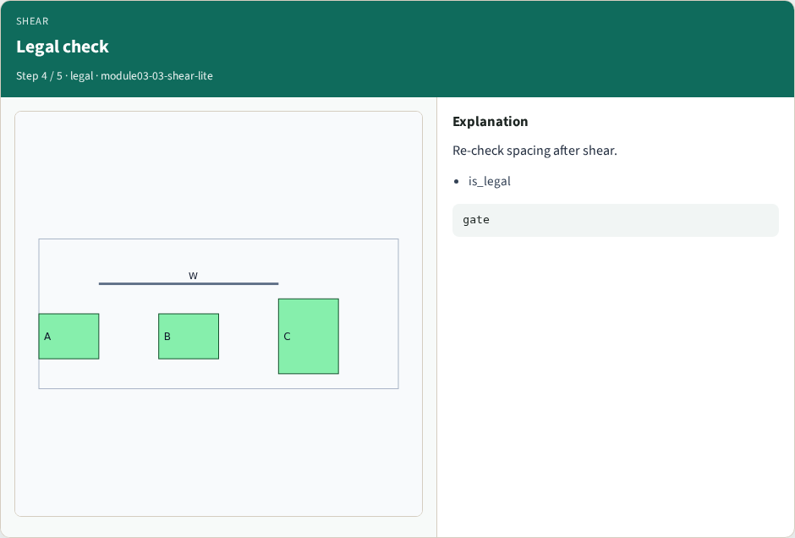
Legal check
Legal check
learn_compaction — 03 shear lite
Notes:
Re-check spacing after shear.

Slide 7
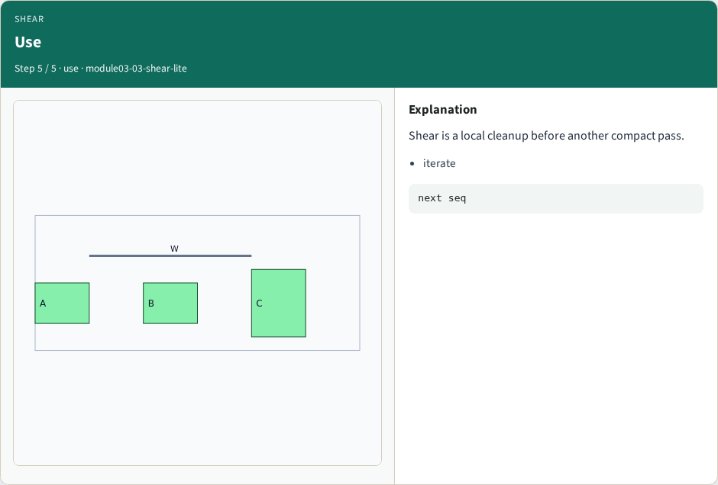
Use
Use
learn_compaction — 03 shear lite
Notes:
Shear is a local cleanup before another compact pass.

Slide 8
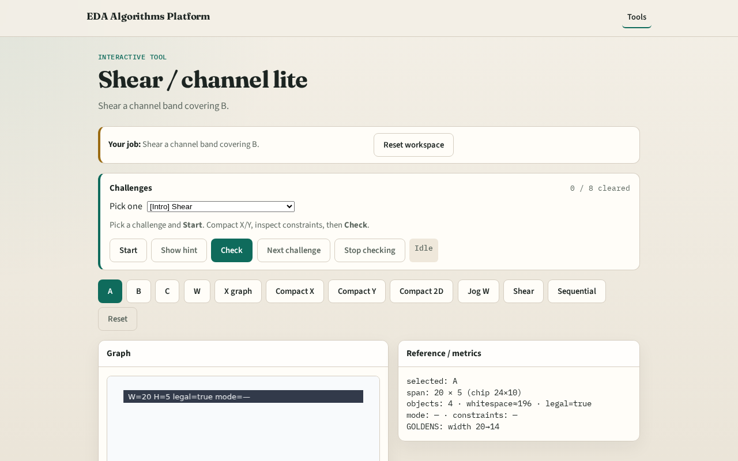
Browser lab track
Browser lab starter
learn_compaction — 03 shear lite
Notes:
Open **shear-lite**. Shear a band; inspect moved ids.

Slide 9
Implement track
Call shear_channel_lite(DATA, 7, 13, 1); print moved
learn_compaction — 03 shear lite
Notes:
Call shear_channel_lite(DATA, 7, 13, 1); print moved.

Slide 10
Pitfalls
Shearing the whole chip blindly
Skipping legality after shear
learn_compaction — 03 shear lite
Notes:
Shearing the whole chip blindly. Skipping legality after shear.

Slide 11
Your turn
Next: sequential compact pipeline
learn_compaction — 03 shear lite
Notes:
Next: sequential compact pipeline.

