Slide 1
Sequential
A full pass chains axis compaction and wire repair like a tiny cleaner
learn_compaction — 05 sequential compact
Notes:
A full pass chains axis compaction and wire repair like a tiny cleaner.

Slide 2
The idea
GOLDEN: width 20→14, legal=True, improved=True
learn_compaction — 05 sequential compact
Notes:
GOLDEN: width 20→14, legal=True, improved=True.

Slide 3
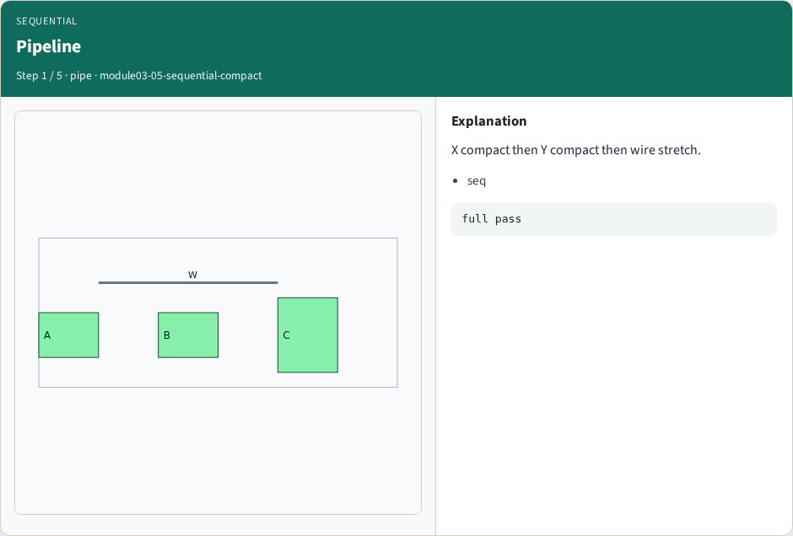
Pipeline
Pipeline
learn_compaction — 05 sequential compact
Notes:
X compact then Y compact then wire stretch.

Slide 4
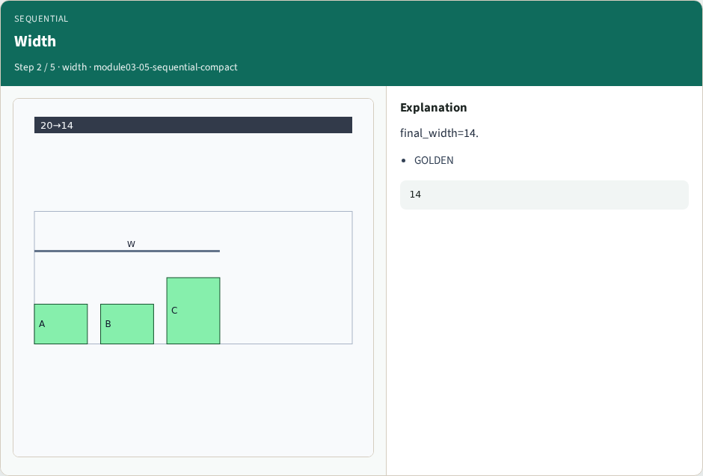
Width
Width
learn_compaction — 05 sequential compact
Notes:
final_width=14.

Slide 5
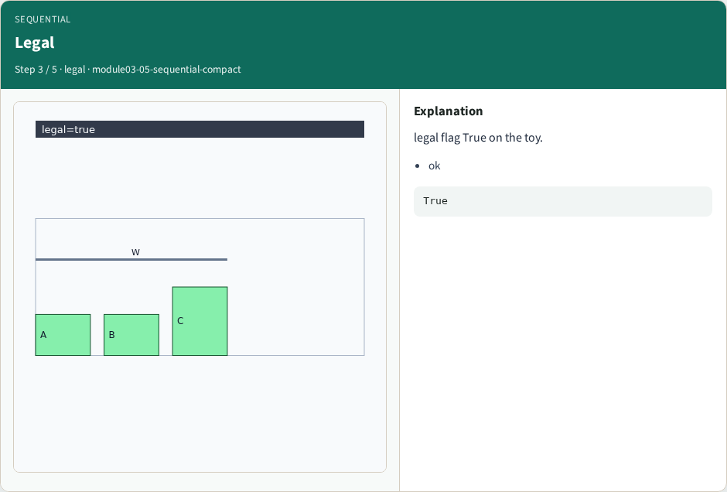
Legal
Legal
learn_compaction — 05 sequential compact
Notes:
legal flag True on the toy.

Slide 6
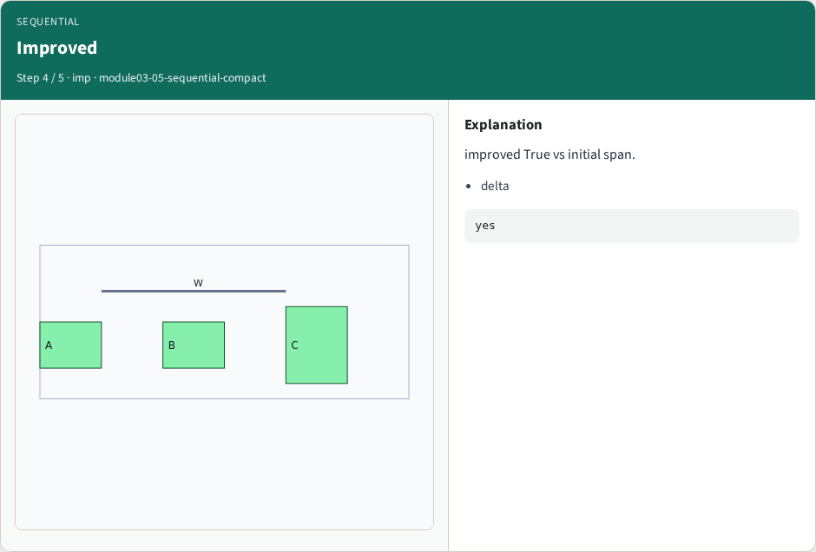
Improved
Improved
learn_compaction — 05 sequential compact
Notes:
improved True vs initial span.

Slide 7
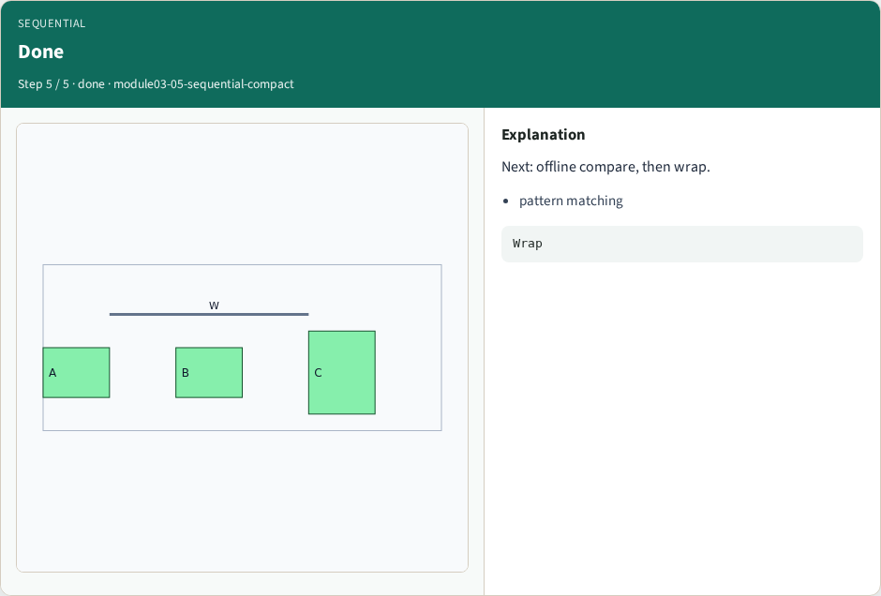
Done
Done
learn_compaction — 05 sequential compact
Notes:
Next: offline compare, then wrap.

Slide 8
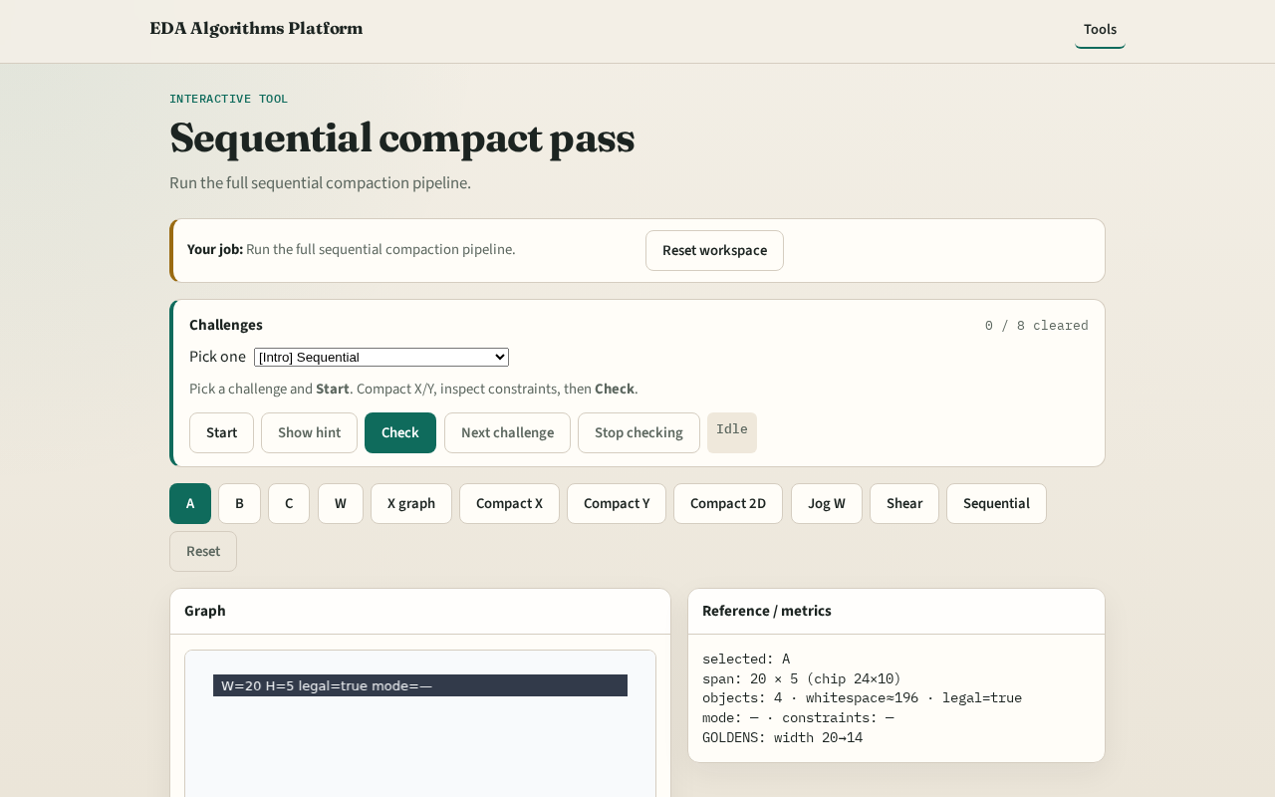
Browser lab track
Browser lab starter
learn_compaction — 05 sequential compact
Notes:
Open **sequential-compact**. Click Sequential compact; confirm 20→14.

Slide 9
Implement track
Call sequential_compact(DATA); assert final_width==14 and legal
learn_compaction — 05 sequential compact
Notes:
Call sequential_compact(DATA); assert final_width==14 and legal.

Slide 10
Pitfalls
Skipping wire stretch
Claiming illegal layouts are OK
learn_compaction — 05 sequential compact
Notes:
Skipping wire stretch. Claiming illegal layouts are OK.

Slide 11
Your turn
Next: offline benchmark, then wrap
learn_compaction — 05 sequential compact
Notes:
Next: offline benchmark, then wrap.

