Slide 1
Metal area
Antenna checks start by summing metal area on each net
learn_antenna — 01 metal area
Notes:
Antenna checks start by summing metal area on each net.

Slide 2
The idea
GOLDEN: metal_area n1=25
learn_antenna — 01 metal area
Notes:
GOLDEN: metal_area n1=25.

Slide 3
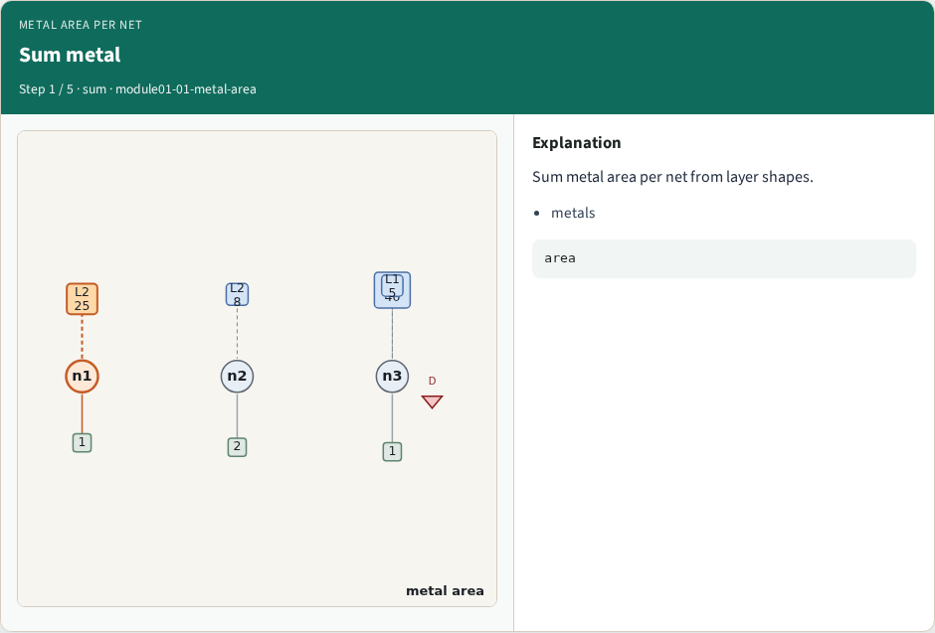
Sum metal
Sum metal
learn_antenna — 01 metal area
Notes:
Sum metal area per net from layer shapes.

Slide 4
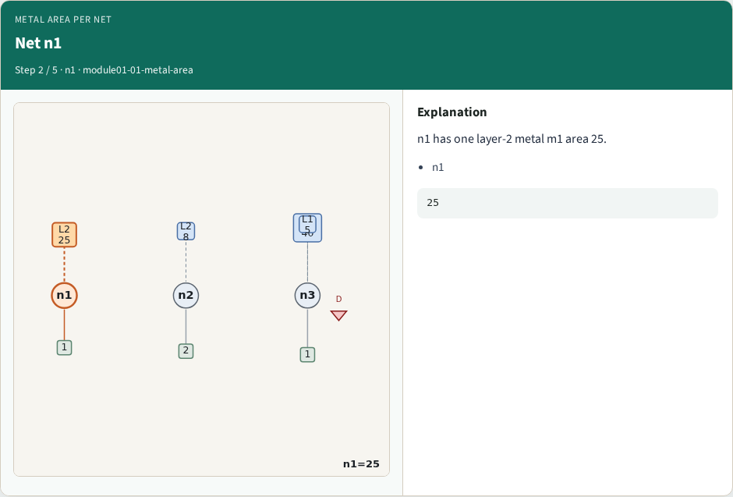
Net n1
Net n1
learn_antenna — 01 metal area
Notes:
n1 has one layer-2 metal m1 area 25.

Slide 5
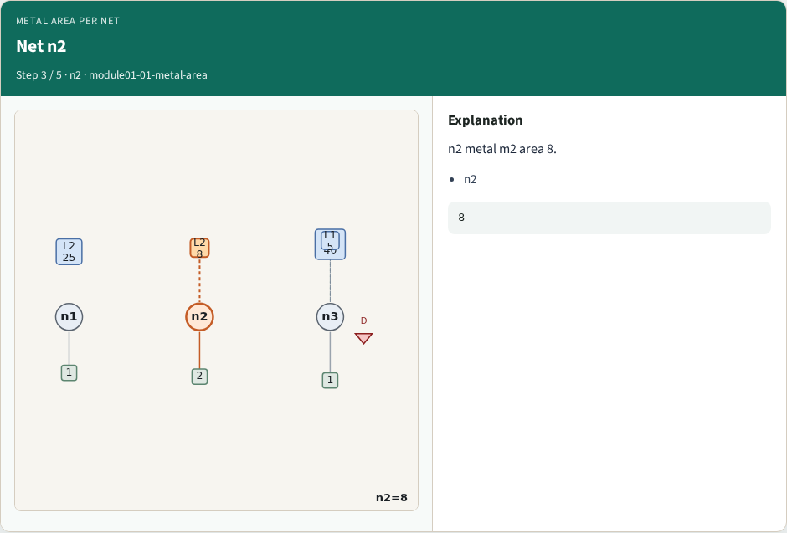
Net n2
Net n2
learn_antenna — 01 metal area
Notes:
n2 metal m2 area 8.

Slide 6
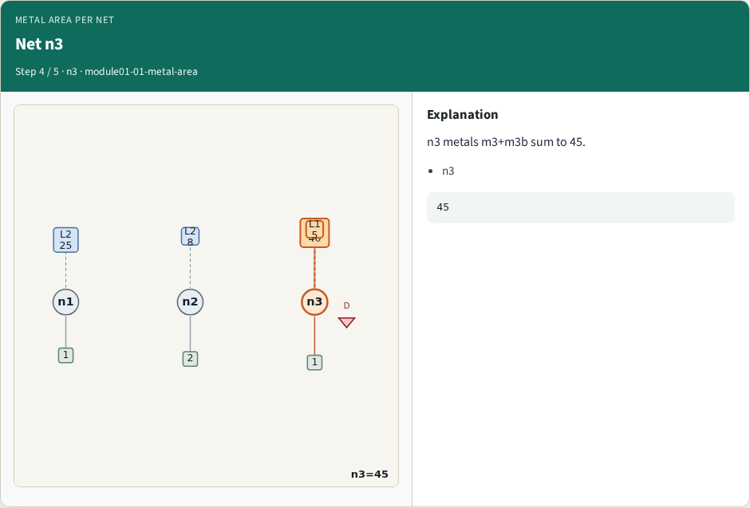
Net n3
Net n3
learn_antenna — 01 metal area
Notes:
n3 metals m3+m3b sum to 45.

Slide 7
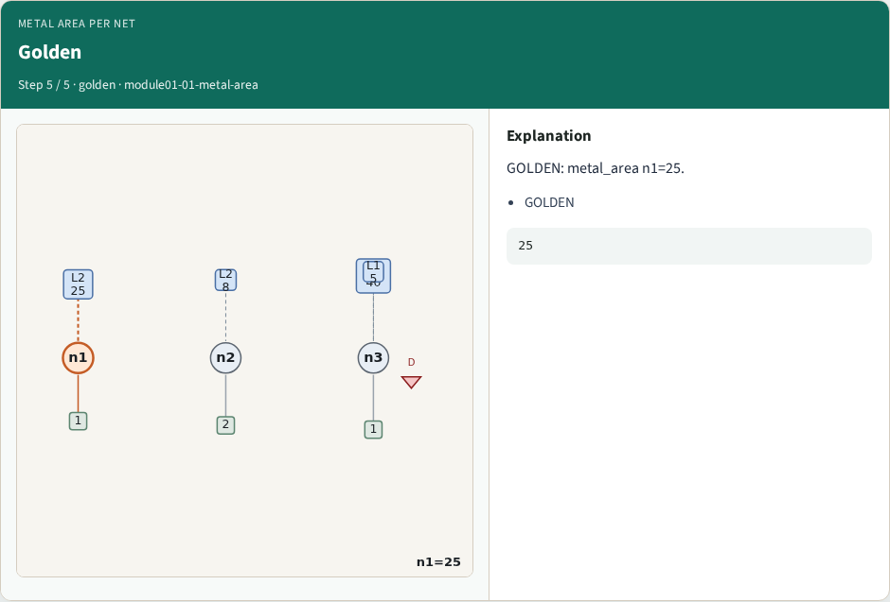
Golden
Golden
learn_antenna — 01 metal area
Notes:
GOLDEN: metal_area n1=25.

Slide 8
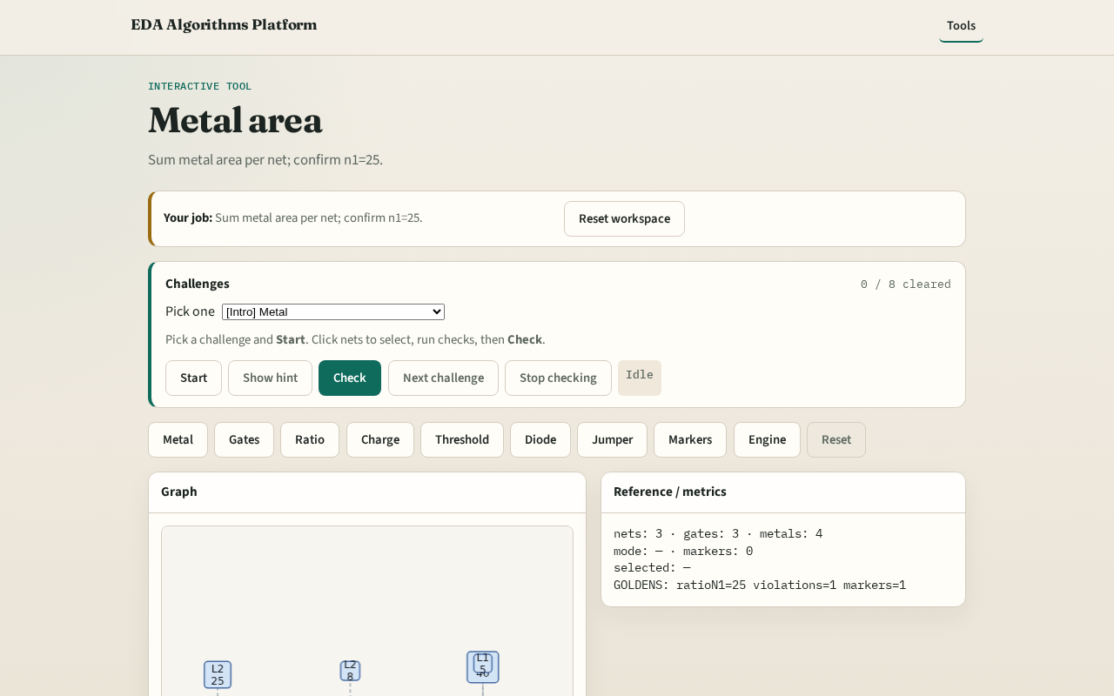
Browser lab track
Browser lab starter
learn_antenna — 01 metal area
Notes:
Open **metal-area**. Inspect tiny_antenna; confirm n1 metal=25.

Slide 9
Implement track
Call metal_area_by_net(); assert area['n1']==25
learn_antenna — 01 metal area
Notes:
Call metal_area_by_net(); assert area['n1']==25.

Slide 10
Pitfalls
Double-counting after jumper cap
Ignoring layer filter
learn_antenna — 01 metal area
Notes:
Double-counting after jumper cap. Ignoring layer filter.

Slide 11
Your turn
Next: gate area per net
learn_antenna — 01 metal area
Notes:
Next: gate area per net.

