Slide 1
Gate area
Antenna ratio divides metal area by gate area on the same net
learn_antenna — 03 gate area
Notes:
Antenna ratio divides metal area by gate area on the same net.

Slide 2
The idea
GOLDEN: gate_area n1=1
learn_antenna — 03 gate area
Notes:
GOLDEN: gate_area n1=1.

Slide 3
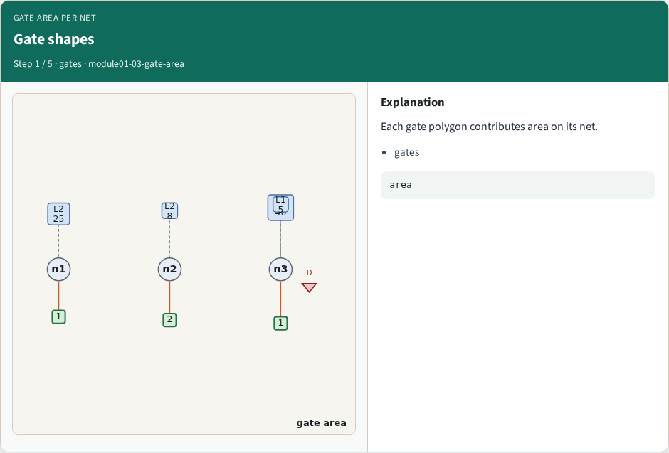
Gate shapes
Gate shapes
learn_antenna — 03 gate area
Notes:
Each gate polygon contributes area on its net.

Slide 4
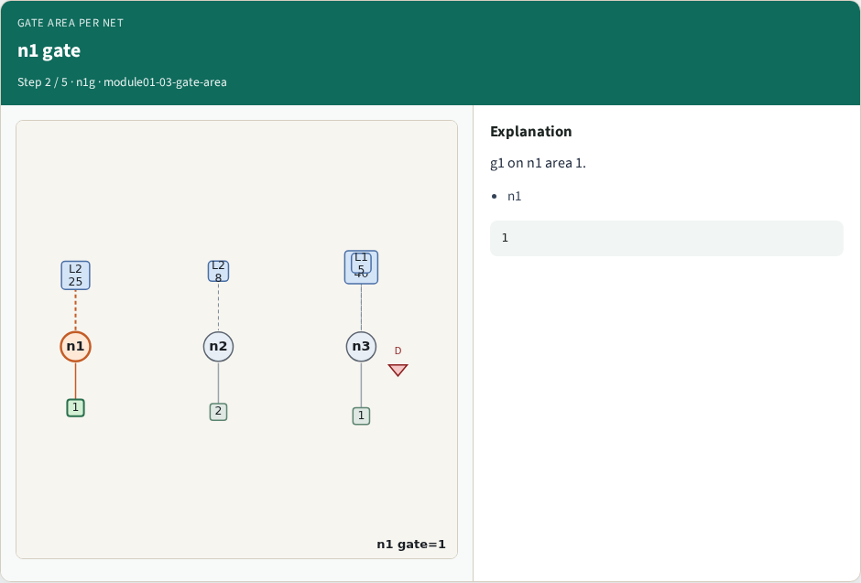
n1 gate
n1 gate
learn_antenna — 03 gate area
Notes:
g1 on n1 area 1.

Slide 5
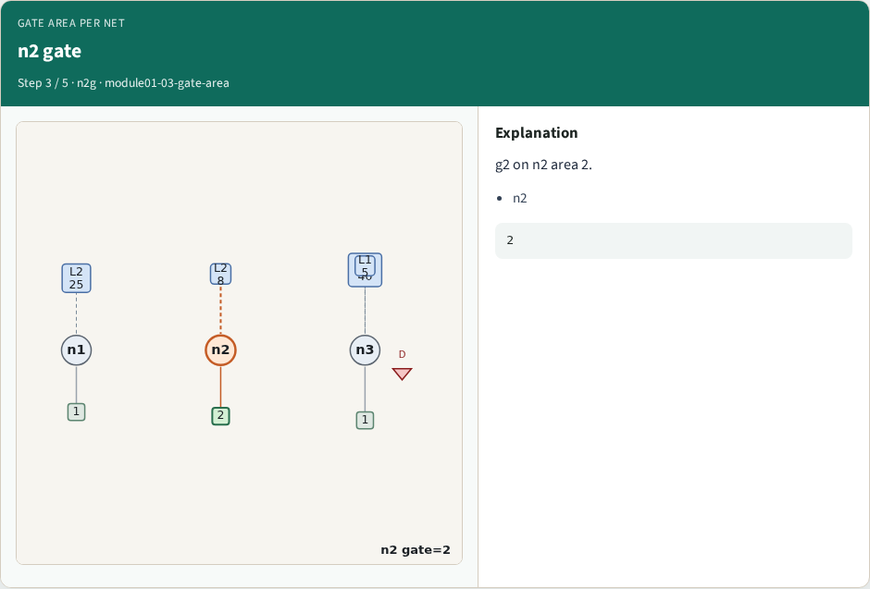
n2 gate
n2 gate
learn_antenna — 03 gate area
Notes:
g2 on n2 area 2.

Slide 6

n3 gate
n3 gate
learn_antenna — 03 gate area
Notes:
g3 on n3 area 1.

Slide 7
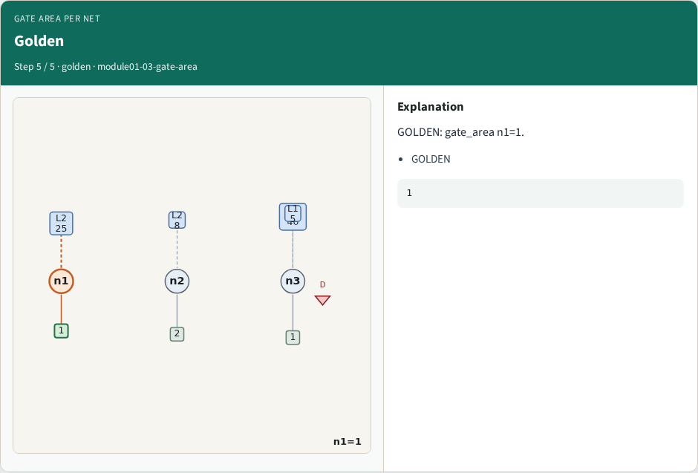
Golden
Golden
learn_antenna — 03 gate area
Notes:
GOLDEN: gate_area n1=1.

Slide 8
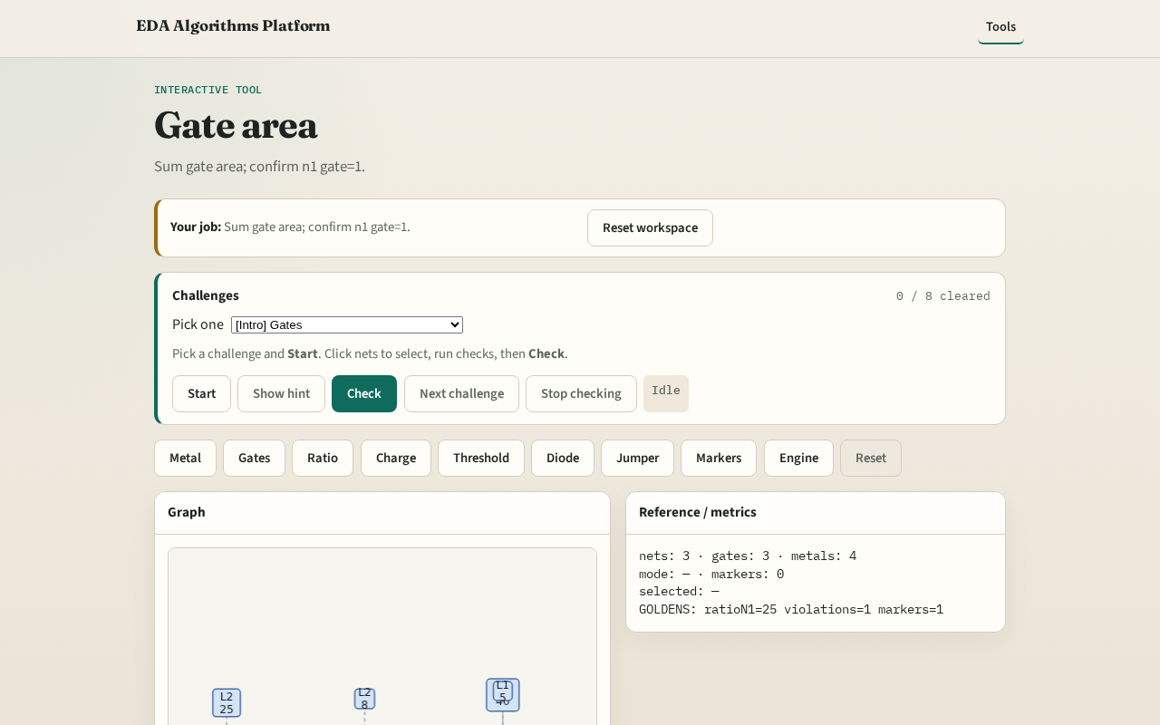
Browser lab track
Browser lab starter
learn_antenna — 03 gate area
Notes:
Open **gate-area**. Confirm n1 gate area=1.

Slide 9
Implement track
Call gate_area_by_net(); assert area['n1']==1
learn_antenna — 03 gate area
Notes:
Call gate_area_by_net(); assert area['n1']==1.

Slide 10
Pitfalls
Mixing gate count with gate area
Using wrong net id
learn_antenna — 03 gate area
Notes:
Mixing gate count with gate area. Using wrong net id.

Slide 11
Your turn
Next: antenna ratio
learn_antenna — 03 gate area
Notes:
Next: antenna ratio.

