Slide 1
Why ratio
Foundry antenna rules compare metal exposure to gate area
learn_antenna — 01 antenna ratio
Notes:
Foundry antenna rules compare metal exposure to gate area.

Slide 2
The idea
GOLDEN: n1=25, n2=4, n3=45
learn_antenna — 01 antenna ratio
Notes:
GOLDEN: n1=25, n2=4, n3=45.

Slide 3
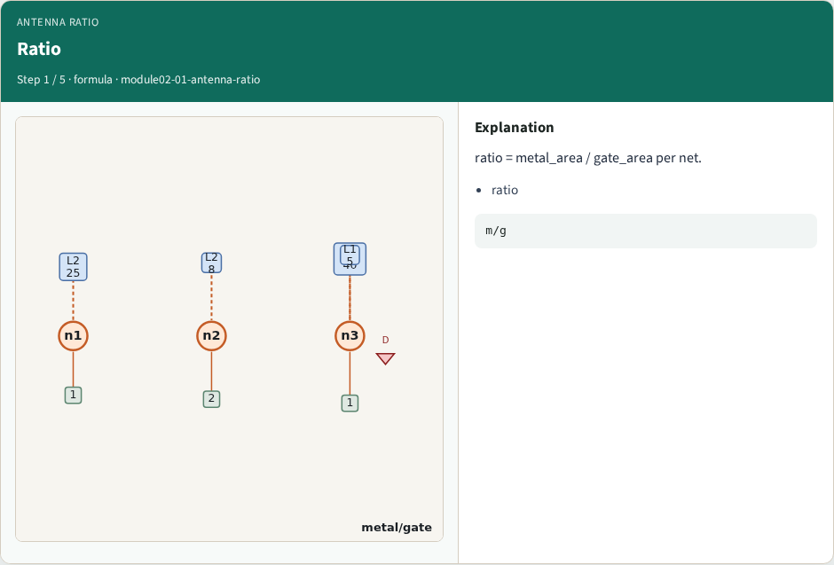
Ratio formula
Ratio
learn_antenna — 01 antenna ratio
Notes:
ratio = metal_area / gate_area per net.

Slide 4
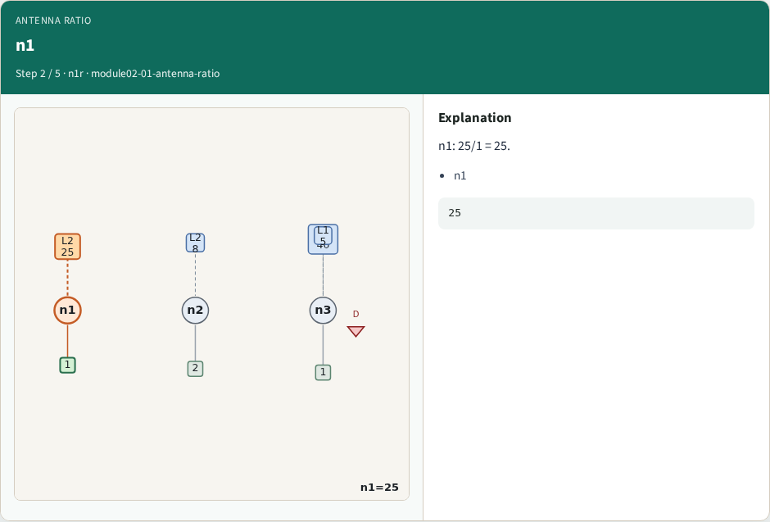
n1
n1
learn_antenna — 01 antenna ratio
Notes:
n1: 25/1 = 25.

Slide 5
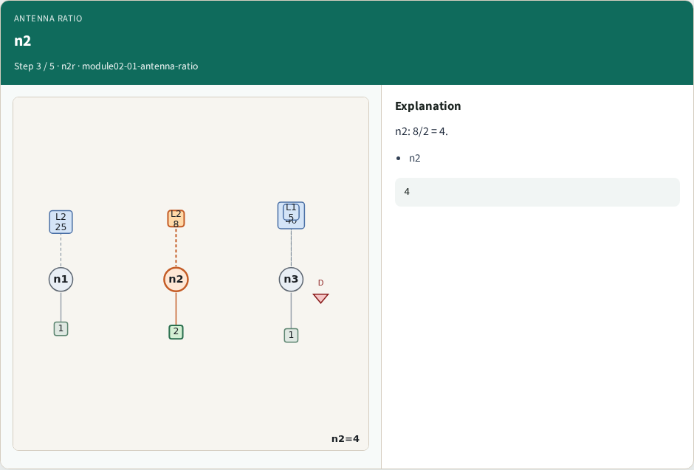
n2
n2
learn_antenna — 01 antenna ratio
Notes:
n2: 8/2 = 4.

Slide 6
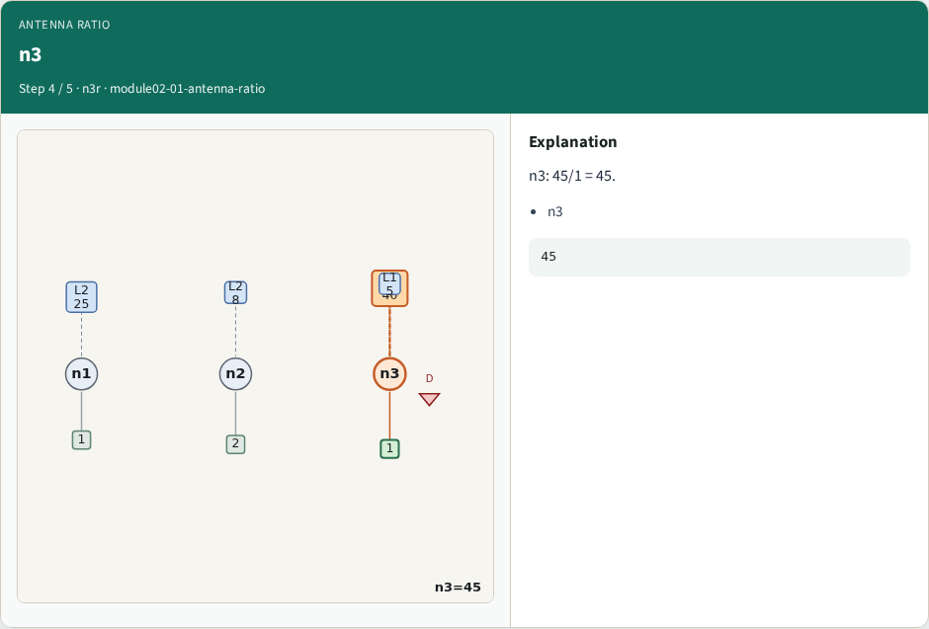
n3
n3
learn_antenna — 01 antenna ratio
Notes:
n3: 45/1 = 45.

Slide 7
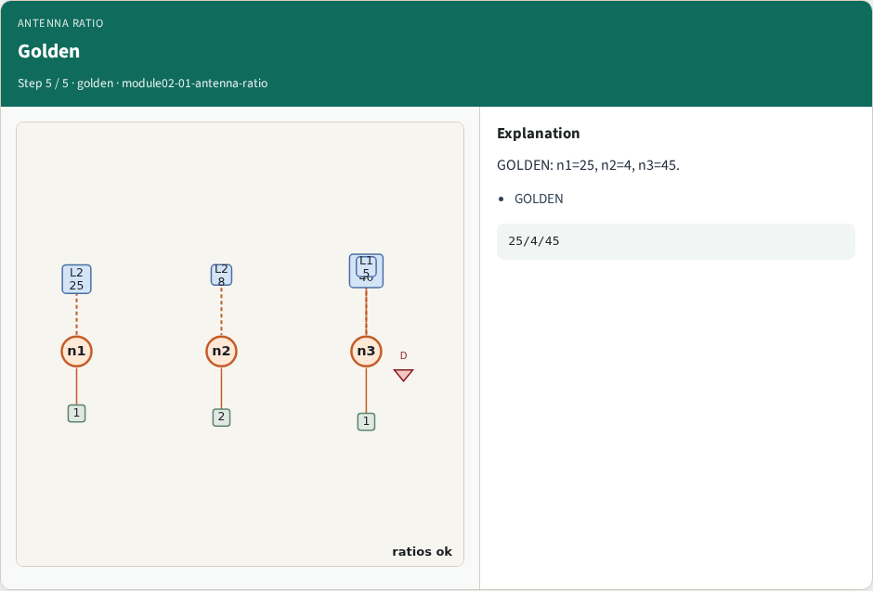
Golden
Golden
learn_antenna — 01 antenna ratio
Notes:
GOLDEN: n1=25, n2=4, n3=45.

Slide 8
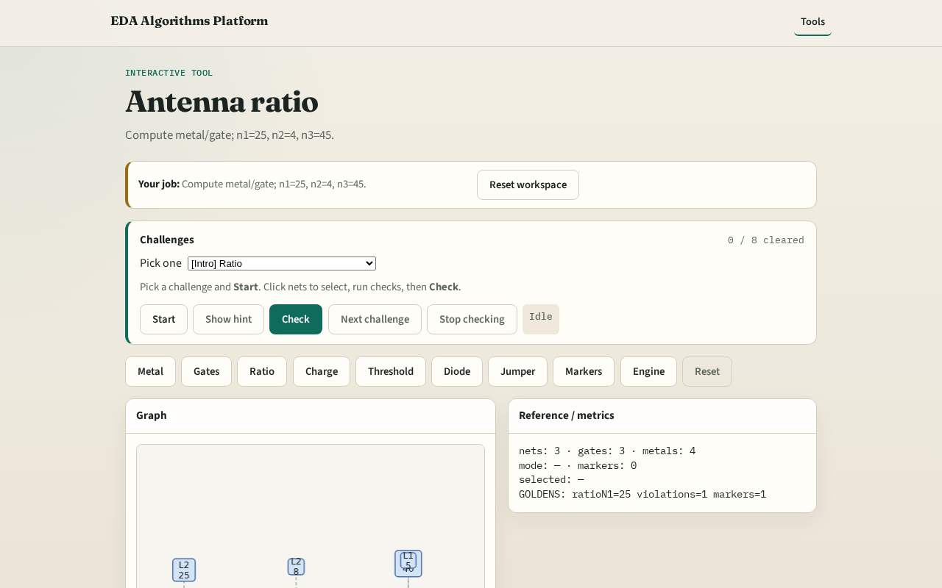
Browser lab track
Browser lab starter
learn_antenna — 01 antenna ratio
Notes:
Open **antenna-ratio**. Confirm the three golden ratios.

Slide 9
Implement track
Call antenna_ratios(); assert ratios['n1']==25, ratios['n2']==4, ratios['n3']==45
learn_antenna — 01 antenna ratio
Notes:
Call antenna_ratios(); assert ratios['n1']==25, ratios['n2']==4, ratios['n3']==45.

Slide 10
Pitfalls
Dividing gate/metal
Forgetting multi-layer metal sum
learn_antenna — 01 antenna ratio
Notes:
Dividing gate/metal. Forgetting multi-layer metal sum.

Slide 11
Your turn
Next: charge accumulation
learn_antenna — 01 antenna ratio
Notes:
Next: charge accumulation.

