Slide 1
Charge
Plasma etch charge scales with exposed metal , toy uses Q=k×metal
learn_antenna — 03 charge accumulation
Notes:
Plasma etch charge scales with exposed metal — toy uses Q=k×metal.

Slide 2
The idea
GOLDEN: charge_n1=25
learn_antenna — 03 charge accumulation
Notes:
GOLDEN: charge_n1=25.

Slide 3
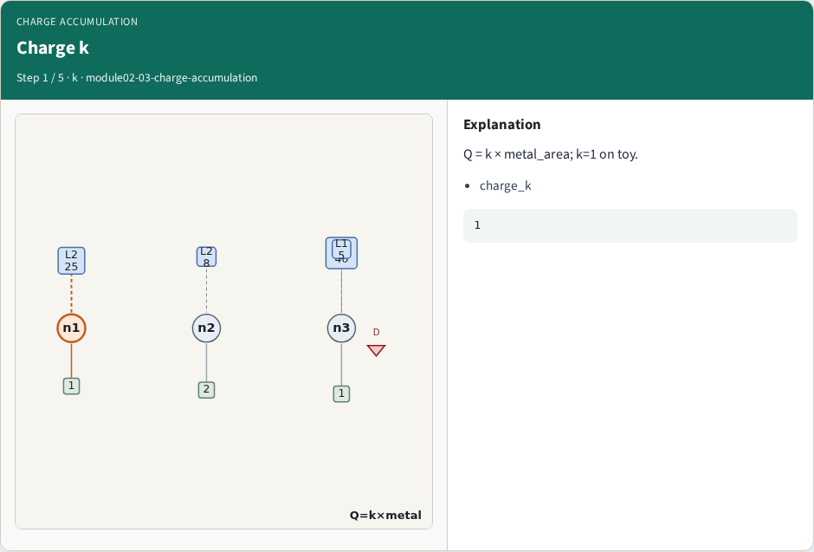
Charge k
Charge k
learn_antenna — 03 charge accumulation
Notes:
Q = k × metal_area; k=1 on toy.

Slide 4
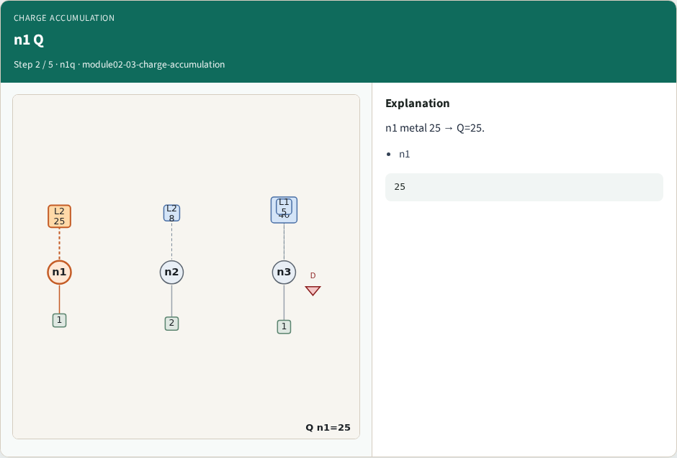
n1 Q
n1 Q
learn_antenna — 03 charge accumulation
Notes:
n1 metal 25 → Q=25.

Slide 5
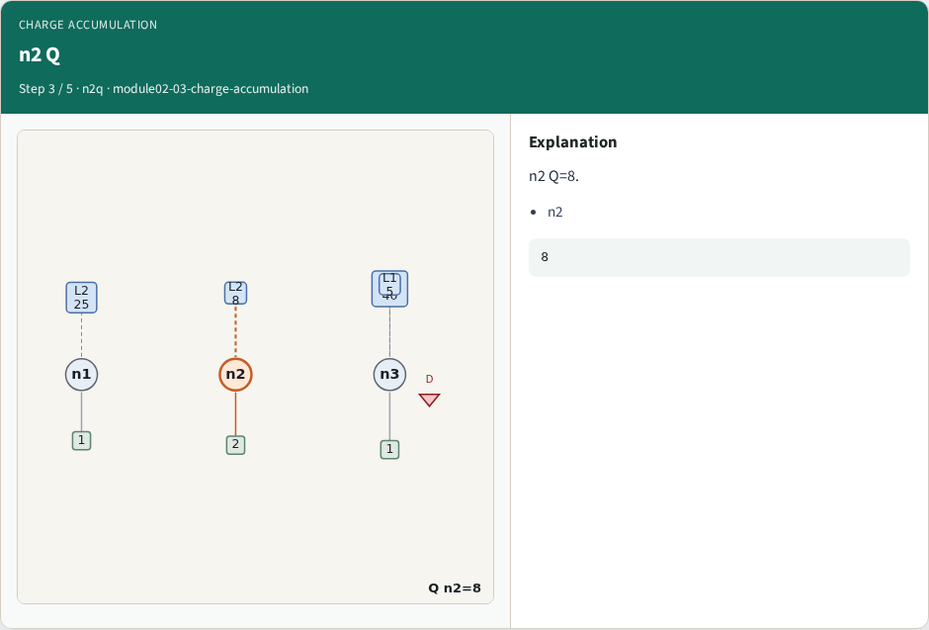
n2 Q
n2 Q
learn_antenna — 03 charge accumulation
Notes:
n2 Q=8.

Slide 6
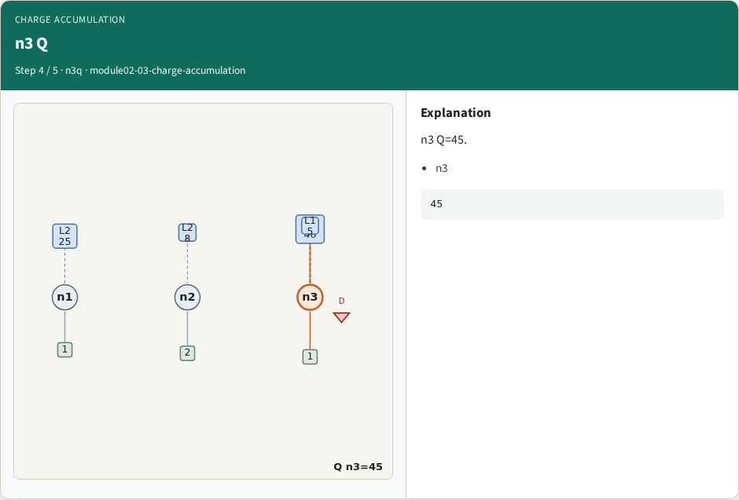
n3 Q
n3 Q
learn_antenna — 03 charge accumulation
Notes:
n3 Q=45.

Slide 7
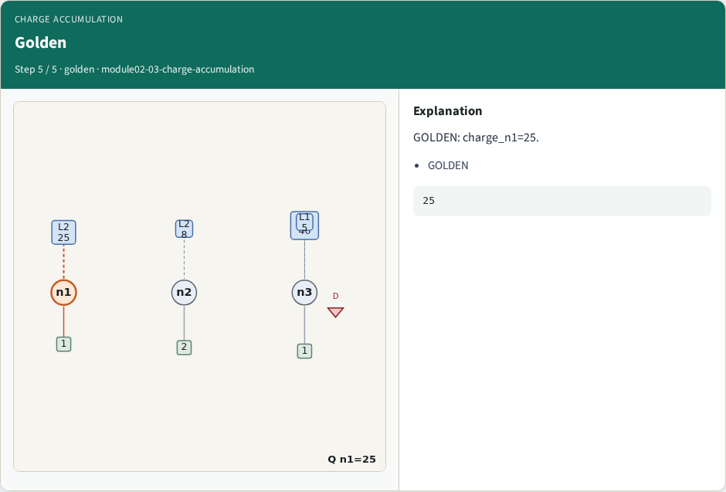
Golden
Golden
learn_antenna — 03 charge accumulation
Notes:
GOLDEN: charge_n1=25.

Slide 8
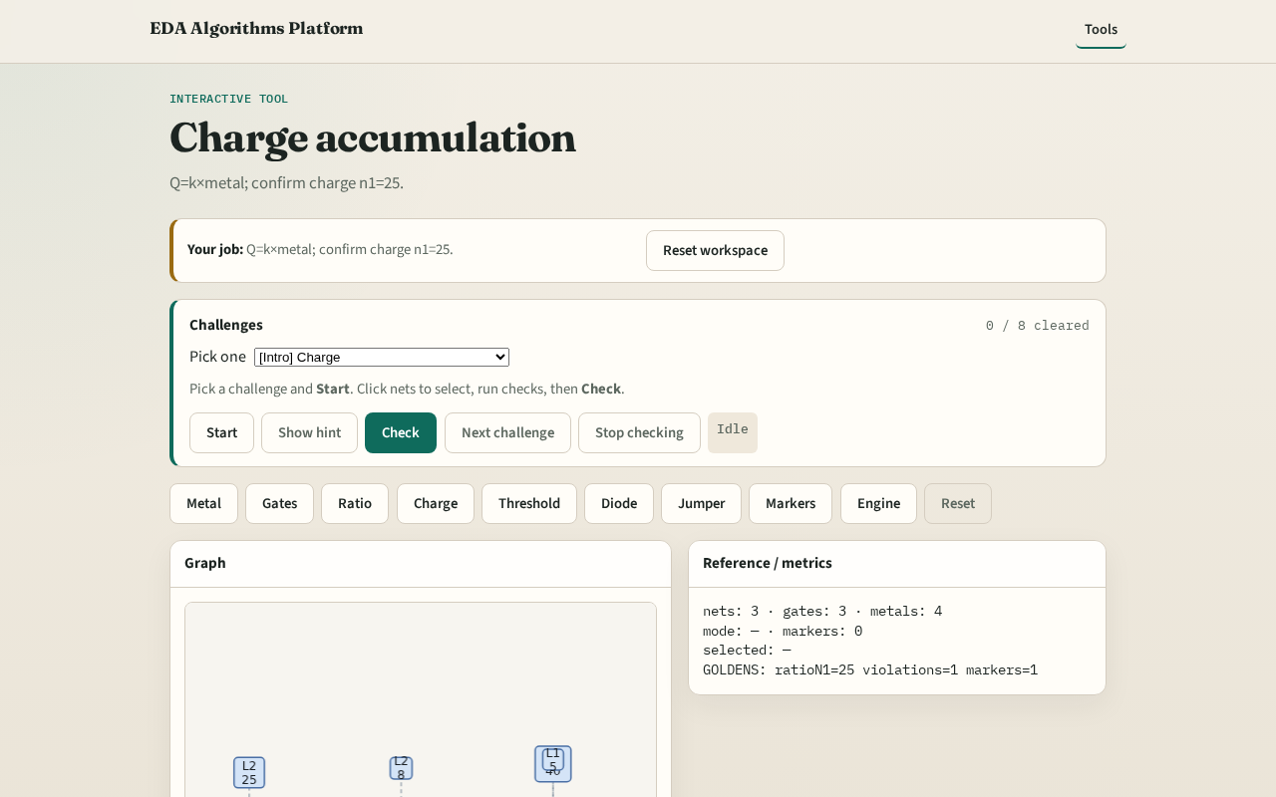
Browser lab track
Browser lab starter
learn_antenna — 03 charge accumulation
Notes:
Open **charge-accumulation**. Confirm Q on n1=25.

Slide 9
Implement track
Call charge_by_net(); assert charge['n1']==25
learn_antenna — 03 charge accumulation
Notes:
Call charge_by_net(); assert charge['n1']==25.

Slide 10
Pitfalls
Using ratio instead of metal for Q
Wrong k constant
learn_antenna — 03 charge accumulation
Notes:
Using ratio instead of metal for Q. Wrong k constant.

Slide 11
Your turn
Next: threshold rules
learn_antenna — 03 charge accumulation
Notes:
Next: threshold rules.

