Slide 1
Threshold
Raw violations before diode protection: any ratio above limit
learn_antenna — 01 threshold rules
Notes:
Raw violations before diode protection: any ratio above limit.

Slide 2
The idea
GOLDEN: raw_violation_count=2 (n1, n3)
learn_antenna — 01 threshold rules
Notes:
GOLDEN: raw_violation_count=2 (n1, n3).

Slide 3
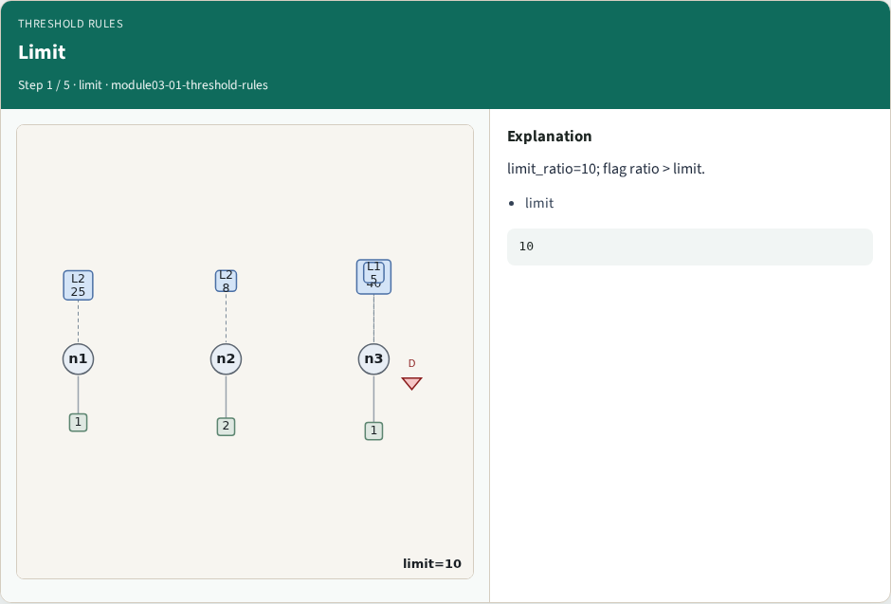
Limit
Limit
learn_antenna — 01 threshold rules
Notes:
limit_ratio=10; flag ratio > limit.

Slide 4
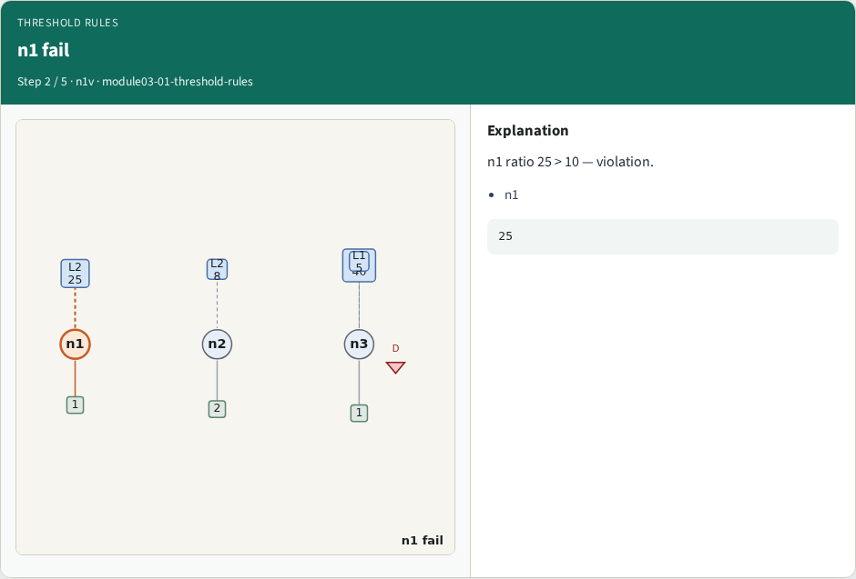
n1 fail
n1 fail
learn_antenna — 01 threshold rules
Notes:
n1 ratio 25 > 10 — violation.

Slide 5
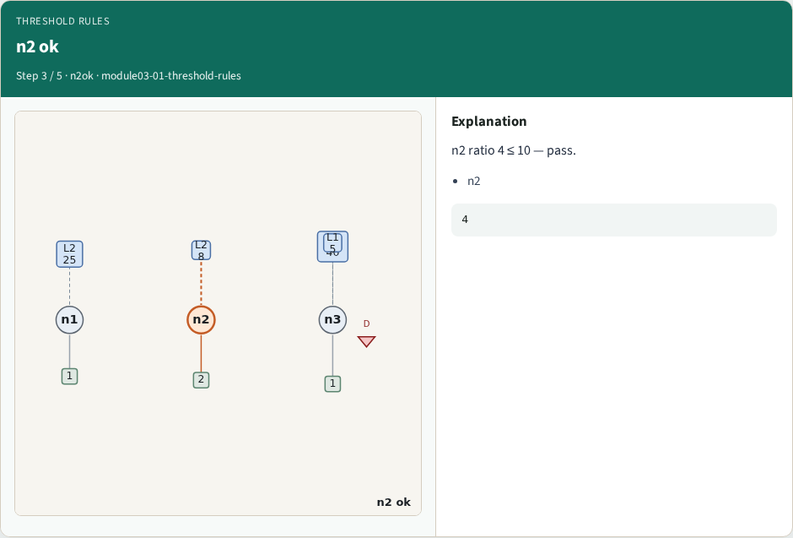
n2 ok
n2 ok
learn_antenna — 01 threshold rules
Notes:
n2 ratio 4 ≤ 10 — pass.

Slide 6
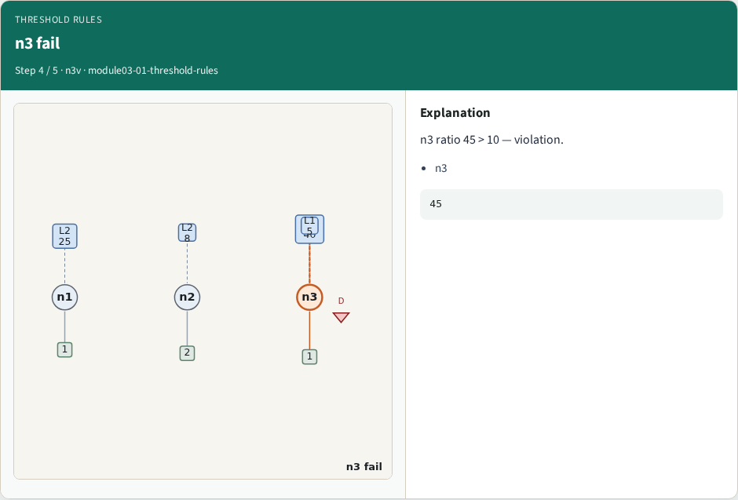
n3 fail
n3 fail
learn_antenna — 01 threshold rules
Notes:
n3 ratio 45 > 10 — violation.

Slide 7
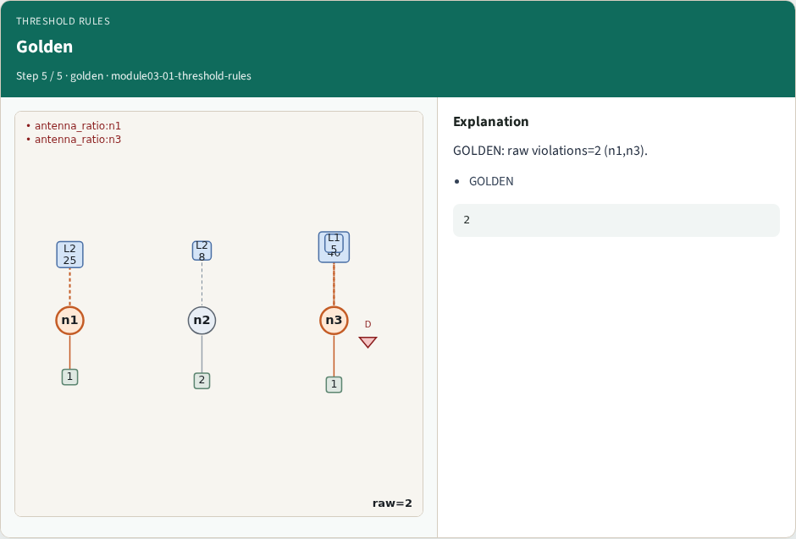
Golden
Golden
learn_antenna — 01 threshold rules
Notes:
GOLDEN: raw violations=2 (n1,n3).

Slide 8
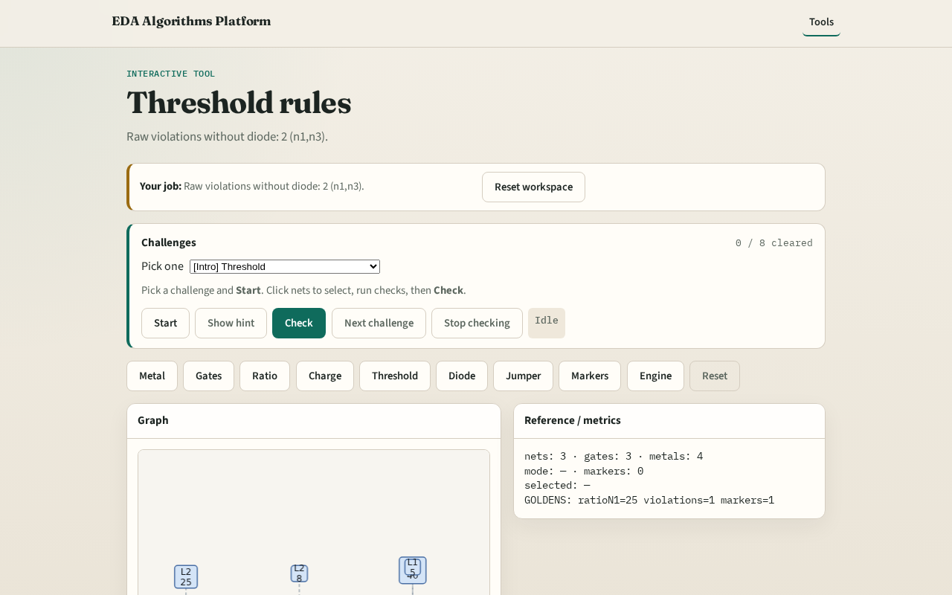
Browser lab track
Browser lab starter
learn_antenna — 01 threshold rules
Notes:
Open **threshold-rules**. Run raw check; confirm 2 violations.

Slide 9
Implement track
Call find_violations(apply_diodes=False); assert count==2
learn_antenna — 01 threshold rules
Notes:
Call find_violations(apply_diodes=False); assert count==2.

Slide 10
Pitfalls
Applying diodes too early
Using charge instead of ratio
learn_antenna — 01 threshold rules
Notes:
Applying diodes too early. Using charge instead of ratio.

Slide 11
Your turn
Next: diode protection
learn_antenna — 01 threshold rules
Notes:
Next: diode protection.

