Slide 1
Why diode
Foundry diode cells waive antenna on protected nets , n3 here
learn_antenna — 03 diode protection
Notes:
Foundry diode cells waive antenna on protected nets — n3 here.

Slide 2
The idea
GOLDEN: violation_count=1 (n1 only after diode)
learn_antenna — 03 diode protection
Notes:
GOLDEN: violation_count=1 (n1 only after diode).

Slide 3
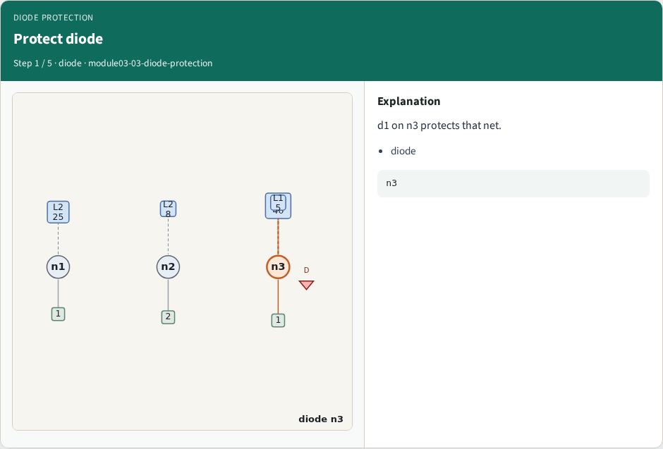
Protect diode
Protect diode
learn_antenna — 03 diode protection
Notes:
d1 on n3 protects that net.

Slide 4

Skip protected
Skip protected
learn_antenna — 03 diode protection
Notes:
Protected nets skip ratio check.

Slide 5
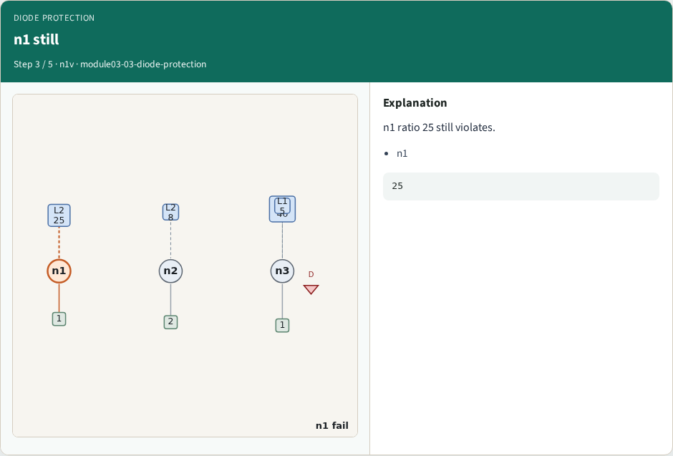
n1 still
n1 still
learn_antenna — 03 diode protection
Notes:
n1 ratio 25 still violates.

Slide 6
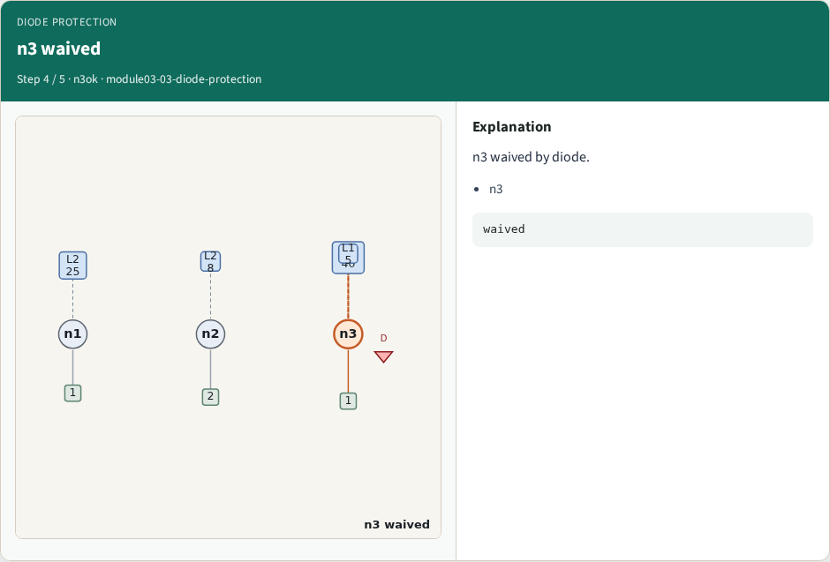
n3 waived
n3 waived
learn_antenna — 03 diode protection
Notes:
n3 waived by diode.

Slide 7
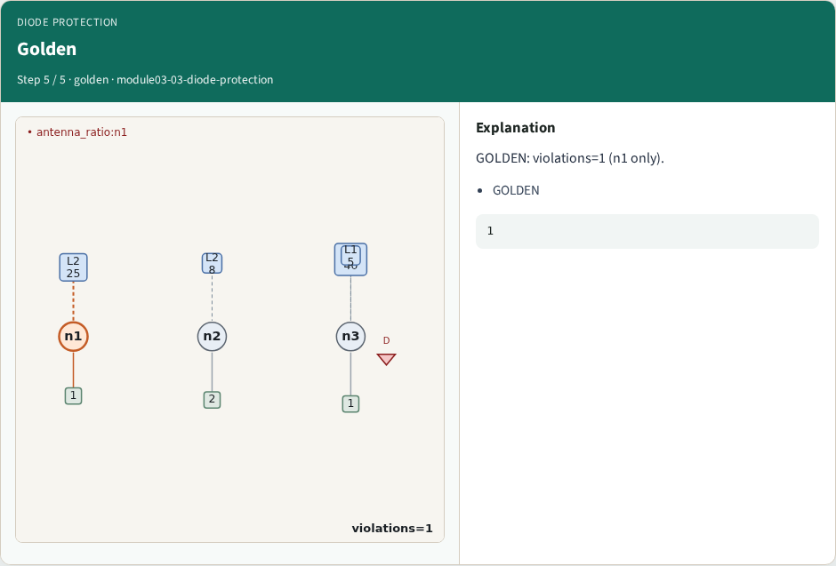
Golden
Golden
learn_antenna — 03 diode protection
Notes:
GOLDEN: violations=1 (n1 only).

Slide 8
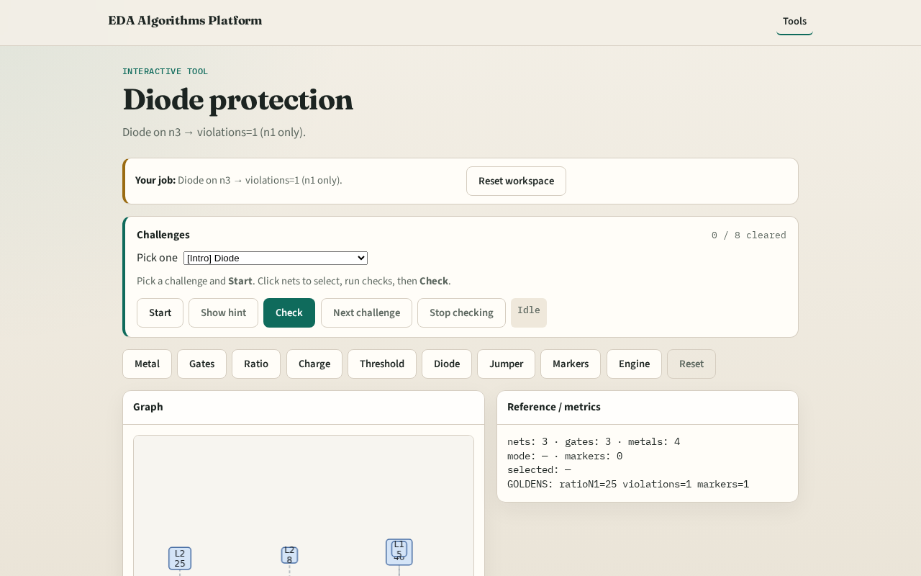
Browser lab track
Browser lab starter
learn_antenna — 03 diode protection
Notes:
Open **diode-protection**. Confirm only n1 violates.

Slide 9
Implement track
Call find_violations(apply_diodes=True); assert count==1 and hits[0]['net']=='n1'
learn_antenna — 03 diode protection
Notes:
Call find_violations(apply_diodes=True); assert count==1 and hits[0]['net']=='n1'.

Slide 10
Pitfalls
Forgetting to apply diode list
Still flagging n3
learn_antenna — 03 diode protection
Notes:
Forgetting to apply diode list. Still flagging n3.

Slide 11
Your turn
Next: jumper break
learn_antenna — 03 diode protection
Notes:
Next: jumper break.

