Slide 1
Why jumper
A jumper on lower metal breaks antenna path , drops high-layer metal
learn_antenna — 01 jumper break
Notes:
A jumper on lower metal breaks antenna path — drops high-layer metal.

Slide 2
The idea
GOLDEN: jumper on n1 max_layer=1 → ratio 0
learn_antenna — 01 jumper break
Notes:
GOLDEN: jumper on n1 max_layer=1 → ratio 0.

Slide 3
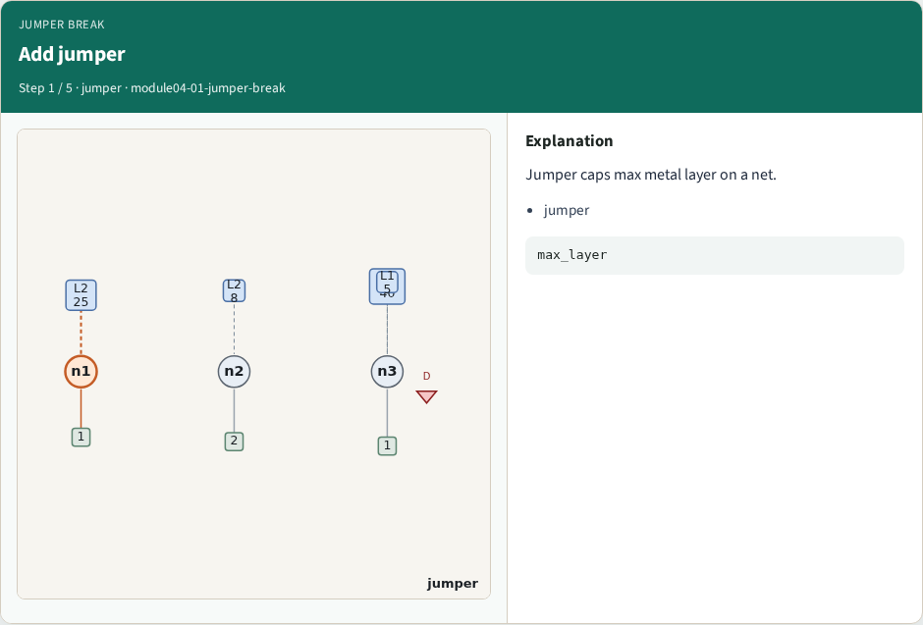
Add jumper
Add jumper
learn_antenna — 01 jumper break
Notes:
Jumper caps max metal layer on a net.

Slide 4
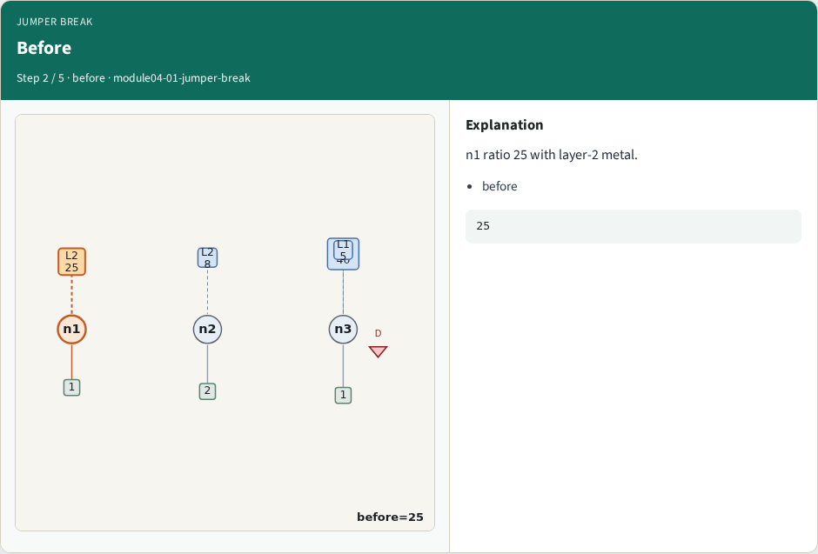
Before
Before
learn_antenna — 01 jumper break
Notes:
n1 ratio 25 with layer-2 metal.

Slide 5
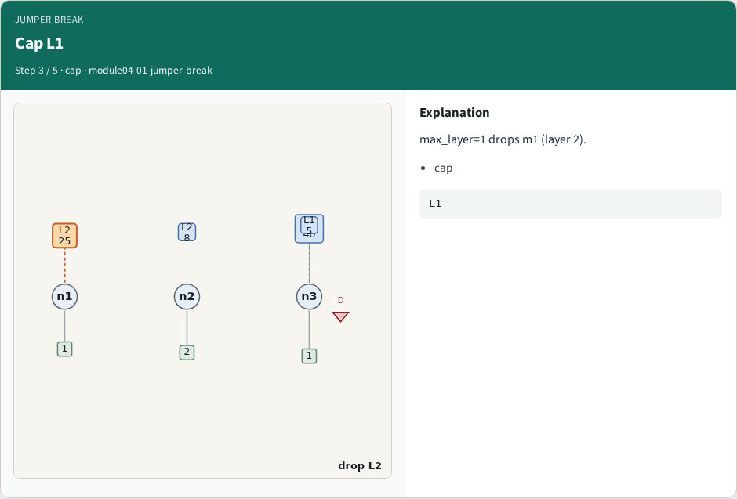
Cap L1
Cap L1
learn_antenna — 01 jumper break
Notes:
max_layer=1 drops m1 (layer 2).

Slide 6
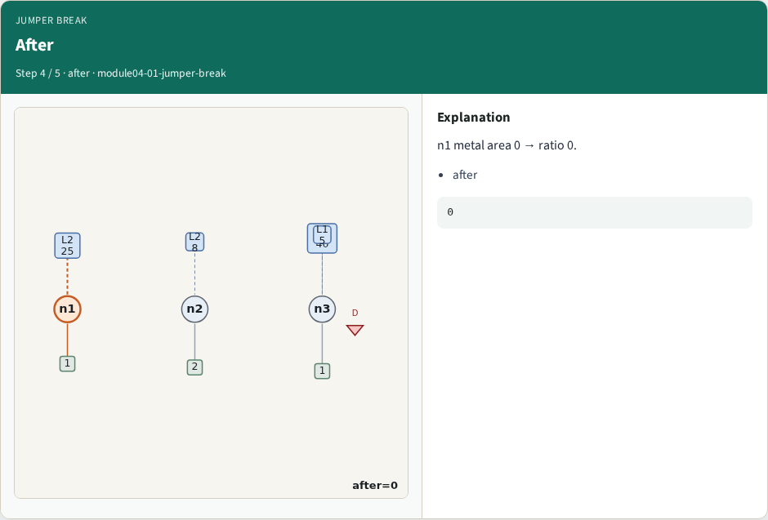
After
After
learn_antenna — 01 jumper break
Notes:
n1 metal area 0 → ratio 0.

Slide 7
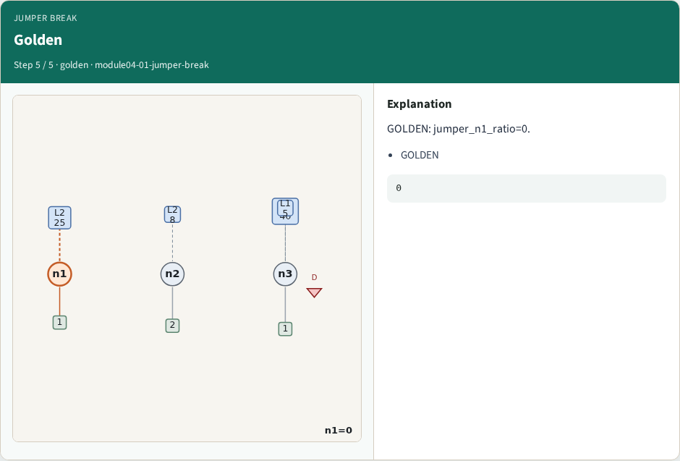
Golden
Golden
learn_antenna — 01 jumper break
Notes:
GOLDEN: jumper_n1_ratio=0.

Slide 8
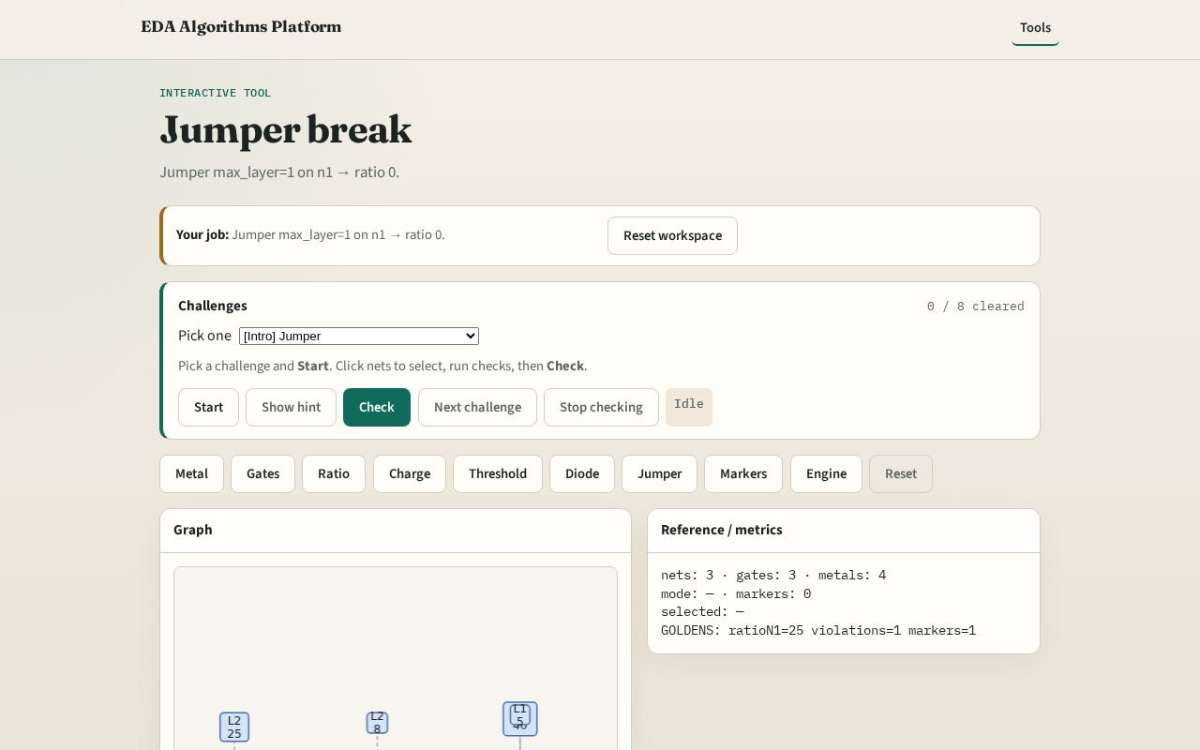
Browser lab track
Browser lab starter
learn_antenna — 01 jumper break
Notes:
Open **jumper-break**. Apply jumper; confirm n1 ratio=0.

Slide 9
Implement track
Call jumper_effect(); assert after_ratio==0
learn_antenna — 01 jumper break
Notes:
Call jumper_effect(); assert after_ratio==0.

Slide 10
Pitfalls
Not filtering by layer
Applying jumper to wrong net
learn_antenna — 01 jumper break
Notes:
Not filtering by layer. Applying jumper to wrong net.

Slide 11
Your turn
Next: antenna markers
learn_antenna — 01 jumper break
Notes:
Next: antenna markers.

