Slide 1
Markers
Signoff antenna emits one marker per violating net (after diode)
learn_antenna — 03 antenna markers
Notes:
Signoff antenna emits one marker per violating net (after diode).

Slide 2
The idea
GOLDEN: marker_count=1 on tiny_antenna
learn_antenna — 03 antenna markers
Notes:
GOLDEN: marker_count=1 on tiny_antenna.

Slide 3
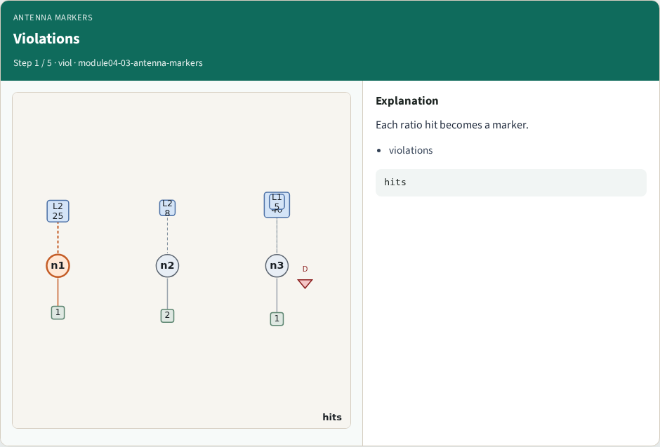
Violations
Violations
learn_antenna — 03 antenna markers
Notes:
Each ratio hit becomes a marker.

Slide 4
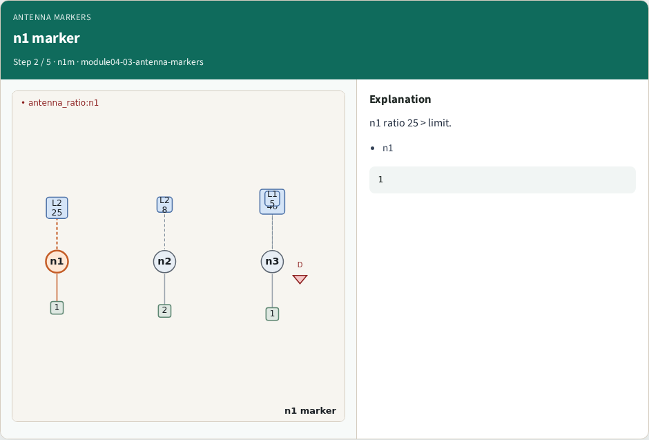
n1 marker
n1 marker
learn_antenna — 03 antenna markers
Notes:
n1 ratio 25 > limit.

Slide 5
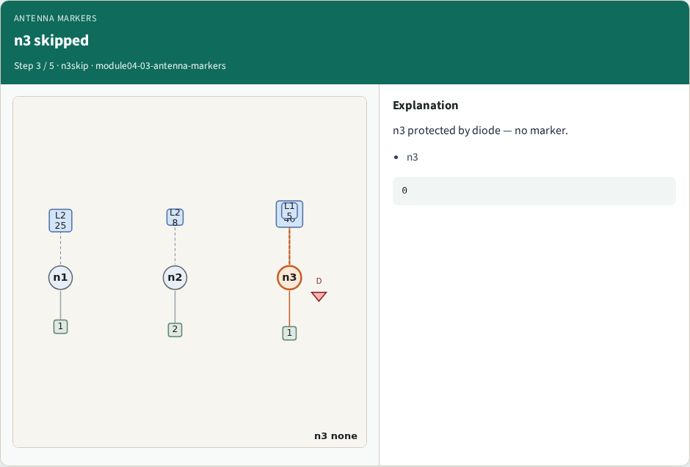
n3 skipped
n3 skipped
learn_antenna — 03 antenna markers
Notes:
n3 protected by diode — no marker.

Slide 6
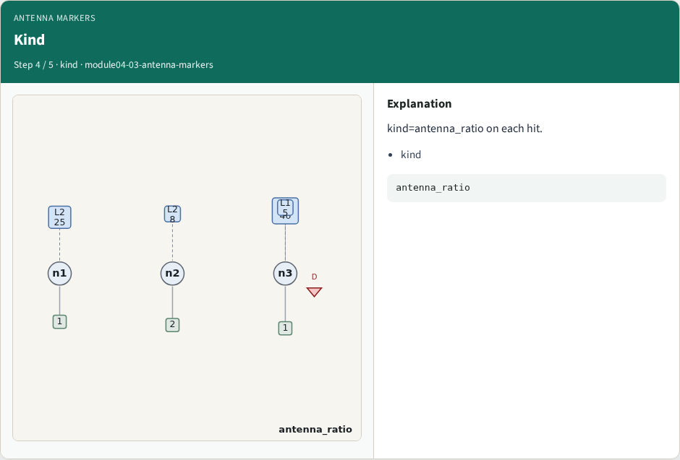
Kind
Kind
learn_antenna — 03 antenna markers
Notes:
kind=antenna_ratio on each hit.

Slide 7
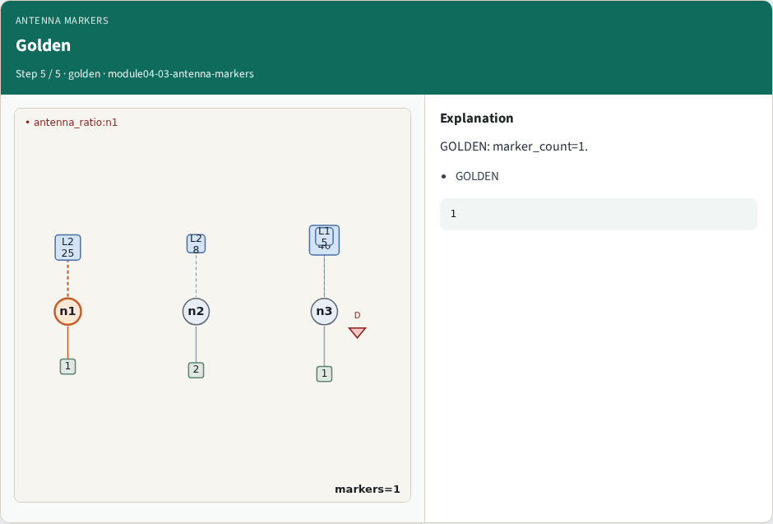
Golden
Golden
learn_antenna — 03 antenna markers
Notes:
GOLDEN: marker_count=1.

Slide 8
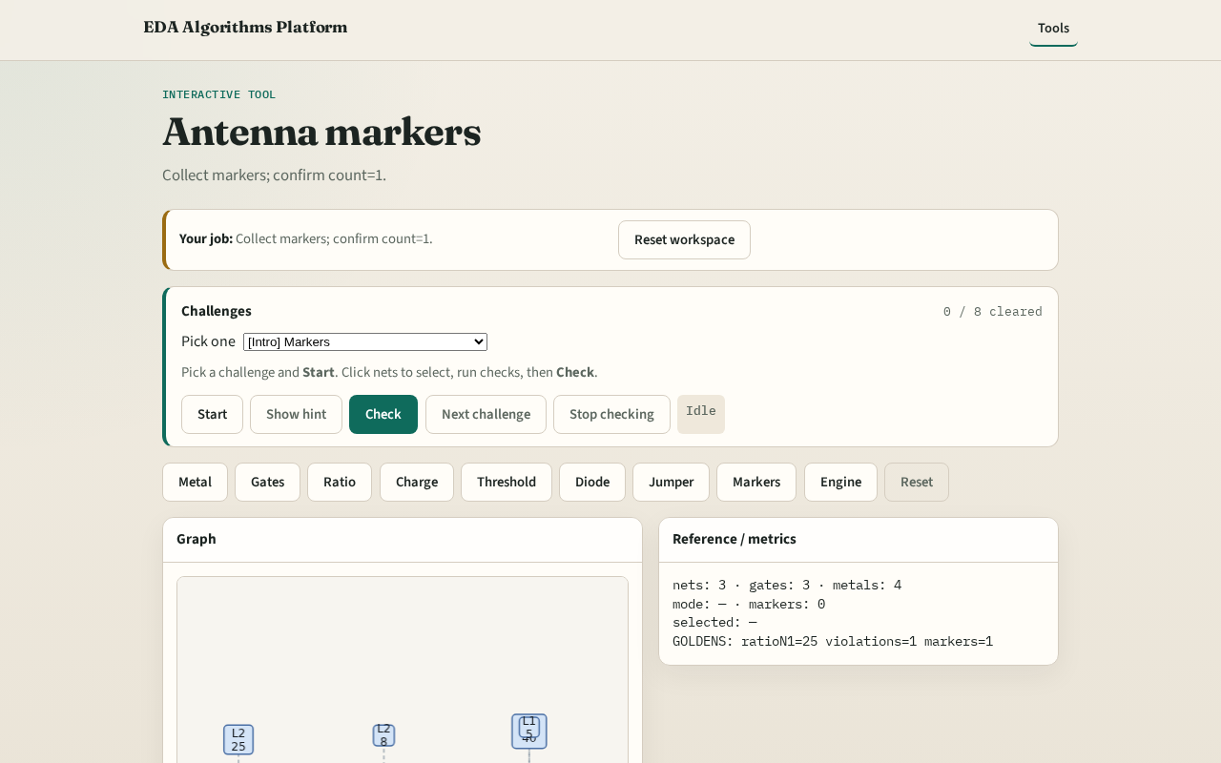
Browser lab track
Browser lab starter
learn_antenna — 03 antenna markers
Notes:
Open **antenna-markers**. Run collect; confirm 1 marker.

Slide 9
Implement track
Call collect_markers(); assert count==1
learn_antenna — 03 antenna markers
Notes:
Call collect_markers(); assert count==1.

Slide 10
Pitfalls
Counting raw violations
Missing diode waiver
learn_antenna — 03 antenna markers
Notes:
Counting raw violations. Missing diode waiver.

Slide 11
Your turn
Next: antenna engine
learn_antenna — 03 antenna markers
Notes:
Next: antenna engine.

