Slide 1
Engine
A tiny engine chains area, ratio, charge, violations, jumper, markers
learn_antenna — 01 antenna engine
Notes:
A tiny engine chains area, ratio, charge, violations, jumper, markers.

Slide 2
The idea
GOLDEN: ratios, violations=1, markers=1, jumper n1=0, ok=True
learn_antenna — 01 antenna engine
Notes:
GOLDEN: ratios, violations=1, markers=1, jumper n1=0, ok=True.

Slide 3
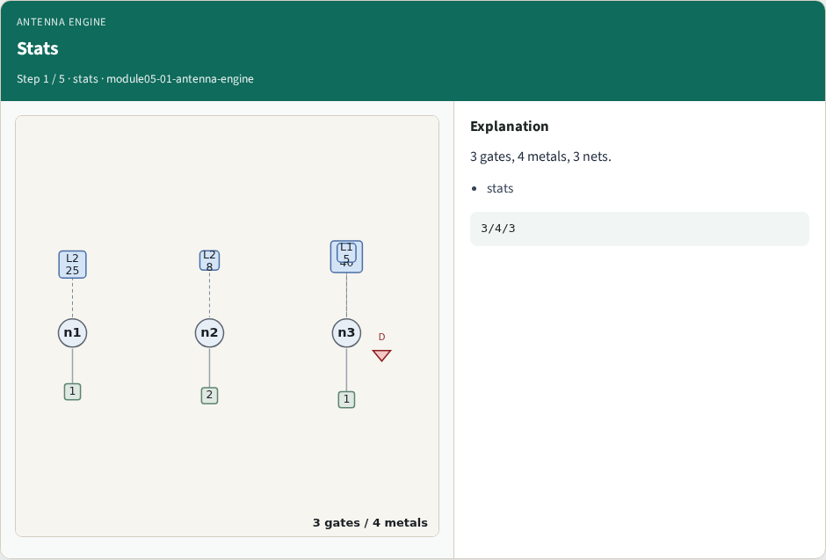
Stats
Stats
learn_antenna — 01 antenna engine
Notes:
3 gates, 4 metals, 3 nets.

Slide 4
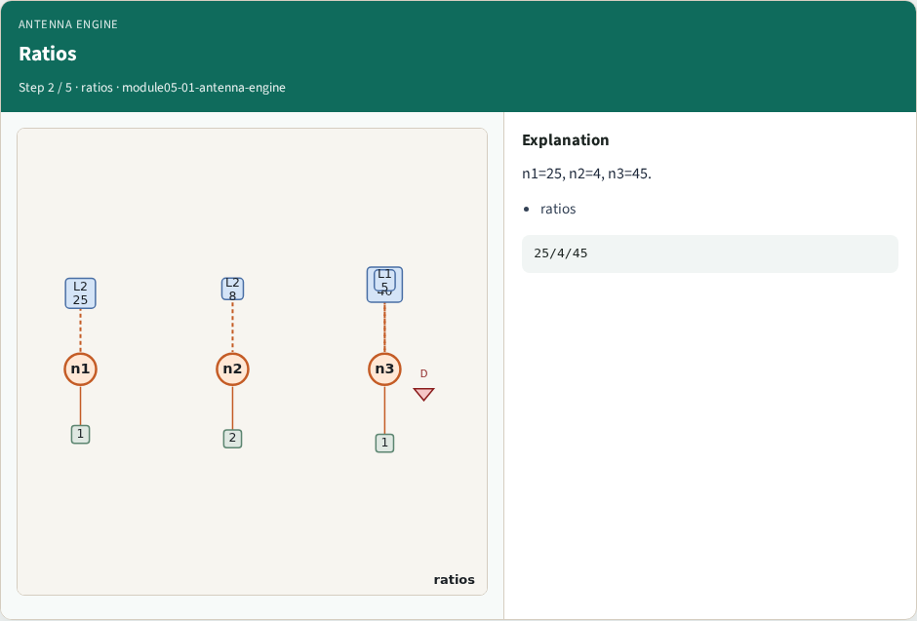
Ratios
Ratios
learn_antenna — 01 antenna engine
Notes:
n1=25, n2=4, n3=45.

Slide 5
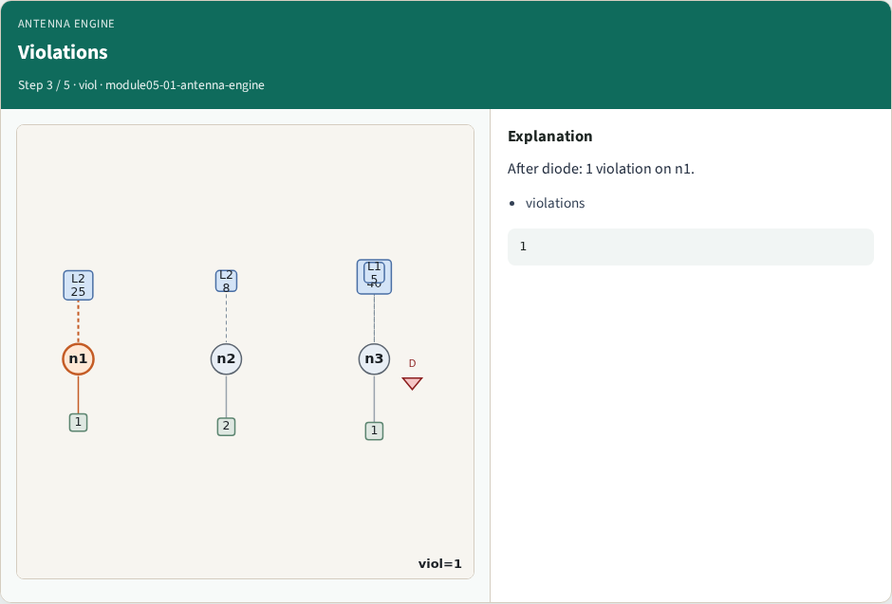
Violations
Violations
learn_antenna — 01 antenna engine
Notes:
After diode: 1 violation on n1.

Slide 6
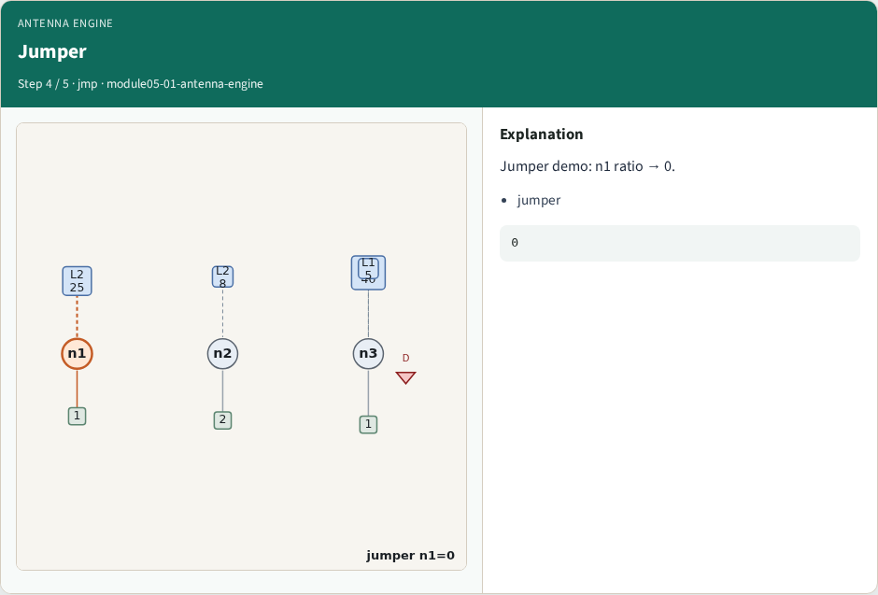
Jumper
Jumper
learn_antenna — 01 antenna engine
Notes:
Jumper demo: n1 ratio → 0.

Slide 7
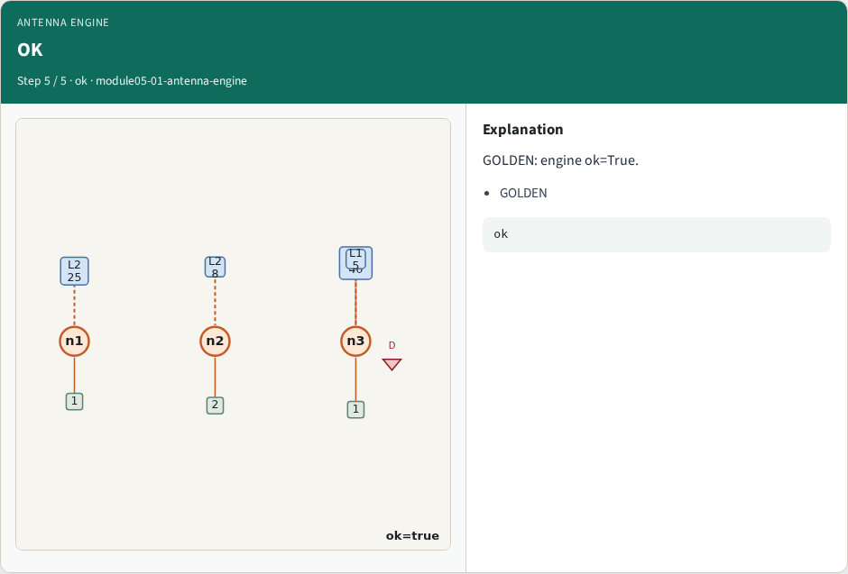
OK
OK
learn_antenna — 01 antenna engine
Notes:
GOLDEN: engine ok=True.

Slide 8
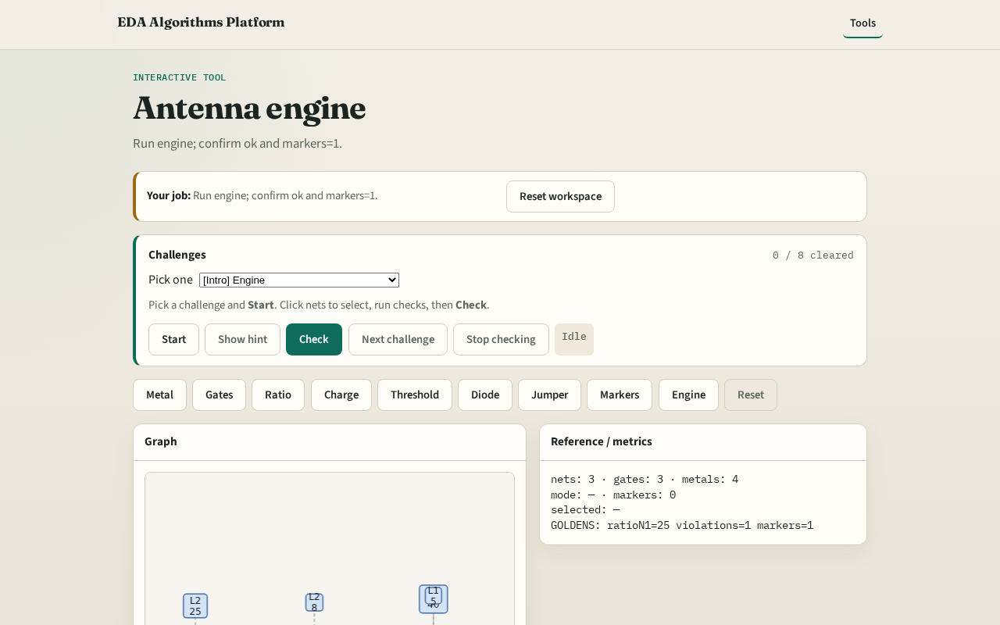
Browser lab track
Browser lab starter
learn_antenna — 01 antenna engine
Notes:
Open **antenna-engine**. Run engine; confirm ok.

Slide 9
Implement track
Call antenna_engine(); assert ok and markers.count==1
learn_antenna — 01 antenna engine
Notes:
Call antenna_engine(); assert ok and markers.count==1.

Slide 10
Pitfalls
Reporting partial checks
Changing toy without updating goldens
learn_antenna — 01 antenna engine
Notes:
Reporting partial checks. Changing toy without updating goldens.

Slide 11
Your turn
Next: offline compare, then wrap
learn_antenna — 01 antenna engine
Notes:
Next: offline compare, then wrap.

