Slide 1
Why graph
ERC starts from a connectivity graph , instances, nets, and pin edges
learn_erc — 01 netlist graph
Notes:
ERC starts from a connectivity graph — instances, nets, and pin edges.

Slide 2
The idea
GOLDEN: 8 nets, 4 instances, 14 pin edges
learn_erc — 01 netlist graph
Notes:
GOLDEN: 8 nets, 4 instances, 14 pin edges.

Slide 3
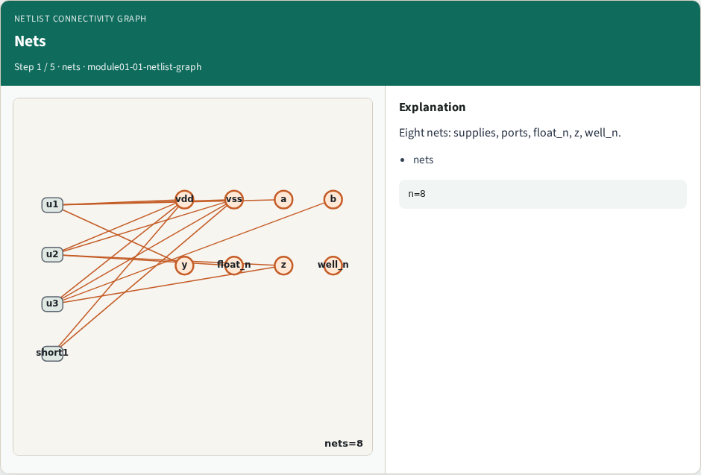
Nets
Nets
learn_erc — 01 netlist graph
Notes:
Eight nets: supplies, ports, float_n, z, well_n.

Slide 4
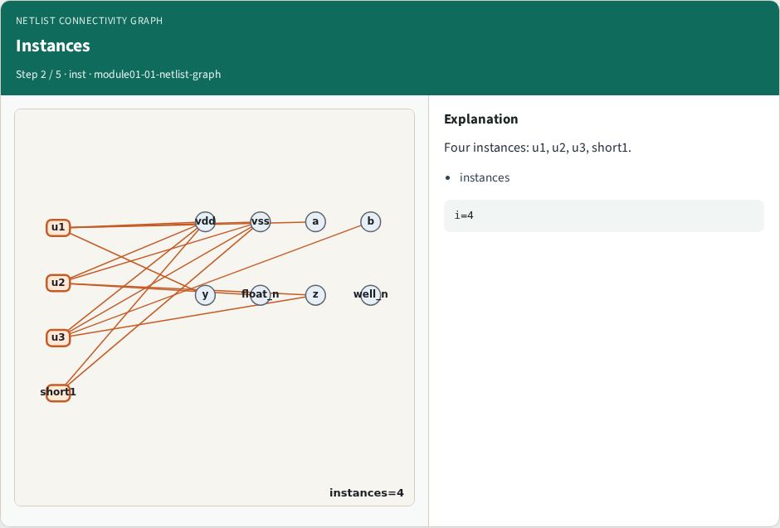
Instances
Instances
learn_erc — 01 netlist graph
Notes:
Four instances: u1, u2, u3, short1.

Slide 5
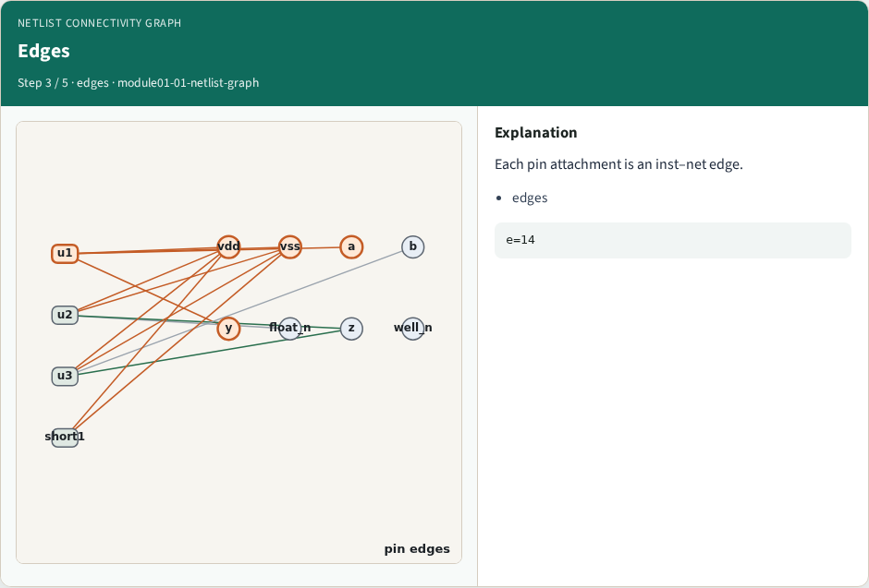
Edges
Edges
learn_erc — 01 netlist graph
Notes:
Each pin attachment is an inst–net edge.

Slide 6
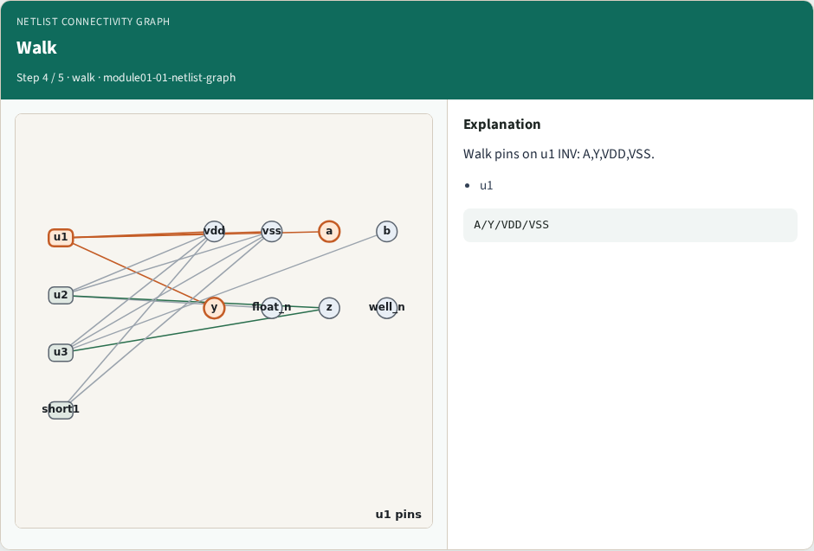
Walk
Walk
learn_erc — 01 netlist graph
Notes:
Walk pins on u1 INV: A,Y,VDD,VSS.

Slide 7
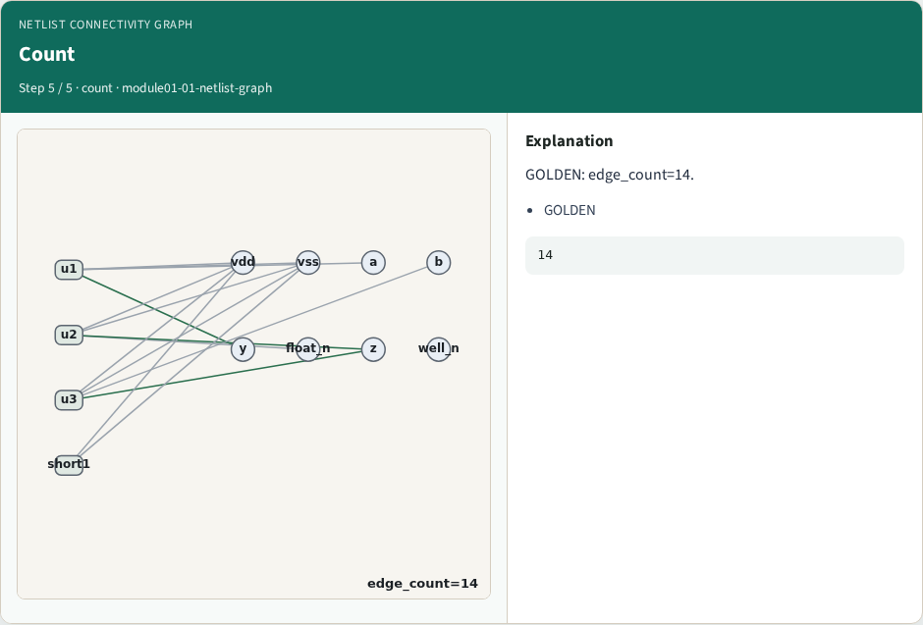
Count
Count
learn_erc — 01 netlist graph
Notes:
GOLDEN: edge_count=14.

Slide 8
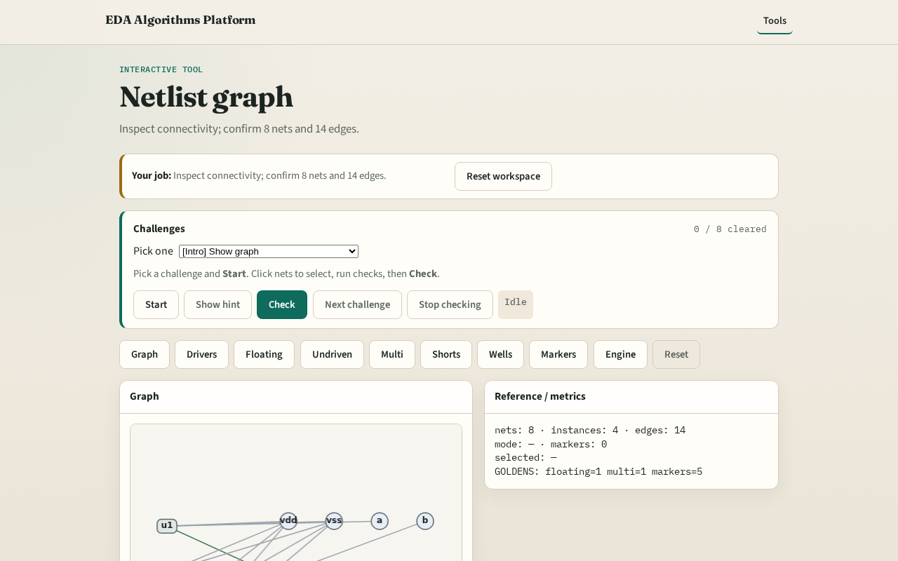
Browser lab track
Browser lab starter
learn_erc — 01 netlist graph
Notes:
Open **netlist-graph**. Inspect tiny_erc; confirm 8 nets and 14 edges.

Slide 9
Implement track
Call design_stats() and build_connectivity(); assert net_count==8, edge_count==14
learn_erc — 01 netlist graph
Notes:
Call design_stats() and build_connectivity(); assert net_count==8, edge_count==14.

Slide 10
Pitfalls
Counting wells as instances
Double-counting supply pins
learn_erc — 01 netlist graph
Notes:
Counting wells as instances. Double-counting supply pins.

Slide 11
Your turn
Next: classify drivers vs loads
learn_erc — 01 netlist graph
Notes:
Next: classify drivers vs loads.

