Slide 1
Why drivers
ERC needs drivers and loads , output pins drive; input pins load
learn_erc — 03 drivers loads
Notes:
ERC needs drivers and loads — output pins drive; input pins load.

Slide 2
The idea
GOLDEN: z has 2 drivers; float_n has 0 drivers and 1 load
learn_erc — 03 drivers loads
Notes:
GOLDEN: z has 2 drivers; float_n has 0 drivers and 1 load.

Slide 3
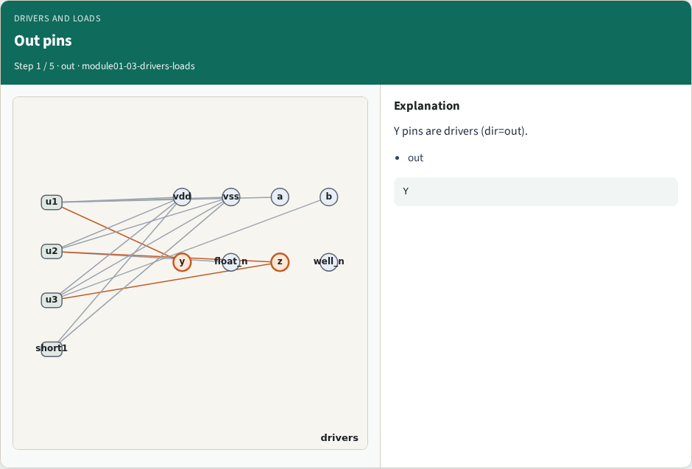
Out pins
Out pins
learn_erc — 03 drivers loads
Notes:
Y pins are drivers (dir=out).

Slide 4
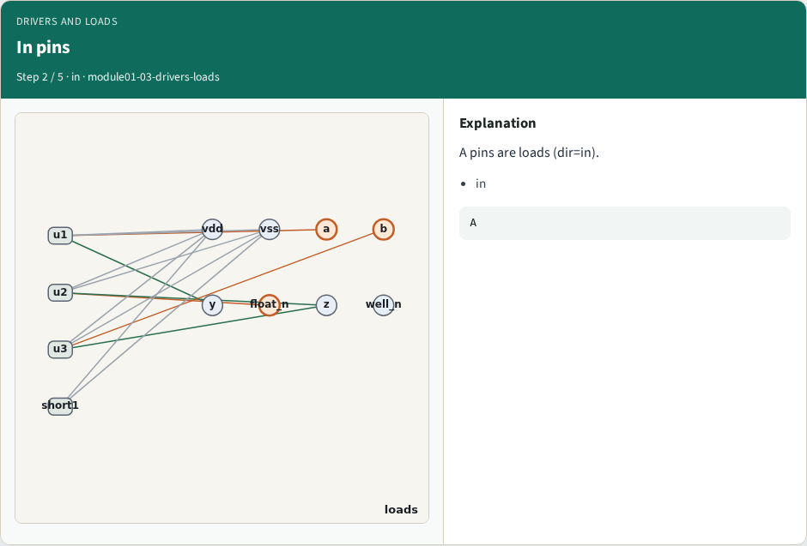
In pins
In pins
learn_erc — 03 drivers loads
Notes:
A pins are loads (dir=in).

Slide 5
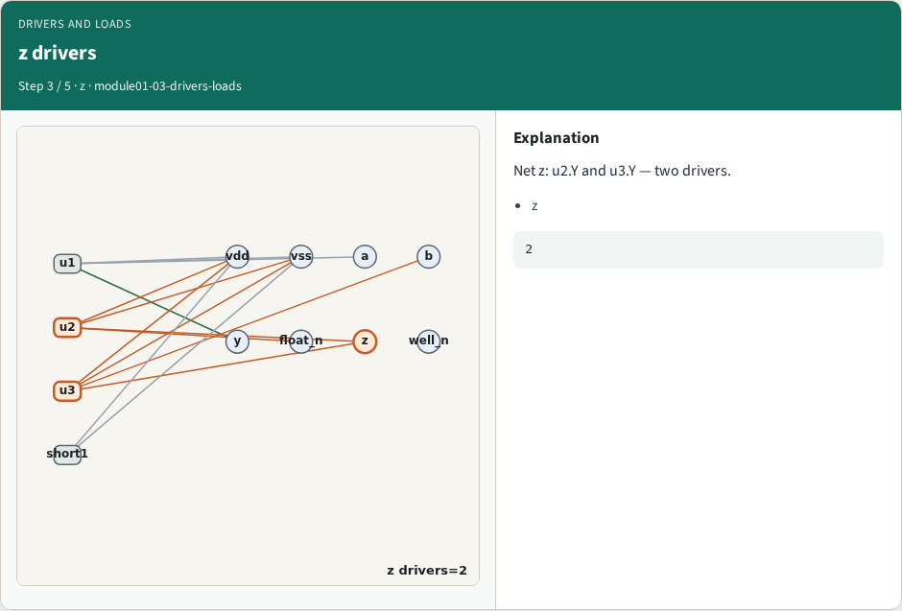
z drivers
z drivers
learn_erc — 03 drivers loads
Notes:
Net z: u2.Y and u3.Y — two drivers.

Slide 6
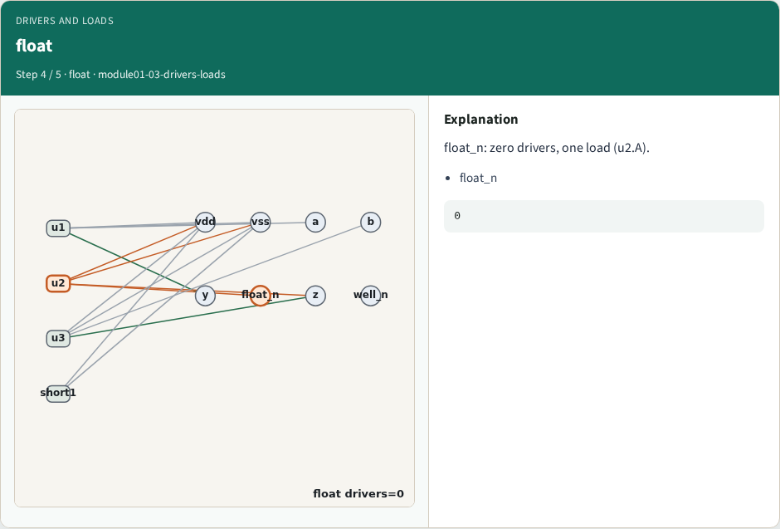
float
float
learn_erc — 03 drivers loads
Notes:
float_n: zero drivers, one load (u2.A).

Slide 7
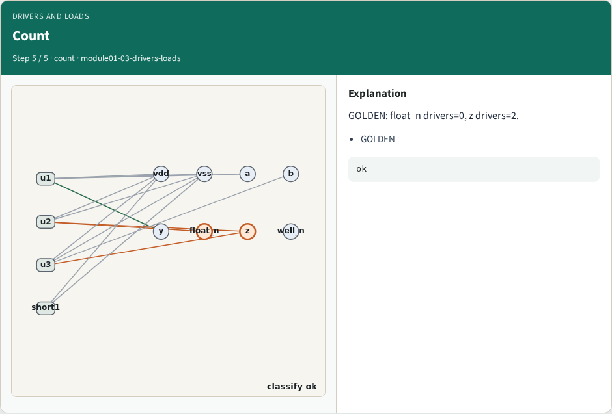
Count
Count
learn_erc — 03 drivers loads
Notes:
GOLDEN: float_n drivers=0, z drivers=2.

Slide 8
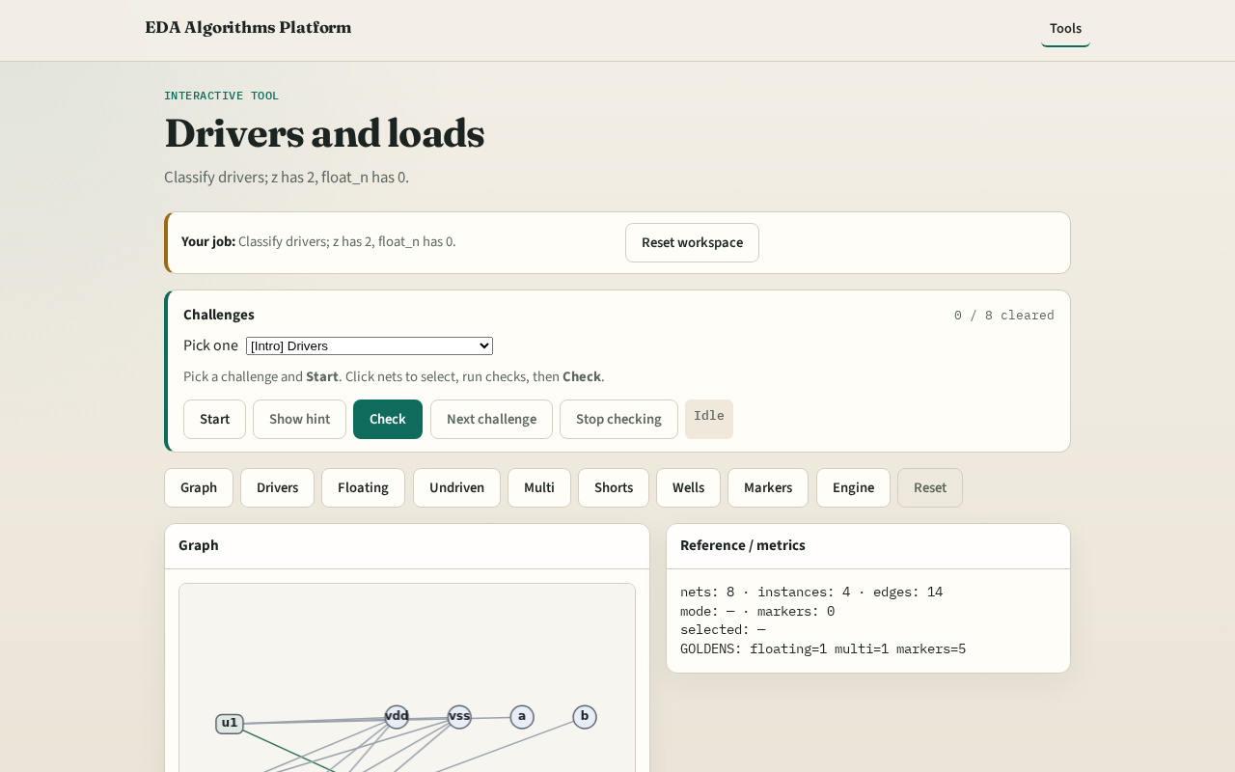
Browser lab track
Browser lab starter
learn_erc — 03 drivers loads
Notes:
Open **drivers-loads**. Confirm z has 2 drivers and float_n has 0.

Slide 9
Implement track
Call drivers_and_loads(); assert len(by_net['z']['drivers'])==2
learn_erc — 03 drivers loads
Notes:
Call drivers_and_loads(); assert len(by_net['z']['drivers'])==2.

Slide 10
Pitfalls
Treating power pins as drivers
Ignoring SHORT io pins
learn_erc — 03 drivers loads
Notes:
Treating power pins as drivers. Ignoring SHORT io pins.

Slide 11
Your turn
Next: floating nets
learn_erc — 03 drivers loads
Notes:
Next: floating nets.

