Slide 1
Why floating
A floating net has loads but no driver , classic ERC fail
learn_erc — 01 floating nets
Notes:
A floating net has loads but no driver — classic ERC fail.

Slide 2
The idea
GOLDEN: floating_nets=['float_n'], count=1
learn_erc — 01 floating nets
Notes:
GOLDEN: floating_nets=['float_n'], count=1.

Slide 3
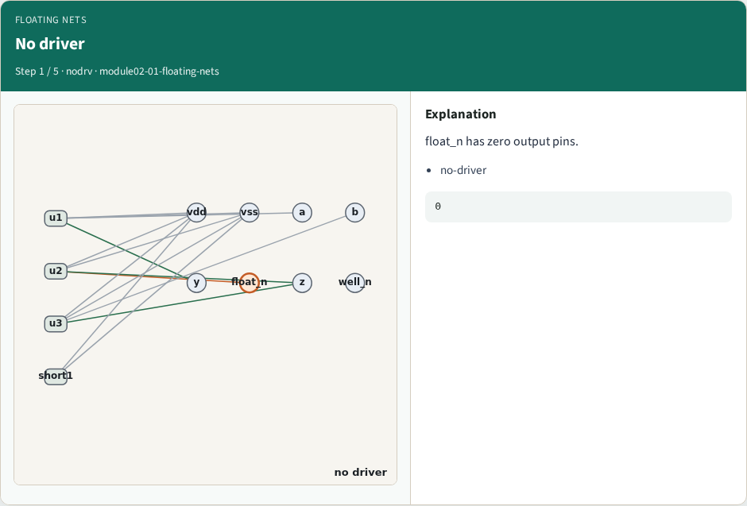
No driver
No driver
learn_erc — 01 floating nets
Notes:
float_n has zero output pins.

Slide 4
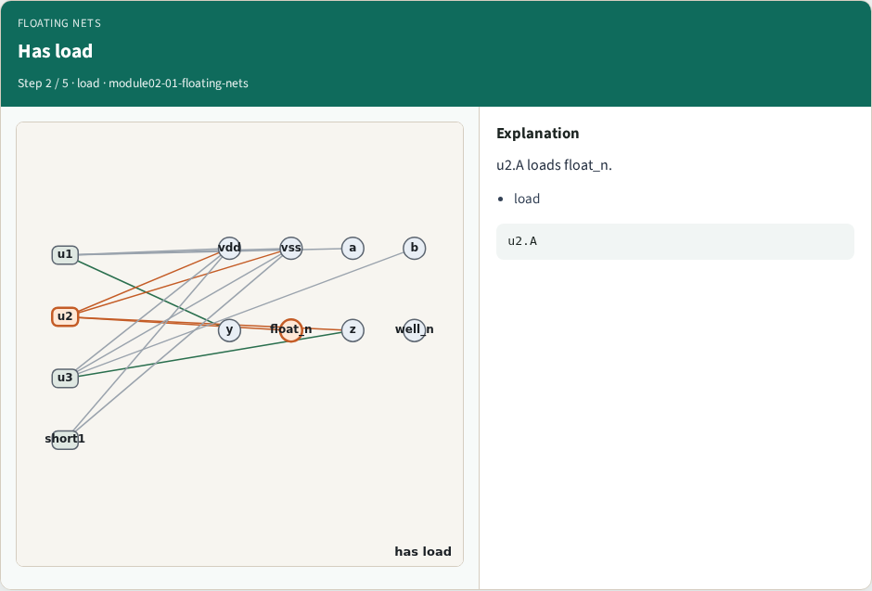
Has load
Has load
learn_erc — 01 floating nets
Notes:
u2.A loads float_n.

Slide 5
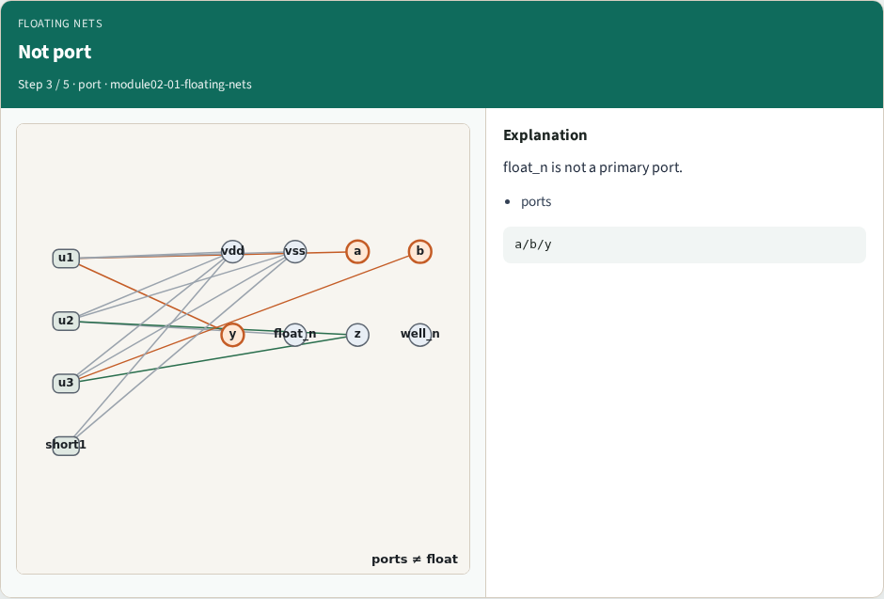
Not port
Not port
learn_erc — 01 floating nets
Notes:
float_n is not a primary port.

Slide 6
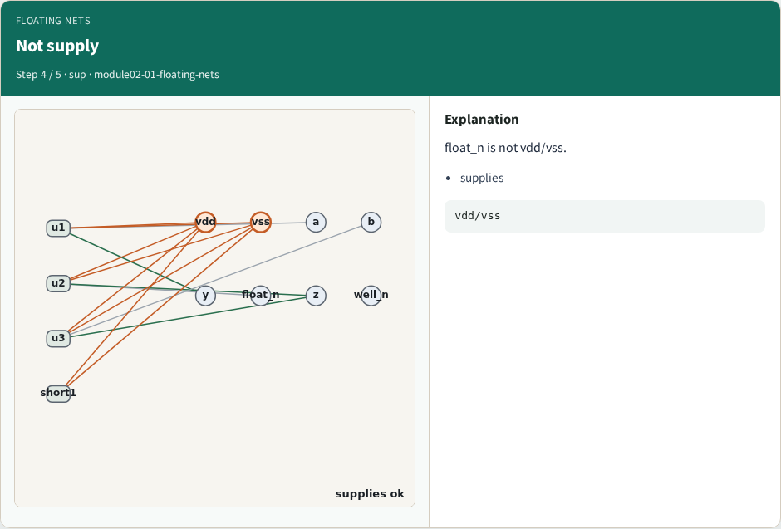
Not supply
Not supply
learn_erc — 01 floating nets
Notes:
float_n is not vdd/vss.

Slide 7

Golden
Golden
learn_erc — 01 floating nets
Notes:
GOLDEN: floating_count=1.

Slide 8
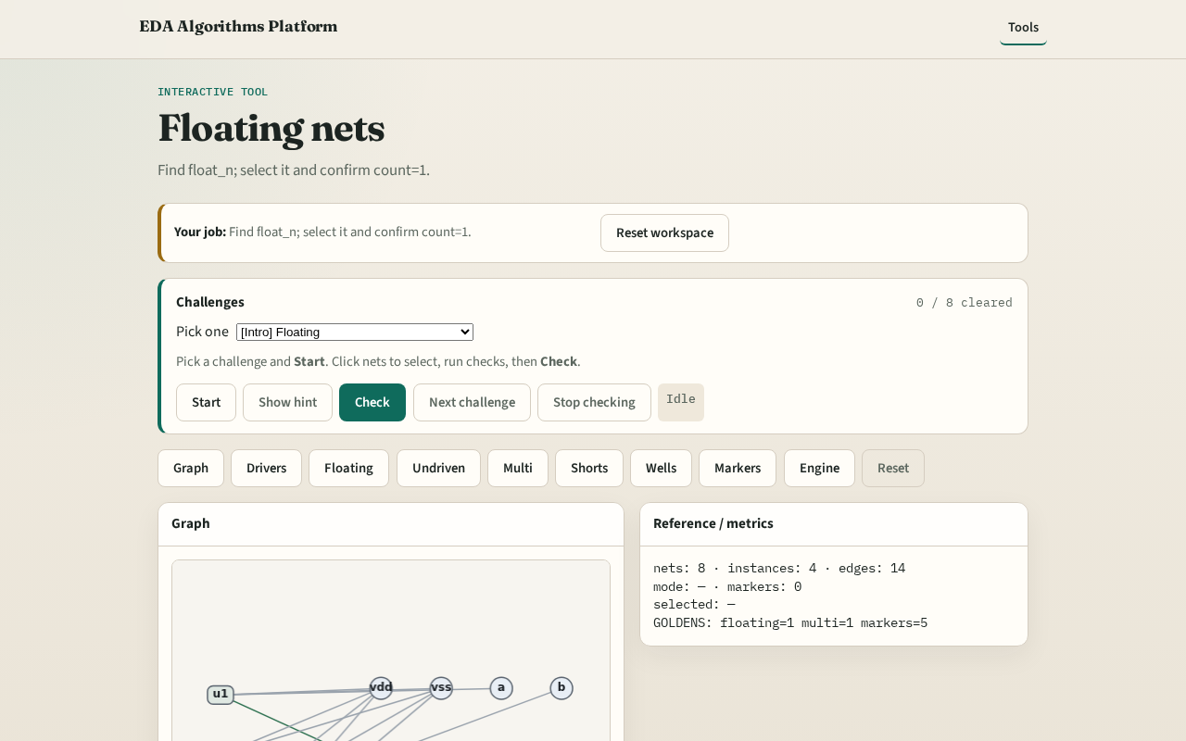
Browser lab track
Browser lab starter
learn_erc — 01 floating nets
Notes:
Open **floating-nets**. Select float_n; run floating check.

Slide 9
Implement track
Call find_floating_nets(); assert nets==['float_n']
learn_erc — 01 floating nets
Notes:
Call find_floating_nets(); assert nets==['float_n'].

Slide 10
Pitfalls
Flagging primary inputs as floating
Ignoring unused well nets
learn_erc — 01 floating nets
Notes:
Flagging primary inputs as floating. Ignoring unused well nets.

Slide 11
Your turn
Next: undriven inputs
learn_erc — 01 floating nets
Notes:
Next: undriven inputs.

