Slide 1
Why undriven
Undriven inputs are the pin-level view of floating connectivity
learn_erc — 03 undriven inputs
Notes:
Undriven inputs are the pin-level view of floating connectivity.

Slide 2
The idea
GOLDEN: one hit , u2.A on float_n
learn_erc — 03 undriven inputs
Notes:
GOLDEN: one hit — u2.A on float_n.

Slide 3
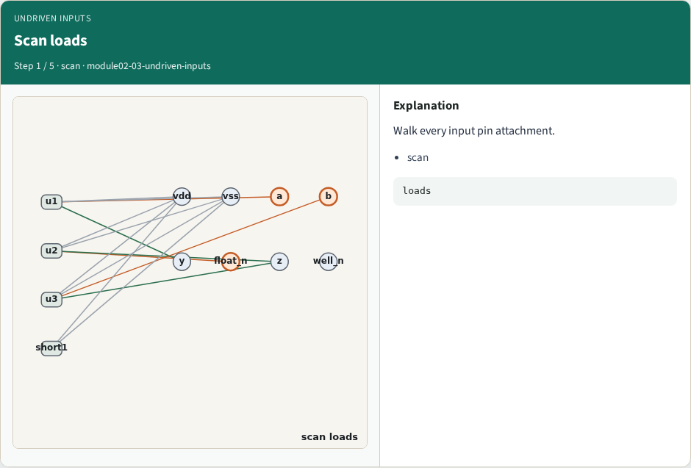
Scan loads
Scan loads
learn_erc — 03 undriven inputs
Notes:
Walk every input pin attachment.

Slide 4
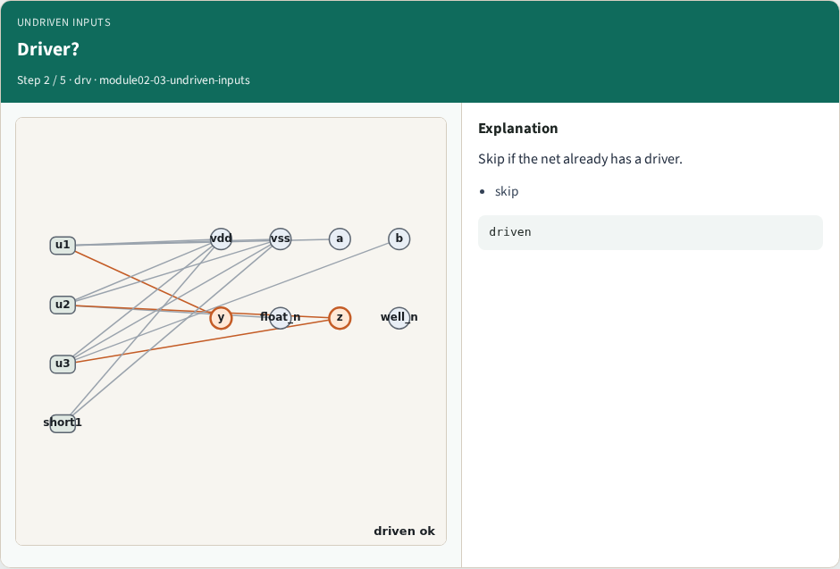
Driver?
Driver?
learn_erc — 03 undriven inputs
Notes:
Skip if the net already has a driver.

Slide 5
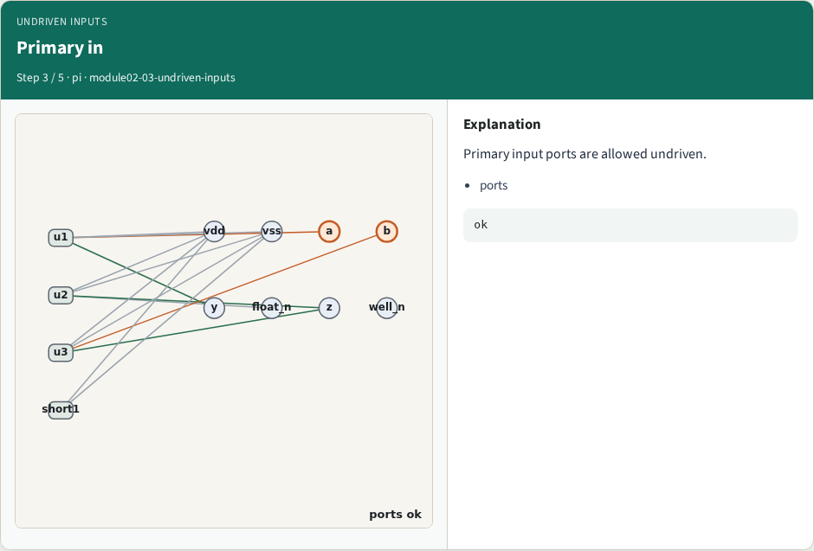
Primary in
Primary in
learn_erc — 03 undriven inputs
Notes:
Primary input ports are allowed undriven.

Slide 6
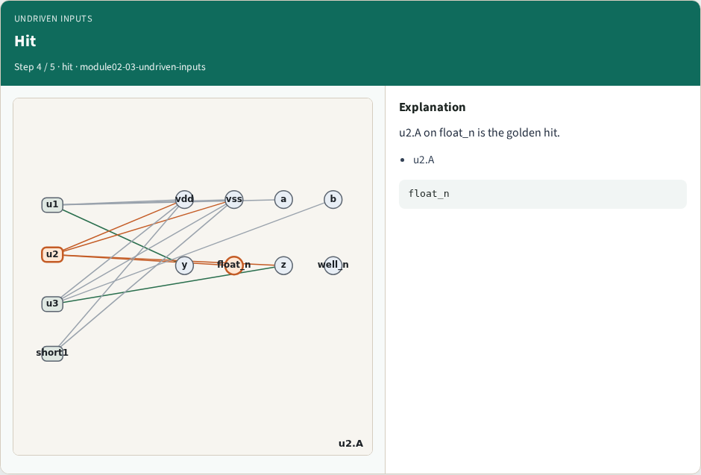
Hit
Hit
learn_erc — 03 undriven inputs
Notes:
u2.A on float_n is the golden hit.

Slide 7
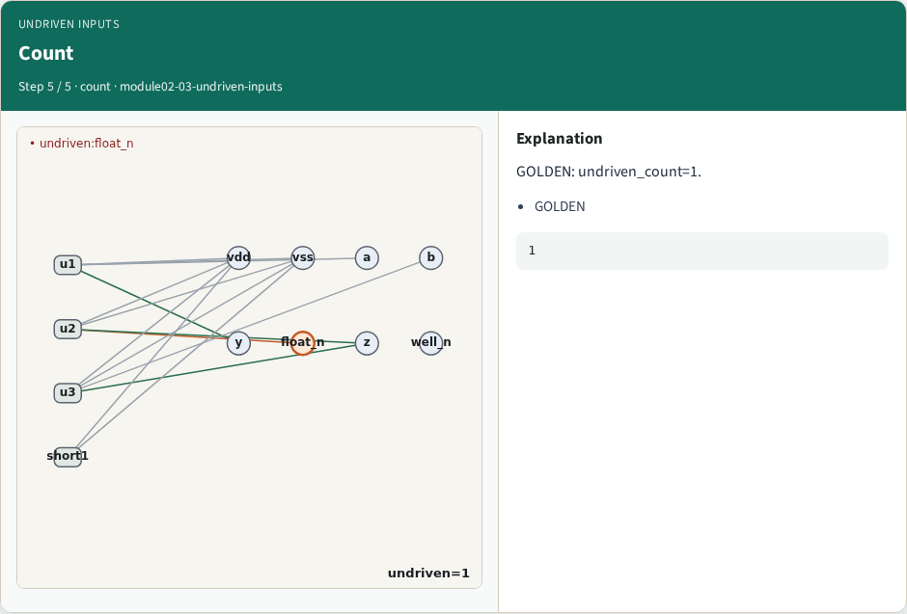
Count
Count
learn_erc — 03 undriven inputs
Notes:
GOLDEN: undriven_count=1.

Slide 8

Browser lab track
Browser lab starter
learn_erc — 03 undriven inputs
Notes:
Open **undriven-inputs**. Confirm u2.A undriven.

Slide 9
Implement track
Call find_undriven_inputs(); assert count==1 and hits[0].net=='float_n'
learn_erc — 03 undriven inputs
Notes:
Call find_undriven_inputs(); assert count==1 and hits[0].net=='float_n'.

Slide 10
Pitfalls
Flagging port a as undriven
Missing the float_n load
learn_erc — 03 undriven inputs
Notes:
Flagging port a as undriven. Missing the float_n load.

Slide 11
Your turn
Next: multi-driven nets
learn_erc — 03 undriven inputs
Notes:
Next: multi-driven nets.

