Slide 1
Why multi
Two outputs on one net is a fight , multi-driven ERC
learn_erc — 01 multi driven
Notes:
Two outputs on one net is a fight — multi-driven ERC.

Slide 2
The idea
GOLDEN: multi_driven_nets=['z'] from u2.Y and u3.Y
learn_erc — 01 multi driven
Notes:
GOLDEN: multi_driven_nets=['z'] from u2.Y and u3.Y.

Slide 3
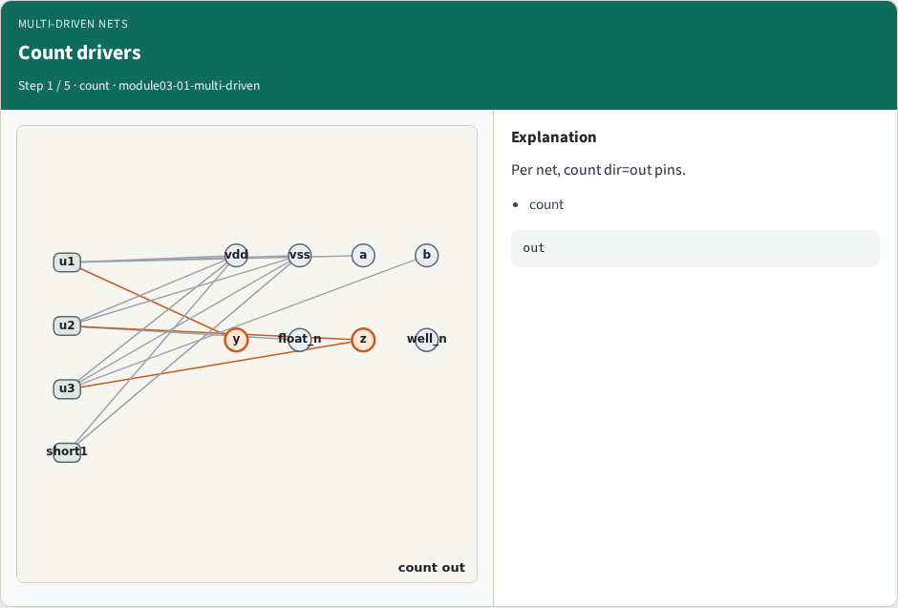
Count drivers
Count drivers
learn_erc — 01 multi driven
Notes:
Per net, count dir=out pins.

Slide 4
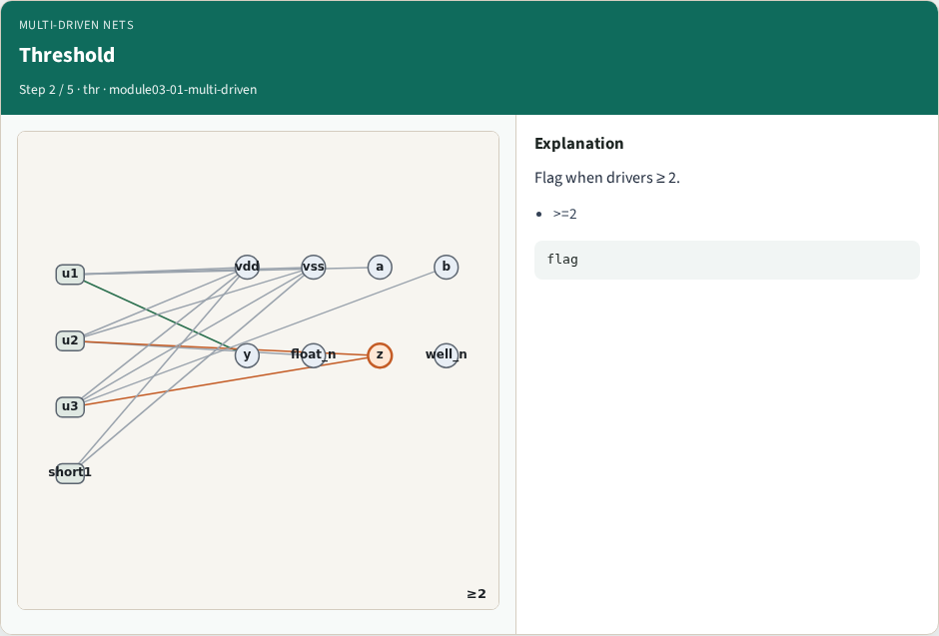
Threshold
Threshold
learn_erc — 01 multi driven
Notes:
Flag when drivers ≥ 2.

Slide 5
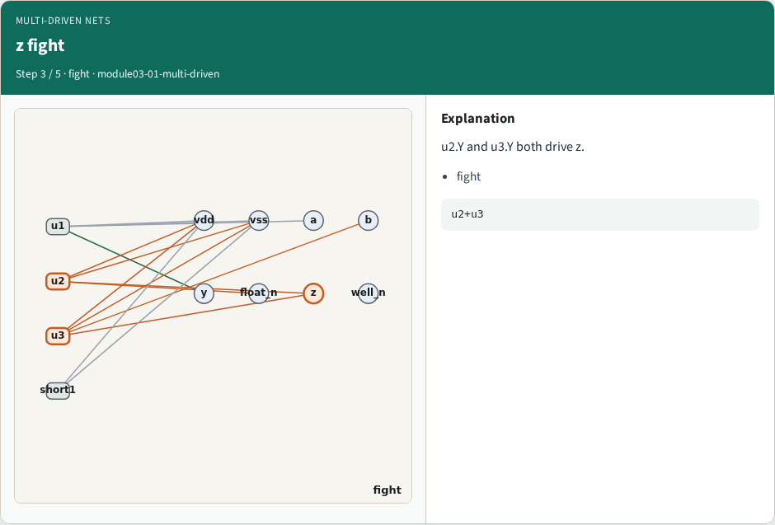
z fight
z fight
learn_erc — 01 multi driven
Notes:
u2.Y and u3.Y both drive z.

Slide 6
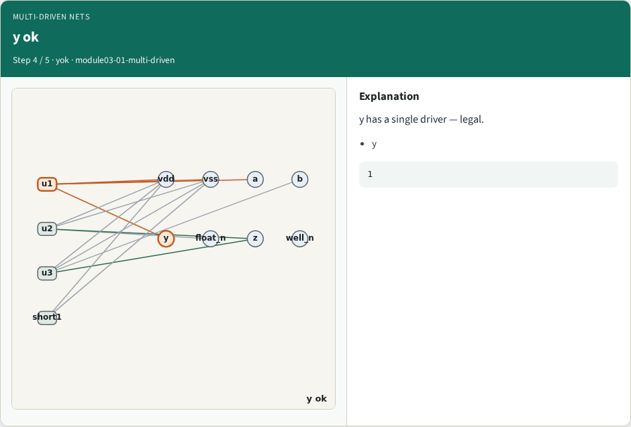
y ok
y ok
learn_erc — 01 multi driven
Notes:
y has a single driver — legal.

Slide 7
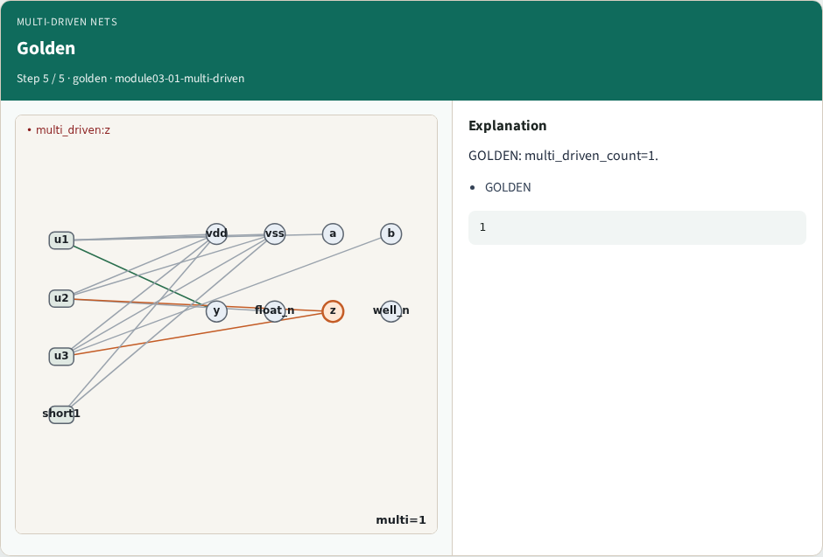
Golden
Golden
learn_erc — 01 multi driven
Notes:
GOLDEN: multi_driven_count=1.

Slide 8

Browser lab track
Browser lab starter
learn_erc — 01 multi driven
Notes:
Open **multi-driven**. Select z; confirm multi-driven.

Slide 9
Implement track
Call find_multi_driven(); assert nets==['z']
learn_erc — 01 multi driven
Notes:
Call find_multi_driven(); assert nets==['z'].

Slide 10
Pitfalls
Counting power pins as drivers
Flagging single-driver nets
learn_erc — 01 multi driven
Notes:
Counting power pins as drivers. Flagging single-driver nets.

Slide 11
Your turn
Next: supply shorts
learn_erc — 01 multi driven
Notes:
Next: supply shorts.

