Slide 1
Why shorts
A hard short between vdd and vss is catastrophic ERC
learn_erc — 03 supply shorts
Notes:
A hard short between vdd and vss is catastrophic ERC.

Slide 2
The idea
GOLDEN: supply_short_count=1 via short1
learn_erc — 03 supply shorts
Notes:
GOLDEN: supply_short_count=1 via short1.

Slide 3
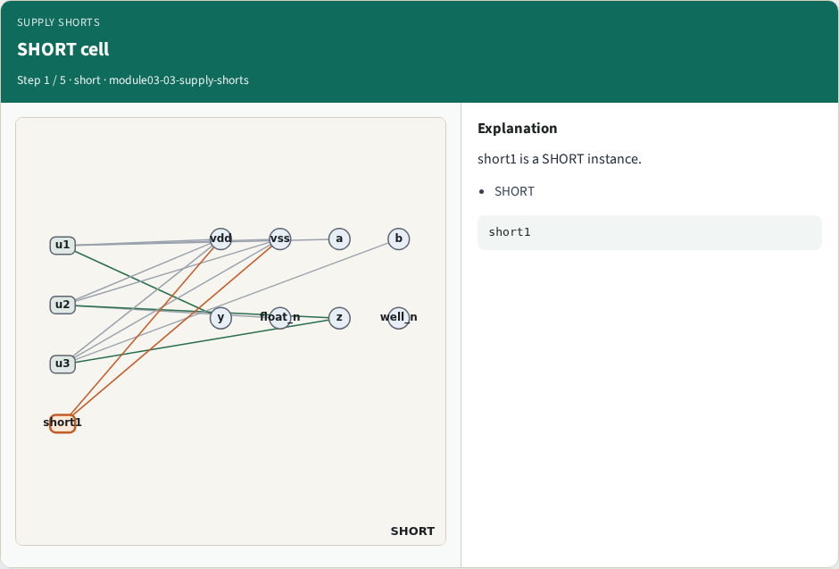
SHORT cell
SHORT cell
learn_erc — 03 supply shorts
Notes:
short1 is a SHORT instance.

Slide 4
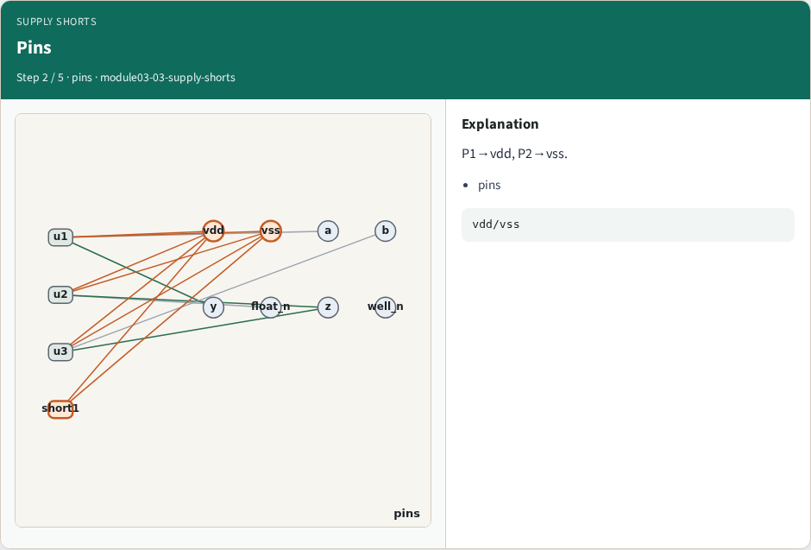
Pins
Pins
learn_erc — 03 supply shorts
Notes:
P1→vdd, P2→vss.

Slide 5
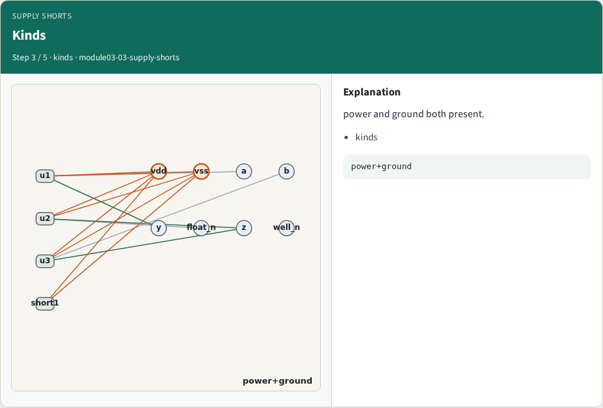
Kinds
Kinds
learn_erc — 03 supply shorts
Notes:
power and ground both present.

Slide 6
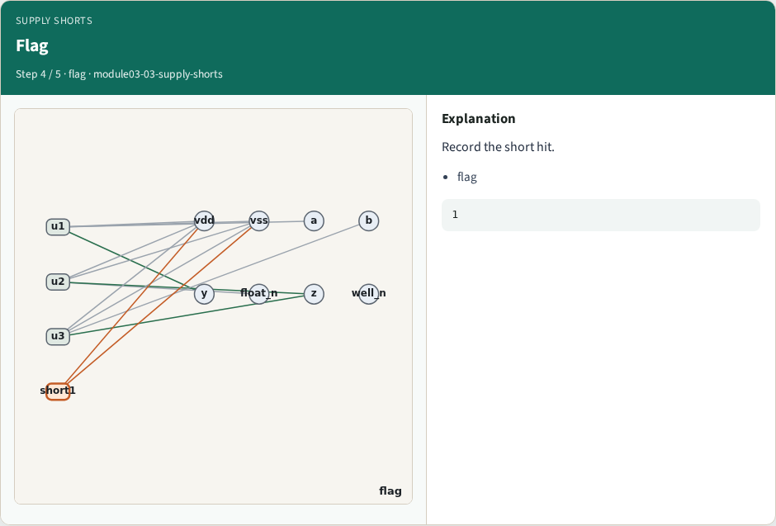
Flag
Flag
learn_erc — 03 supply shorts
Notes:
Record the short hit.

Slide 7
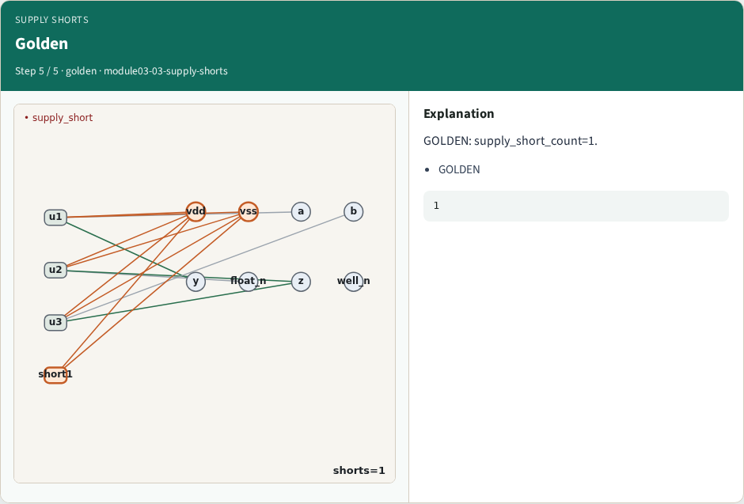
Golden
Golden
learn_erc — 03 supply shorts
Notes:
GOLDEN: supply_short_count=1.

Slide 8

Browser lab track
Browser lab starter
learn_erc — 03 supply shorts
Notes:
Open **supply-shorts**. Confirm short1 bridges vdd↔vss.

Slide 9
Implement track
Call find_supply_shorts(); assert count==1
learn_erc — 03 supply shorts
Notes:
Call find_supply_shorts(); assert count==1.

Slide 10
Pitfalls
Treating normal INV VDD/VSS as a short
Missing SHORT cell type
learn_erc — 03 supply shorts
Notes:
Treating normal INV VDD/VSS as a short. Missing SHORT cell type.

Slide 11
Your turn
Next: well/substrate ties
learn_erc — 03 supply shorts
Notes:
Next: well/substrate ties.

