Slide 1
Why wells
Wells must tie to the right rail , nwell→power, pwell→ground
learn_erc — 01 well substrate
Notes:
Wells must tie to the right rail — nwell→power, pwell→ground.

Slide 2
The idea
GOLDEN: well_error_count=1 , nw1 nwell tied to vss
learn_erc — 01 well substrate
Notes:
GOLDEN: well_error_count=1 — nw1 nwell tied to vss.

Slide 3
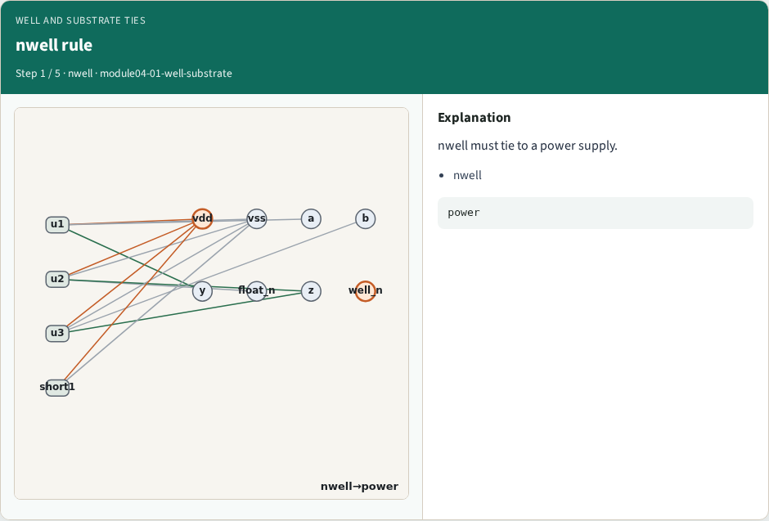
nwell rule
nwell rule
learn_erc — 01 well substrate
Notes:
nwell must tie to a power supply.

Slide 4
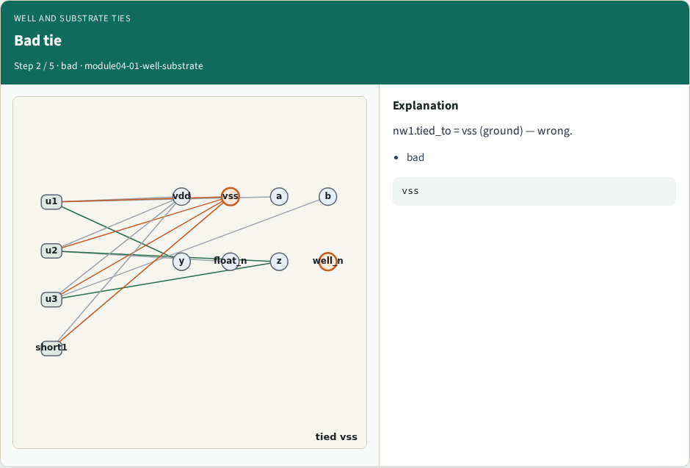
Bad tie
Bad tie
learn_erc — 01 well substrate
Notes:
nw1.tied_to = vss (ground) — wrong.

Slide 5
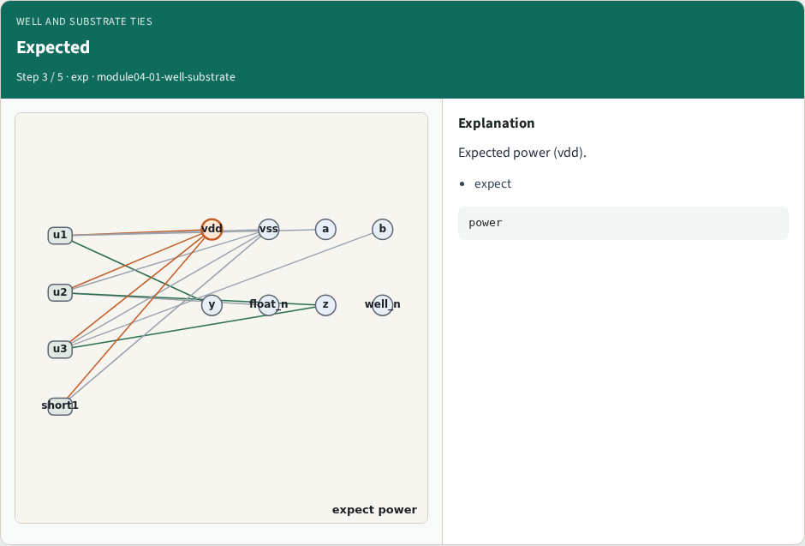
Expected
Expected
learn_erc — 01 well substrate
Notes:
Expected power (vdd).

Slide 6
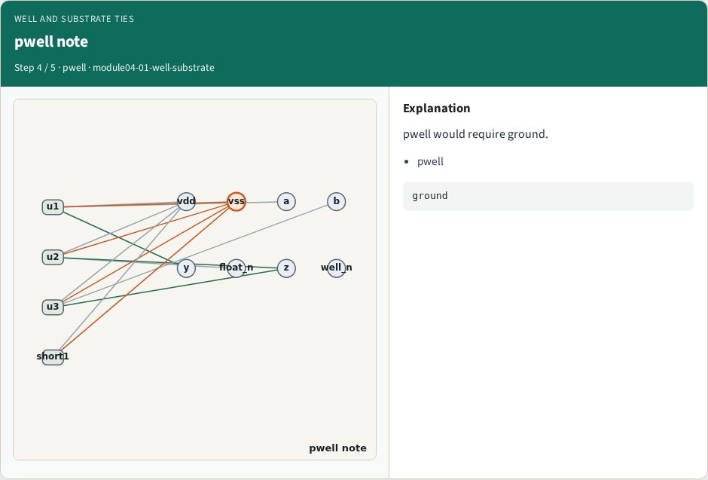
pwell note
pwell note
learn_erc — 01 well substrate
Notes:
pwell would require ground.

Slide 7
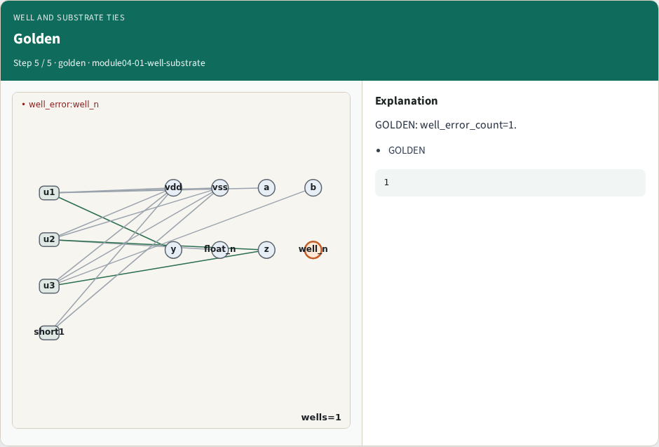
Golden
Golden
learn_erc — 01 well substrate
Notes:
GOLDEN: well_error_count=1.

Slide 8

Browser lab track
Browser lab starter
learn_erc — 01 well substrate
Notes:
Open **well-substrate**. Confirm nw1 error.

Slide 9
Implement track
Call find_well_errors(); assert count==1
learn_erc — 01 well substrate
Notes:
Call find_well_errors(); assert count==1.

Slide 10
Pitfalls
Accepting nwell→vss
Ignoring well records
learn_erc — 01 well substrate
Notes:
Accepting nwell→vss. Ignoring well records.

Slide 11
Your turn
Next: collect ERC markers
learn_erc — 01 well substrate
Notes:
Next: collect ERC markers.

