Slide 1
Why markers
Signoff ERC emits markers , one record per violation class hit
learn_erc — 03 erc markers
Notes:
Signoff ERC emits markers — one record per violation class hit.

Slide 2
The idea
GOLDEN: marker_count=5 on tiny_erc
learn_erc — 03 erc markers
Notes:
GOLDEN: marker_count=5 on tiny_erc.

Slide 3
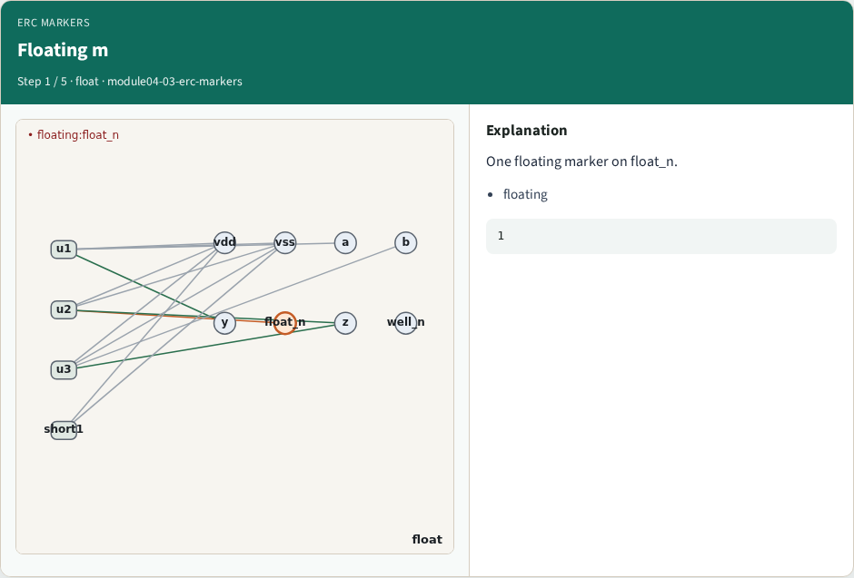
Floating m
Floating m
learn_erc — 03 erc markers
Notes:
One floating marker on float_n.

Slide 4
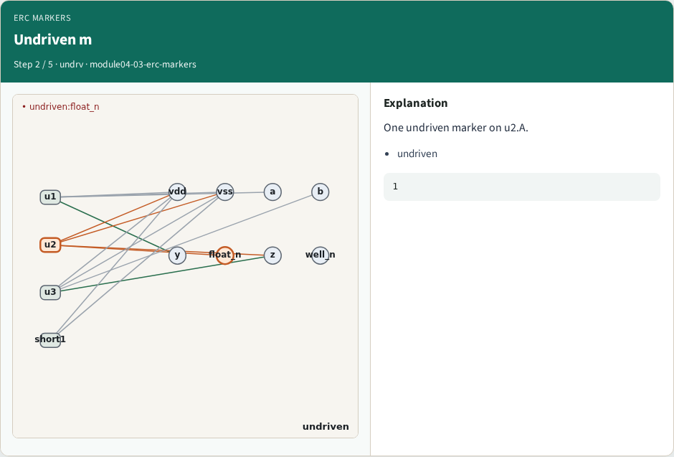
Undriven m
Undriven m
learn_erc — 03 erc markers
Notes:
One undriven marker on u2.A.

Slide 5

Multi m
Multi m
learn_erc — 03 erc markers
Notes:
One multi-driven marker on z.

Slide 6
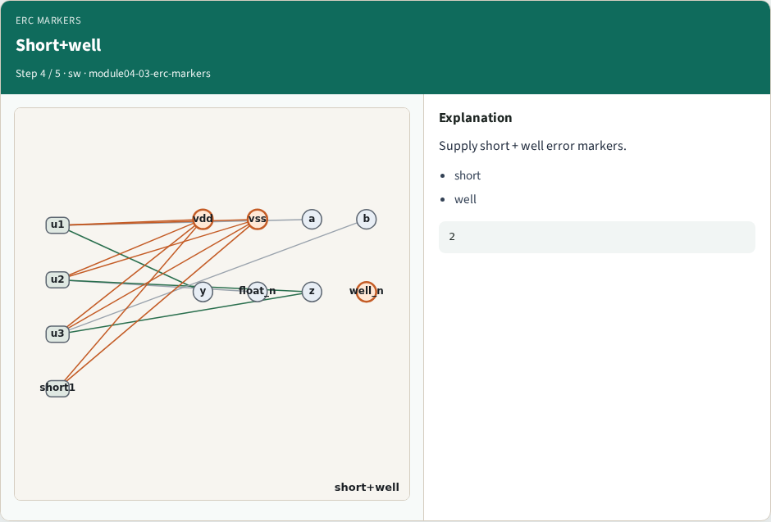
Short+well
Short+well
learn_erc — 03 erc markers
Notes:
Supply short + well error markers.

Slide 7
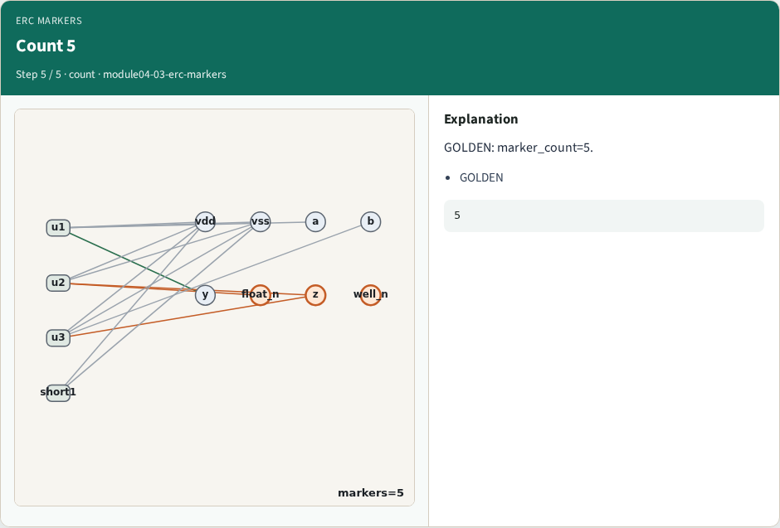
Count 5
Count 5
learn_erc — 03 erc markers
Notes:
GOLDEN: marker_count=5.

Slide 8

Browser lab track
Browser lab starter
learn_erc — 03 erc markers
Notes:
Open **erc-markers**. Run collect; confirm 5 markers.

Slide 9
Implement track
Call collect_markers(); assert count==5
learn_erc — 03 erc markers
Notes:
Call collect_markers(); assert count==5.

Slide 10
Pitfalls
Double-counting float as two markers incorrectly in the golden
Missing well
learn_erc — 03 erc markers
Notes:
Double-counting float as two markers incorrectly in the golden. Missing well.

Slide 11
Your turn
Next: erc_engine integration
learn_erc — 03 erc markers
Notes:
Next: erc_engine integration.

